Slide 1
Populating A
Knowledge Base
From Text
Clay Fink, Tim Finin, Christine Piatko and Jim Mayfield

Slide 2
The Problem
The target of some current information extraction systems is XML, intended to be loaded into relational databases or other data structures
We want to populate logic-based knowledge bases with information extracted from text & speech
We need a KB schema compatible with systems used in the research community
  For example, NIST’s Automatic Content Extraction (ACE) evaluation’s ACE Program Format (APF)

Slide 3
Objectives
Develop an ontology that can
  Represent information extracted by current NLP systems (e.g., BBN Serif’s APF/XML output)
Develop approach to evaluate KB quality
  Use 2008 ACE evaluation as a test scenario: how to compare a system’s output to the ground truth?
Experiment with text populated KBs
  Explore new ways to exploit extracted
  Support interoperability and integration with additional data & knowledge resources (e.g., DBpedia)

Slide 4
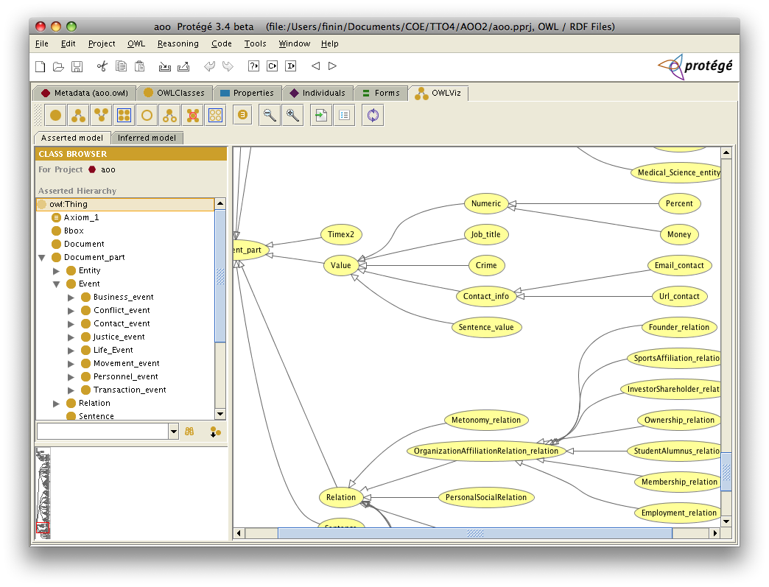
ACE OWL Ontology (AOO)
AOO is an OWL ontology
  Derived from ACE APF XML DTD Version 5.11
Basic metrics
  165 classes and 63 properties
  OWL DL, ALCHIF(D) expressivity
Coverage
  Entities, events, relations, values, time expressions, and mentions plus supporting concepts
  Annotations in the APF 2005 documents and extensions for ACE 2008 (cross-document entity extraction)

Slide 5
Text to XML to OWL
cwm
pellet
ACE
collections
Jena
reasoners
text
Serif
NLP
XML
Instance
OWL
Instance
APF-2-AOO
APF
DTD
AOO

Slide 6
KB Evaluation
Consistency is establish using an OWL reasoner (e.g., Pellet)
  In AOO a “geopolitical entity” can’t also be a “celestial object”
Compare test results to the known gold standard answer
  We’ll use the ACE 2008 evaluation and RDF delta (Zeginis et al. ISWC 2007)

Slide 7

Open Calais
The Reuters/Clearforest OpenCalais system has similar goals. (http://opencalais.com/
It offers services that accept text and return an RDF document that identifies the entities, relations and facts found in it
The underlying ontology is similar to AOO
One difference is that APF/AOO can represent that a set of “mentions” in a text all refer to the same entity
  E.g., “George Bush”, “President Bush”, “The President”, “he”, “Bush”

Slide 8
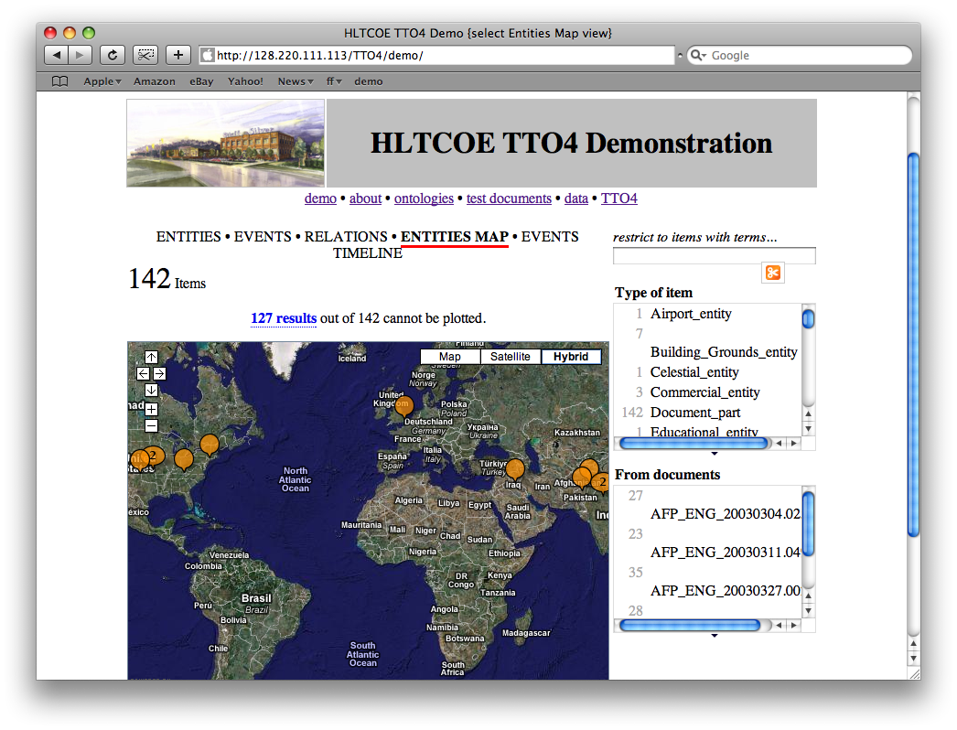
Next Steps
Mashups with Google Maps, MIT’s Simile, etc.
Integrating with other KB sources such as DBpedia

Slide 9
Next Steps
Revise and refactor AOO
  Examine what concepts are really necessary to improve performance
  Separate entity/event/relation layer from mention layer for modularity and efficiency
Do 500 documents in ACE 2008 training collection (200K triples?)
Do 10K documents in ACE 2008 evaluation collection (4M triples?)
Scalability experiments

Slide 10
Backup

Slide 11
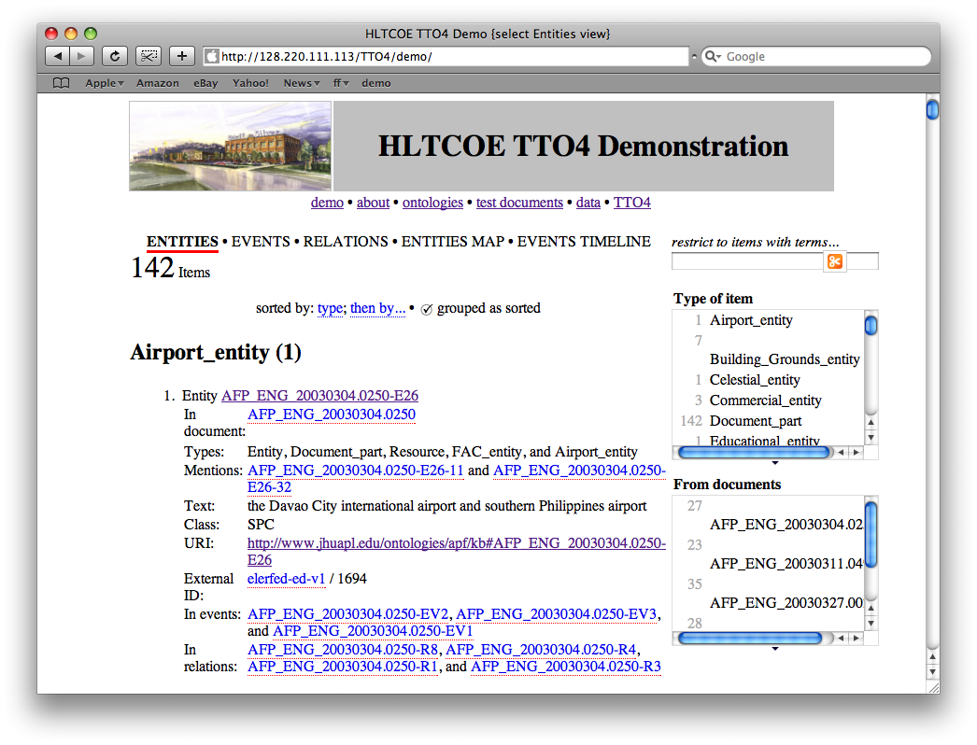

Slide 13
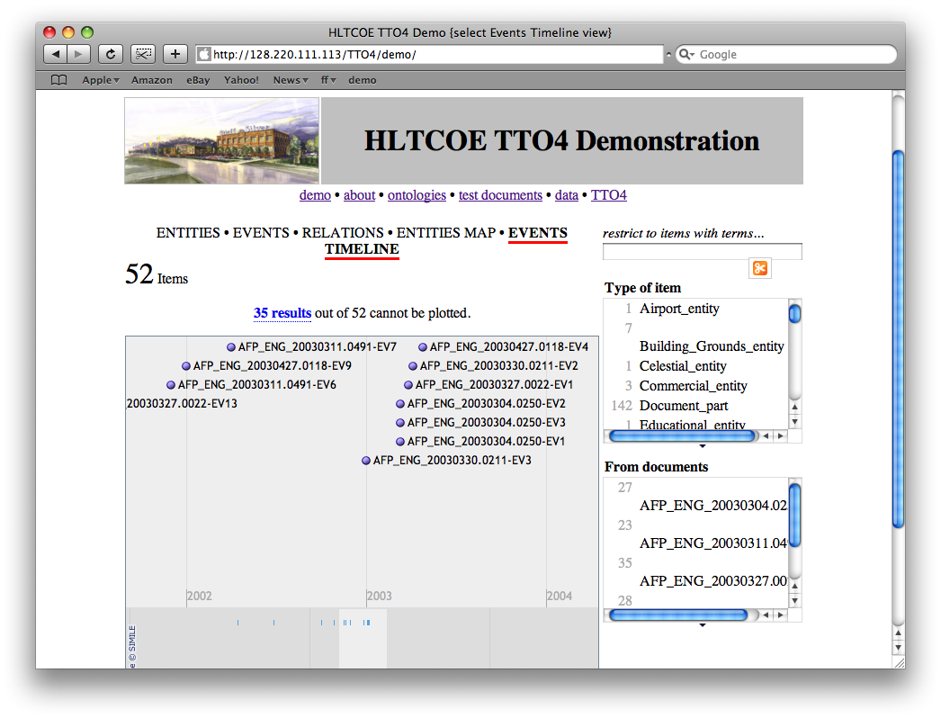

Slide 15
… to Knowledge Based Services
KB system A
Bayes
pellet
Jena
KB system
on Web
or Intranet
reasoners
Web
Apps
(exhibit)
RDF_x0004_
KB
server
sparql
API
KB system B

Slide 16
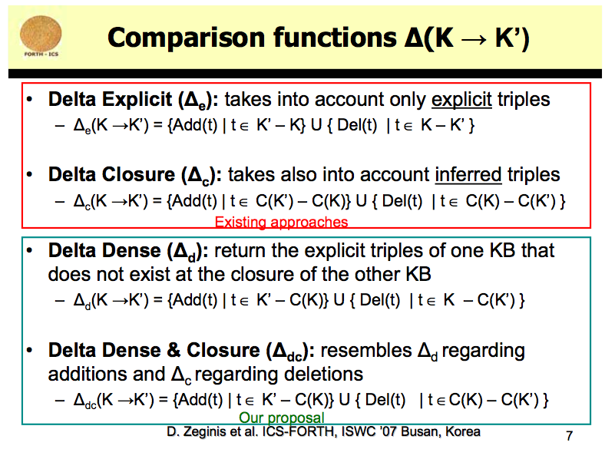

Slide 17
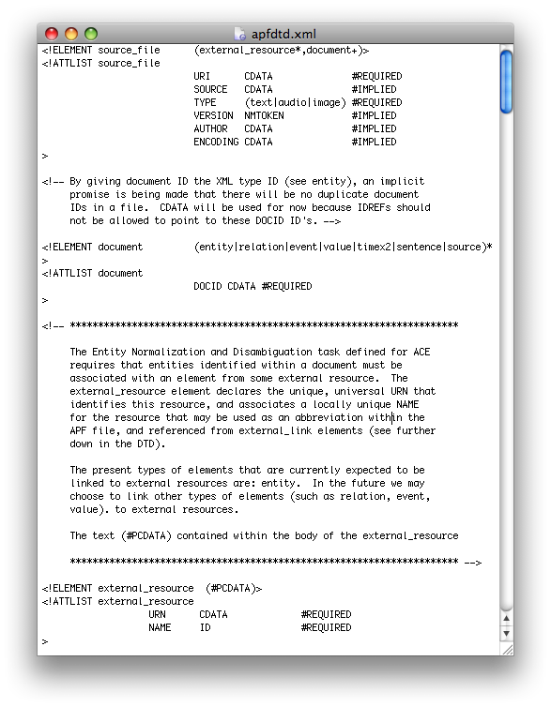
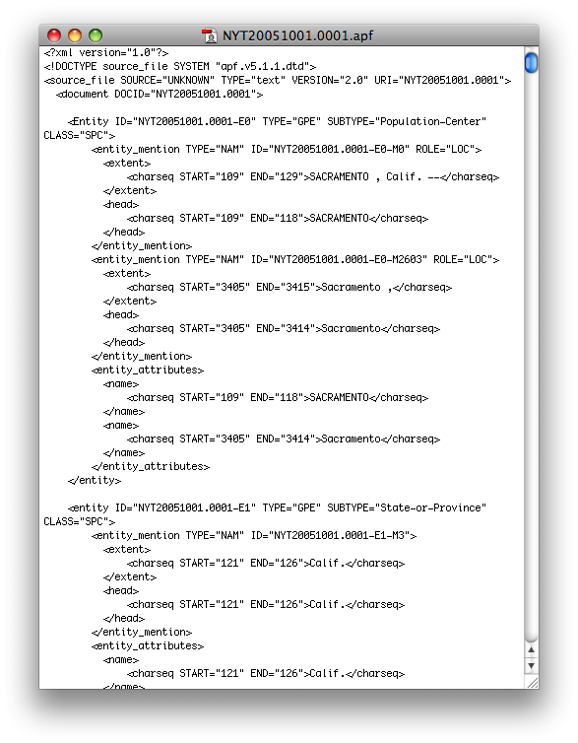
APF DTD and Document

Slide 18

AOO in Protege

Slide 19
RDF Delta
person
person
age
int
isa
isa
type
isa
TA
student
age
int
john
student
type
isa
KB₁
john
KB₂
TA
How close is KB₁ to KB₂ ?
One characterization uses the set of RDF triples that must be added to or deleted from KB₁ to produce KB₂
A metric should involve inference and redundancy elimination
We plan to implement the ∆_{dc} measure proposed by Zeginis et al. (ISWC 2007).

Slide 20
RDF Delta
K closure
{triples to delete}
K’ closure
K
explicit
K’
explicit
{triples to add}
 | Add | Delete
∆_{e} | { K’ - K } | { K - K’ }
∆_{c} | { C(K’) - C(K) } | { C(K) - C(K’) }
∆_{d} | { K’ - C(K) } | { K - C(K’) }
∆_{dc} | { K’ - C(K) } | { C(K) - C(K’} )

Slide 21
RDF Delta
person
person
age
int
isa
isa
type
isa
TA
student
age
int
john
student
type
isa
KB₁
john
KB₂
TA
 |  | Add | Delete
∆_{e} | 6 | TA<Student, domain(age,person), Person(jim) | TA<Person, domain(age,student), Student(jim)
∆_{c} | 4 | TA<Student, domain(age,person), domain(age,TA) | Student(jim)
∆_{d} | 3 | TA<Student, domain(age,person) | Student(jim)
∆_{dc} | 3 | TA<Student, domain(age,person) | Student(jim)

