Slide 1
Use of OWL in the Legal Domain
Statement of Interest
Rinke Hoekstra
OWLED 2008 DC, Gaithersburg

Slide 2
Overview
Context
Texts and Representation
Representation and Reasoning
Conclusions
OWLED 2008 DC, Gaithersburg

Slide 3
Context
Legal Knowledge Representation
  Formal models of Legal Theory
    Case based reasoning, Argument theory, Deontic logics, Dispute resolution
  Formal models of Legal Content
    Assessment, Planning, Ontologies, Harmonisation, Simulation
  Annotation
    Versioning, authority, accessibility, cross-referencing
OWLED 2008 DC, Gaithersburg

Slide 4
Text and Representation (1)
Legal texts
  Official status
  Closely interlinked
  Different authorities
  Intricate versioning
Decisions are based on authority of text ➙ Trust
OWLED 2008 DC, Gaithersburg

Slide 5
Text and Representation (2)
A KR:
  should be traceable to source,
  should mimic the
    structural, and
    dynamic properties of texts, and
  is secondary, it is an annotation
Definitions are scoped
  (Parts of) a particular text
  Temporal validity
  Jurisdiction
OWLED 2008 DC, Gaithersburg

Slide 6
Law and the Semantic Web
Strong analogy
  Different users
  Different uses
  No single information provider
Two languages
  MetaLex/CEN XML
    Structure, references, versions of legal texts
  Legal Knowledge Interchange Format (LKIF)
    ESTRELLA Project
OWLED 2008 DC, Gaithersburg

Slide 7
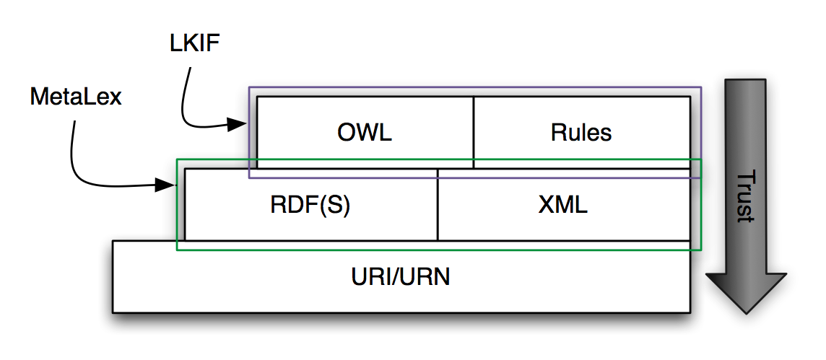
Legal Layer Cake
OWLED 2008 DC, Gaithersburg

Slide 8
Representation and Reasoning (1)
Lessons learned
  LKIF-Core Ontology
Expressiveness
  Significant impact on reasoner performance
  But still too restricted to represent common patterns (e.g. transactions, structured objects)
  … resort to DL-Safe rules? No!
  Interest: Description graphs
OWLED 2008 DC, Gaithersburg
Notes:
SWRL requires us to represent information in rules that can be expressed using DL (prevent classification can only be done by expressing class entirely in rules)
Abox assertions not necessarily valid model of Tbox,
Variables and property reflexivity not very intuitive.

Slide 9
Representation and Reasoning (2)
Hybrid Approaches
  Unavoidable when building KBS
  Interaction with legacy systems
  Extensions (of OWL)
  Interest: DLP/Prime/RIF (DLRule)
Conditional (or partial) Classification
  Geo: LegalAtlas
  Compensation of land use
  Interest: Pronto
OWLED 2008 DC, Gaithersburg
Notes:
Hybrid approaches are not avoidable in a knowledge based system.

Slide 10
Representation and Reasoning (3)
Extension mechanisms
  Adding non-standard semantics
  Stratified meta-levels
  Connection to text sources (as RDF)
  Interest: advanced annotations
Accountability
  Interest: explanation
OWLED 2008 DC, Gaithersburg

Slide 11
Conclusions
We want it all:
  Expressivity
  Performance
  Explanation
  Annotation
  Extensions
  Versioning
  Interaction with Rules
Sorry
OWLED 2008 DC, Gaithersburg

Slide 12
Links
Leibniz Center for Law
  http://www.leibnizcenter.org
MetaLex/CEN
  http://www.metalex.eu
LKIF Core
  http://www.estrellaproject.org/lkif-core
OWLED 2008 DC, Gaithersburg

