Slide 1



A Comparison of three Controlled Natural Languages for OWL 1.1
Rolf Schwitter, Kaarel Kaljurand, Anne Cregan,
Catherine Dolbear & Glen Hart

Slide 2
Motivation
Source of knowledge, domain experts, find OWL too difficult
‘Pedantic but explicit’ paraphrase language needed [Rector et al, 2004]
Recent user testing of Manchester syntax shows <50% comprehension of all structures

Slide 3
CNL Task Force
Aim: to make ontologies accessible to people with no training in formal logic
Three current offerings:
  Attempto Controlled English, University of Zurich
  Rabbit, Ordnance Survey
  Sydney OWL Syntax, NICTA & Macquarie University

Slide 4
Attempto Controlled English
ACE covers FOL, with a fragment that can be bidirectionally mapped to OWL 1.1. (excluding datatype properties)
Often several possibilities for expressing the same OWL axiom
Implemented and in use in ACE View and ACE Wiki ontology editors

Slide 5
Rabbit
Developed from a requirement for domain experts to write ontologies using OS authoring methodology
Used to develop two medium-scale (~600 concept) ontologies
  Hydrology (ALCOQ)
  Buildings and Places (SHOIQ)
Design concentrates on structures frequently required by authors, and where mistakes are often made
  E.g. ‘of’ keyword, defined class construct, imports
Protégé plugin being developed to allow authoring in Rabbit with translation to OWL.

Slide 6
Sydney OWL Syntax
1-to-1 bidirectional mapping between SOS and OWL
Only uses limited reference to OWL constructs like “class” and “relation”
Uses variables known from high school textbooks
  e.g. “if X is larger than Y, then Y is not larger than X” to indicate asymmetric object property

Slide 7
Requirements and design choices
Language should be “natural” – a subset of English that doesn’t use any formal notation
Should have a straightforward mapping to and from OWL 1.1
These requirements can conflict!
User testing to inform the design balance
As a first step, datatype properties, annotations and namespaces ignored

Slide 8
Some examples
Languages compared using a subset of OS topographic ontologies
Many constructs are similar across the 3 CNLs.
OWL | SubClassOf(OWLClass(RiverStretch), ObjectMaxCardinality(2, ObjectProperty(hasPart), OWLClass(Confluence)))
ACE | Every river-stretch has-part at most 2 confluences.
RABBIT | Every River Stretch has part at most 2 confluences.
SOS | Every river stretch has at most 2 confluences as a part.

Slide 9
Examples continued
OWL | SubClassOf(OWLClass(Factory), ObjectSomeValuesFrom(ObjectProperty(hasPart), ObjectIntersectionOf([ObjectSomeValuesFrom(ObjectProperty(hasPurpose), OWLClass(Manufacturing)), OWLClass(Building)])))
ACE | For every factory its part is a building whose purpose is a manufacturing.
RABBIT | Every Factory has a part Building that has Purpose Manufacturing.
SOS | Every factory has a building as a part that has a manufacturing as a purpose.

Slide 10
Examples continued – defined class
OWL | EquivalentClasses([OWLClass(Source), ObjectIntersectionOf([ObjectUnionOf(OWLClass(Spring), OWLClass(Wetland)]), ObjectSomeValuesFrom(ObjectProperty (feeds), ObjectUnionOf([OWLClass(River), OWLClass(Stream)]))])])
ACE | Every source is a spring or is a wetland, and feeds something that is a river or that is a stream. Everything that is a spring or that is a wetland, and that feeds something that is a river or that is a stream is a source.
RABBIT | Every Source is defined as: Every Source is a kind of Spring or Wetland; Every Source feeds a River or a Stream.
SOS | The classes source and spring or wetland that feed some river or some stream are equivalent.

Slide 11
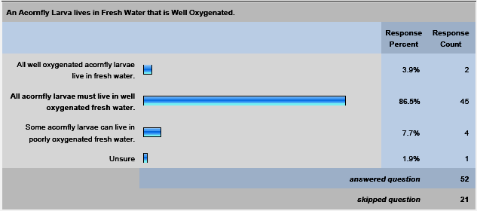
User testing of Rabbit
Distinguishing between testing usability of a tool and comprehension of a CNL
Phase 1: 31 Multiple choice questions, 223 participants
  An imaginary domain, wrong answers demonstrate specific misunderstandings

Slide 12
User testing - results
Well understood structures (>75% correct)
  ‘exactly’, ‘at least’, ‘at most’
  ’1 or more of A or B or C’, ‘that’, ‘eats is a relationship’
Asymmetry, reflexivity and irreflexivity understood, transitivity and inverses weren’t
  Users assumed the characteristic only applied to the concepts in the supplied example, not to the relationship globally?

Slide 13
User testing: preliminary results of phase 2
Updated Rabbit compared against Manchester syntax
Every Rabbit sentence had a higher comprehension except:
  Disjoint Classes – Both scored very high, only a 1% difference
  Functional object properties – both scored very low.
In Rabbit, users still have issues with:
  Functional object properties
  Defined classes
  Inverse object properties
  GCIs
  Object property ranges

Slide 14
Conclusions and current plans
Differences to be resolved:
  Style: river-stretch versus river stretch
  ‘has’: has-part, has part, has…as a part
  Mathematical constraints: tool support versus explain-through-example
Systematically resolve the differences, guided by user testing

Slide 15
Thank you for your attention
Any questions?

