Slide 1


Supporting the Construction of Conceptual Ontologies with the ROO Tool
Confluence Project funded by Ordnance Survey UK
(July 2007-December 2008)‏
School of Computing
FACULTY OF ENGINEERING
School of Computing
Tony Cohn
Ilaria Corda
Ronald Denaux
Vania Dimitrova
Ordnance Survey
Catherine Dolbear
John Goodwin
Glen Hart
Ian Holt

Slide 2
The Problem
  Ordnance Survey GeoSemantics Research
  Developing topographic ontologies is considered as a key activity that will enable third parties to integrate their data with topographic data OS provides.
  Developing ontologies is challenging and requires domain experts’ active involvement
  conceptual ontology modelling (performed by domain experts)‏
  ontology modelling (performed by knowledge engineers)‏
  Existing ontology construction tools are not suited for domain experts, this hinders their effective involvement

Slide 3
CONFLUENCE Project Goal
  The project will develop a tool with the following key characteristics:
  Effectiveness: support the main stages in the OS ontology creation methodology:
    identifying domain terms,
    populating a glossary;
    entering conceptual knowledge via structured sentences;
    inspection and verification of the encoded knowledge;
  Flexibility: convenient switching between different stages of the ontology construction cycle;
  Multifaceted input-output:
    Input: text files, structured sentences, or parts of existing ontologies in OWL
    Output: OWL files, text files.
  Usability: suitable for people without knowledge engineering skills;
  Scalability: robust and capable of dealing with fairly large ontologies (approx. 8000 concepts, initial tests will be done with an ontology containing about 200 concepts);
  Deployable: should be tested with ontologies being developed at OS.

Slide 4
Previous Research
Kanga: Ontology Construction Methodology.
Rabbit: Controlled language to formalise the ontology.
  Brass Instrument is a concept.
  Every Music Instrument produces Sound.
  Brass Instrument is a kind of Music Instrument.
  No Woodwind Instrument is made of Brass.

Slide 5
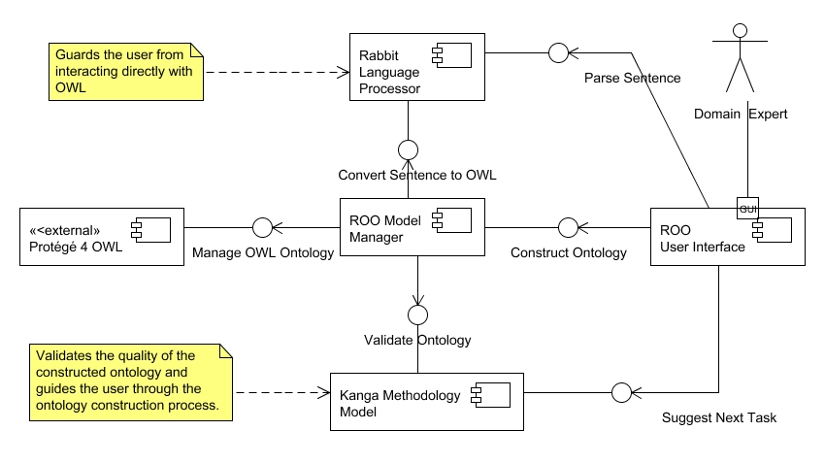
ROO Tool Architecture

Slide 6
ROO Demo
ROO available from http://sf.net/projects/confluence
Main parts of the application
Adding and removing concepts and relations
Adding Rabbit sentences based on a natural language description
Using the feedback based on Kanga.
Built ontology in Protégé
Examples of users interacting with ROO

Slide 7
Summary
  ROO:
  Is grounded on a methodology for ontology construction
  Utilises Rabbit to enter knowledge constructs
  Guides the user through the ontology construction process
  Development based on active user engagement
  Future work:
  Evaluation
  Complete set of Rabbit patterns
  Support for Ontology verification
  Support for Ontology construction best practices.

