Slide 1
Application of OWL 1.1 to Systems Engineering
01 April 2008
Henson Graves Ian Horrocks
Notes:
Abstract
.

Slide 2
Use of Knowledge Representation and Reasoning in Product Development
Current Systems Engineering languages, standards, and tools are
  Restricted in (certain aspects of) their expressiveness and do not provide formal semantics
  Yet many activities involve (some form of) reasoning, e.g., requirements verification
Long history of attempts to use formal methods for engineering
  Too hard to use, don’t scale
Can OWL 1.1 provide a semantic integration framework?
  For engineering domain, with ontology capturing meaning independent of interpretation by subject matter experts?
  So automated reasoning can be used to check design properties such as consistency and conformance with specification?
  Not to replace SysML, UML, and engineering tools, but incorporate them into an integrated framework

Slide 3
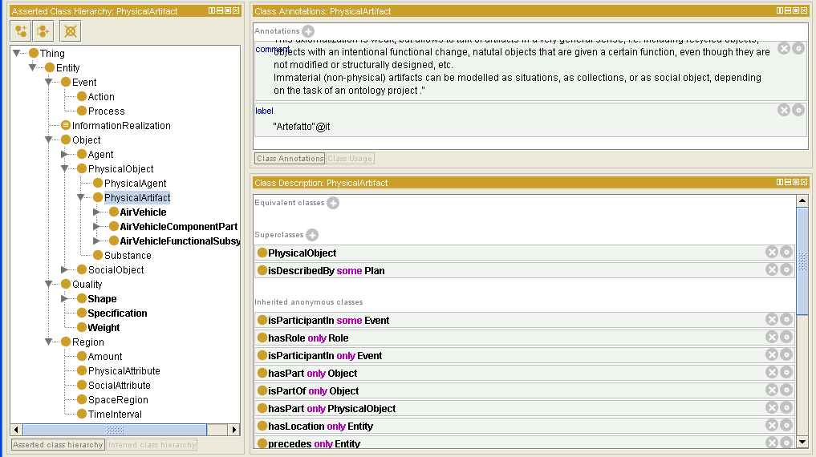
We Are Developing an Air System Ontology in Protégé 4.0 Using the Fact++ Reasoner and DOLCE Ultra Lite (DUL)
…use of a foundation ontology saves a lot of time

Slide 4
Achievements
Used class constructors to define (requirements) classes of physical objects with structural and measurable properties
Resulting ontology has about 300 classes
Verified that requirements class is consistent
Defined (design) classes characterized by generic instances
Gone outside the logic to database that represents results of measurement analysis & simulation to conclude additional properties of design instance
Verified that resulting extended generic design instance still satisfies requirements

Slide 5
Benefits and Shortcomings of OWL 1.1
OWL 1.1 with DUL classes works well for representation of product structure and (static) properties
  Used partOf relations, Quality, with values in Region
New OWL 1.1 features crucial
  Complex role inclusions
    Transfer of properties across part-whole relations
  Extended support for datatypes
    Numerous design constraints relate to concrete values such as weight, speed, temperature, distance, …
    Complex datatypes, representing, e.g., shapes or performance measures
  Extended annotation
    E.g., for provenance of information

Slide 6
Benefits and Shortcomings of OWL 1.1
Some requirements not (easily) expressible OWL DL
  Extended reasoning with datatypes and values, e.g., agregation
    Weight of product is sum of weights of components
  Behavioral and other dynamic requirements
    I.e., statements involving state change
  Interfacing and integrating with other systems
    Storage and representation systems such as DBs
    Testing and measurement systems such as simulators

Slide 7
Lessons Learned
OWL 1.1 is not a replacement for systems engineering language and tools
  But is a good candidate for semantic integration
Potential for reasoning in OWL for systems engineering is great
  Achieved reasoning experiments for requirements consistency, and design satisfaction of requirements
Further language and tool development is needed
  Ontology management
  Explanation and annotation
  Modularization
  Architecture to integrate with other computational and reasoning systems

