Slide 2

Tomorrow’s CSS
Client Technology Days 2023
Mithusan Sivakumar | 11.07.2023

Slide 3
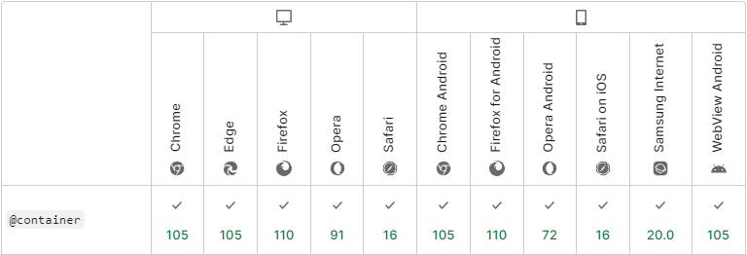
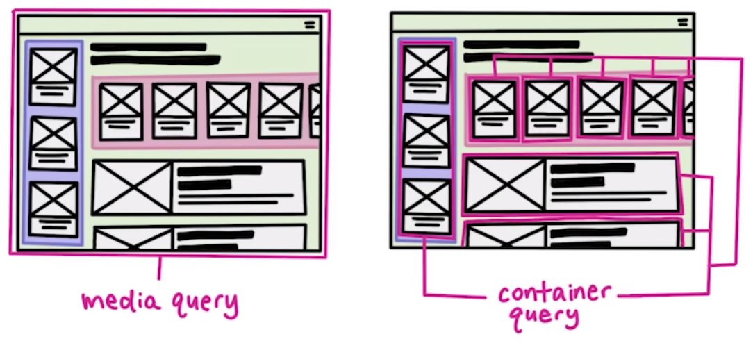
Container Queries

Slide 4
Container Queries

Slide 5
Container Queries
.card { container-type: inline-size; container-name: todo-card; }
<section class="card"> <div class="details"> <div class="title">...</div> <div class="description">...</div> </div> </section>
@container todo-card (inline-size < 235px) { .details { font-size: 1rem; } }

Slide 6
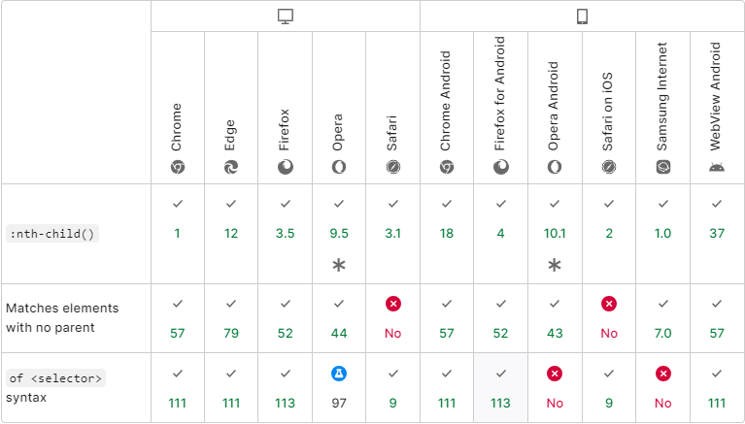
nth-of-syntax
1
2
3
4
5
6
7
8
div { background: blue; }
div.special { background: green; }

Slide 7
nth-of-syntax
1
2
3
4
div.special:nth-child(2) { border: purple; }
5
6
7
8
div { background: blue; }
div.special { background: green; }

Slide 8
nth-of-syntax
1
2
3
4
div.special:nth-child(2) { border: purple; }
5
6
7
8
div:nth-child(2 of .special) { border: purple; }
div { background: blue; }
div.special { background: green; }

Slide 9
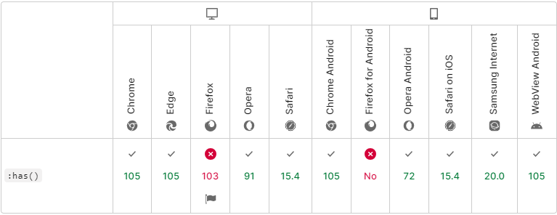
:has()
Parent
.parent { background: blue; }
.child { background: green; }
Child
Sibling
.sibling { visibility: hidden; }
h2

Slide 10
:has()
Parent
.parent { background: blue; }
.child { background: green; }
Child
Sibling
.sibling { visibility: hidden; }
h2
.parent:has(> .child > h2) .sibling { visibility: visible; }

Slide 11

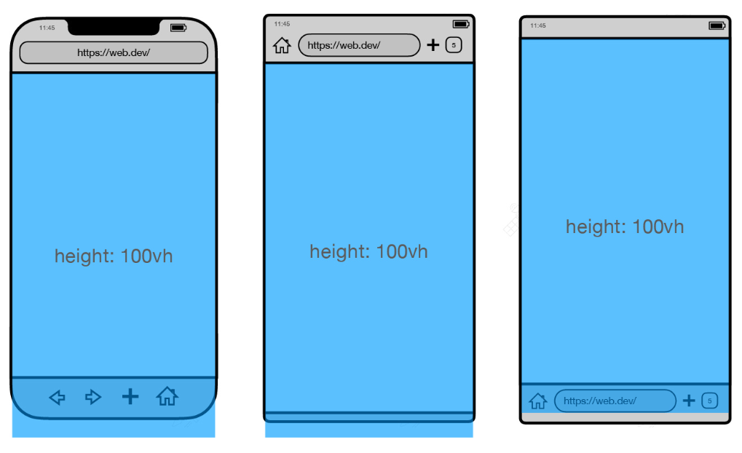
Dynamic viewport units

Slide 12
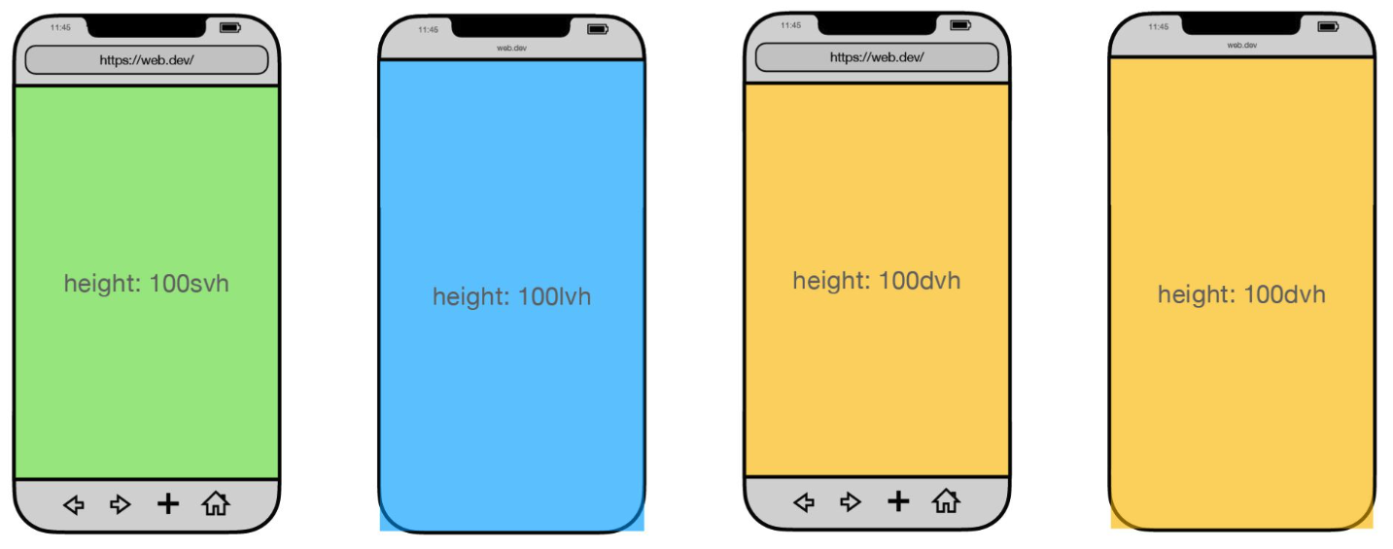
Dynamic viewport units

Slide 13

Nesting
CSS
SASS
button { background: purple; } button:hover { background: blue; }
button { background: purple; &:hover { background: blue; } }

Slide 14
Nesting
CSS
CSS!
button { background: purple; } button:hover { background: blue; }
button { background: purple; &:hover { background: blue; } }

Slide 15
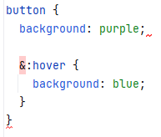

Nesting
CSS
CSS!
button { background: purple; } button:hover { background: blue; }
button { background: purple; &:hover { background: blue; } }

Slide 16
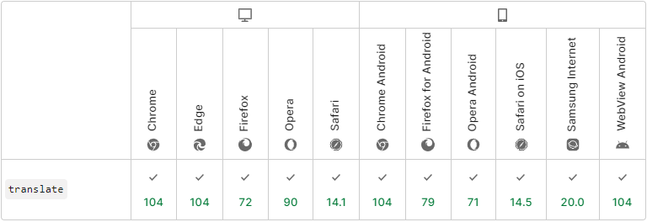
Individual transform properties
button { transform: translateX(50%) rotate(30deg) scale(1.2); } button:hover { transform: translateX(50%) rotate(30deg) scale(2); }

Slide 17
Individual transform properties
button { transform: translateX(50%) rotate(30deg) scale(1.2); } button:hover { transform: translateX(50%) rotate(30deg) scale(2); }
button { translate: 50% 0; rotate: 30deg; scale: 1.2; } button:hover { scale: 2; }
Order
translate
rotate
scale

Slide 18
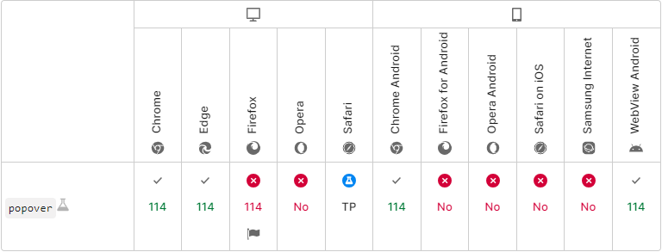
Popover
<button popovertarget="dialog"> Open Dialog </button>
<div id="dialog" popover>
…
<button popovertarget="dialog" popovertargetaction="hide">Close</button>
</div>
div::backdrop { background: rgba(0, 0, 0, 0.6); }

Slide 19
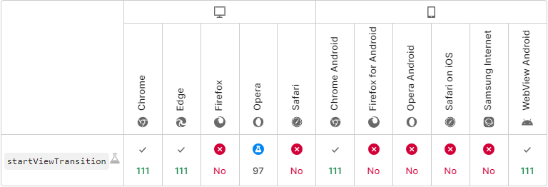
View transitions
Previous Page
Next Page

Slide 20
View transitions
navigate(url: string): void { // fallback if (!document.startViewTransition) { navigateLogic(url); return; } document.startViewTransition(() => navigateLogic(url)); }

Slide 21
View transitions
Angular
navigateTo(url: string): void { if (this.router.url !== url) { // fallback, if startViewTransition is not supported by browser if (!document.startViewTransition) { void this.router.navigateByUrl(url); return; } document.startViewTransition(() => this.ngZone.run(() => this.router.navigateByUrl(url))); } }

Slide 22
View transitions
@keyframes slide-from-right { from { opacity: 0; transform: translateX(75px); } } @keyframes slide-to-left { to { opacity: 0; transform: translateX(-75px); } } ::view-transition-old(root) { animation: 350ms both slide-to-left ease; } ::view-transition-new(root) { animation: 350ms both slide-from-right ease; }

Slide 23
View transitions
@keyframes slide-from-right { from { opacity: 0; transform: translateX(75px); } } @keyframes slide-to-left { to { opacity: 0; transform: translateX(-75px); } } ::view-transition-old(root) { animation: 350ms both slide-to-left ease; } ::view-transition-new(root) { animation: 350ms both slide-from-right ease; }
nav { view-transition-name: nav-header; }

Slide 24
View transitions
@keyframes slide-from-right { from { opacity: 0; transform: translateX(75px); } } @keyframes slide-to-left { to { opacity: 0; transform: translateX(-75px); } } ::view-transition-old(root) { animation: 350ms both slide-to-left ease; } ::view-transition-new(root) { animation: 350ms both slide-from-right ease; }
nav { view-transition-name: nav-header; }
/* must be in a root css file, e. g. styles.css in Angular */
::view-transition-old(nav-header) { animation: 350ms both slide-from-right ease; } ::view-transition-new(nav-header) { animation: 350ms both slide-to-left ease; }

Slide 25
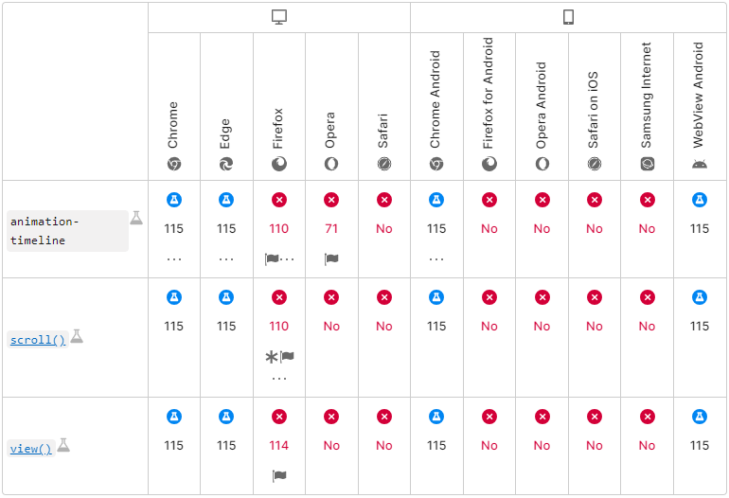
Scroll-driven animations
@keyframes fancy-scroll-animation { … } .subject { animation: fancy-scroll-animation linear; animation-timeline: scroll(root block); }

Slide 26
Scroll-driven animations
@keyframes fancy-scroll-animation { … } .subject { animation: fancy-scroll-animation linear; animation-timeline: view(); }

Slide 27
Scroll-driven animations
@keyframes fancy-scroll-animation { … } .subject { animation: fancy-scroll-animation linear; animation-timeline: view();
animation-range: entry 0% entry 100%; }

Slide 28
Wrap up
Container Queries: @container
nth-of-syntax: :nth-child(2 of .some-class)
:has()
Dynamic viewport units: svh, lvh, dvh
Nesting in CSS
Individual transform properties: translate, rotate, scale
Popover
View transitions
Scroll-driven animations

Slide 30
Sources
Github Repo: https://github.com/webplatformz/ctd-2023-tomorrows-css
Rest of the sources are listend in the Github repo ☺

