Slide 1

Welcome to Compiler Design Presentation
Topic : Code Generation

Slide 2
Code Generation
What is code generation
Minimum properties
High Level Representation
Code Generator
Code

Slide 3
Next Use Information
Definition
Goal
How it works
Algorithms for Next Use Information(NUI)

Slide 4
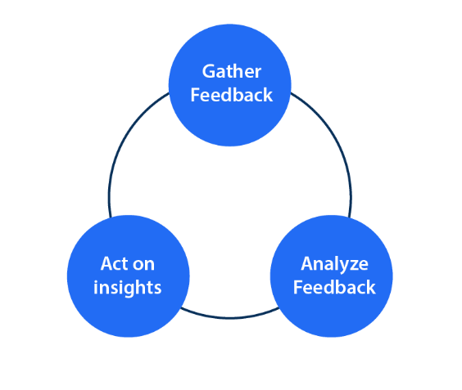

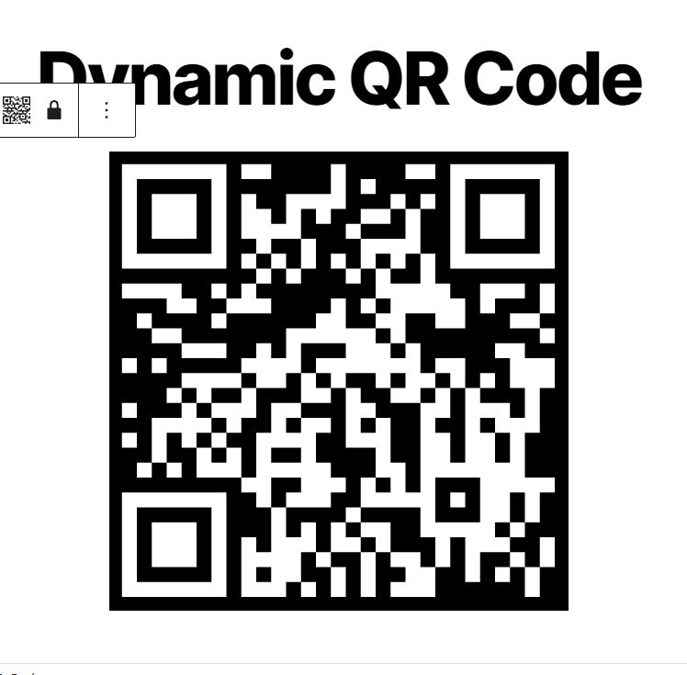
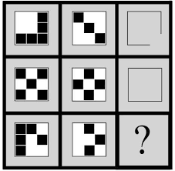
Application Of NUI
Feedback Loops
Usage Analytics
Dynamic Code Generation
Pattern Recognition

Slide 5
Some other applications
produces machine code that is more efficient
can be used with other optimization strategies
helps the compiler in selecting the variables
lowers the number of memory accesses needed
Optimizes the allocation of registers in a computer's CPU

Slide 6
Graph Coloring Algorithm
Representation
Variables and their dependencies are represented as nodes and edges in a graph.
Graph Construction
Each variable is a node.
Edges connect variables that cannot share a register due to live-time overlap.

Slide 7
Greedy Coloring
Start with an arbitrary node.
Assign the lowest available color not used by neighbor nodes.
Repeat until all nodes are colored.
Benefits
Improves code efficiency.
Enhances performance by minimizing register usage.

Slide 8
Application of Graph Coloring Algorithm
Register Allocation in Compiler Optimization
Frequency Assignment in Wireless Networks
Scheduling Tasks
Map Coloring

Slide 9
Why Next Use Algorithm & Graph Coloring Algorithm is used in Register Allocation
Next-Use Algorithm
aims to minimize register pressure
works by tracking the "next use" of variables in the program
useful in situations where the number of available registers is limited
Graph Coloring Algorithm
views register allocation as a graph coloring problem
provides an efficient way to allocate registers optimally
minimizing the number of spills to memory

Slide 10
Thank You
Presented By :
Riyadul Islam Riyadh
Rokaiya Sultana Bonhy
Habiba Sultana Othy
Md. Abu Talab Anik
Oindrila Islam
Presented to :
Anusha Aziz
Lecturer
Dept. of CSE , BUBT

