Slide 1
Barriers to Implementing Just Culture
Aaron Crose
Module 9.2

Slide 2
What is "Just Culture"
A framework that balances accountability with learning from errors to improve safety and system reliability.
Essential for fostering innovation, security, and team collaboration while minimizing risks.

Slide 3
Barrier 1: Fear of Retaliation
Employees fear reporting mistakes due to possible punishment or blame.
If this is the case, critical issues go unreported and lead to recurring errors and system vulnerabilities.
An example of this would be developers hesitating to report a bug introduced during a sprint.

Slide 4
Barrier 2: Lack of Clear Behavioral Standards
Uncertainty about what defines errors, at-risk actions, and recklessness.
If this is the case, it may lead to misaligned expectations and inconsistent incident handling.
An example of this would be teams interpreting security protocol breaches differently during incident reviews.

Slide 5
Barrier 3: Resistance to Change
Employees and leadership could resist changing from punitive to learning-focused models.
If this barrier is run into then the organization can fail to fully integrate just culture principles.
An example of this is reluctance to swap traditional performance metrics with collaborative feedback mechanisms.

Slide 6
Barrier 4: Resource Limitations
The implementation of just culture requires investments in training, tools, and time.
If the resources are not abundant enough then a smaller company may not prioritize this switch.
Delays in getting automated monitoring tools due to cost concerns would be an example of this.

Slide 7
Strategies to Overcome Barriers
Build mental safety by encouraging non-punitive reporting.
01
Host regular workshops on just culture principles for all employees.
02
Develop clear guidelines for categorizing behaviors and incidents.
03
Allocate resources for monitoring systems and incident tracking.
04

Slide 8
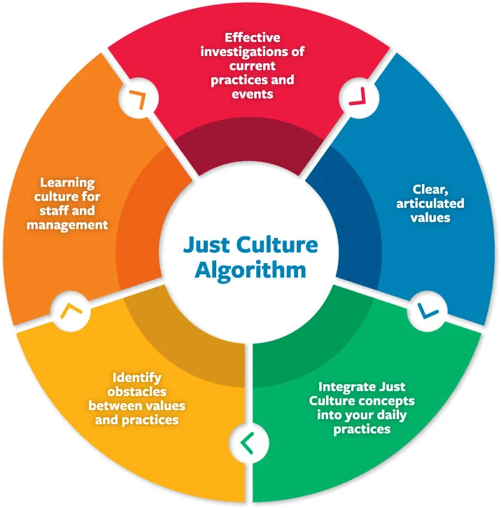
The Cycle of Just Culture

