Slide 1
Manual testing

Slide 2
Course purpose
What is QA?
Why we are testing?
How we are testing?
Writing a defect
Writing a testcase

Slide 3
What is QA ?
QA is a series of procedures and processes that ensures a good quality is delivered for each product
Testing is an activity of the QA

Slide 4
Why we are testing?
Testing is done to ensure the product is doing what it was requested to do, without issues or human intervention
Increase Quality and Confidence in the product

Slide 5
How we are testing
White Box Testing
Black Box Testing
Non-Functional testing

Slide 6
White Box Testing
White box testing tests internal programming structures of an application.
This type of testing technique is known as clear box testing, open box testing, structural testing, and transparent box testing.
Its operation is opposite to black-box testing and is used at unit, integration, and system levels of the testing process.
The testing techniques of white box testing include:
Statement Coverage – In this technique, all programming statements are applied with a minimal number of tests.
Branch Coverage – In this type of technique, all branches shall be tested by running them a sequence of tests.
Path Coverage – All paths including statements and branches are tested using this technique.

Slide 7
Black Box Testing
Black box testing is a type of software testing, which checks for the functionality of a software or an application without knowing the design, internal components, or structure of an application to be tested. It is also referred to as Specifications-based testing.
The black box testing method is mainly used to find missing functions, performance errors, initialization errors, and errors while accessing the external database.
The testing techniques of black box testing include:
Equivalence Partitioning
Boundary Value analysis
Decision Table
State Transition Diagram
Experience Based Testing
All-pairs Testing

Slide 8
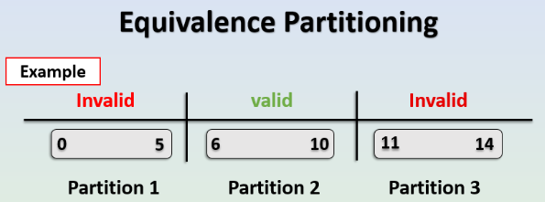
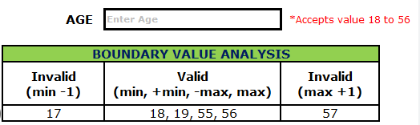
Equivalence Partitioning
In equivalence partitioning, the input data of an application to be tested into equal partitions.
This technique ensures to
cover each partition at least once.
Boundary Value Analysis
In boundary value analysis
is a technique in which the testing of
an application is done
using the boundary values.

Slide 9
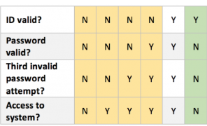
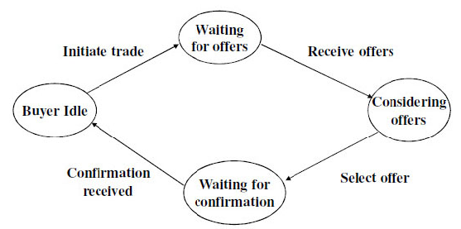
Decision Table
In this type of testing technique, causes
are the inputs of a program and effects
are the outputs.
State Transition Diagram
In this technique the focus is on
different states and transitions
that a flow of the application can have

Slide 10

Experience Based Testing
Also known as Error guessing and exploratory testing.
This is the spot where functional QA Engineers shine. Using their creativity, skill and experience the QA team perform various scenarios in order to break the system/component/feature or at least show its limits.
All-pairs Testing
In this approach, the software is tested using a combinatorial method to test all the possible discrete combinations of the parameters involved.

Slide 11
Non-Functional testing
1. Static testing - is a software testing technique which is used to check defects in software application without executing the code. Here we can include the documentation review, branch coverage review and code coverage review.
2. Performance - this type of testing checks that a system can handle the stresses of a production environment in any circumstance (practically every ecommerce app on black Friday).
3. Security - is a type of Software Testing that uncovers vulnerabilities, threats, risks in a software application and prevents malicious attacks from intruders. The purpose of Security Tests is to identify all possible loopholes and weaknesses of the software system which might result in a loss of information, revenue, repute at the hands of the employees or outsiders of the Organization.
4. Usability - also known as User Experience(UX) Testing, is a testing method for measuring how easy and user-friendly a software application is. A small set of target end-users, use software application to expose usability defects. Usability testing mainly focuses on user’s ease of using application, flexibility of application to handle controls and ability of application to meet its objectives.
5. Compatibility - Compatibility Testing is a type of Software testing to check whether your software is capable of running on different hardware, operating systems, applications, network environments or Mobile devices.
6. Scalability – it is a testing method that focuses on the decrease or increase of the number of users, transactions, volumes of data, network traffic.

Slide 12
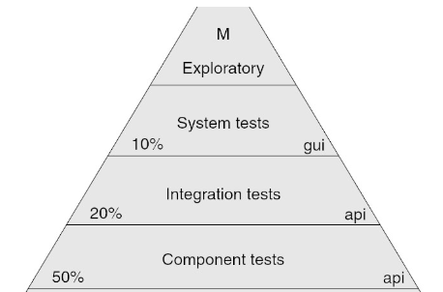
Testing can also be categorized by its granularity:
1. Unit - test which are done in isolation of a given small component or given function (usually done by the dev team)
2. Integration - tests which are validating how the components function together
3. System testing - a type of testing which checks the whole system for faults and unwanted behavior, usually done through black box techniques.
4. Acceptance - usually done by a specific team or by the client, tests which follow the flow of the system. This type of testing is not looking for defects, as are the rest of the methods of testing, but it is checking that the client's requirements are met (practically it encourages the system to pass).

Slide 13
Writing a defect
A defect should inform the team of a problem found in the system under test, should be very explicit and easy to understand.
A defect should have:
Title – concise description of the problem
Description – detailed description of the problem
Steps to reproduce – actions performed to simulate the defective behavior
Actual results - self explanatory
Expected results - self explanatory
Attached evidence – screenshots, logs, db extracts, other data evidence proving the existence of the defect
Severity – defect importance from technical impact perspective (established by QA team)
Priority – defect importance from business value perspective (established by business representatives)
Assignee – delegated developer that looks into the issue - this will be handled by the defect management system used (JIRA, Bugzilla etc.)
Status – current state the defect is in - same as assignee
Other optional info: Build version, fix version, release version Root cause, environment, resolution SLA, detected in phase, labels, components Many others, depending on the tools used for defect management.

Slide 14
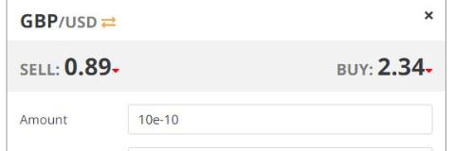
Example of a defect:
Title:
The user can insert exponent into the Amount field.
Description:
When trying inserting the amount of currency the user wants to buy or sell he can also insert exponent
in an all numerical, thus possibly creating transactions which can exploit the system.
Steps to reproduce:
1.Launch the FXTrading app
2.Login with a valid user
3.Add an exchange container and choose a currency pairs
4.Choose any Tenor
5.Insert any number followed by an exponent, positive or negative -> 76e-5
6.Buy or Sell
7.See the transaction is processed without triggering an error message.
Expected results:
The user should not be able to insert
any non integer number into the Amount field.
Actual results:
The user can insert an exponent, thus possibly
inserting a non integer number into the Amount field.
Notes:
Please check the attached screenshot.

Slide 15
Writing a test case:
Testcases are used to validate that a given functionality of a system is implemented correctly.
A testcase contains:
Test steps, test data, precondition, postcondition developed for specific test scenario to verify any requirement.
The testcase includes specific variables or conditions, using which a testing engineer can compare expected and actual results to determine whether a software product is functioning as per the requirements of the customer.
Testcase can have two outcomes:
1. positive - where the test is passed if a successful operation is done (The user can successfully purchase 1 item from an ecommerce app)
2. negative - where the user is passed if a validation message is triggered (The user cannot successfully login into the system with an empty password)
Testcase need to have the following:
Title and description - should be VERY specific so that the whole team can instantly identify what is being done in that particular case
Prerequisites (if applicable) - this will contain all that is needed in order to start a testing scenario (username and passwords, access to databases, environment grants etc.)
Test steps - these need to be succinct and only checking one aspect, they will also need to have a description of what the QA needs to do, what is the EXPECTED result and what is the ACTUAL result.
Post requisites (if applicable) - cleanup which needs to be done after the testing was performed, so that the system is not altered and make other testing a false positive or false negative.

Slide 16
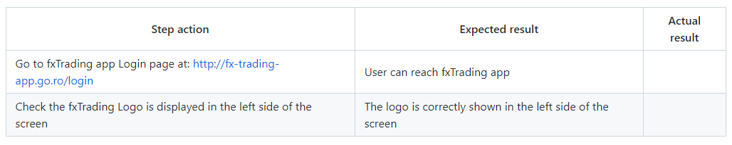
Best Practices:
While drafting a test case include the following information:
- The description of what requirement is being tested
- The explanation of how the system will be tested
- The test setup like a version of an application under test, software, data files, operating system, hardware, security access, physical or logical date, time of day, prerequisites such as other tests and any other setup information pertinent to the requirements being tested
- Inputs and outputs or actions and expected results
- Any proofs or attachments
- Use active case language
- Test Case should not be more than 15 steps
- An automated test script is commented with inputs, purpose and expected results
- The setup offers an alternative to pre-requisite tests
- With other tests, it should be an incorrect business scenario order
- The test case should generate the same results every time no matter who tests it
Example of a test case

