Slide 1
Apply MLT to Model 3D Chromatin Structures
Weiyi Chen, Tianyi Hao

Slide 2
Overview
T.H.
Dimension Reduction (MLT)
Example tech: Locally Linear Embedding (LLE)
W.C.
Modified MLT for Structure Prediction
Implementation and results
Former step and next step (L.W. and Z.W.)

Slide 3
Part 1:Dimension Reduction
Motivations and Techniques

Slide 4
Dimension Reduction
Manifold learning techniques
Embed data from high to low dimensional
Goal 1: Reduce Complexity
Goal 2: Extract Key Low Dimensional Features
Goal 3: Data Visualization

Slide 5
Dimension Reduction
Possible MLTs
Principle Component Analysis (PCA)
SVD, high speed and good result
Multidimensional Scaling (MDS)
Hw2, a bit slower but better
Locally Linear Embedding (LLE)
Improved LLE

Slide 6
Part 2: Locally Linear Embedding (LLE)
Intuitions and Algorithm

Slide 7
Assumptions
Data points are sampled from a low dimensional manifold
Data points can be locally approximately embedded into a plane
The nearer two data points, the more similar they are

Slide 8
Intuitions
Every data point can be approximately expressed as an combination of its neighbors
LLE constructs a neighborhood preserving mapping by
Calculate combinations for each data point
Fit into a low dimensional Euclidean space

Slide 9

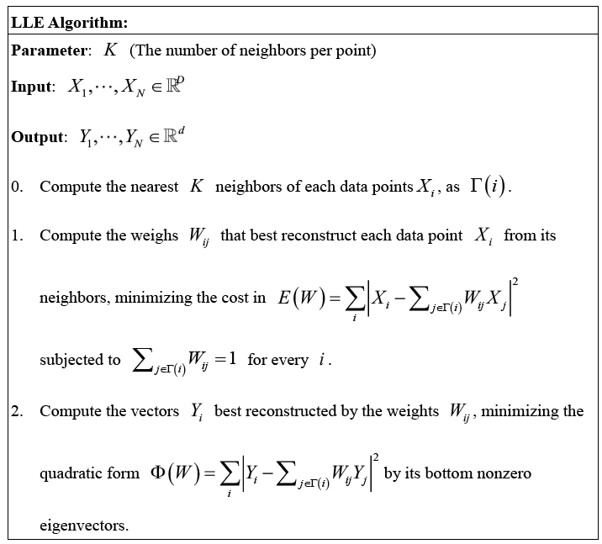

Slide 10
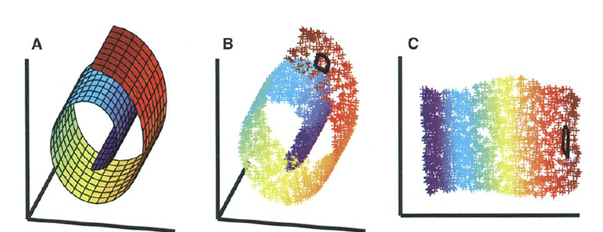
Illustration of LLE [4]

Slide 11
Part 3: Modified LLE for Structure Prediction
Problem Specification and Ideas

Slide 12
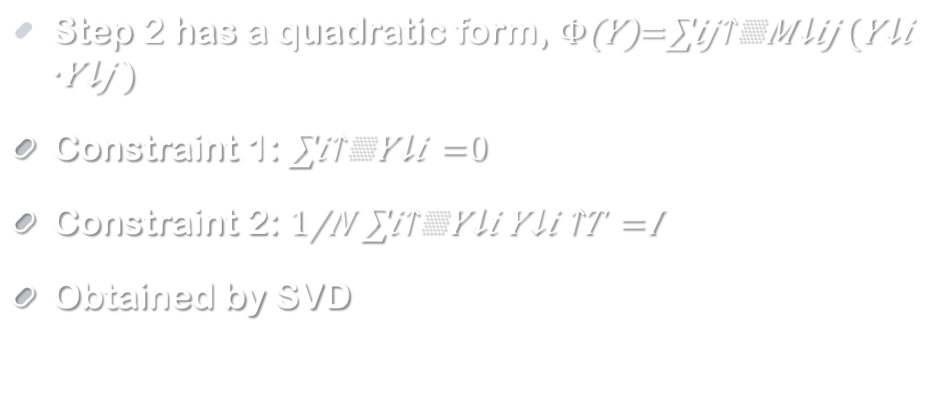
Implementations
Step 1 & 2 are both quadratic programming such that they can be solved efficiently
Step 2 has a quadratic form,
Constraint 1:
Constraint 2:
Obtained by SVD

Slide 13
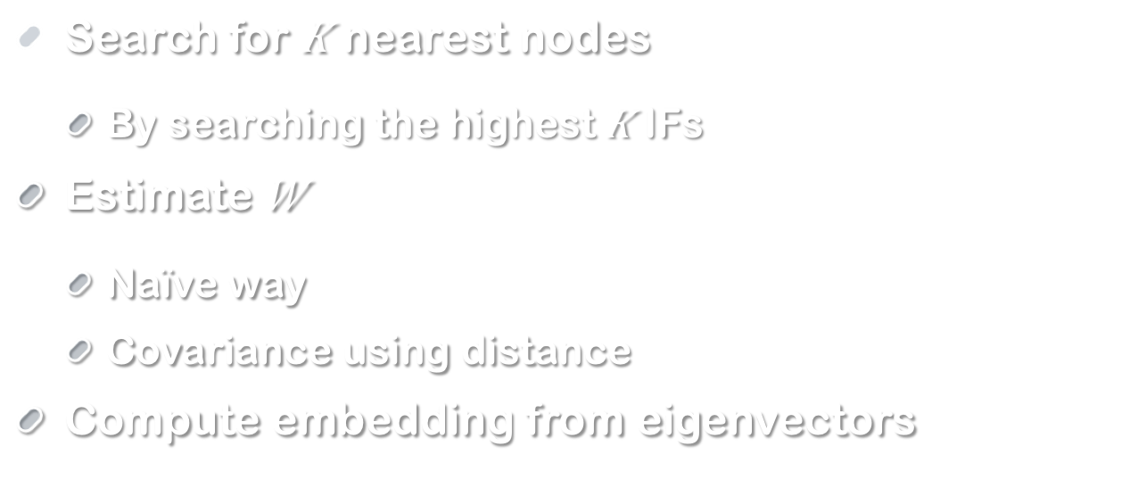
Algorithm (Z.W.)
Search for $K$ nearest nodes
By searching the highest $K$ IFs
Estimate $W$
Naïve way
Covariance using distance
Compute embedding from eigenvectors

Slide 14
Parameters and return
Input
Interaction Frequency information
Matrix information
Output
3 dimensional coordinates for each point

Slide 15
Part 4: Implementation & results

Slide 16
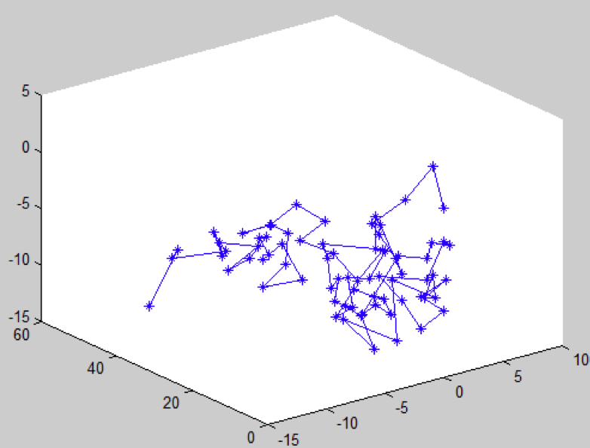
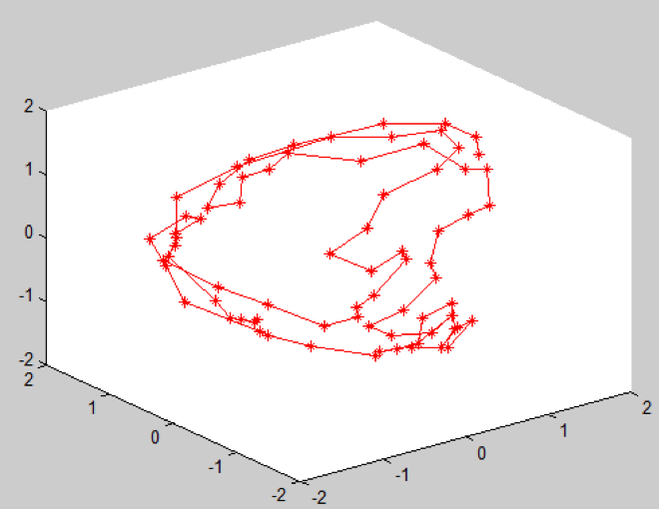
LLE performance

Slide 17
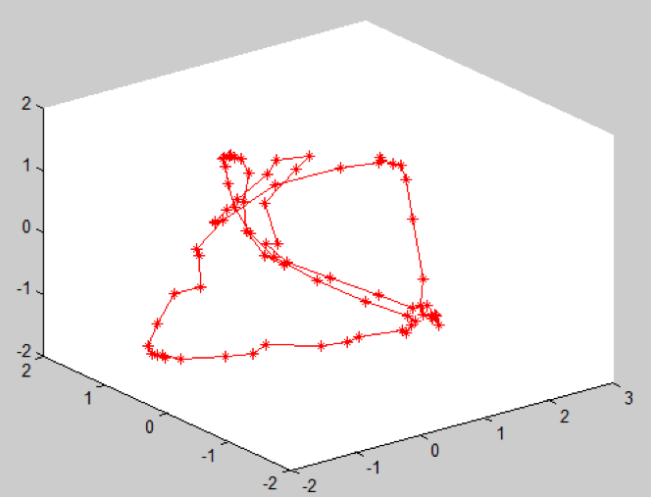
Sensitivity of k

Slide 18
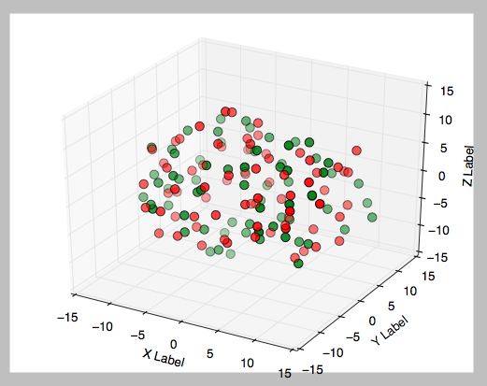
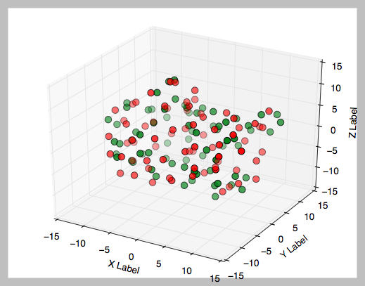
MDS performance

Slide 19
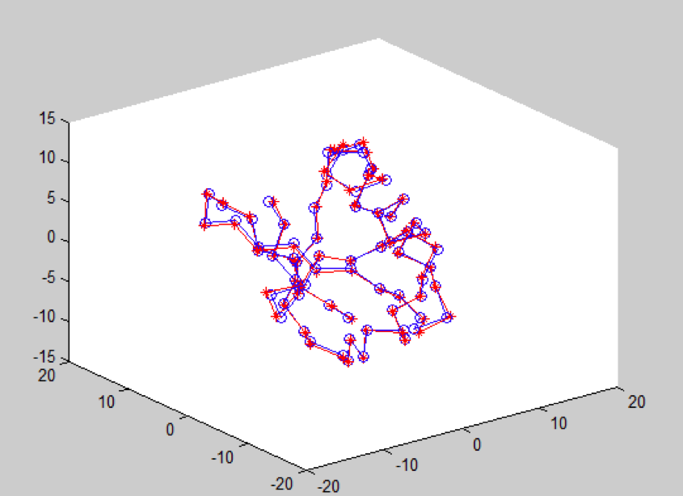
MDS RMSD = 0.01544373

Slide 20
MDS RMSD = 0.01544373

Slide 21
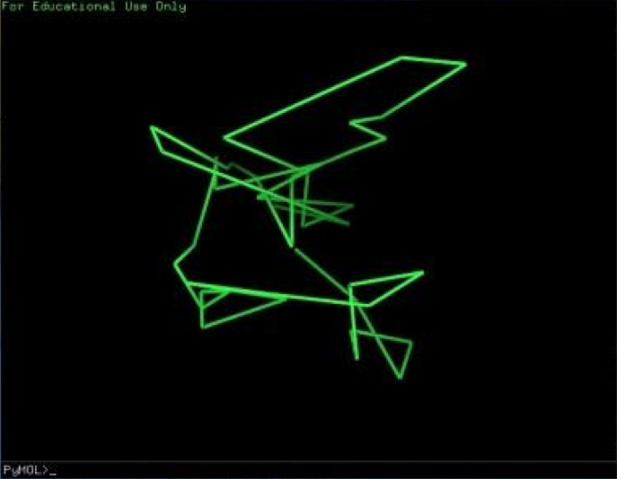
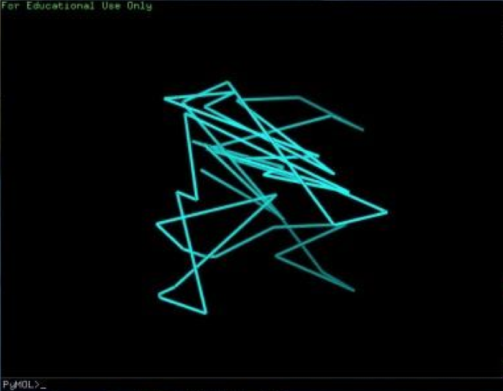
PCA performance

Slide 22
Why? Reason - 1
The IF information from one to its nearest points is not enough
need more IF from its neighbor to its neighbor

Slide 23
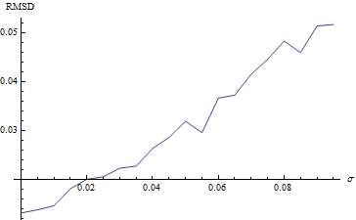
Why? Reason - 2
Random structure is not reasonable
W.L’s MLT: decrease energy function by random walk
Inapplicable cause of complexity

Slide 24
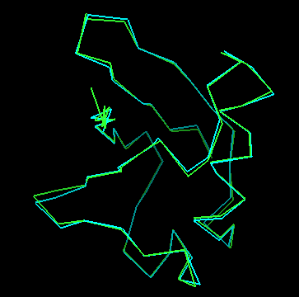
Why? Reason - 3
Pure LLE doesn’t work well, requiring modifications
Hessian LLE, MLLE

Slide 25
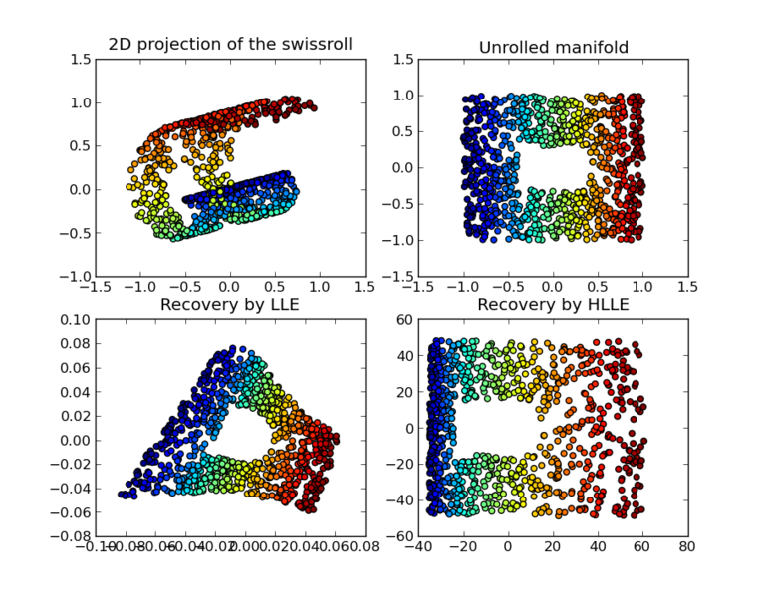

Slide 26
Improvement
1. Still have to convert IF to distance
Estimate the distance between one’s neighbors
2. Dataset
Modify random structure
Search for real data to run more structures
3. LLE modification (HLLE works better)

Slide 27
Reference
[1] An Introduction to Locally Linear Embedding, Lawrence K. Saul, Lawrence K. Saul
[2] A Survey of Dimension Reduction Techniques, Imola K. Fodor
[3] Dimension Reduction: A Guided Tour, Christopher J. C. Burges
[4] Nonlinear Dimensionality Reduction by Locally Linear Embedding Sam T. Roweis and Lawrence K. Saul

