Slide 1


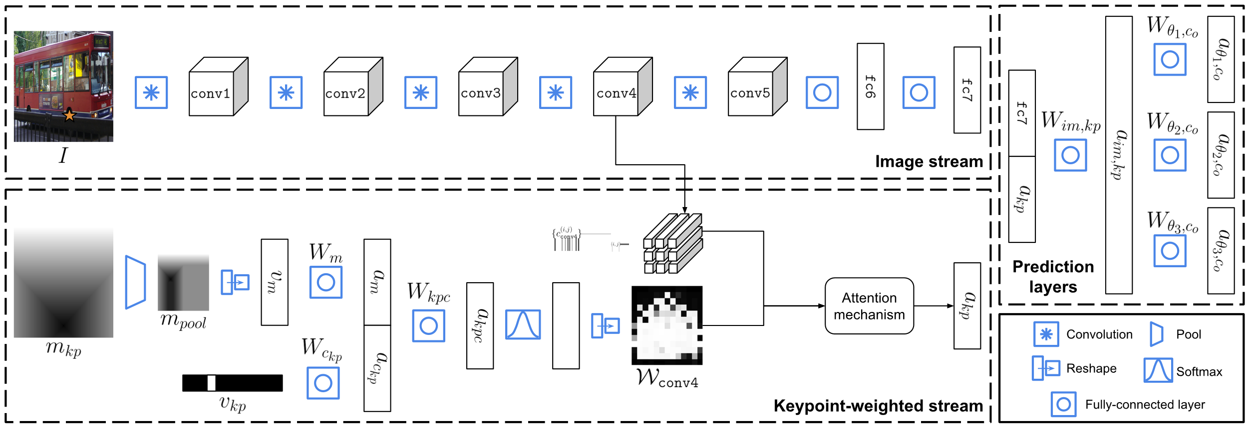
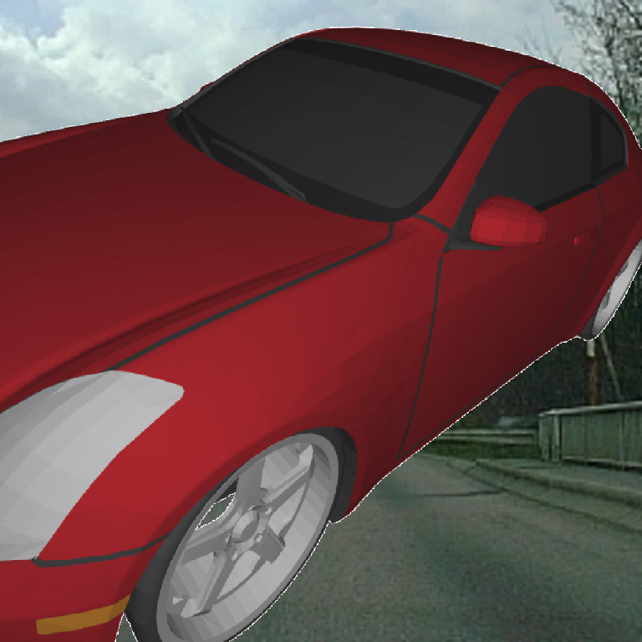
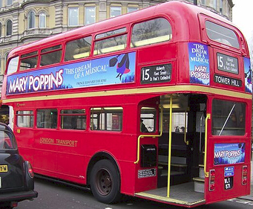
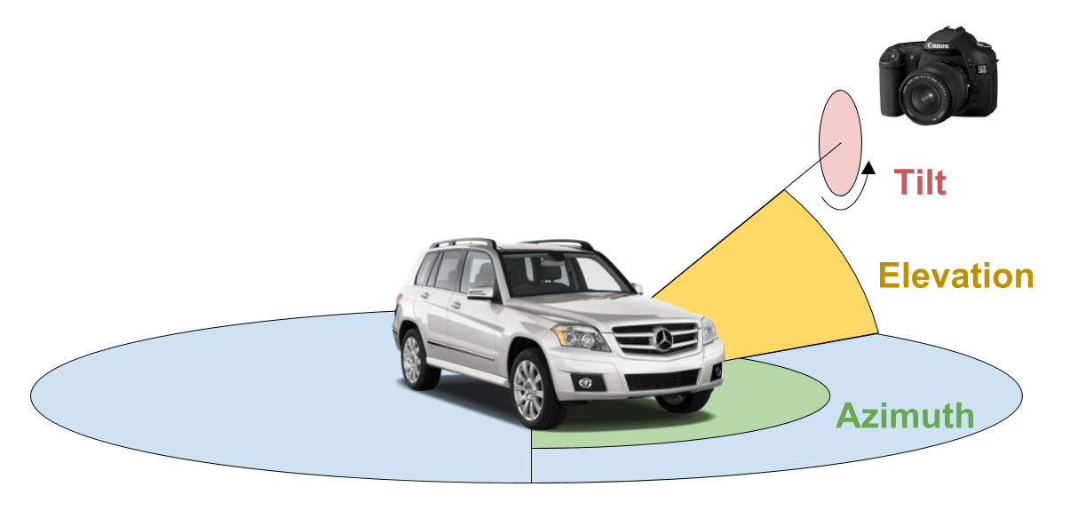
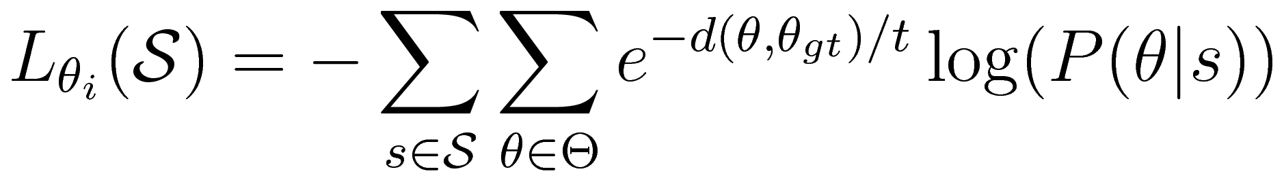
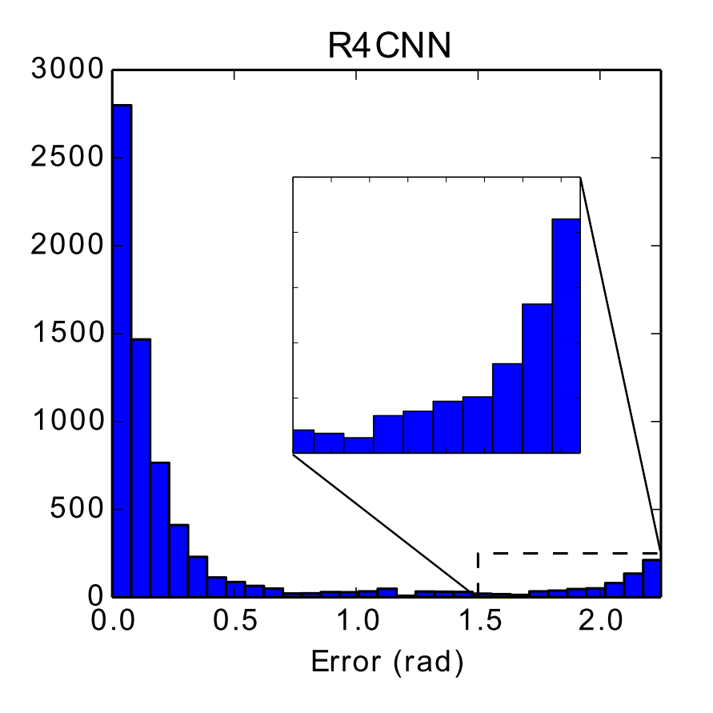
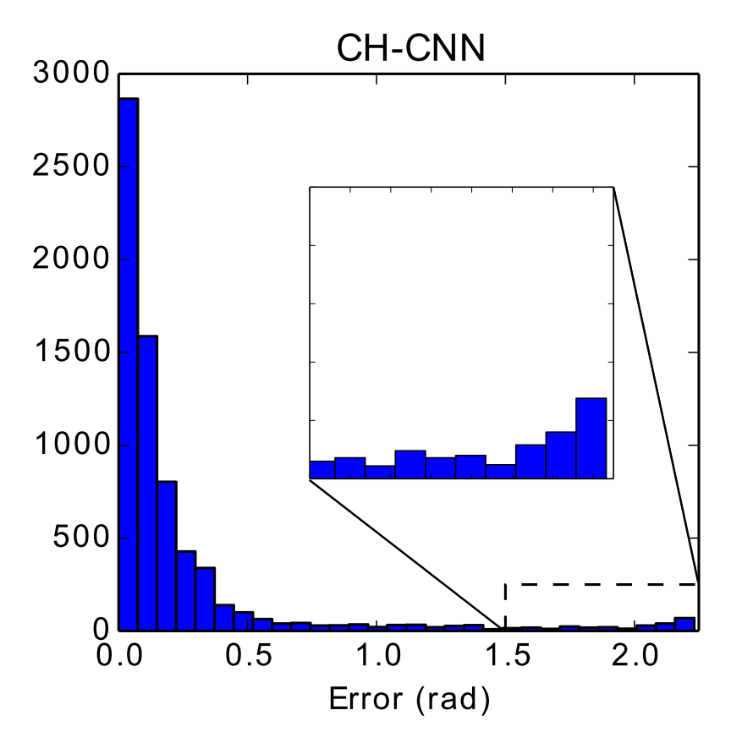

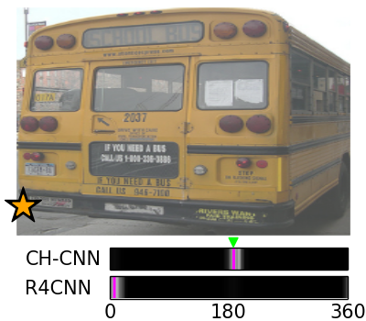
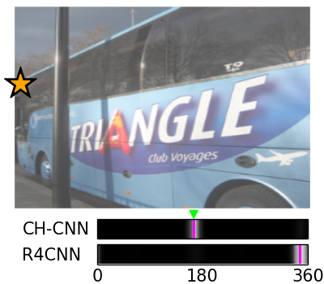
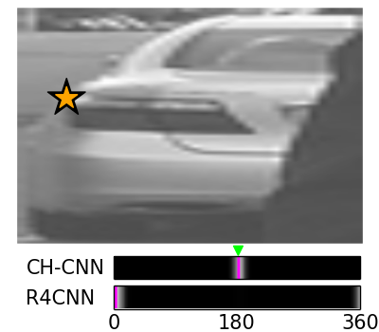
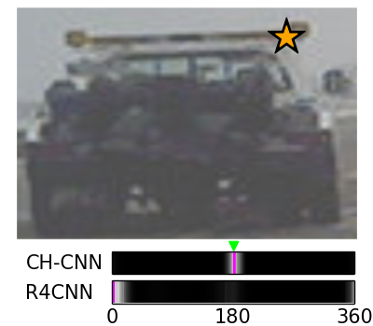
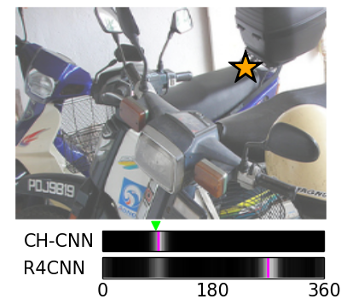
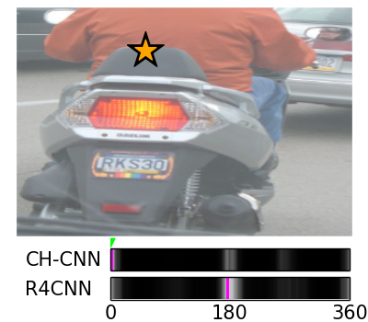
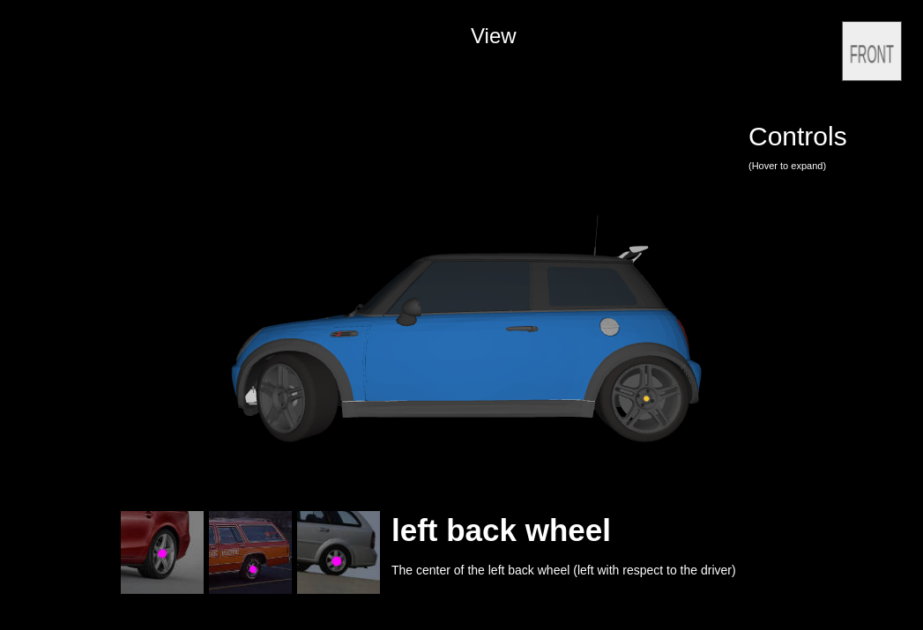
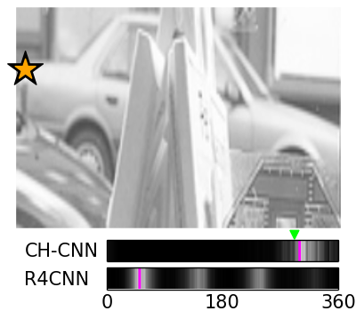
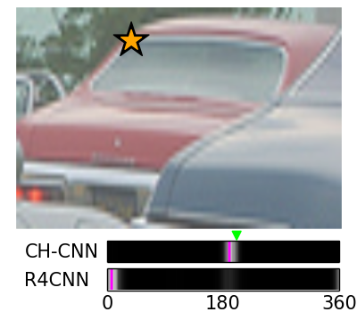
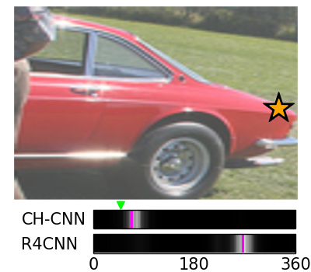
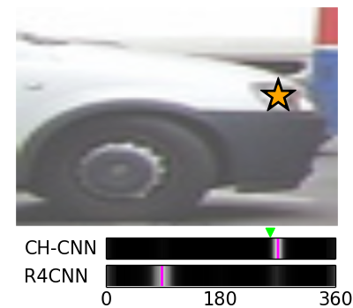
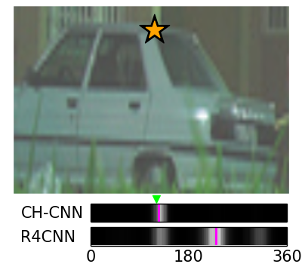
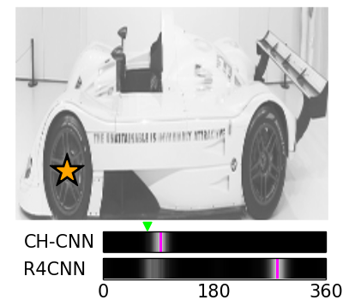

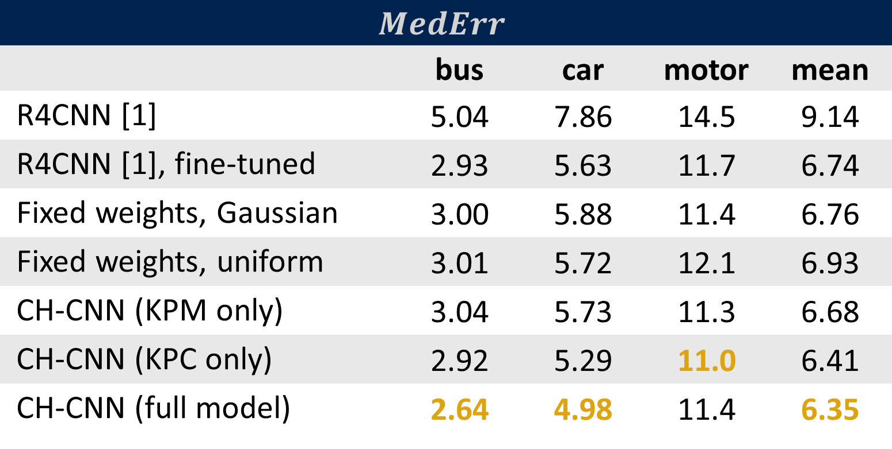
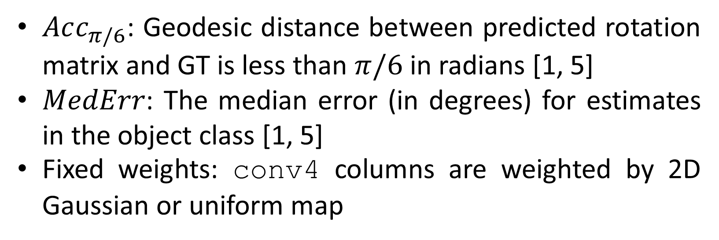
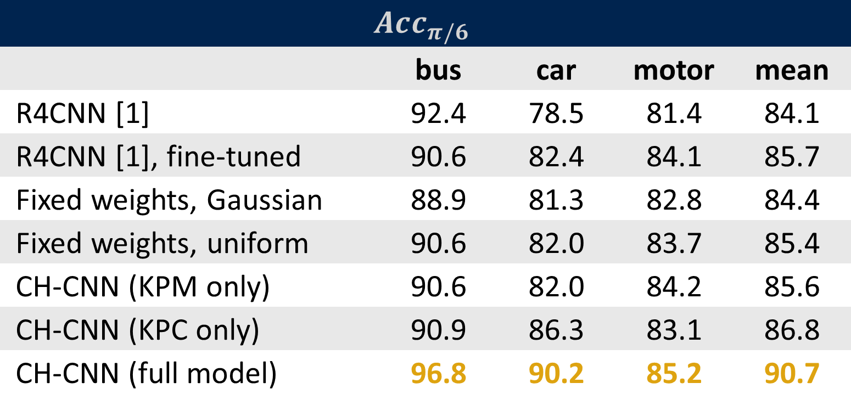
Click Here: Human-Localized Keypoints as Guidance for Viewpoint Estimation
Ryan Szeto and Jason J. Corso
Electrical Engineering and Computer Science, University of Michigan, Ann Arbor, MI
{szetor,jjcorso}@umich.edu
Project URL: ryanszeto.com/
projects/ch-cnn
Objective and Contributions
Click-Here CNN (CH-CNN)
Experiments: Accuracy and Median Error
We leverage human guidance at inference time to improve monocular viewpoint estimation performance over image-only approaches.
Motivations:
Human guidance can help overcome challenges due to occlusion, truncation, and symmetry
High benefit-to-human-effort ratio: Humans can quickly locate keypoints, and the information can help disambiguate viewpoint candidates
Contributions:
Click-Here CNN (CH-CNN), a model that estimates the viewpoint from an image and information about a single keypoint
A publicly-available dataset of keypoint locations on over 8,500 CAD models from ShapeNet [2]
Better viewpoint estimates: CH-CNN achieves 90.7% accuracy on PASCAL 3D+ [3], whereas the state-of-the-art image-only model [1] obtains 85.7%
$Acc_{π/6}$: Geodesic distance between predicted rotation matrix and GT is less than $π/6$ in radians [1, 5]
$MedErr$: The median error (in degrees) for estimates in the object class [1, 5]
Fixed weights: conv4 columns are weighted by 2D Gaussian or uniform map
$$Acc_{π/6}$$
 | bus | car | motor | mean
R4CNN [1] | 92.4 | 78.5 | 81.4 | 84.1
R4CNN [1], fine-tuned | 90.6 | 82.4 | 84.1 | 85.7
Fixed weights, Gaussian | 88.9 | 81.3 | 82.8 | 84.4
Fixed weights, uniform | 90.6 | 82.0 | 83.7 | 85.4
CH-CNN (KPM only) | 90.6 | 82.0 | 84.2 | 85.6
CH-CNN (KPC only) | 90.9 | 86.3 | 83.1 | 86.8
CH-CNN (full model) | 96.8 | 90.2 | 85.2 | 90.7
Training Data
$$MedErr$$
 | bus | car | motor | mean
R4CNN [1] | 5.04 | 7.86 | 14.5 | 9.14
R4CNN [1], fine-tuned | 2.93 | 5.63 | 11.7 | 6.74
Fixed weights, Gaussian | 3.00 | 5.88 | 11.4 | 6.76
Fixed weights, uniform | 3.01 | 5.72 | 12.1 | 6.93
CH-CNN (KPM only) | 3.04 | 5.73 | 11.3 | 6.68
CH-CNN (KPC only) | 2.92 | 5.29 | 11.0 | 6.41
CH-CNN (full model) | 2.64 | 4.98 | 11.4 | 6.35
Synthetic Data
PASCAL 3D+ Data
Extend Render for CNN pipeline [1] to generate synthetic images with keypoint data
Sample viewpoint and cropping parameters, add background image
Extract keypoint location and visibility from rendering engine
Object bounding boxes, keypoint locations, and viewpoint labels included
Crop the object and create one training instance for each visible keypoint
Problem Statement
Given an image, information about one keypoint (2D location and class), and the object class, predict the azimuth, elevation, and tilt of the camera w.r.t. the object.
CH-CNN surpasses state-of-the-art image-only model
Weighing conv4 columns dynamically from keypoint data works better than hand-crafted maps
Best results from using both keypoint location and class
Training Procedure
Initialize image feature layers with R4CNN [1] weights
Fine-tune on synthetic data until convergence
Fine-tune on PASCAL 3D+ data until convergence
Geometric structure-aware loss [1]:
Experiments: Error Histograms
Keypoint class
Keypoint map
car_left_front_wheel
(x,y)
Qualitative Results
car_left_back_wheel
Gray bars indicate confidence across 360 azimuth angles
Green triangles mark the ground truth, purple lines indicate each model’s most confident prediction
R4CNN: Multiple peaks, wide bands, or high confidence for the angle opposite the ground truth
CH-CNN: Higher confidence within smaller intervals around the ground truth compared to R4CNN
CH-CNN: More robust to occlusion, truncation, and symmetry
bus_right_front_wheel
car_left_front_wheel
bus_left_front_wheel
$$m_{kp}^{\left(i,j\right)}=\max\left(\left|i−x\right|,\left|j−y\right|\right)$$
Buses
Cars
Motorcycles
Keypoint Collection
CH-CNN: Large errors are less frequent
CH-CNN takes advantage of keypoint features when image features are insufficient
Occlusion
Truncation
Symmetry
References
[1] Su et al. Render for CNN: Viewpoint Estimation in Images Using CNNs Trained with Rendered 3D Model Views. ICCV 2015.
[2] Chang et al. ShapeNet: An Information-Rich 3D Model Repository. ArXiv 2015.
[3] Xiang et al. Beyond PASCAL: A Benchmark for 3D Object Detection in the Wild. WACV 2014.
[4] Li et al. Deep Supervision with Shape Concepts for Occlusion-Aware 3D Object Parsing. CVPR 2017.
[5] Tulsiani and Malik. Viewpoints and Keypoints. CVPR 2015.
Our dataset, with annotations for 918 bus, 7,377 car, and 320 motorcycle models, includes over ten times more models than the next-largest ShapeNet keypoint dataset [4]. It is available on our project website.
Acknowledgements
This work was partially supported by the Denso Corporation, NSF CNS 1463102, and DARPA W31P4Q-16-C-0091.

