Slide 1
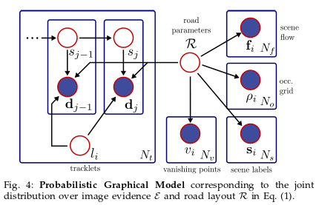
3D Traffic Scene Understanding

Slide 2
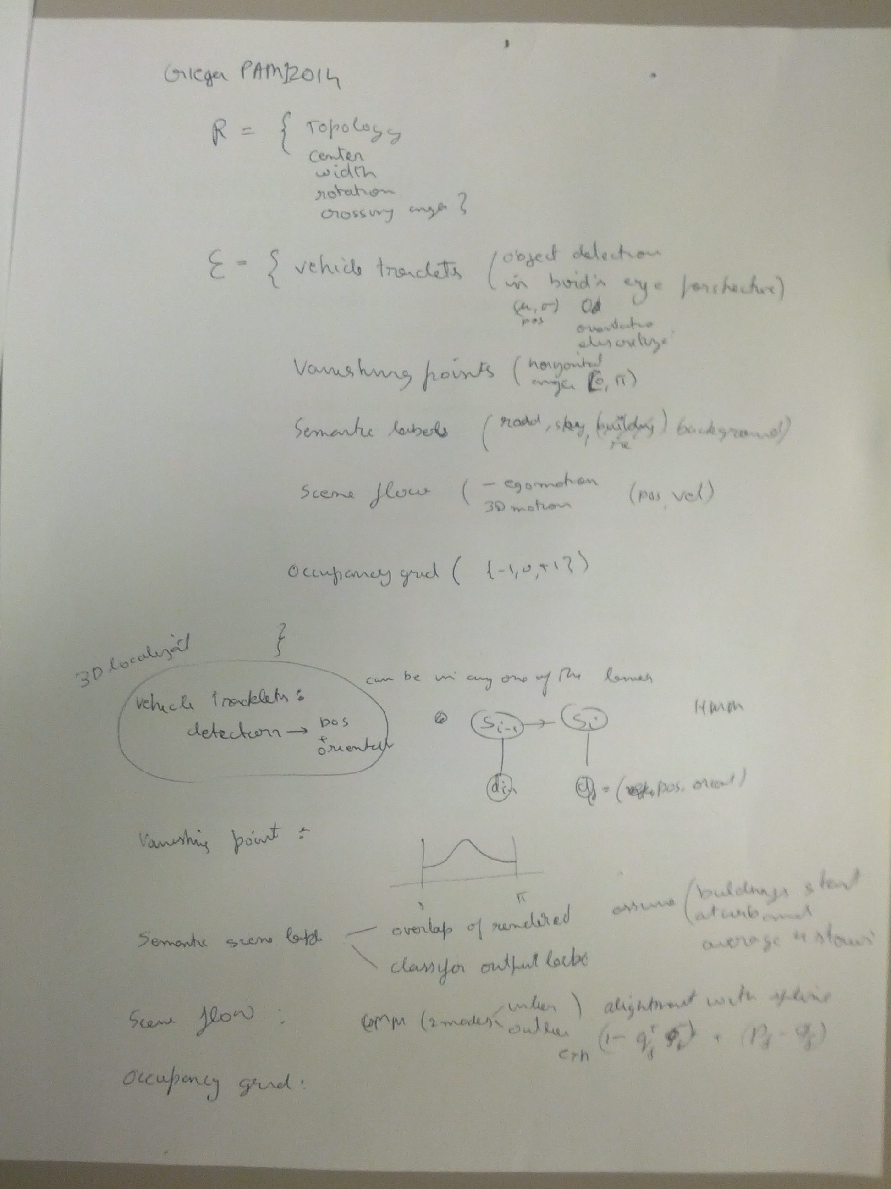

Slide 3
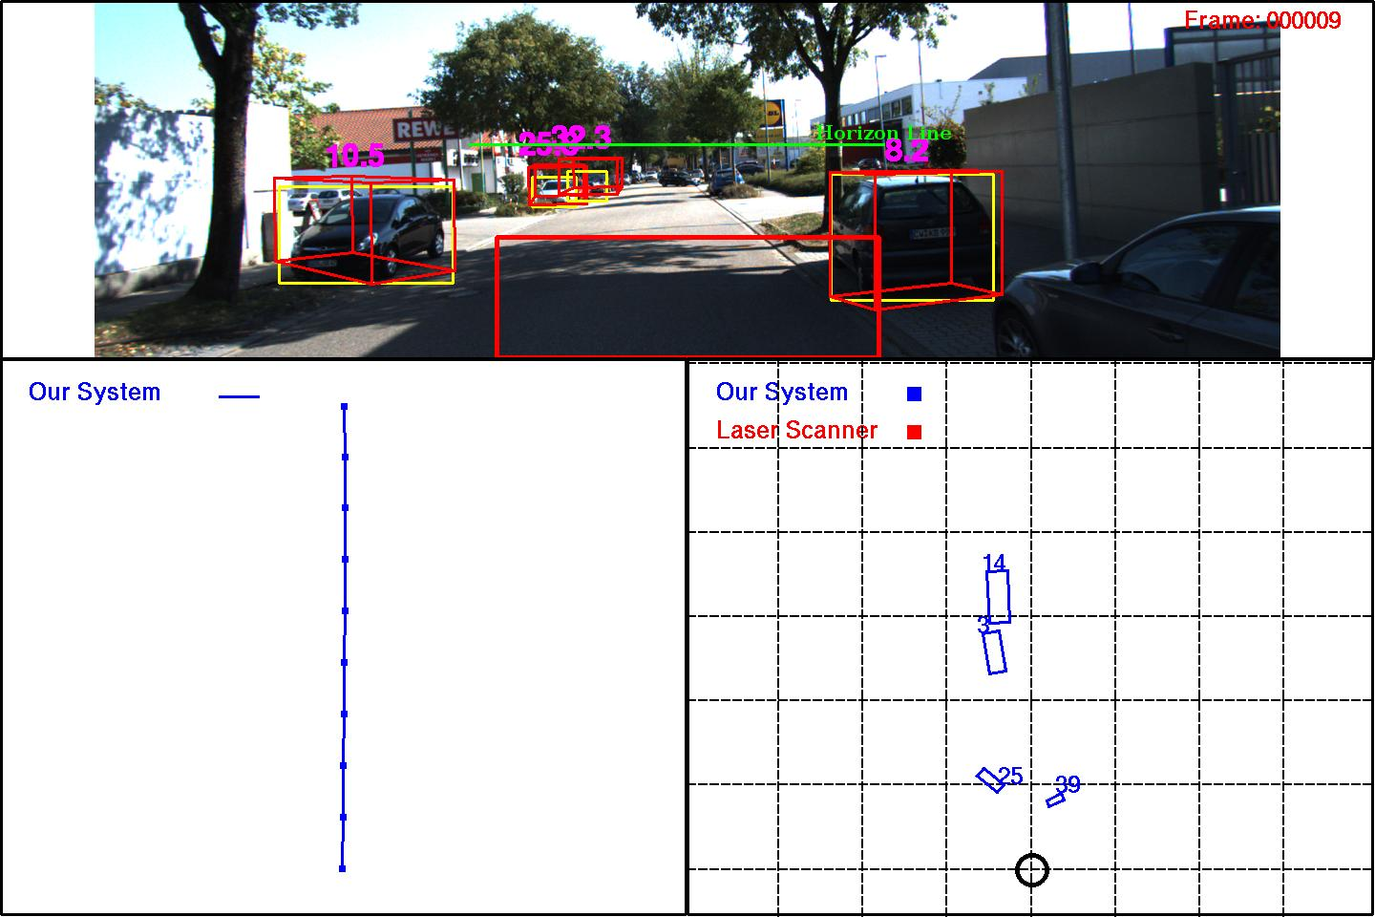
Possible heuristics to fix 3D localization
(2)Lane alignment
(non intersection scenes)
(static cars)
(3) Vanishing points on car?
(1) Prior over car size
Detector pose is not being used (0009)
- @manu

Slide 4
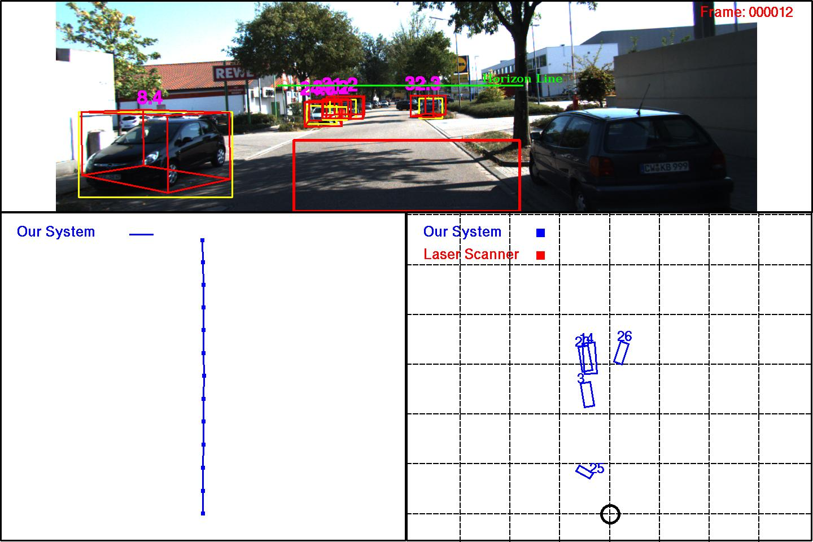
(4) No overlaps in bird eye view.

Slide 5
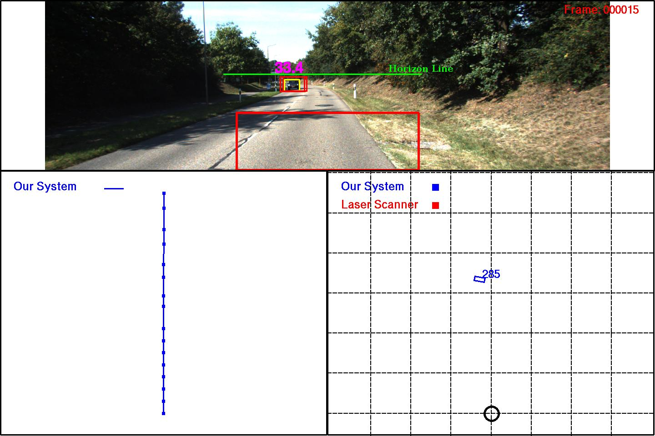
Resident/0019/000015.jpg
Holonomic constraint
Being violated

Slide 6
How important is orientation of static cars?
For good visualization?

Slide 7
May 21, 2014

Slide 8
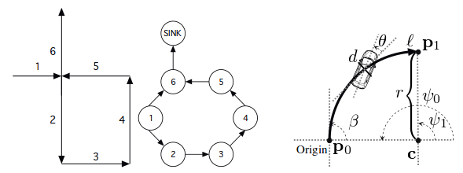
Localization using Visual odometry
Uses straight line segments and circular arcs to model maps
Uses GMM to model probability of localization.
Novel filtering algorithm for fast inference.

Slide 9
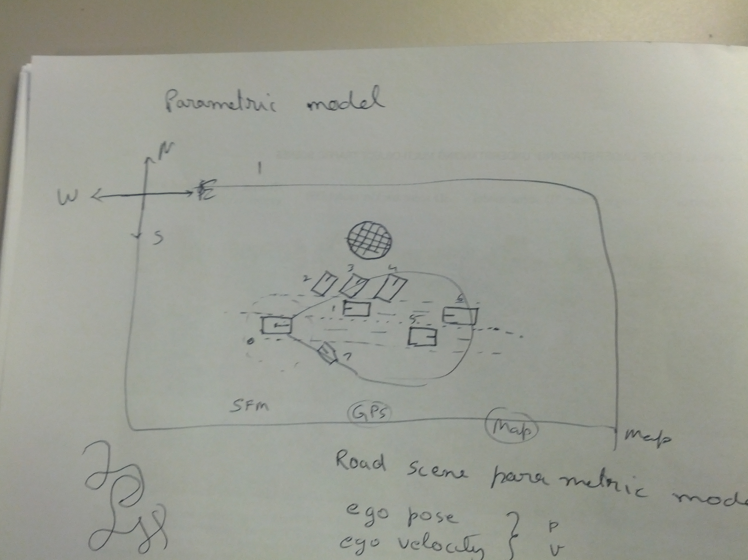

Slide 10
