Slide 1
Work done
Geiger PAMI 2014:
Combine various source of information to estimate Road geometry and traffic participants
Wojek PAMI 2013: Use monocular cam with occlusion handling for pedestrian tracking.
Brubaker CVPR 2013: Localizes traffic participants within a given map.
Flint ICCV 2011: Uses manhattan world constraints to efficiently reconstruct indoors with monocular cam.
Milan PAMI 2014: Uses Gaussian occlusion for differentiable objective function.

Slide 2
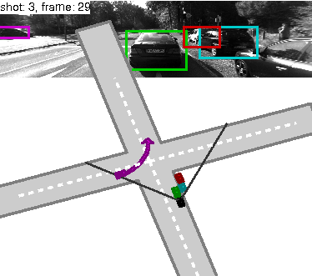
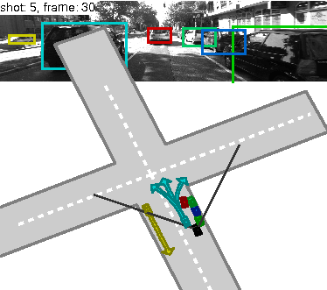
Work done
Ran Geiger's code:
Observation: There are very few collisions in the results.

Slide 3
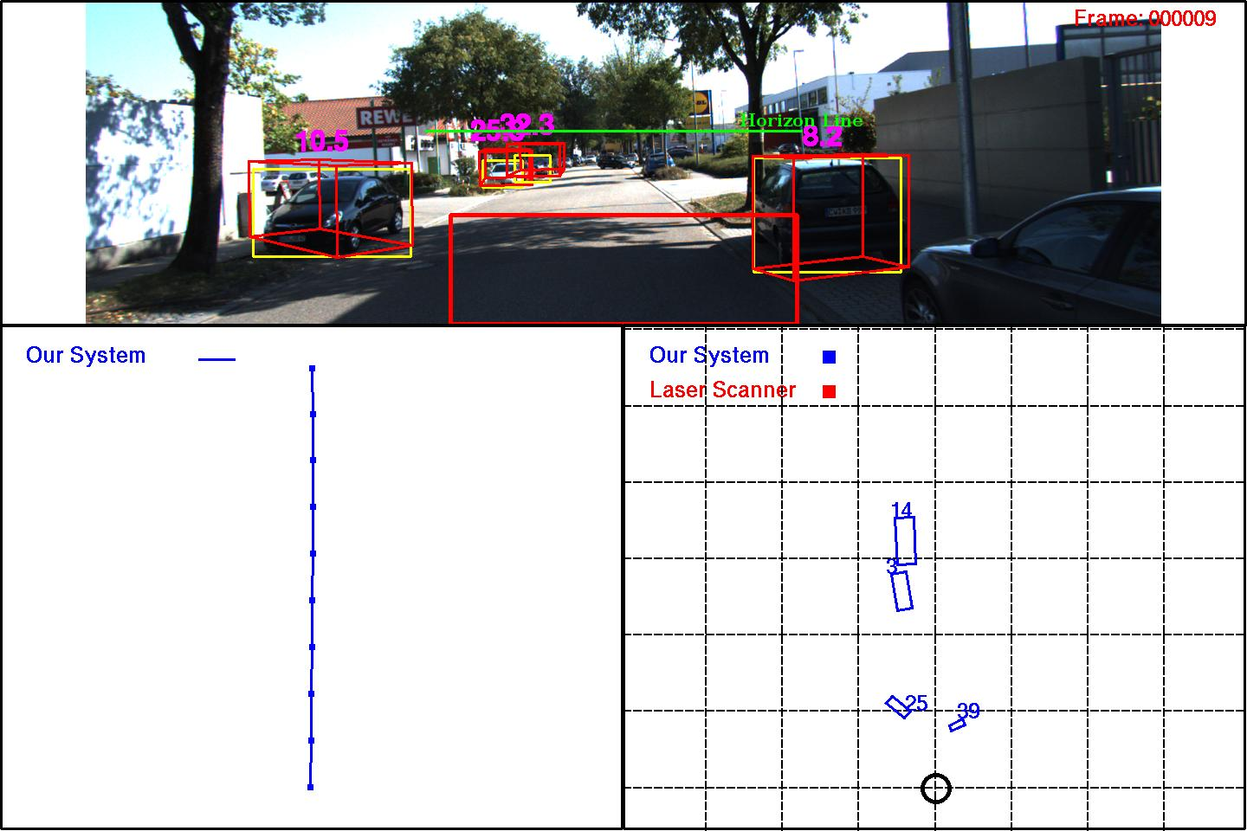
Possible heuristics to fix 3D localization
(2)Lane alignment
(non intersection scenes)
(static cars)
(3) Vanishing points on car?
(1) Prior over car size
Detector pose is not being used (0009)
- @manu

Slide 4
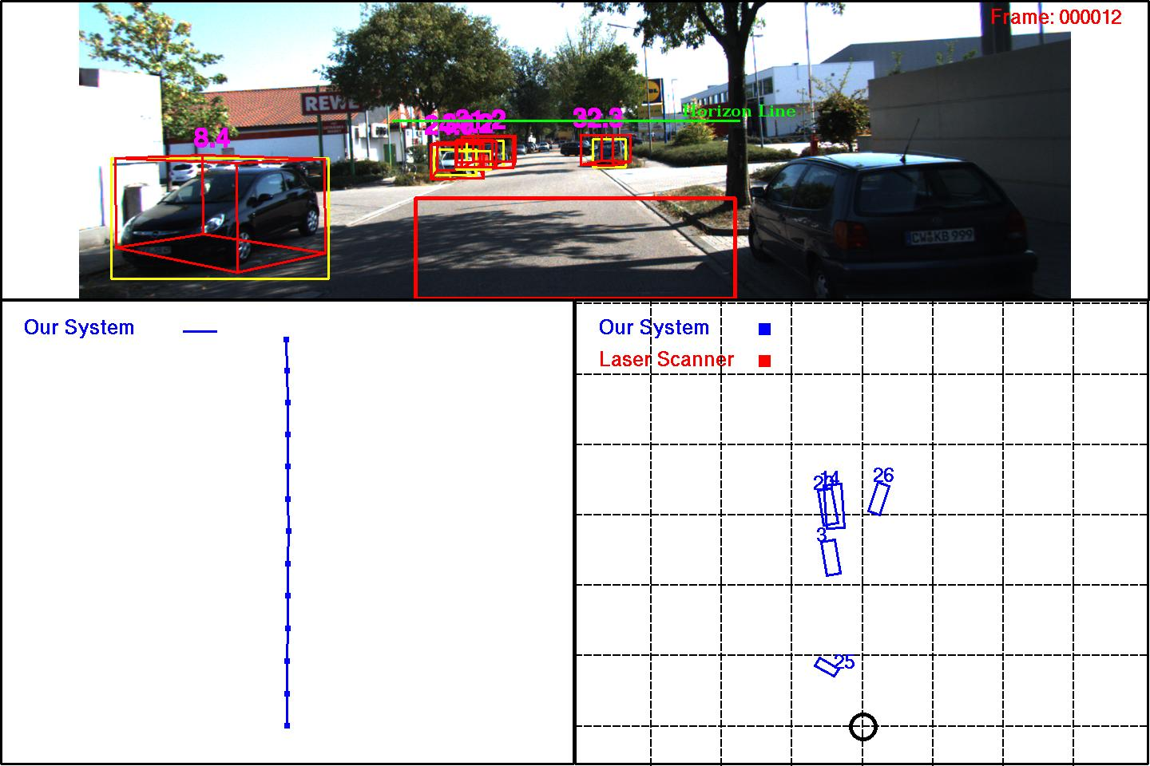
(4) No overlaps in bird eye view.

Slide 5
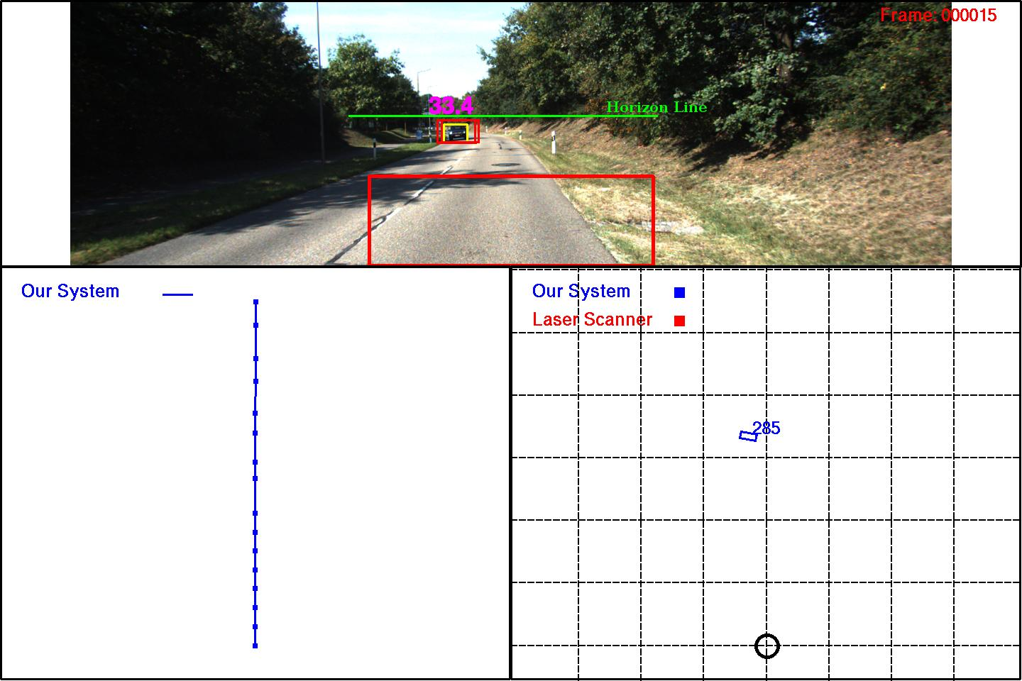
Resident/0019/000015.jpg
Holonomic constraint
Being violated

Slide 6
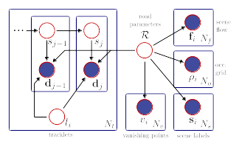
Plans
Start with Geiger's model and assume lane geometry is given.
Our Model
Geiger's Model

