Slide 1


13 AMERICAN COLONIES · RESEARCH PROJECT
South
Carolina
The Palmetto Colony
Founded 1670 · Southern Colonies
NAME
PERIOD
Maksym Shchastenko
2
FIG. 1 Illustration: Charles Town harbor by moonlight. Ships carried rice, indigo and deerskins to Europe; the palmetto became South Carolina’s symbol.
Notes:
1

Slide 2

02 / FOUNDING
Founding of the Colony
WHEN
WHO
WHY
1670
Lords Proprietors
Land & profit
April 1670: about 130 English settlers land at Albemarle Point on the Ashley River. In 1680 the town moves to Oyster Point, today’s Charleston.
In 1663 King Charles II gave Carolina to eight loyal supporters. William Sayle became the first governor, and settlers came from England and Barbados.
The Proprietors wanted wealth from land and trade. They offered land grants and religious freedom to fill the territory between Virginia and Spanish Florida.
In short: a king paid back eight allies with a colony, and its owners built Charles Town to turn Carolina’s land into profit.
SOUTH CAROLINA · 1670–1783
2
Notes:
2

Slide 3
03 / REGION & RELIGION
Region & Religion
REGION
RELIGION
New England
1670s–1700
Founders promised “full and free Liberty of Conscience,” drawing Presbyterians, Baptists and French Huguenots.
Middle
The Church Act made the Church of England the official, tax-supported church and split the colony into ten parishes.
1706
Southern
After 1706
Dissenters and Jews could still vote and worship; Catholics were shut out of colonial life for most of the 1700s.
Southern Colonies: a warm climate, a long growing season and large plantations growing cash crops (rice, indigo) for export.
Impact
Parish vestries were the only local government from 1716 until the Revolution. The Church was disestablished in 1778.
SOUTH CAROLINA · 1670–1783
3
Notes:
3

Slide 4

04 / ECONOMICS
Economics: Rice, Indigo & Trade
Deerskins
Rice
The first big business: trading deerskins with Native Americans.
By 1700, rice was becoming the top crop. Enslaved West Africans’ skills made it pay.
Indigo
Port trade
Eliza Lucas Pinckney made it work in the 1740s. One-third of exports by the Revolution.
Charles Town shipped crops to Britain and imported goods, rum, sugar and enslaved Africans.
FIG. 2 Illustration: flooded rice fields in the Lowcountry at dusk. Enslaved Africans dug and worked these fields, and rice became the colony’s dominant cash crop.
Built on forced labor: enslaved Africans grew the crops. By about 1708, Black people were the majority of the colony.
SOUTH CAROLINA · 1670–1783
4
Notes:
4

Slide 5
05 / GEOGRAPHY & CLIMATE
Geography & Climate
BLUE RIDGE
PIEDMONT
SANDHILLS
COASTAL PLAIN
COAST
mountains
rolling red-clay hills
sand & clay
the Lowcountry: flat & marshy
& islands
CLIMATE
Hot, humid, subtropical
FALL LINE
Hot, humid summers and mild winters
Long growing season for rice and indigo
Hurricanes can batter the coast and flood fields
SOUTHEAST
NORTHWEST
elevation not to scale
FIG. 3 Cross-section from mountains to coast. Land drops from the Blue Ridge to the flat Coastal Plain, where rice farming and Charles Town took root.
Lowcountry
Midlands
Upcountry
Flat coastal plain with tidal marshes, sea islands and rivers. Rice country and home of Charles Town.
Sandhills and red-clay hills. The Fall Line, where rivers drop in rapids, stopped boats heading inland.
The Blue Ridge and Piedmont foothills, called the Backcountry in colonial days and settled later.
SOUTH CAROLINA · 1670–1783
5
Notes:
5

Slide 6
06 / POLITICS & GOVERNMENT
Politics & Government
PROPRIETARY · 1670–1729
ROYAL · 1729–1776
Eight Lords Proprietors (in England)
The Crown (King George II)
Governor and Council
Royal governor and Council
Commons House of Assembly (elected)
Commons House of Assembly (elected)
Fundamental Constitutions (1669) were drafted by Lord Ashley and John Locke. William Sayle was the first governor.
After a 1719 revolt, the Crown bought out the Proprietors in 1729. Robert Johnson became royal governor.
Key laws: Church Act (1706); slave codes (1696, 1712, 1740 Negro Act) that stripped enslaved people of legal rights. The Commons House was the only elected branch and the most powerful.
SOUTH CAROLINA · 1670–1783
6
Notes:
6

Slide 7
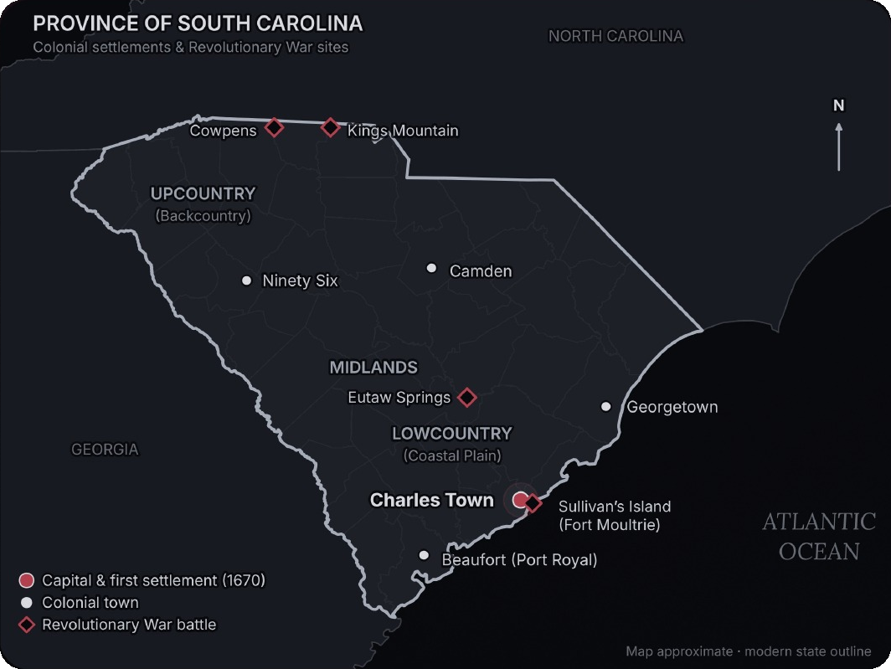
07 / MAP
Map of the Colony
FIG. 4 · WHAT THE MAP SHOWS
A labeled map of colonial South Carolina: Charles Town (the capital and main port, in red), other towns, the three regions and key Revolutionary War battle sites.
WHY IT MATTERS
Towns and wealth clustered on the coast, where the ocean and rivers carried trade.
The Upcountry filled up later with small farmers and traders.
The state saw 100+ Revolutionary War battles and skirmishes, more than any other.
Approximate map using today’s state outline.
SOUTH CAROLINA · 1670–1783
7
Notes:
7

Slide 8
08 / TIMELINE
Timeline: 1663–1783
1663
1680
1715
1729
1776
1781
Charles II grants Carolina to eight Lords Proprietors
Town moves to Oyster Point, today’s Charleston
Yamasee War: Native attacks nearly capture Charles Town
Crown buys out the Proprietors: royal colony
Palmetto fort beats British fleet at Sullivan’s Island
Patriots win at Cowpens (Jan. 17)
1670
1706
1718
1739
1780
1782–83
Settlers land at Albemarle Point (Charles Town)
Church Act makes the Church of England official
Blackbeard’s pirates blockade Charles Town harbor
Stono Rebellion; Negro Act of 1740 follows
British capture Charleston after a six‑week siege
British leave Charleston (Dec. 1782); Treaty of Paris
FIG. 5 Major events from the founding through 1783. Red marks turning points: the first settlement, the royal takeover and the Revolution.
SOUTH CAROLINA · 1670–1783
8
Notes:
8

Slide 9
09 / THE PITCH
Why Move to South Carolina?
Land that pays
A booming port
Come for the land.
Stay for the coast.
Rich coastal soil and a long, warm growing season. Rice and indigo made planters wealthy.
Charles Town linked the colony to Britain, Barbados and the wider Atlantic world.
Freedom to worship
A real voice
What can South Carolina offer that other colonies cannot? Warm weather, cash crops that pay, a busy port and a say in how you are governed.
Presbyterians, Baptists, Quakers, Huguenots and Jews settled here, and dissenters could vote.
Landowning men could sit in the elected Commons House, the colony’s most powerful body.
Note: this wealth rested on enslaved labor (see Economics).
Your move: pack your bags for Charles Town.
SOUTH CAROLINA · 1670–1783
9
Notes:
9

Slide 10
10 / WORKS CITED
Works Cited
“Atlas of South Carolina, Third Edition.” South Carolina Geographic Alliance, manifold.sc.edu.
Behre, Robert. “22 SC Sites Where the Fighting Was Fiercest in the Revolutionary and Civil Wars.” The Post and Courier, 30 June 2019, postandcourier.com.
“Blackbeard’s Terror.” American Heritage, americanheritage.com/blackbeards-terror.
Butler, Nic. “The Carolina Charter of 1663.” Charleston County Public Library, 27 Dec. 2019, ccpl.org/node/17535.
“Charleston in the Revolutionary War.” American Battlefield Trust, battlefields.org/learn/articles/charleston-revolutionary-war.
“A Chronicle of Significant Events, Battles, and Skirmishes.” Fort Dorchester, SC Society SAR, fortdorchester.scssar.org/?p=663.
“Church Act.” South Carolina Encyclopedia, scencyclopedia.org/sce/?p=3102.
“Colonial Economy.” Know It All, SCETV, knowitall.org/subject/sc-history/settlement-south-carolina/colonial-economy.
“Commons House of Assembly.” South Carolina Encyclopedia, scencyclopedia.org/sce/?p=3163.
“Dissenters.” South Carolina Encyclopedia, scencyclopedia.org/sce/entries/dissenters/.
“The Founding of Carolina.” Inland Rice Project, Charleston County, inlandrice.charlestoncounty.org/founding.html.
Greene, Harlan. “The Founding.” Charleston Living, 30 Mar. 2013, charlestonlivingmag.com/the-founding.
“A History of Charles Town, South Carolina.” Carolana, carolana.com/SC/Towns/Charles_Town_SC.html.
“The James Poyas Daybook: Historical Context.” Lowcountry Digital History Initiative, ldhi.library.cofc.edu.
“Life Story: Eliza Lucas Pinckney.” New-York Historical Society, wams.nyhistory.org.
“Slave Codes.” South Carolina Encyclopedia, scencyclopedia.org/sce/entries/slave-codes/.
“South Carolina.” Encyclopaedia Britannica, britannica.com/place/South-Carolina.
“South Carolina’s Early History of Immigrant Religious Diversity.” Clemson Humanities Hub, 4 Feb. 2017, blogs.clemson.edu/humanitieshub.
“The Yamasee War, 1715.” Haywood County GenWeb, tngenweb.org/haywood/the-yamasee-war-1715/.
Illustrations and the map were created for this project (not historical photographs). Map outline from modern U.S. county boundary data. All sources accessed 15 Oct. 2026.
SOUTH CAROLINA · 1670–1783
10
Notes:
10

