Slide 1
Advanced Encryption Standard (AES)
Alex X. Liu
alexliu@cse.msu.edu
http://www.cse.msu.edu/~alexliu
2132 Engineering Building
Department of Computer Science and Engineering
Michigan State University

Slide 2
History
Clear a replacement for DES was needed
  Have theoretical attacks that can break it
  Have demonstrated exhaustive key search attacks
  Block size small
  Can use Triple-DES – but slow
US NIST issued call for ciphers in 1997
  15 candidates accepted in Jun 98
  5 were shortlisted in Aug-99
  Rijndael was selected as the AES in Oct 2000
  Issued as FIPS PUB 197 standard in Nov 2001

Slide 3
AES Requirements
Symmetric key block cipher
128-bit data, 128/192/256-bit keys
Stronger & faster than Triple-DES
Active life of 20-30 years (+ archival use)
Provide full specification & design details
Both C & Java implementations
NIST have released all submissions & unclassified analyses

Slide 4
AES Evaluation Criteria
Initial criteria:
  Security – randomness, soundness, effort for practical cryptanalysis
  Cost – computational efficiency, no licensing fee, small memory
  Algorithm & implementation characteristics – flexibility, implementable in both software and hardware, simplicity
Final criteria
  General security – NIST relies on the cryptanalysis by crypto researchers
  Ease of software & hardware implementation
  Implementation attacks – finding keys based on implementation characteristics
    Timing attacks: an encryption or decryption algorithm often takes slightly different amounts of time on different inputs.
    Power analysis: the power consumed by a smart card at any particular time during the cryptographic operation is related to the instruction being executed and to the data being processed. For example, multiplication consumes more power than addition, and writing 1s consumes more power than writing 0s
  Flexibility (encryption, decryption, keying, and other factors)

Slide 5
AES Shortlist
After testing and evaluation, shortlist in Aug 99:
  MARS (IBM) - complex, fast, high security margin
  RC6 (USA) - very simple, very fast, low security margin
  Rijndael (Belgium) - clean, fast, good security margin
  Serpent (Euro) - slow, clean, very high security margin
  Twofish (USA) - complex, very fast, high security margin
Then subject to further analysis & comment
Saw contrast between algorithms with
  Few complex rounds vs. many simple rounds
  which refined existing ciphers vs. new proposals
Notes:
NIST wished to evaluate the likelihood that an analytic shortcut attack would be found
for the candidate algorithms with all specified rounds in the next several decades, or
before attacks by key exhaustion become practical. It is difficult, however, to extrapolate
the data for reduced-round variants to the actual algorithms. The attacks on reduced
round variants are generally not even practical at this time because they require huge
amounts of resources. In fact, most of these attacks on reduced round variants are,
arguably, more difficult to execute in practice than attacks by exhaustive key search,
despite smaller processing requirements, because of their information and memory
requirements. Moreover, even if a shortcut attack on a simplified variant were practical,
the original algorithm might remain secure.
Nevertheless, attacks will improve in the future, and the resources available to carry them
out will be greater, so it might be prudent to favor algorithms that appear to have a
greater margin for security. If only a little simplification allows an attack on one
23
algorithm, but a second algorithm has only been attacked after much greater
simplification, then that may be an indication that the second algorithm has a greater
margin for security. Simplification (in Sec. 3.2.2) includes round reductions, which is not
surprising, because the most notable frameworks of attacks, differential and linear
cryptanalysis, may be effectively resisted if the number of rounds is high enough.
Therefore, the full number of rounds specified for the algorithm has been compared to the
largest number of rounds at which an attack currently exists. In Ref. [85], the ratio of
these numbers was defined as the “safety factor” and calculated for each candidate.
There are several problems with relying heavily on this measure, or on any single figure
of merit that is based on the attacks on reduced-round variants. In general, the results
will be biased against algorithms that attract greater scrutiny in a limited analysis period.
This could plausibly occur, for example, if a particular algorithm is simpler, or at least
appears to be simpler, to analyze against certain attacks. Another factor could be the
ancestry of the algorithm and its constituent techniques, and the existence of previous
attacks upon which to build. The proposed measure would tend to favor novel techniques
for resisting attacks, techniques that have not yet stood the test of time. Similarly, the
proposed measure may not be a good index to the resistance of the algorithms to new and
novel techniques for attacking algorithms.
To develop a measure based on the largest number of rounds that are currently attacked is
also technically problematic, as is acknowledged in Ref. [85]. There is no natural
definition for the number of analyzed rounds, or even the total number of rounds
specified for each algorithm. For example, should the whitening in MARS, Twofish,
RC6, and Rijndael count as rounds or partial rounds? MARS has 16 unkeyed mixing
rounds and 16 keyed core rounds: is MARS a 16 round or a 32 round algorithm, or
something in between? Should attacks that ignore the mixing rounds be considered?
Should reduced-round variants of Serpent or Rijndael be required to inherit the slightly
modified final round? Another complicating factor is the key size, especially for Rijndael,
which varies the number of rounds depending on the key size.
What types of attacks should be included in the definition? Some attacks were successful
against only a small fraction of keys; some required encryption operations under related
unknown keys; some distinguished outputs from random permutations without an explicit
method for recovering the key; and some relied on experimental conjectures. In addition,
the attacks required considerably different resources; some even assume that nearly the
entire codebook was available to the attacker.
In light of these difficulties, NIST did not attempt to reduce its assessment of the security
margins of the finalists to a single measurement. NIST considered all of the reported
data, and used the raw number of analyzed rounds out of the total rounds specified for an
algorithm as a first approximation. The results are summarized below for each finalist.
Note that the rounds defined for the candidates are not necessarily comparable to each
other. For example, the algorithms based on the Feistel construction, MARS, RC6, and
24
Twofish, require two rounds to alter an entire word of data, while a single round of
Rijndael or Serpent accomplishes this.

Slide 6
The AES Cipher - Rijndael
Designed by Rijmen-Daemen in Belgium
Has 128/192/256 bit keys, 128 bit data
An iterative rather than Feistel Cipher
  Processes data as block of 4 columns of 4 bytes
  Operates on entire data block in every round
Designed to be:
  resistant against known attacks
  Speed and code compactness on many CPUs
  Design simplicity

Slide 7
Advanced Encryption Standard (AES)
Input
128 bit plaintext
128 bit cipher key
33 | 88 | 31 | e0
43 | 5a | 31 | 37
f6 | 30 | 98 | 07
a8 | 8d | a2 | 34
k₀ | k₄ | k₈ | k₁₂
k₁ | k₅ | k₉ | k₁₃
k₂ | k₆ | k₁₀ | k₁₄
k₃ | k₇ | k₁₁ | k₁₅
Encryption Progress
Key Expansion

Slide 8
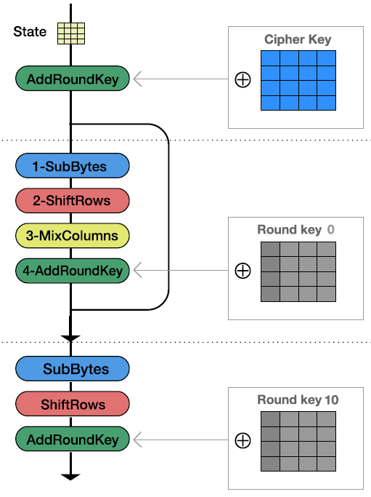
Encryption Progress
Initial round
Encryption Progress
  Substitute Bytes
  Shift Rows
  Mix Columns
  Add Round Key
9 rounds
1~9
final rounds

Slide 9
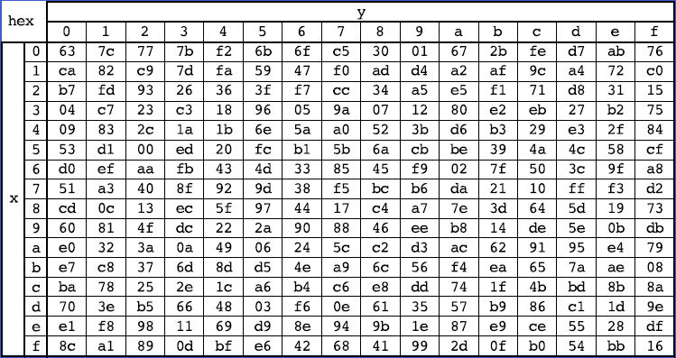
Encryption Progress – Substitute Bytes
19 | a0 | 9a | e9
3d | f4 | c6 | f8
e3 | e2 | 8d | 48
be | 2b | 2a | 08
d4 | e0 | b8 | 1e
27 | bf | b4 | 41
11 | 98 | 5d | 52
ae | f1 | e5 | 30
d4

Slide 10
Encryption Progress – Shift Rows
d4 | e0 | b8 | 1e
27 | bf | b4 | 41
11 | 98 | 5d | 52
ae | f1 | e5 | 30
Left rotate 0 byte
d4 | e0 | b8 | 1e
Left rotate 1 byte
bf | b4 | 41 | 27
Left rotate 2 bytes
5d | 52 | 11 | 98
Left rotate 3 bytes
30 | ae | f1 | e5

Slide 11
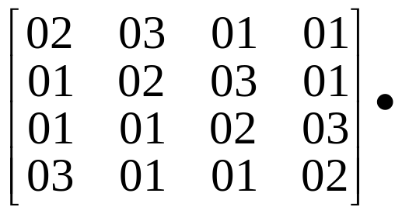

Encryption Progress – Mix Columns
04
66
81
e5
d4
bf
5d
30
04 | e0 | 48 | 28
66 | cb | f8 | 06
81 | 19 | d3 | 26
e5 | 9a | 7a | 4c
e0 | b8 | 1e
b4 | 41 | 27
52 | 11 | 98
ae | f1 | e5

Slide 12
Encryption Progress – Add Round Key
a4
9c
7f
f2
Round Key
⊕
04
66
81
e5
a4 | 68 | 6b | 02
9c | 9f | 5b | 6a
7f | 35 | ea | 50
f2 | 2b | 43 | 49
e0 | 48 | 28
cb | f8 | 06
19 | d3 | 26
9a | 7a | 4c
04
66
81
e5
e0 | 48 | 28
cb | f8 | 06
19 | d3 | 26
9a | 7a | 4c

Slide 13
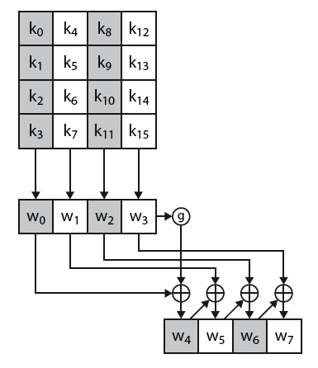
Key Expansion (1/2)
Function g
  Rotate word
  Substitute bytes
  XOR with round constant
Cipher Key
g
Round Key 0
……

Slide 14
Key Expansion (2/2)
Function g
  Rotate word
  W₃ = (K₁₂, K₁₃, K₁₄, K₁₅) → (K₁₃, K₁₄, K₁₅, K₁₂)
  Substitute bytes
  Replace each of these four bytes with the corresponding element in S-box
  Let (K*₁₃, K*₁₄, K*₁₅, K*₁₂) denote the result.
  XOR with round constant

Slide 15
AES Animation
http://www.cse.msu.edu/~alexliu/courses/rijndael_ingles2004.swf
  Made by Enrique Zabala, Universidad ORT, Montevideo, Uruguay.

Slide 16
Mode of Operations
Alex X. Liu
alexliu@cse.msu.edu
http://www.cse.msu.edu/~alexliu
2132 Engineering Building
Department of Computer Science and Engineering
Michigan State University

Slide 17
How to use a block cipher?
Block ciphers encrypt fixed size blocks
  E.g. DES encrypts 64-bit blocks
We need some way to encrypt a message of arbitrary length
  E.g. a message of 1000 bytes
NIST defines five ways to do it, Called modes of operations
  Electronic codebook mode (ECB)
  Cipher block chaining mode (CBC) – most popular
  Output feedback mode (OFB)
  Cipher feedback mode (CFB)
  Counter mode (CTR)

Slide 18
Message Padding
The plaintext message is broken into blocks,
  E.g., P₁, P₂, P₃, ...
The last block may be short of a whole block and needs padding.
Possible padding:
  Known non-data values (e.g. nulls)
  Or a number indicating the size of the pad
  Or a number indicating the size of the plaintext
  The last two schemes may require an extra block.

Slide 19
Electronic Code Book (ECB)
Simplest mode
Plaintext is handled 64 bits at a time
Each block is encrypted using the same key
For a given key, there is a unique ciphertext for every 64-bit block of plaintext
Each block of 64 plaintext bits is encoded independently using the same key
Application: secure transmission of short pieces of information (e.g. a temporary encryption key)

Slide 20
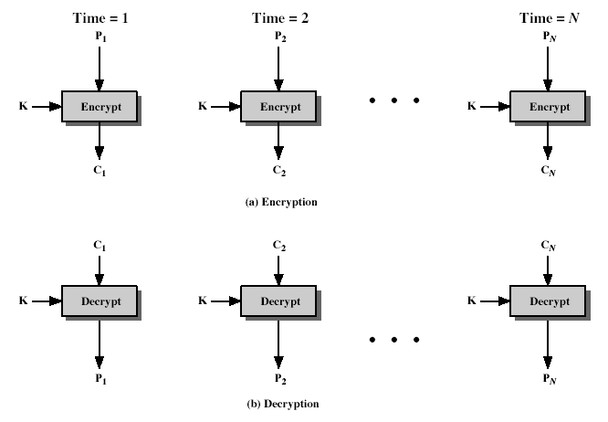
Encryption and Decryption of ECB

Slide 21
Strength and Weakness of ECB
Strength
  Simple
  Efficient
Weakness
  the encrypted message blocks are independent
  message repetitions may show in ciphertext
    if aligned with message block
    particularly with data such as graphics
    or with messages that change very little, which become a code-book analysis problem

Slide 22
Cipher Block Chaining (CBC)
The plaintext is broken into blocks: P₁, P₂, P₃, ...
Each plaintext block is XORed (chained) with the previous ciphertext block before encryption:
C_{i} = E_{K}(C_{i-1} ⊕ P_{i})
C₀ = IV
Use an Initial Vector (IV) to start the process
Decryption
P_{i} = C_{i-1} ⊕ D_{K}(C_{i})
Application: general block-oriented transmission

Slide 23
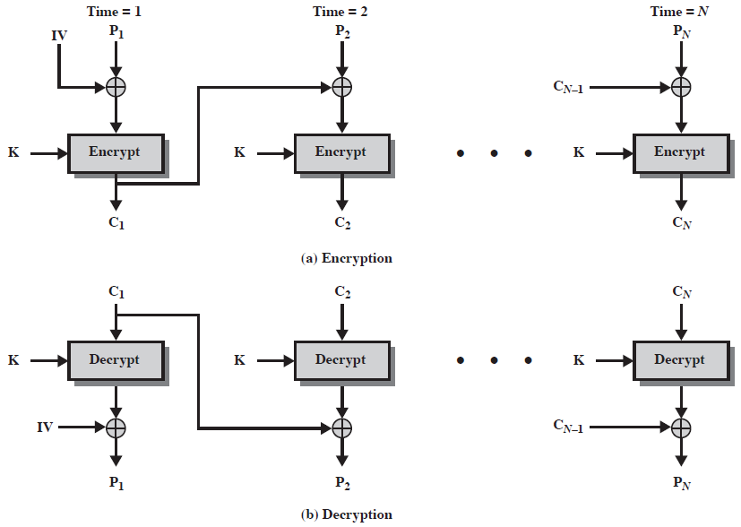
Encryption and Decryption of CBC

Slide 24
Strength and Weakness of CBC
Strength
  The encryption of a block depends on the current and all blocks before it.
  Thus, repeated plaintext blocks are encrypted differently.
Weakness
  Modifying Ciphertext Blocks
  Rearranging Ciphertext Blocks

Slide 25
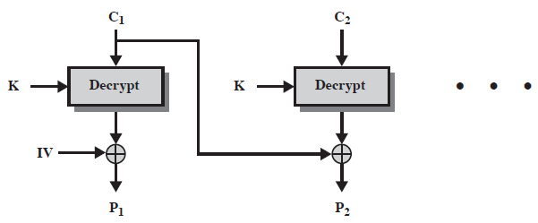
Modifying Ciphertext Blocks
If an attacker changes a ciphertext block, say C₁, the attacker knows the predictable effect on P₂
  Because P₂ = C₁ ⊕ D_{K}(C₂)
  Changing the i-th bit of C₁ will change the i-th bit of P₂
  Example: Suppose P₂ is A’s salary.
  If A changes one bit of C₁, the corresponding bit of P₂ will change.
  Note that: 1.Changing C₁ will also changes P₁
  2. There is no predictable effect on P₁ by changing C₁

Slide 26
Rearranging Ciphertext Blocks
Suppose A knows the plaintext IV, P₁, P₂, P₃, ... and the corresponding ciphertext C₁, C₂, C₃, ..., A can deduce the modified plaintext.
  A can also deduce D_{K}(C_{i}), because D_{K}(C_{i}) = C_{i-1} ⊕ P_{i}
  Let D₁, D₂, D₃, ... denote D_{K}(C₁), D_{K}(C₂), D_{K}(C₃), ..., respectively
  If A swaps C₁ and C₂, A can deduce the modified plaintext P₁ and P₂
C₁
C₂
……
K
Decrypt
K
Decrypt
D₁
D₂
IV
⊕
⊕
P₁
P₂
IV⊕D₁
C₂⊕D₂

Slide 27
Designing Stream Ciphers
ECB and CBC are not stream ciphers
To encrypt P₁, P₂, P₃, ..., we want to use E_{K} to generate a different keys for each P_{i}:
K₁, K₂, K₃, ...
Then encrypt P_{i} as C_{i} = P_{i} ⊕ K_{i}
Three different ways to generate K₁, K₂, K₃, ...
  Cipher Feedback (CFB) Mode
  Output Feedback (OFB) Mode
  Counter Mode (CTR)

Slide 28
Cipher Feedback Mode (CFB)
The plaintext is a sequence of segments of s bits (s ≤ block size):
P₁, P₂, P₃, ...,
Encryption is used to generate a sequence of keys, each of s bits:
K₁, K₂, K₃, ...
The ciphertext is C₁, C₂, C₃, ..., where
C_{i} = P_{i} ⊕ K_{i}
How to generate the key stream?
  The input to the block cipher is a shift register x, whose value at stage i is denoted as x_{i}
  Initially, x₁ = an initial vector (IV)
  For i>1, x_{i} = shift-left-s-bits(x_{i-1}) | C_{i-1}
  Then, K_{i} = s-most-significant-bits(E_{K}(x_{i}))
  Example value of s is 8, and example value of shift register size is 64 for DES.

Slide 29
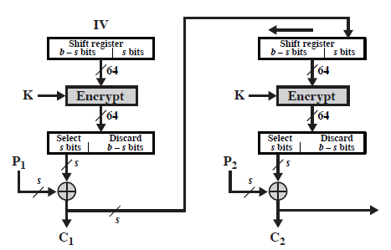
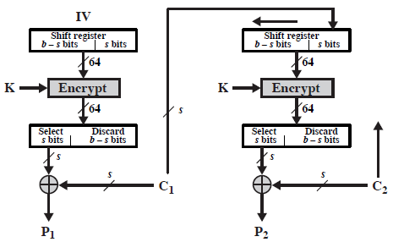
Encryption and Decryption of CFB
(a) Encryption
(b) Decryption

Slide 30
Strength and Weakness of CFB
Strength
  Compared with ECB and CBC:
    The block cipher is used as a stream cipher.
    Appropriate when data arrives in bits/bytes.
    s can be any value; a common value is s = 8.
    A ciphertext segment depends on the current and all preceding plaintext segment.
  Compared with OFB:
    Can decrypt at any point. No need to start from the beginning. This makes CTR mode ideal for applications like decrypting an encrypted randomly accessed file.
Weakness
  A corrupted ciphertext segment during transmission will affect at most (b/s)+1 plaintext segments.

Slide 31
Output Feedback Mode (OFB)
Very similar to CFB in structure
But K_{i-1} rather than C_{i-1} is feedback to the next stage
How to generate the key stream?
  As in CFB, the input to the block cipher is a shift register x, whose value at stage i is denoted as x_{i}
  Initially, x₁ = an initial vector (IV)
  For i>1, x_{i} = shift-left-s-bits(x_{i-1}) | K_{i-1}
  Then, K_{i} = s-most-significant-bits(E_{K}(x_{i}))

Slide 32
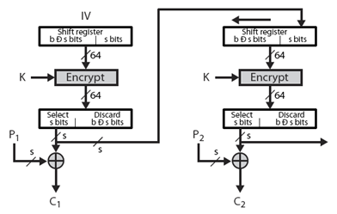
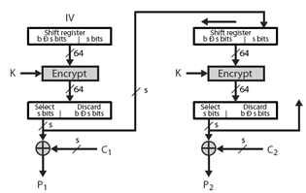
Encryption and Decryption of OFB
(a) Encryption
(b) Decryption

Slide 33
Strength and Weakness of OFB
Strength
  Keys can be pre-computed. Encryption and decryption is only an XOR in real-time.
  Fast parallel encryption/decryption: blocks can be processed (encrypted or decrypted) in parallel; good for high speed links
  More resistant to transmission errors; a bit error in a ciphertext segment affects only the decryption of that segment.
Weakness
  IV should be generated randomly each time and sent with the ciphertext.
    Insecure if different data are encrypted with the same key and the initial counter: attacker can get the XOR of two plaintext blocks by XORing the two corresponding ciphertext blocks.

Slide 34
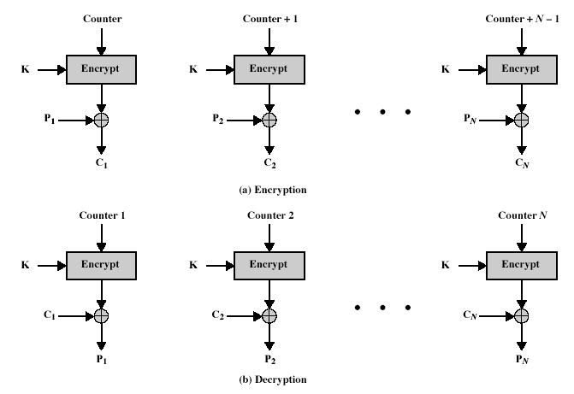
Counter Mode (CTR)

Slide 35
Strength and Weakness of CTR
Strength:
  Has OFB advantage:
    Keys can be pre-computed. Encryption and decryption is only an XOR in real-time.
    Fast parallel encryption/decryption: blocks can be processed (encrypted or decrypted) in parallel; good for high speed links
    More resistant to transmission errors; a bit error in a ciphertext segment affects only the decryption of that segment.
  Has CFB advantage:
    Can decrypt at any point. No need to start from the beginning. This makes CTR mode ideal for applications like decrypting an encrypted randomly accessed file.
Weakness
  Has OFB weakness: IV should be generated randomly each time and sent with the ciphertext.
    Insecure if different data is encrypted with the same key and the initial counter: attacker can get the XOR of two plaintext blocks by XORing the two corresponding ciphertext blocks.

Slide 36
Reading Assignment
Textbook Chapter 3 and 4.

