Slide 1
CSCI E-33A - Final Project
WeCountWords
Tiffany Egan

Slide 2
WeCountWords for Writing Productivity
Concept
WeCountWords.com (WCW) is a virtual writing productivity coach to help writers establish and maintain a daily writing habit.
By establishing a habit of writing (what is sometimes referred to as a writing practice), writers increase their productivity and ability to successfully complete their projects.
WCW helps writers establish writing goals, track their progress against their goals, and analyze their progress with data visualizations.
Through curated content on regional conferences, organizations, and articles on the business of writing, WCW helps writers move from inspiration to action

Slide 3
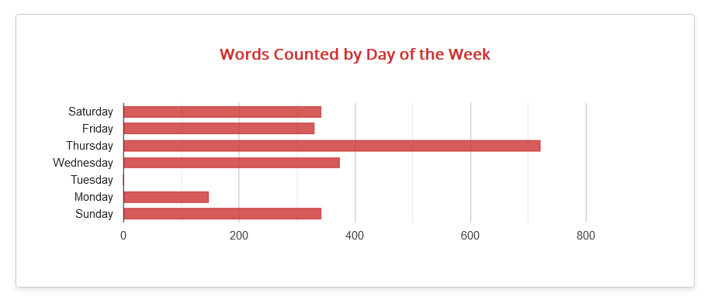
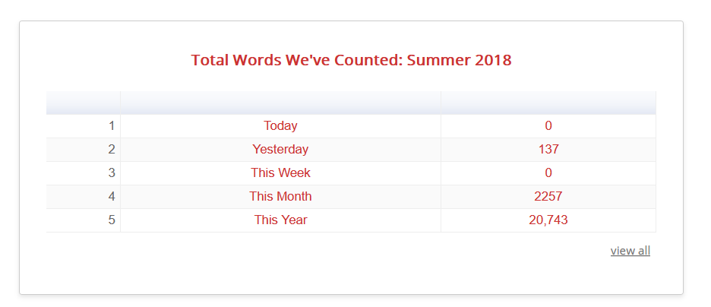
WeCountWords for Writing Productivity
Concept
Users (aka members) add their word count daily, or on the days that they write
The act of adding word counts daily and reviewing history through visualizations helps the author build their productivity.
Members and non-members alike also have access to a selection of content

Slide 4
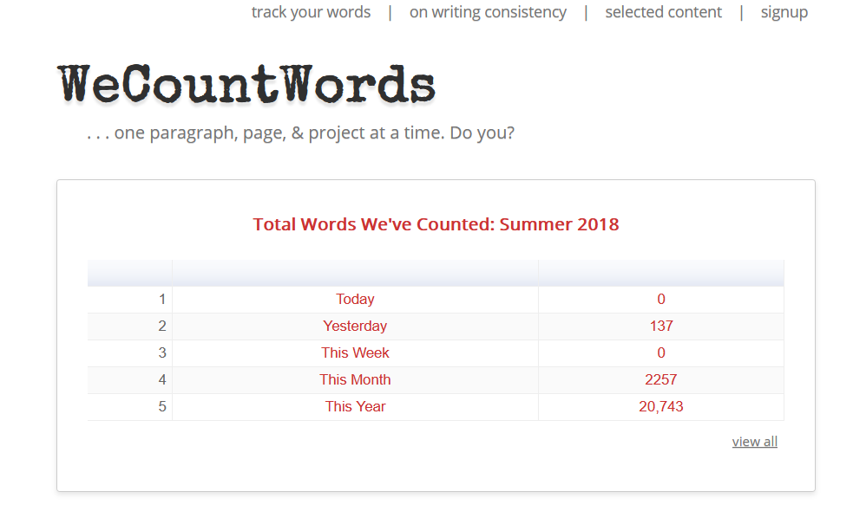


Mockup: Index.html
Add Words | Selected Content | Register | Sign-In
Before Login
Top nav allows users to add word counts, access content pages, register and sign-in
Data visualizations on this page spotlight cumulative progress of all WCW members updated once per day (outside of the scope of this project)
Button Start Counting Words is a call to action for new visitors
Button Why We Count Words is an anchor to the page area that answers this question, for those who need more info

Slide 5
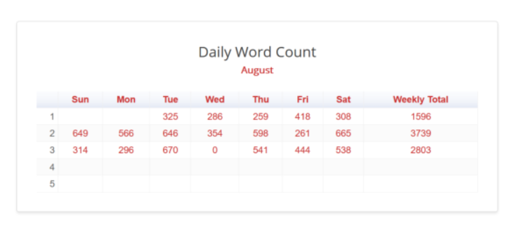
Mockup: Index.html
Susan | Add Words | Selected Content | logout
After Login: Member Page
Members are taken to the member page after login to view data visualizations that spotlight cumulative progress
Cumulative word count celebrates progress through various time frames
Daily word count, calendar style, shows writing practice consistency (“Best” Requirement)
Words Counted by Day of Week, over time, surfaces problem productivity vs great productivity days of the week
From the top nav bar, add word count, access the profile page, selected content, and logout

Slide 6

Mockup: Add Words Form
Susan | Add Words | Selected Content | logout
Add Words
The link to add word count is available on the top nav bar on every page except login or registration page
Clicking on this link brings up the Add Words form
Logged-in users are offered a word count field to add their daily count.
For users who are not logged in, they are required to add their member email address
Email *
Words Counted Today *

Slide 7
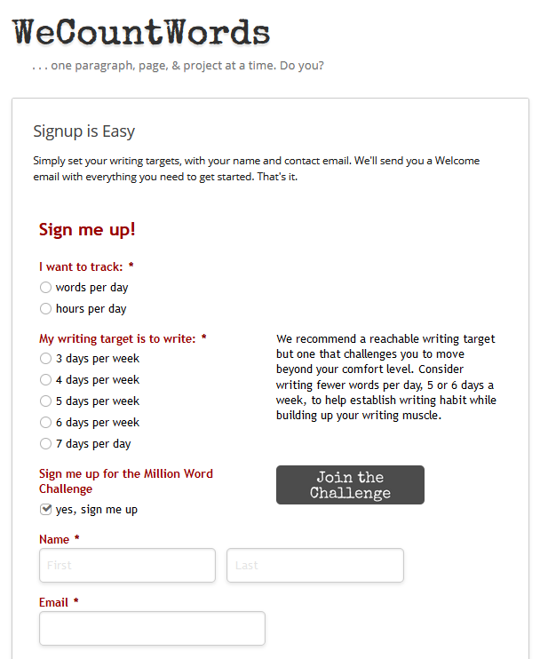
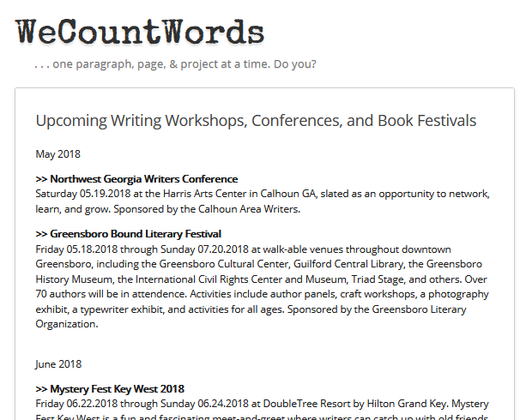
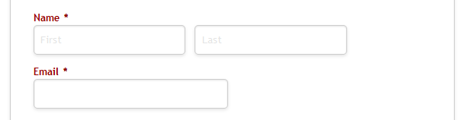
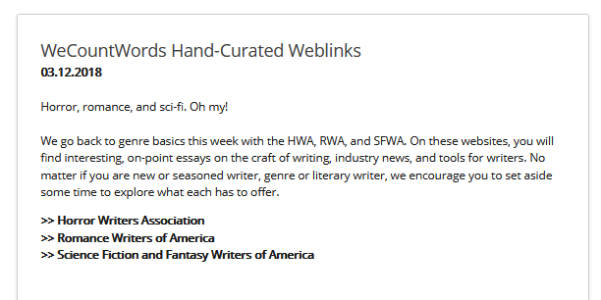
Mockup: Profile and Selected Content
Susan | Add Words | Selected Content | Logout
Member Profile Page
Members can update their email address, how they track their work per day, and writing targets
Selected Content
Articles, writing links, and listings of regional writing conferences and book festivals available to members and casual users

Slide 8
Mockup: Add Content
Sally | Logout
For content developers
Single page app to upload and save content for the Selected Content pages
Content type options include articles, events, or links
Option to save and publish later in the “Good” requirement
title
Email
content
Content type
save
publish

Slide 9
Dev Stack, Apps, Templates
Dev stack: Django, Python, HTML, CSS, & JavaScripts
Integrations
Google charts: https://developers.google.com/chart
Register and Login: from previous assignments
New Templates
WCW member site: layout.html, index.html, profile.html, content.html
WCW content development site: layout, index

Slide 10
Minimum Required Feature Set for Final Project
WeCountWords: member site for writers as laid out in concept and mockups above with two data visualizations
Count by Day of Week, Total Words with real-time (dynamic) updating when word counts are added
Integration with Google Charts to draw the visualizations
Basic profile and content pages as setout in the mockups
WeCountWords: basic feature set for content developer site
Add, Save, Publish content where published content is added to the member site.

Slide 11
Additional Features for “Better” Final Project
All minimum required features
WeCountWords: new features for the content developer site
New landing page with Content List and current state: Saved, Published, Archived
Ability to select unpublished content from the list and take the following actions: edit, save, publish, or archive (soft delete)
Ability to select published content from the list and move it from a Published state to a Saved state, removing it from the content on the member site

Slide 12
Additional Features for “Best” Final Project
All minimum required features and “good” features
Members can opt to add a calendar visualization to track daily word count (leap year excluded from this assignment)

Slide 13
Excluded from the final project
Features that are considered outside the scope of the final project
Leap year calculations needed to support the daily count in the calendar view in the “BEST” requirements
Dynamic nightly updates of the all-member cumulative word count visualizations on index.html before login.

