Slide 1
Undergraduate Research Project
Spring 2011
Ben Fain

Slide 2
Project Details
Research and implement inter-process communication in a server/client model.
  Interaction between Mumps programs and a Mumps database server.
  Potential Methods:
    Named Pipes
    Shared Memory
    Sockets
    Message Queues

Slide 3
Method: Shared Memory
The mapping of a segment of memory that will be shared by more than one process.
Function:
  Process obtains a segment in memory
  Process writes to the segment
  Another process reads from the segment

Slide 4
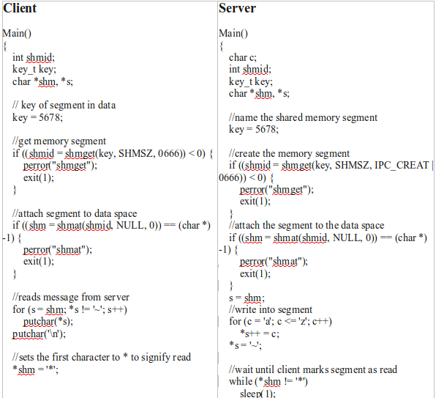
Shared Memory: Example

Slide 5
Shared Memory Cont.
Advantages
  Fastest form of IPC
Disadvantages
  Race conditions/Synchronization
  Handling multiple clients

Slide 6
Method: Message Queue
A queue can be set up on a system that accepts messages in a specified format.
Any process that has proper permissions and the unique ID for the queue can both write and read from the queue.
Messages must contain a parameter denoting the messages ID number.

Slide 7
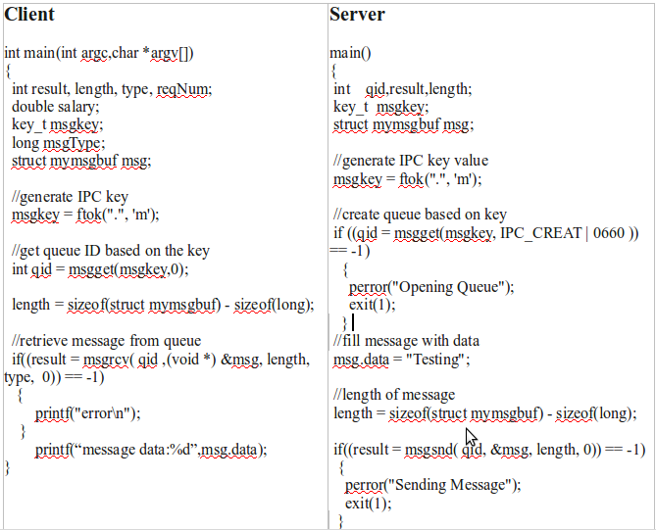
Message Queue: Example

Slide 8
Message Queue Cont.
Advantages
  Provides a non-intimidating paradigm for message communication.
  Acts as a buffer for messages which helps eliminate synchronization problems.
Disadvantages
  Indirect communication provides slower performance compared to shared memory.

Slide 9
Method: Sockets
Local namespace socket addresses are filenames. You can name the socket anything as long as you have proper directory permissions.
Common location is in the /tmp directory
Only usable on the host machine
After finished, remove the socket as if it were a file by calling remove or unlink.

Slide 10
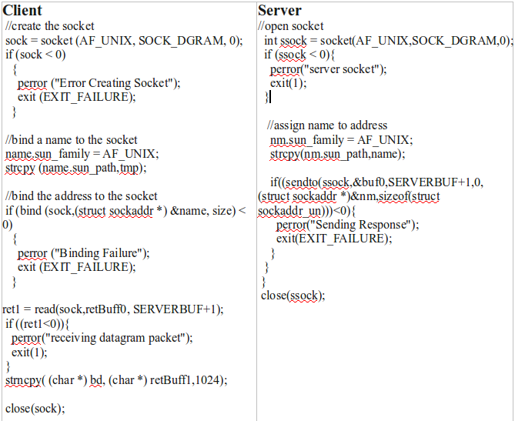
Sockets: Example

Slide 11
Sockets Cont.
Advantages
  Similar to the message queue, provide communication between processes.
Disadvantages
  Each process requires a unique socket.

Slide 12
Method: Named Pipes
Data is written to the pipe by one process and can be read by another process.
Data is handled in first-in, first out (FIFO) order.
Exist as a special file in the file system.

Slide 13
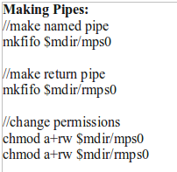
Named Pipes: Example
Making Pipes:

Slide 14
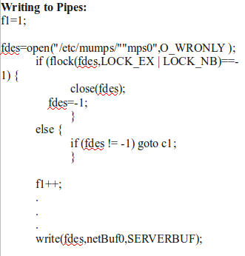
Named Pipes: Example
Writing To Pipes:

Slide 15
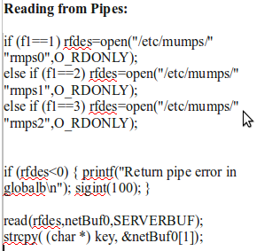
Named Pipes: Example
Reading from Pipes:

Slide 16
Named Pipes: Example
Removing Pipes:
  rm -f $mdir/mps0

Slide 17
Named Pipes Cont.
Advantages
  Processes of different ancestry can share data through a named pipe.
Disadvantages
  Need to make and remove a discrete number of pipes.

Slide 18
Current Implementation
The current client/server implementation in Mumps is using named pipes.
Six sending and returning pipes are made and removed.
Chosen because of it's relative simplicity.

Slide 19
Reasons for Alternative
Potential increase in performance
Potential for simpler model
Educational purposes

Slide 20
My Implementation
Server creates a message queue and the client will send messages to the queue.
Server polls on the queue waiting for messages.
When message received, process the result.
Send response message back through a socket that was created by the client.

Slide 21
Message Construction
In order to send a message, you need to create a message structure with all the information needed.
Message Contents:
  Message ID (Client ID)
  Message Data
  Socket Info

Slide 22
IPC – Client-Side
Fill the message with required data
Open socket for receiving
Bind with a name; name based on the current process ID
Attach socket info into message
Send the message
Wait for response from the server
Receive response and close

Slide 23
IPC - Server-Side
Create the message queue
Poll the queue for messages
If message received, process message
Send result back via socket
Return to polling

Slide 24
Roadblocks
Lack of C/C++ knowledge
Permissions on sockets and on the queue
Lack of examples combining sockets and message queues

Slide 25
Success!
Demo

Slide 26
Timing: Separate

Slide 27
Timing: Parallel

Slide 28
Timing: Combined

Slide 29
Timing: Parallel Revisited

Slide 30
CPU Time Comparison

Slide 31
Conclusion
The client/server implementation using message queues seems to perform better when running parallel compared to named pipes.
The message queue version and the named pipe version perform nearly identical when one client is involved.

Slide 32
What I Learned
Introduction to C/C++
Introduction to IPC communication and the differences between the implementations
Expanded knowledge of client/server paradigm

Slide 33
Questions?

Slide 34
References
www.gnu.org/software/libc/manual/html_mono/libc.html
www.linuxhq.com/guides/LPG/node27.html

