Slide 1

The Java Programing
Environment

Slide 2
Java Jargon
Name | Acronym | Explanation
Java Development Kit | JDK | The software for programmers who want to write Java programs
Java Runtime Environment | JRE | The software for consumers who want to run Java programs
Server JRE | -- | The software for running Java programs on servers
Standard Edition | SE | The Java platform for use on desktops and simple server applications
Enterprise Edition | EE | The Java platform for complex serverapplications
Micro Edition | ME | The Java platform for use on small devices
JavaFX | -- | An alternate toolkit for graphical user interfaces that is included with certain Java SE distributions prior to Java 11
OpenJDK | -- | A free and open source implementation of Java SE
Java 2 | J2 | An outdated term that described Java versions from 1998 until 2006
Software Development Kit | SDK | An outdated term that described the JDK from 1998 until 2006
Update | u | Oracle’s term for a bug fix release up to Java 8
NetBeans | -- | Oracle’s integrated development environment

Slide 3
Java 9
Prior to Java 9, there were 32-bit and 64-bit versions of the Java Development
Kit. The 32-bit versions are no longer developed by Oracle. You need to have
a 64-bit operating system to use the Oracle JDK.
With Linux, you have a choice between an RPM file and a .tar.gz file.
We recommend the latter—you can simply uncompress it anywhere you like.
Now you know how to pick the right JDK. To summarize

Slide 4
Using the command-Line Tools
Prior to Java 9, there were 32-bit and 64-bit versions of the Java Development
Kit. The 32-bit versions are no longer developed by Oracle. You need to have
a 64-bit operating system to use the Oracle JDK.
With Linux, you have a choice between an RPM file and a .tar.gz file.
We recommend the latter—you can simply uncompress it anywhere you like.
Now you know how to pick the right JDK. To summarize

Slide 5

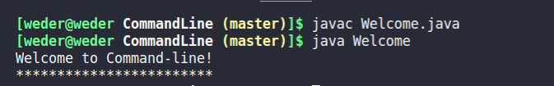
Using the command-Line Tools
/**
* This program displays a welcome for the reader.
* @version 1.30 2021-03-13
* @author Weder Sousa
*/
public class Welcome {
public static void main(String[] args) {
String strTxt = "Welcome to Command-line!";
System.out.println(strTxt);
for (int i = 0; i < strTxt.length(); i++)
System.out.print("*");
System.out.println();
}
}
java Welcome2
Erro: Não foi possível localizar nem carregar a classe principal Welcome2 Causada por: java.lang.ClassNotFoundException:
Welcome2

Slide 6
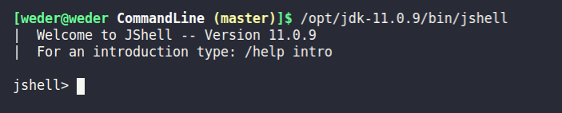
JShell
Anteriormente, vimos como compilar e executar um programa Java.
Java 9 apresenta outra maneira de trabalhar com Java.
O programa JShell fornece um “loop de leitura-avaliação-impressão” ou REPL.
Você digita uma expressão Java;
JShell avalia sua entrada, imprime o resultado e aguarda sua próxima entrada.
Para iniciar o JShell, basta digitar jshell em uma janela de terminal

Slide 7
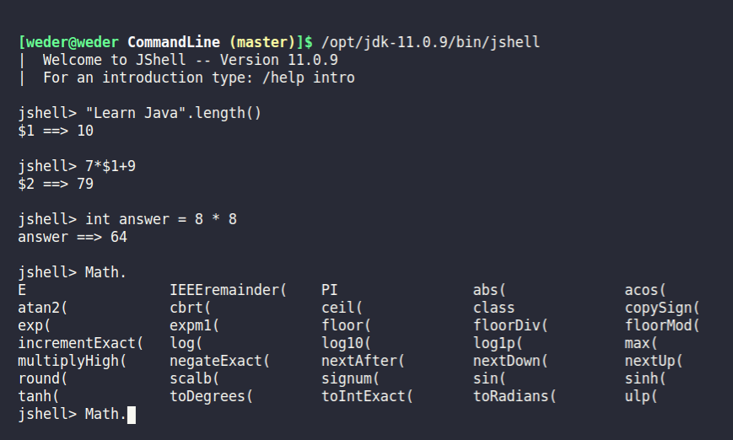
JShell
Observação: A lib Math. possui mais funções que foram recortada para visualização da imagem.
https://docs.oracle.com/en/java/javase/11/jshell/scripts.html#GUID-C3A41878-9A9A-4D31-BBDF-909729848A3E

