Slide 1

Application for the post of Product Management Intern
Name: Faiza Kashish
2024 Graduate
IIT Kharagpur

Slide 2

Problem Overview
In the context of India's dynamic economic landscape, managing personal finances efficiently is becoming increasingly important for individuals. This project proposes an Automated Expense Tracker and Financial Advisor application designed to help individuals manage their expenses more effectively and make informed financial decisions using technology.
Objective:
To develop a comprehensive mobile application that not only tracks expenses automatically but also provides personalized financial advice based on the user’s spending patterns and financial goals.

Slide 3





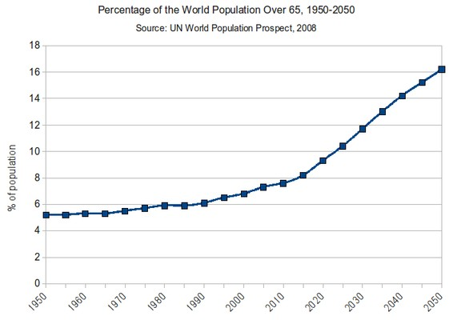


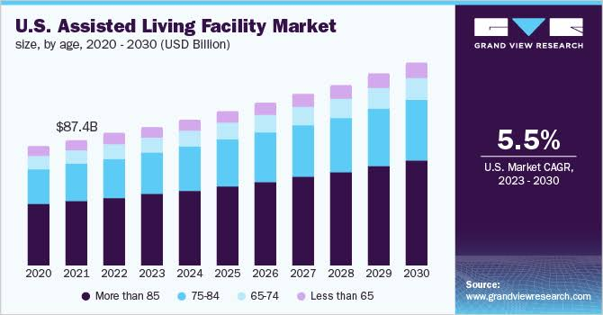

Problem: Lack of Automated expense tracker and financial advisor application
3. Financial management tools
5.Competing Apps
o
O Indian population expected to rise from 9% to
12% from 2020 to 2023 which means more people
need advices regarding their spending pattern to
maintain the GDP of the country.
Multiple accounts and multiple payments
Rising living costs for families.
•
•
•
[3]
There are various apps that could compete with the upcoming app that we are going to design but they have some shortcomings as well.
. Good for budgeting and expense tracking but lacks financial advice
.They have a complex interface for users.
•
•
[1]
4.Comparison with US Market
India is supposed to face more dire conditions on the financial fore front as finances will not be manageable by a single person.
Living costs are sure to go high so we might need help from US.
•
[4]
•
[5]
2. Need for the app
[8]
TAM= % people finances × % people needing app× avg spending
[6]
7]
*To develop a comprehensive mobile app that not only tracks expenses automatically but also provides financial advice based on the user’s spending patterns
and financial goals.
*Need for an app with less technical features so that
anyone can use it.
TAM = INR 240 lakh crores
•
Assumptions
People above the age of 18 are only using financial apps
Average spending on the app is according to the number of 18 year old and above in India.
•
•
•
[2]
•
•
Why enter the market?
Large market size of INR 240 lakh crores.

Slide 4


















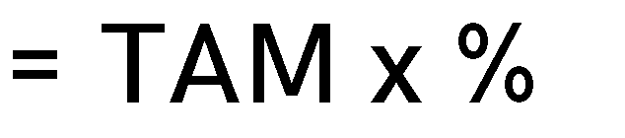


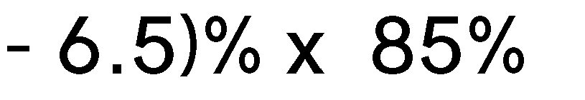











•
He represents a larger population of society as only a few people are engaged in freelancing.
. He has to manage his finances well so that his family can live in peace.
[9]
Profile: Family head for a 6 member family.
Profile: Works remotely as the tech lead of Meta.
Profile: Freelancer
Goals: To provide good living conditions to their family.
Goals: Maintain the budget and pay bills on time.
Goals: To be able to manage finances.
people finances × %of middle class and upper class in
[10]
Pain points: Is really old so needs help from family.
Pain points: Unable to pay bills on time due to busy
schedule.
Pain points: Unable to manage finances due to uneven nature of work.
•
•
Our product would cater to adults above the achievable age of 18.
. Account Integration: Implementing robust account integration capabilities to connect with users bank accounts, credit cards, investment accounts and other financial institutions securely. This integration should support automatic transaction syncing and categorization to minimize manual data entry.
.Expense tracking: Developing features for tracking daily expenses, including categorization, tagging and the ability to set budgets. Users should easily be able to view their spending habits and identify areas where they can save money.
Bills reminders: Features to managing recurring bills and payments such as rents, utilities, subscriptions and loan payments.
[]

Slide 5


















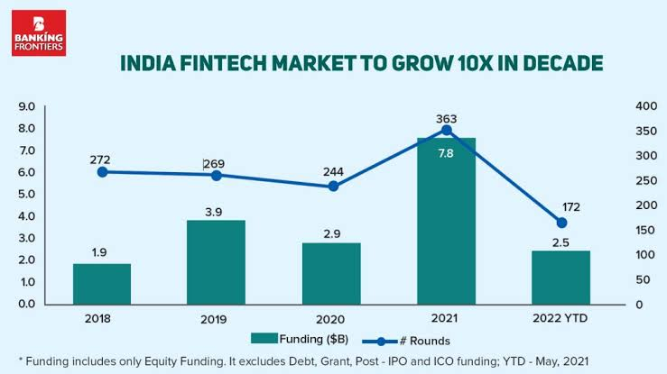



F
2.Potential Impacts and Benefits
By providing users with detailed insights into their financial habits ,the app empowers them.
By offering personalized recommendations.
By leveraging data analytics tools like python and SQL ,better advices are given to the users.
Users can achieve their financial goals through goals. .
•
•
•
User downloads and installs the financial tracking app .
The user is prompted to create an account
After account creation, the user is prompted to link their bank accounts.
Once the accounts are linked,the app begins syncing
The user explore the dashboard
They notice a lot of unpaid bills from last month
3. Market Potential
Quickly pays the bills from the help of the app.
They navigate to the bills section to look for unpaid bills.
They navigate to expense section to see overspending.
It displays overview of their finances.
. The financial tracking app is designed to cater to diverse demographics including young professionals, families and retirees by offering customizable features and insights tailored to their specific financial needs and goals.
. Its scalability is evident in its ability to adapt to various user profiles, accommodating differences in income levels, spending habits and financial priorities.
The app calculates the monthly savings or debt repayment for goal.
Derek tracks progress of his achievable goal.
[13]
Based on the Dereks transaction history,the app provides advice
Derek decides to set specific financial goals
Navigates to the goal section of the app and creates a new goal.
The app provides tools for tracking financial goals.
These tools include progress bars,charts and graphs
He then turns to the app for managing his budgets using tools
He makes a budget list to spend for his sisters birthday.
He sets a reminder for his sisters birthday coming .
The spending by Derek in this month was far beyond expectations
The app gives a notification to Derek to reduce his spendings.
Derek takes this into consideration and reduces his budget for next month.
Importance of the app.

Slide 6
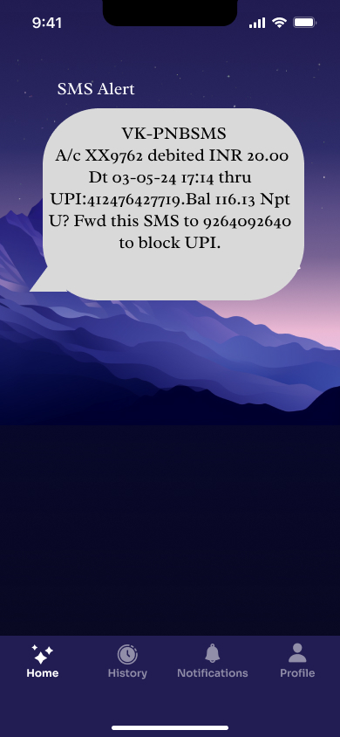
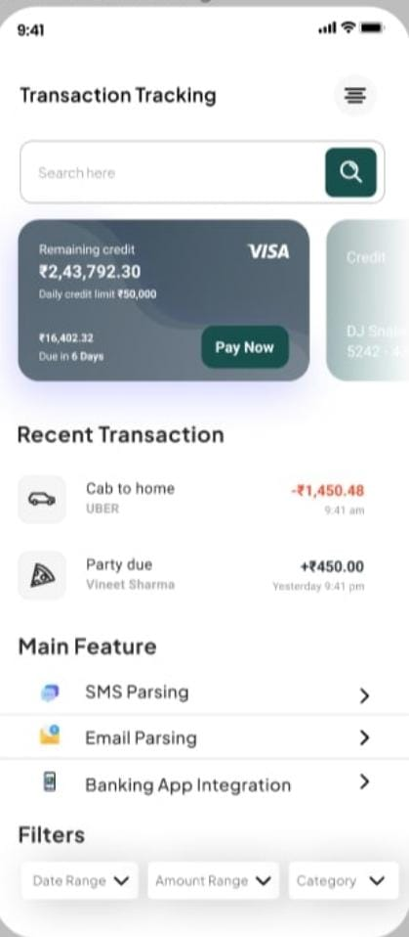
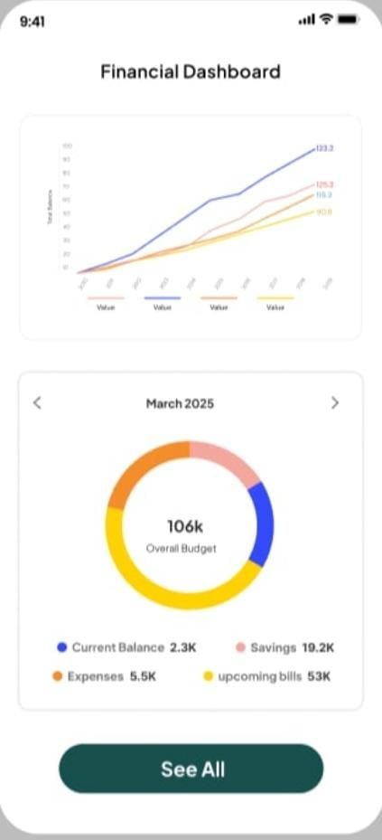
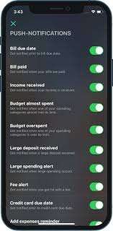








The Solution
Part A- SMS Alert from bank
Part B- Transactions
Part C- Alerts and Notifications
SMS Alert
The user has received
a SMS from the bank
he is a customer of.
Financial Dashboard
Provide a overview of the users finance
Notifications
Notifications are pushed accordingly
Transaction Tracking
It tracks a transaction
based on sms parsing
and shows
transactions.
Alerts
Push notifications are on for various budgeting issues
SMS Parsing
Uses ocr and nlp
techniques to extract
transaction data from
the messages.
See All button
The see all button offers financial advise for the users.
SMS Alert
Transaction Tracking
Financial Dashboard
Alerts and notifications
Data Capture: Uses Optical Character Recognition (OCR) and natural language processing to extract transaction data from SMS and emails.
Data Security: Implements robust encryption methods to ensure user data privacy and compliance with financial regulations.
.Behavioral Analysis Models: Uses AI like ocr and nlp techniques to learn individual spending behaviors and predict future trends.
.Custom Advice Algorithms: The app uses ai and user data to generate personalised financial advice.
•
Transaction Alerts: Notifies users whenever a transaction is made on their linked accounts. Include details such as transaction amount, merchant name, and category.
Budget Alerts: Sends notifications when users are nearing or have exceeded their budget limits for specific categories. Provide suggestions on how they can adjust their spending to stay on track
•
•

Slide 7
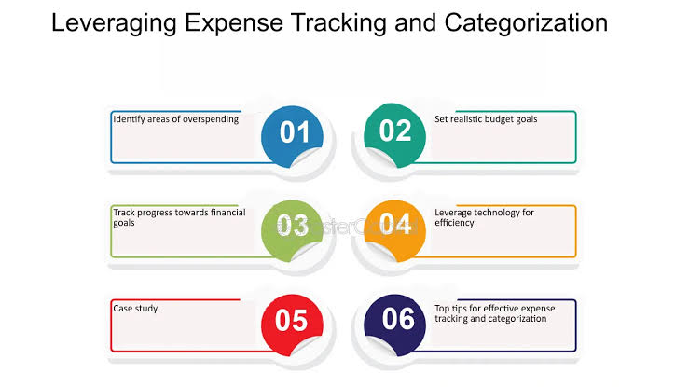
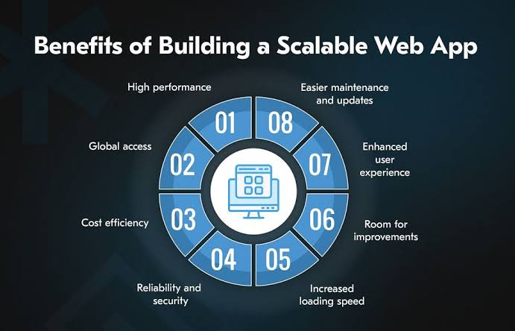
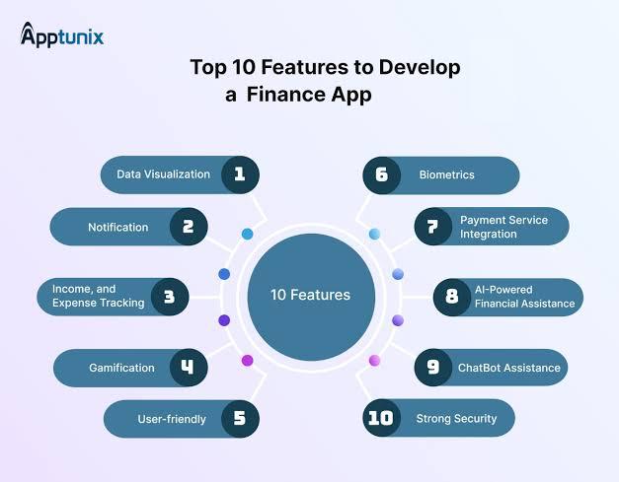
1. Scalability plans
2. Future features
Scalability in financial expense tracker app involves both horizontal and
vertical scalability. Horizontal scalibility refers to the ability to handle increased . loads by adding more resources such as servers,while vertical scalability involves enhancing the existing infrastructure to handle more transactions per unit of time.
Database architecture: Employing a scalable database architecture like sharding portioning to distribute the data across multiple servers.This ensures that as the number of users and transactions grows,the database can handle the increased loads efficiently.
Caching mechanisms: Utilize caching mechanisms to reduce the load on the database.Implementing a catching layer can significantly improve performance by storing frequently accessed data in memory,reducing the number of database queries.
Advanced features for financial tracking app like investment tracking, integration with tax filing services, and expansion to include financial planning for retirement.
Real-time Portfolio Analysis: Provide users with real-time analysis of their investment portfolios, including performance metrics, asset allocation, and risk assessment. This feature can help users make informed decisions about their investments.
Automatic Bill Payment Integration: Integrate with bill payment services to allow users to automate their bill payments directly from the app. This feature can help users stay organized and avoid late fees.
Budget Optimization: Implement machine learning algorithms to analyze user spending patterns and recommend personalized budget optimization strategies. This feature can help users optimize their spending and achieve their financial goals more efficiently.

Slide 8
























 | • Employ robust security measures such as encryption , two factor authentication . . Ensure regular security audits and compliance with industry standards like GDPR and PCI DSS.
• • | • •
 | • • •
 | •
Lack of automated sms and email services for financial expense tracker app due to which proper financial advices aren’t able to reach them
Security breaches: One of the most significant concerns is the risk of data breaches where sensitive information could be compromised.
Older adults above the age of 18 years.
We solved for various parameters such as as integration,expense tracking and bills reminders.
Our solutions aims to solve the following problems through the app.
Account integration: Implementing robust account integration capabilities to connect with users bank accounts.
Expense tracking: Developing features for tracking daily expenses, including categorization, tagging.
Bills reminders: Features to managing recurring bills and payments .
The app may be misused by users due to not reading the instructions carefully.
Ensure proper functioning of app
Ensure AI is working properly.
Reduces the amount of burden on user by using sms parsing using ai and deep learning tools.
Users may try to cheat the app by creating multiple accounts under the same name.
Unique users who have downloaded the app atleast thrice(Goal:
Acquisition)

