Slide 1




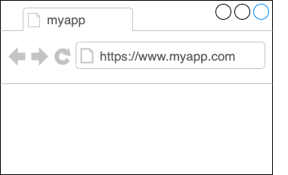



Request Flow through the K8s Components
Namespace: mongodb-namespace
Deployment:
mongodb-deployment
Service:
mongodb-service
NGINX Ingress Controller Pod
External request from browser
Pod:
mongodb
ConfigMap
Secret
Deployment:
mongodb-express-deployment
database_url
mongo-root-username
mongo-root-password
Pod:
mongodb-express
Service:
mongodb-express-service
Ingress:
mongodb-ingress
Minikube Node | K8s Cluster

