Slide 1
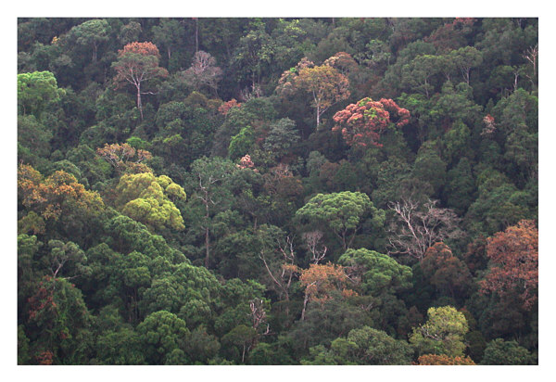
Examining Spatial Predictions of the METE

Slide 2
Maximum Entropy Theory of Ecology (METE)
4 state variables are used to make community pattern predictions
  S₀ : number of species in the region
  N₀ : number of individuals
  A₀ : area of the region
  E₀ : total rate of metabolic energy

Slide 3
Current Projects
Geographic models of METE state variables
  Can we model S and N accurately enough to predict the abundance distribution where we have no census data?
Spatially explicit predictions of METE
  METE predicts spatially implicit patterns
  However, spatially explicit predictions have not yet been formalized

Slide 4
Spatial Patterns and METE
Basic Questions:
  What is the shape of the METE distance decay function (e.g., exponential, power, …)?
  Does METE result in non-independence of species although independence of species is assumed, as the neutral model does.
  Does the METE seem to fit real community data?

Slide 5
Maximum Entropy Theory of Ecology (METE)
4 state variables are used to make community pattern predictions
  S₀ : number of species in the region
  N₀ : number of individuals
  A₀ : area of the region
  E₀ : total rate of metabolic energy

Slide 6
METE Spatial Simulator
Given S₀ and N₀
Bisect an area many times to generate a grid
At each bisection randomly decide which individuals go to the left and right halves
S₀ and N₀ + MaxEnt = MaxEnt SAD

Slide 7
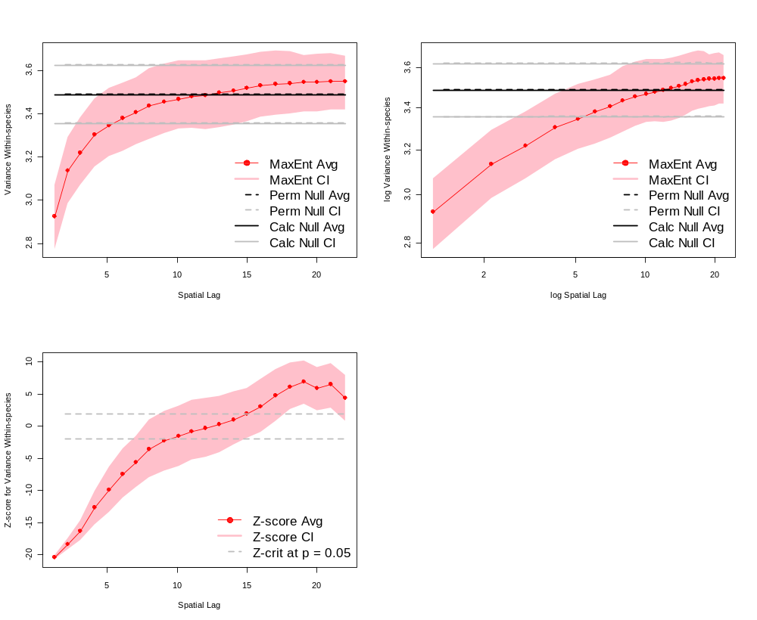
METE – variance within-species
Variance Within-species
Log Variance Within-species
Spatial Lag
Log Spatial Lag

Slide 8
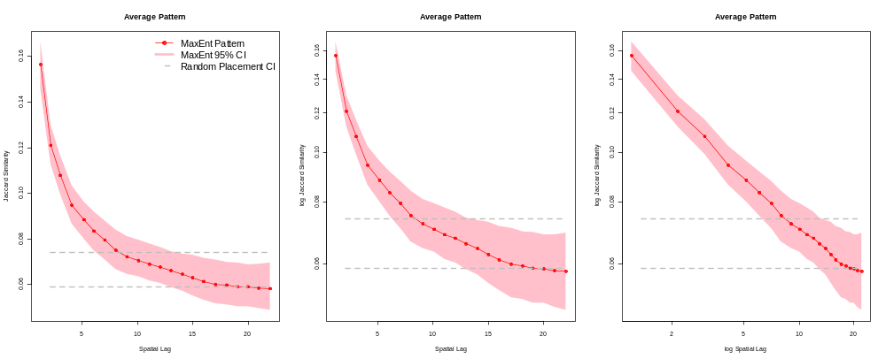
METE – Jaccard’s Index
Jaccard’s Dissimilarity Index
Log Jaccard’s Dissimilarity Index
Spatial Lag
Log Spatial Lag

Slide 9
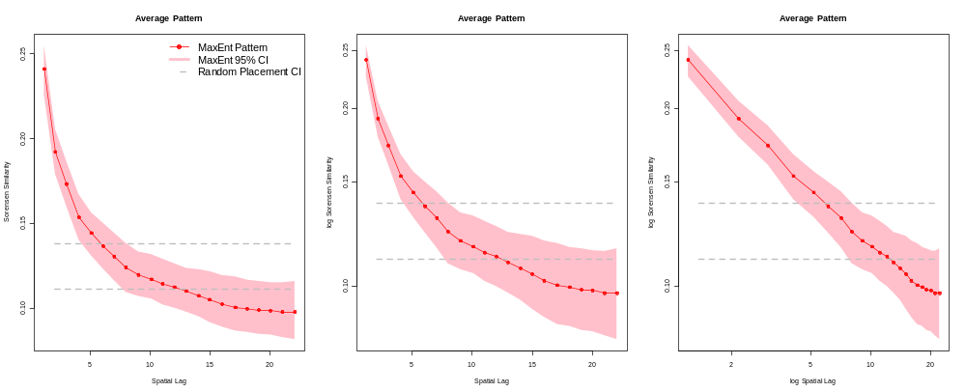
METE – Sorensen’s index
Sorensen’s Dissimilarity Index
Log Sorensen’s Dissimilarity Index
Spatial Lag
Log Spatial Lag

Slide 10
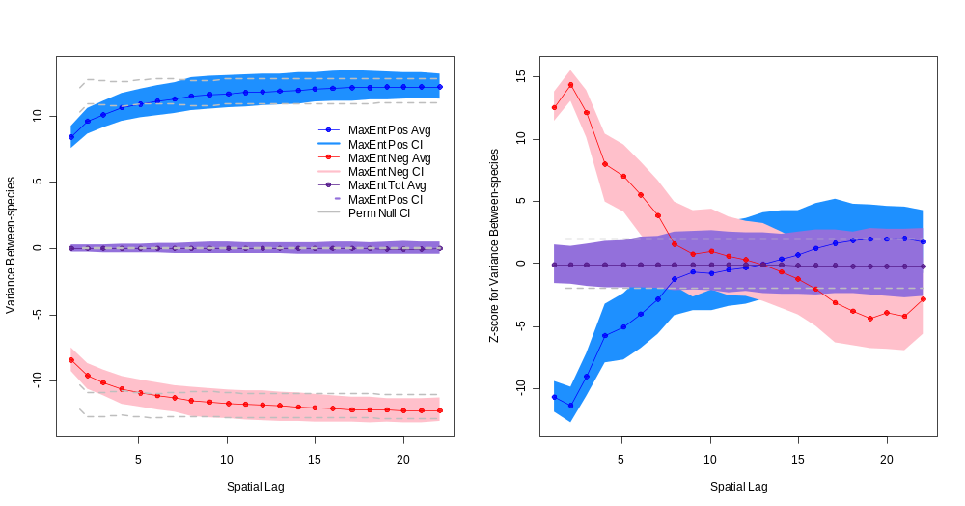

Slide 11
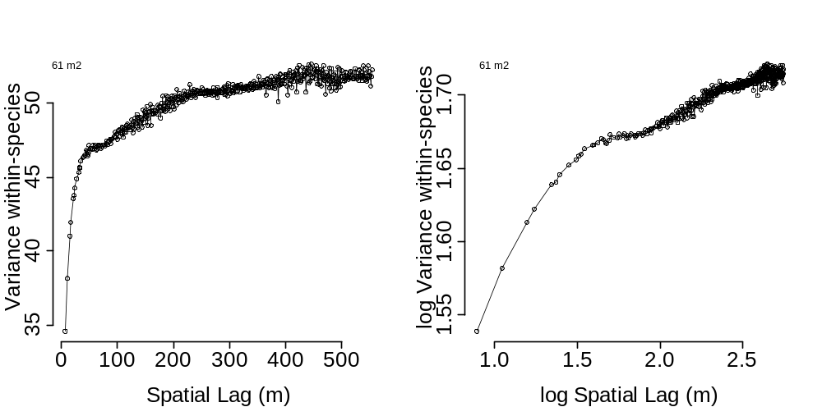
BCI – Variance within-species

Slide 12
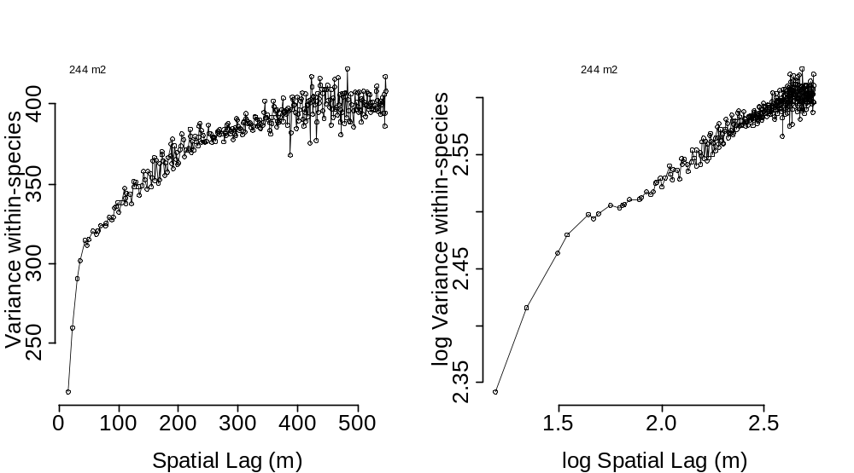
BCI – Variance within-species

Slide 13
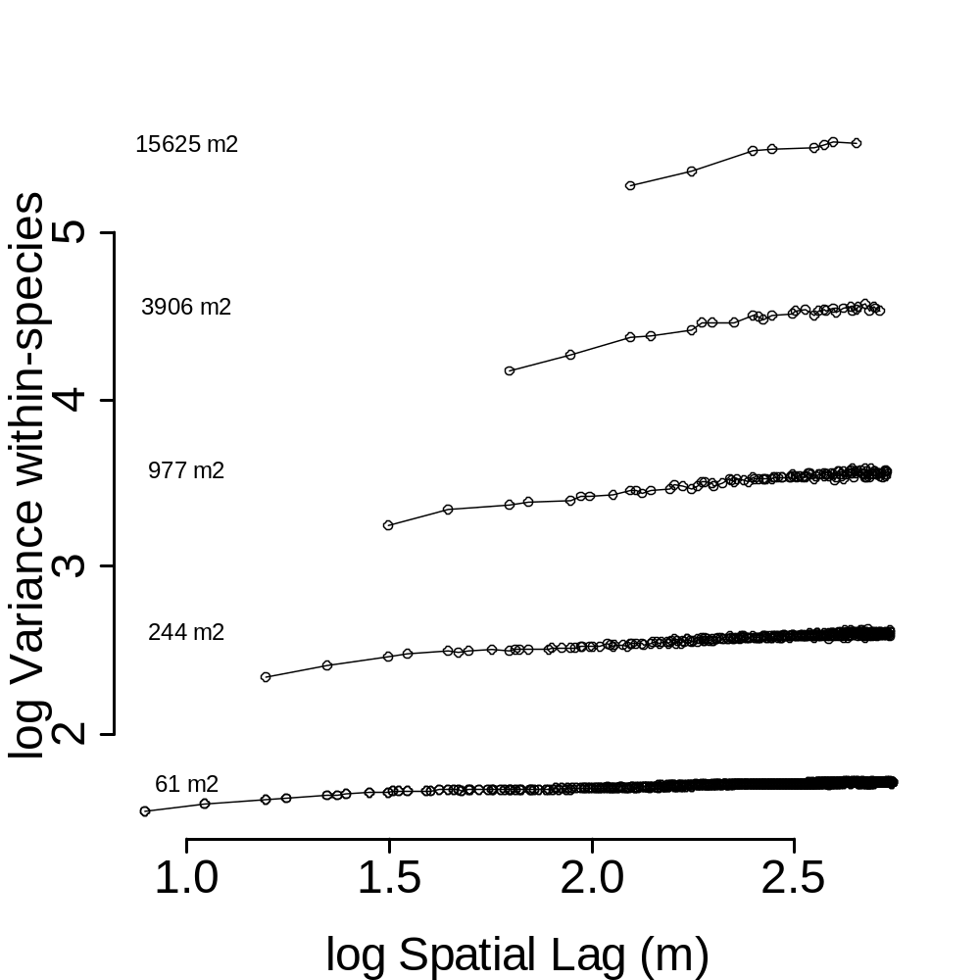
BCI – Variance within-species

Slide 14
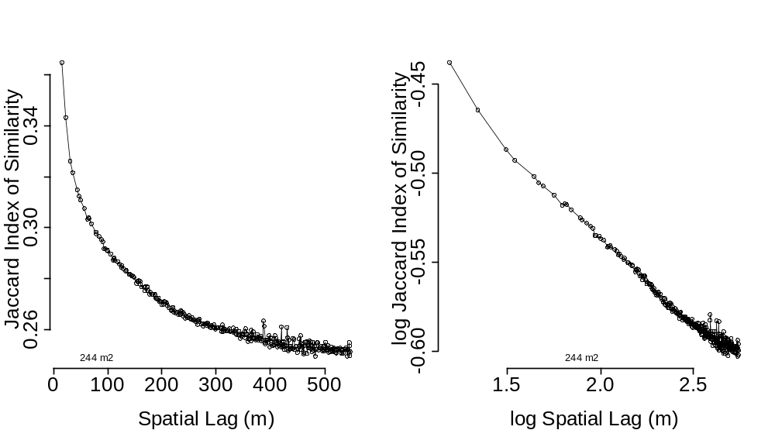
BCI – Jaccard’s Index

Slide 15
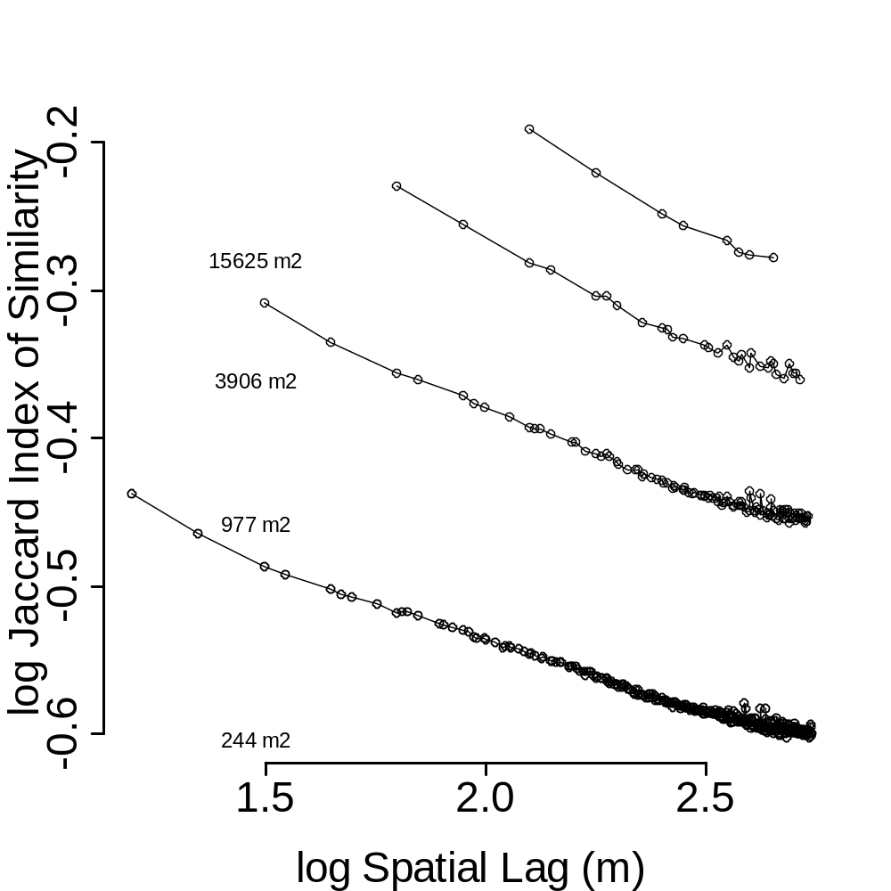
BCI – Jaccard’s Index

Slide 16
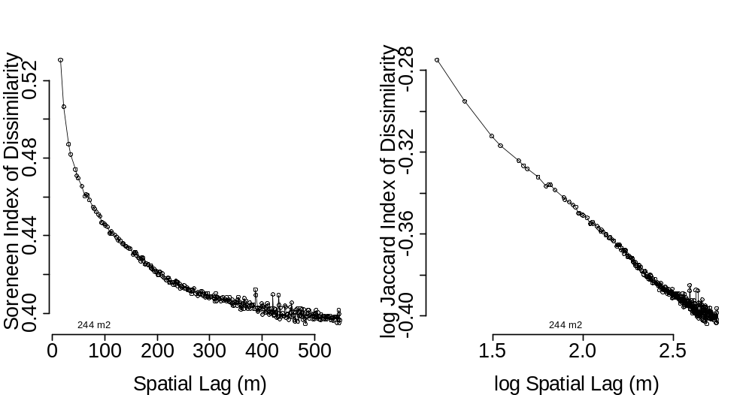
BCI – Sorensen’s Index

Slide 17

BCI – Sorensen’s Index

Slide 18
METE prediction for BCI
BCI S₀ = 301, N₀ = 204,988
Use these to make a specific predictions about spatial patterns in the BCI community
Remaining Questions:
  How does the shape and slope of the METE prediction change with spatial grain?
  Can we apply these predictions to non-grid data?

