Slide 2
Empirical Community Summary
 | shape | area (ha) | S | N
BCI | rectangle | 50.0000 | 301 | 205096
Cocoli | rectangle | 2.0000 | 136 | 4411
Cocoli | rectangle | 2.0000 | 141 | 4241
Crosstimbers | square | 4.0000 | 7 | 7625
Sherman | rectangle | 2.0000 | 191 | 6660
Sherman | rectangle | 2.0000 | 168 | 7743
Sherman | square | 1.9600 | 181 | 7502
Serpentine | square | 0.0064 | 24 | 37182

Slide 3
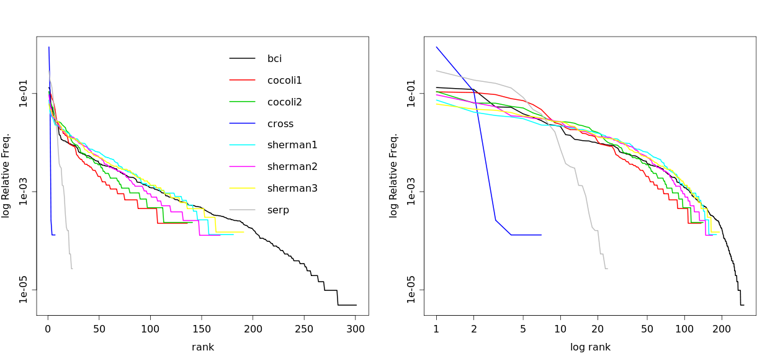
Empirical SADs

Slide 4
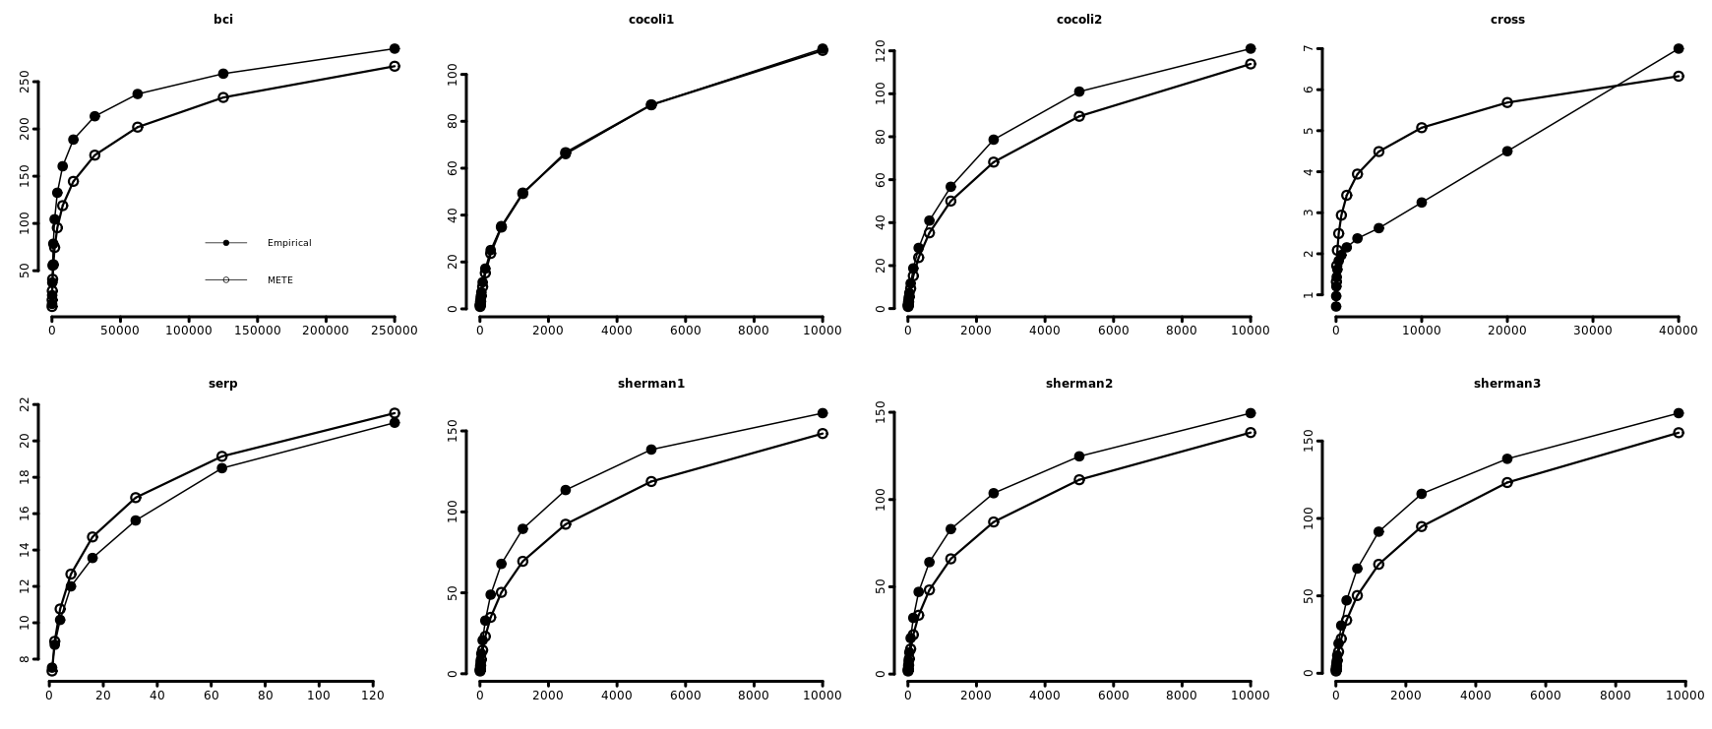
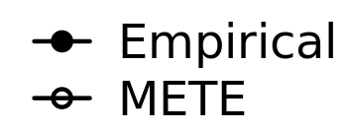
Arithmetic SARs

Slide 5
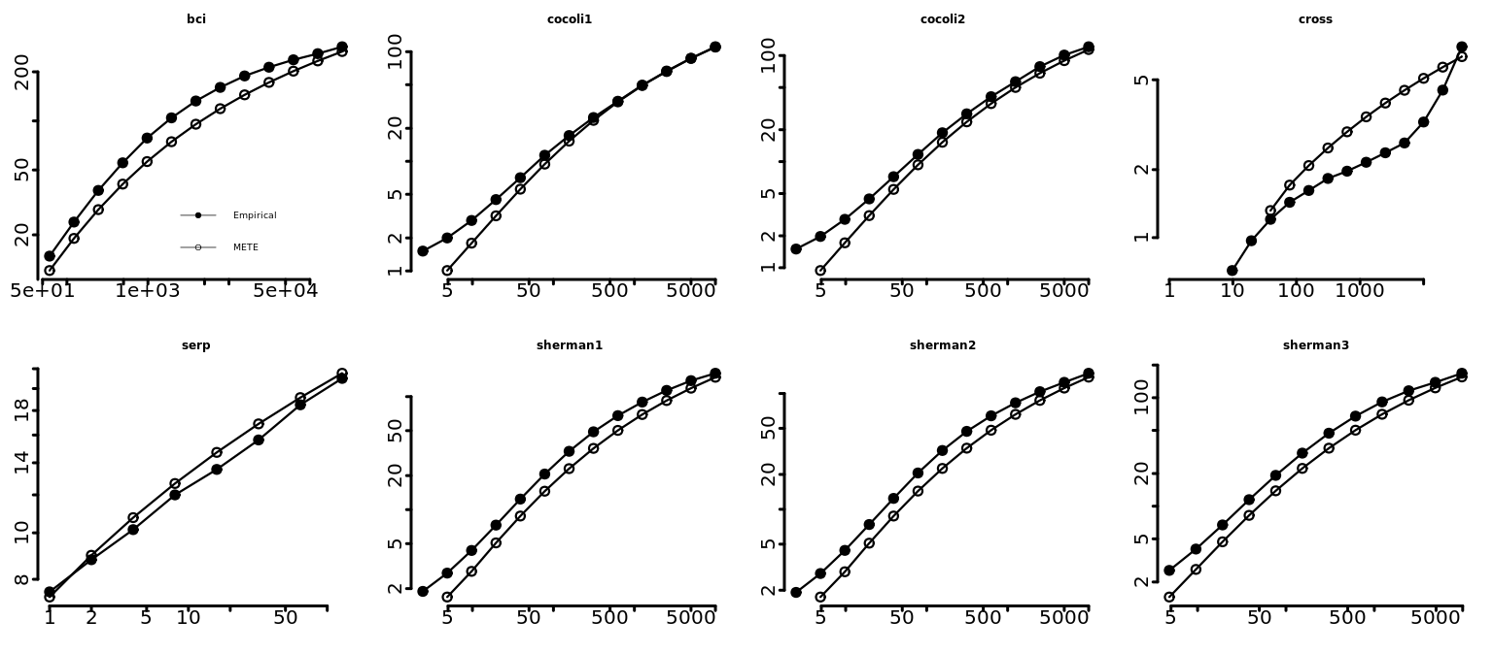
Log-Log SARs

