Slide 1
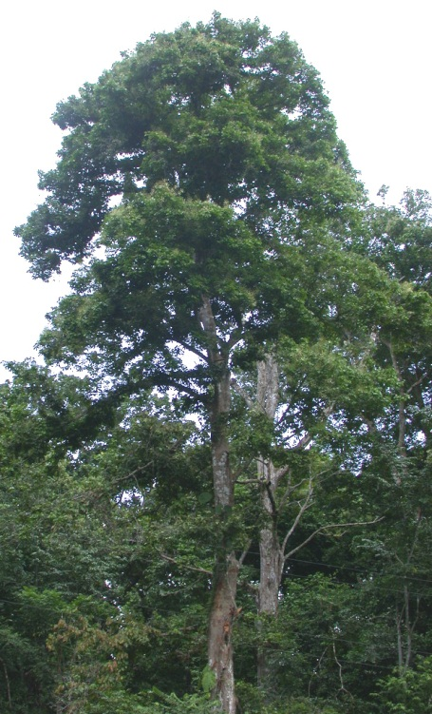
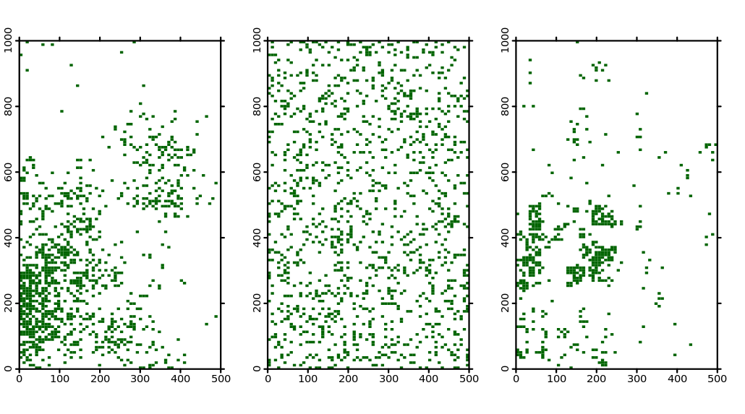
Spatially Explicit Predictions
Random Placement and METE models both are constrained by N
How well does METE do?
Observed
Pattern
Random
Placement
METE
Prioria copaifera

Slide 2
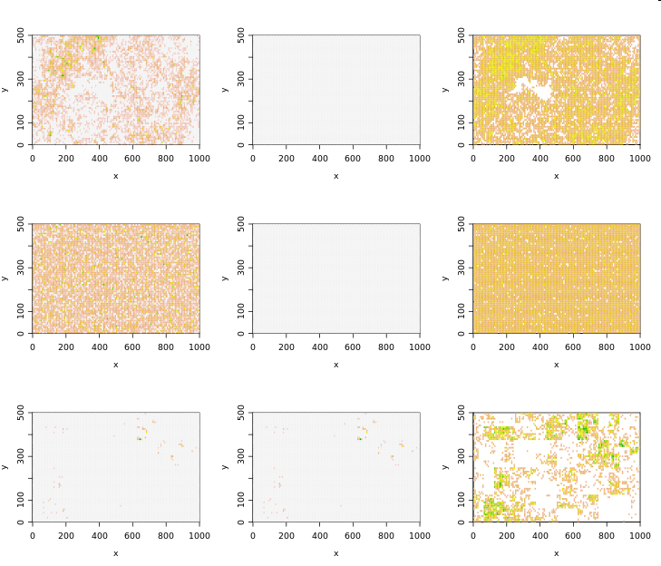

Slide 3
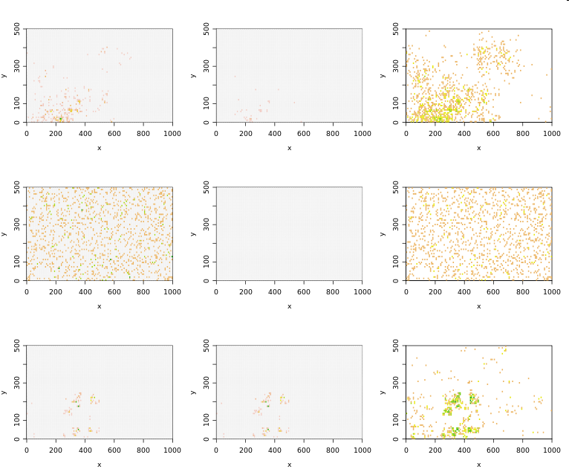

Slide 4
Empirical Community Summary
 | habitat | shape | area (ha) | S | N
BCI | tropical | rectangle | 50.0000 | 301 | 205096
Cocoli1 | tropical | rectangle | 2.0000 | 136 | 4411
Cocoli2 | tropical | rectangle | 2.0000 | 141 | 4241
Crosstimbers | savanna | square | 4.0000 | 7 | 7625
Sherman1 | tropical | rectangle | 2.0000 | 191 | 6660
Sherman2 | tropical | rectangle | 2.0000 | 168 | 7743
Sherman3 | tropical | square | 1.9600 | 181 | 7502
Serpentine | serpentine | square | 0.0064 | 24 | 37182

Slide 5
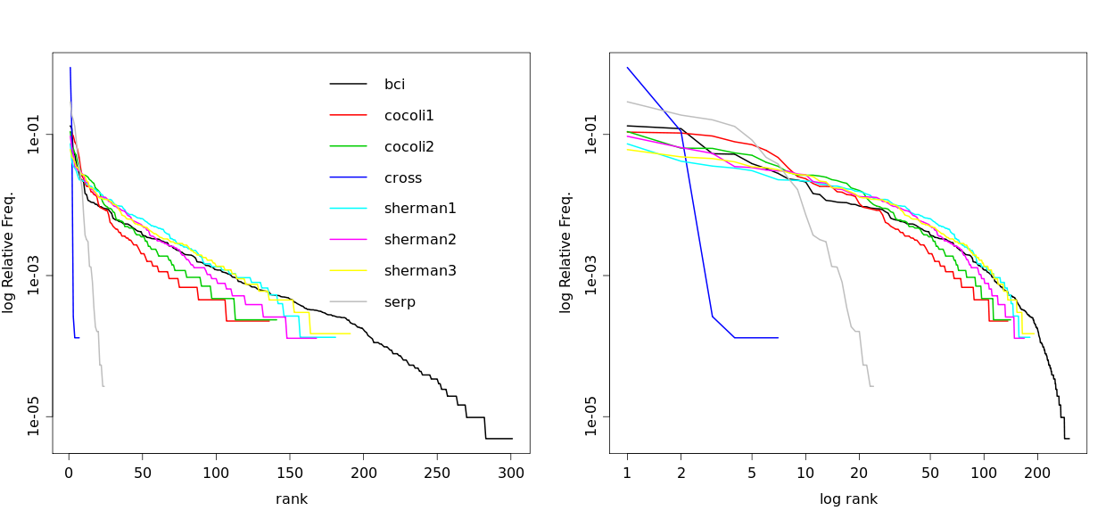
Empirical SADs

Slide 6
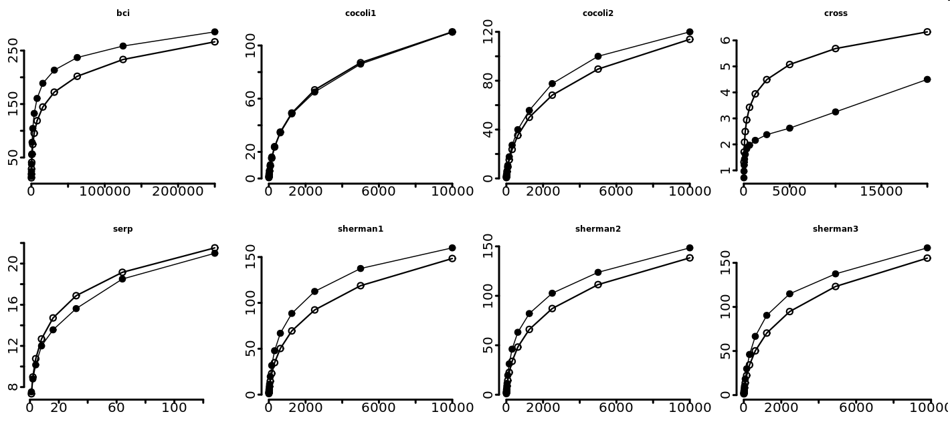
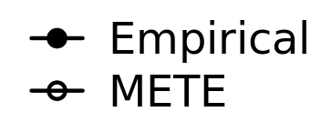
Arithmetic SARs
Area (m²)

Slide 7
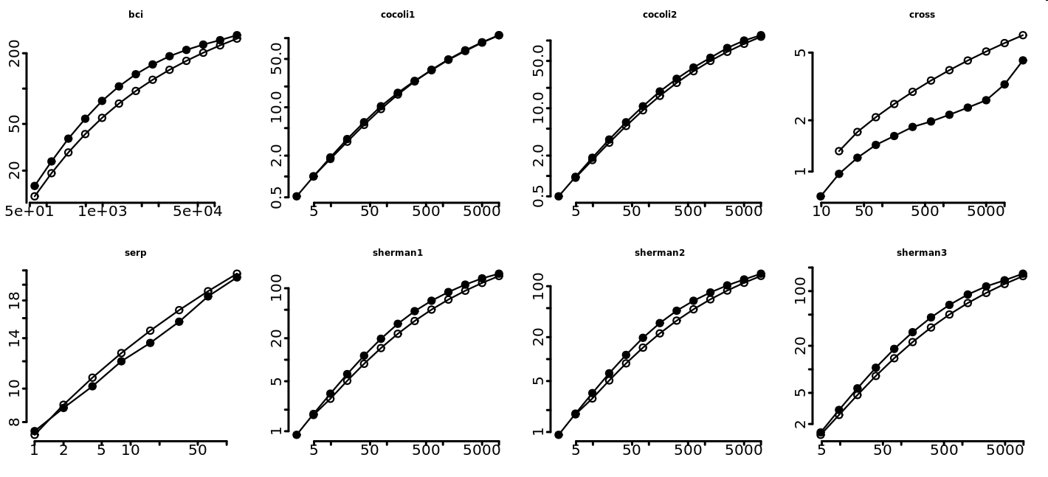
Log-Log SARs
Area (m²)

Slide 8
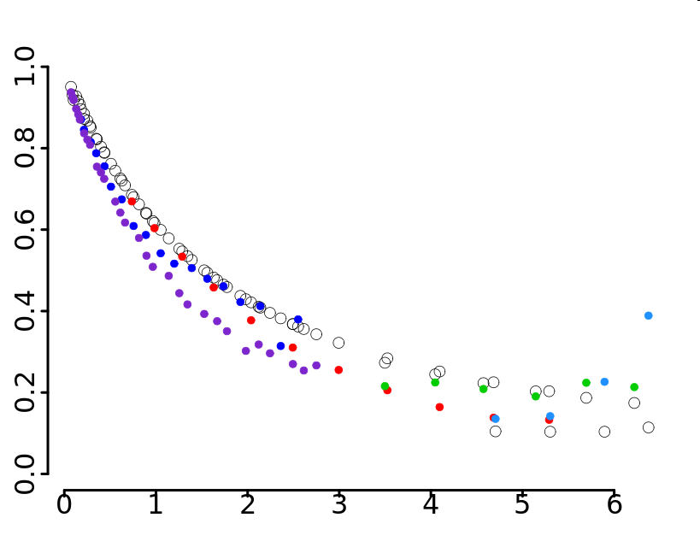
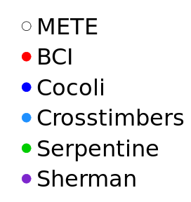
Universal Curve
Slope
ln(N/S)

Slide 9
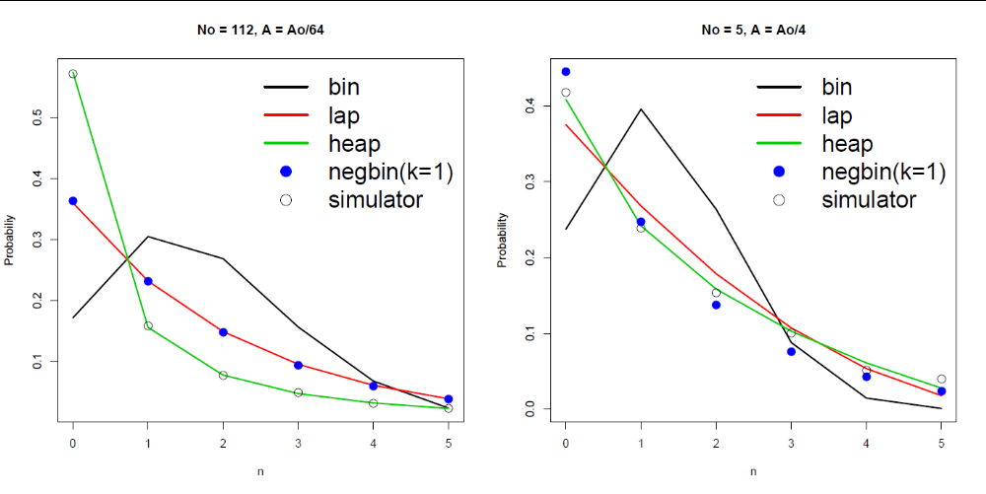
Spatial Abundance Distribution

Slide 10
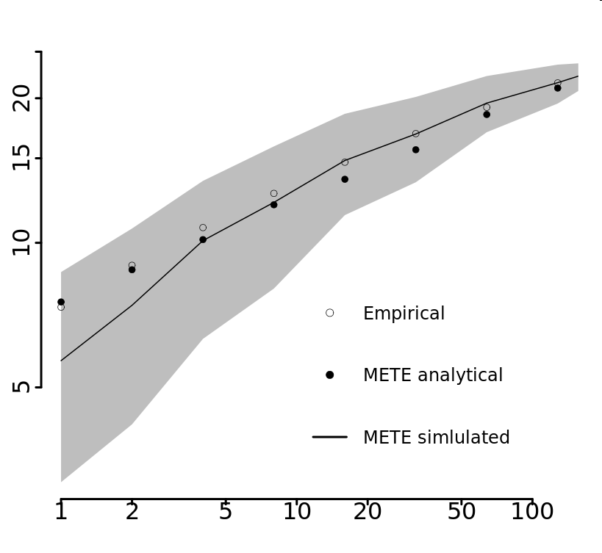
METE analytical & simulated
Serpentine
Richness
Area (m²)

Slide 11
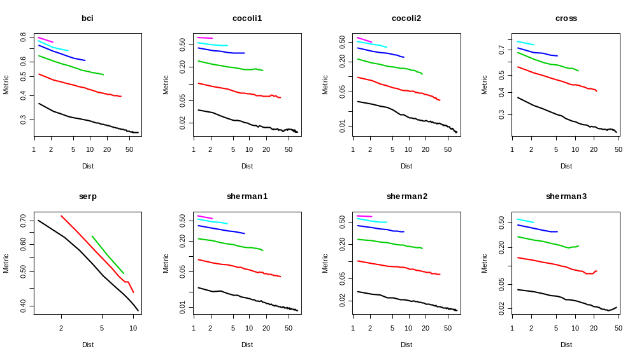
Empir. Distance Decay – Abu.

Slide 12
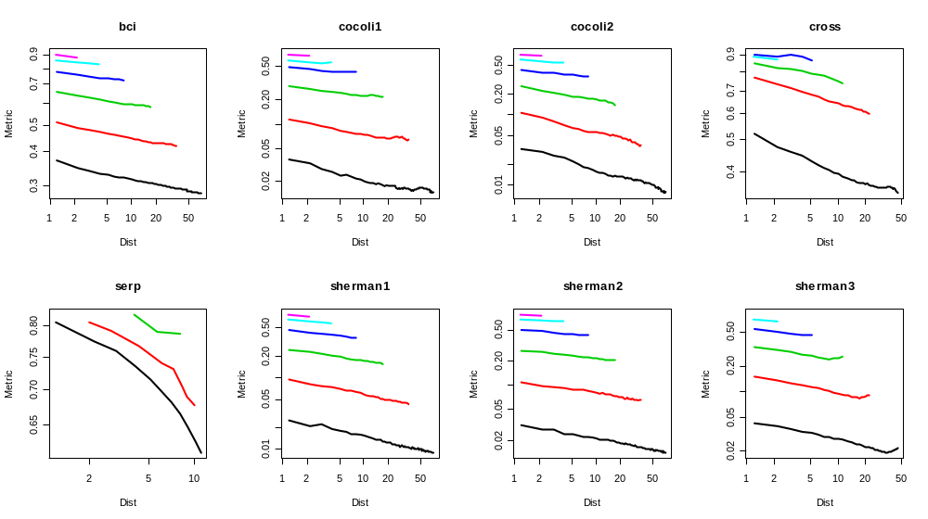
Empir. Distance Decay – Pres/Abse

Slide 13
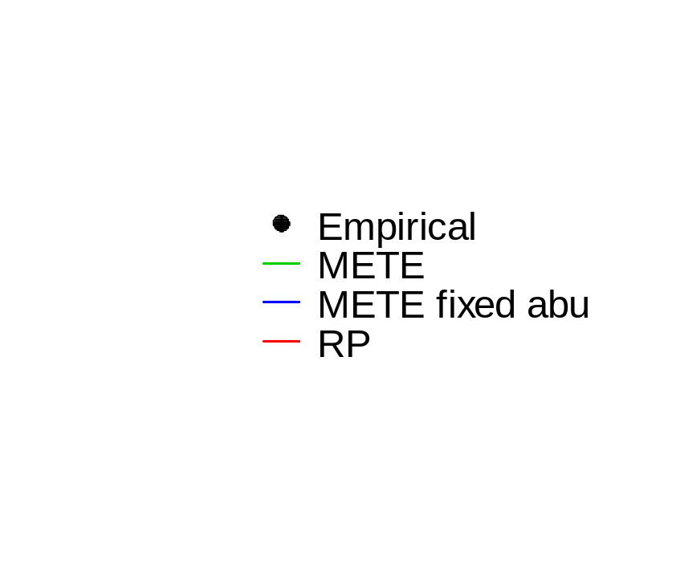
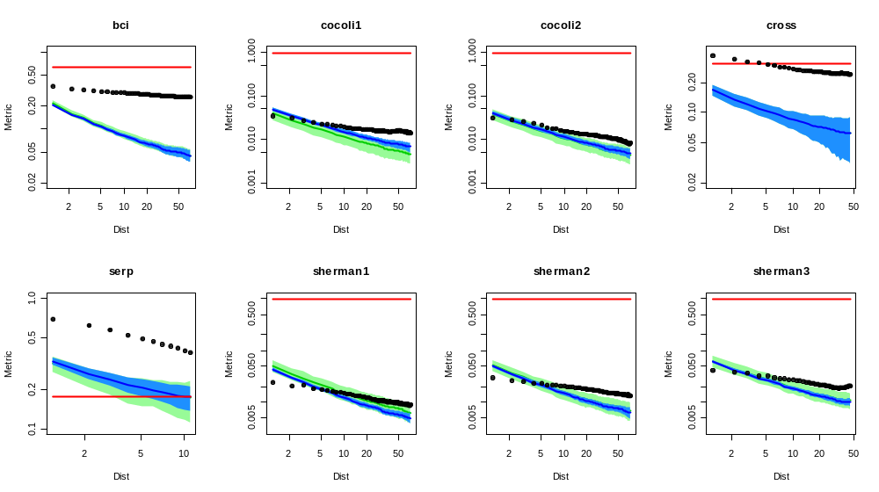
Abu. Data

Slide 14
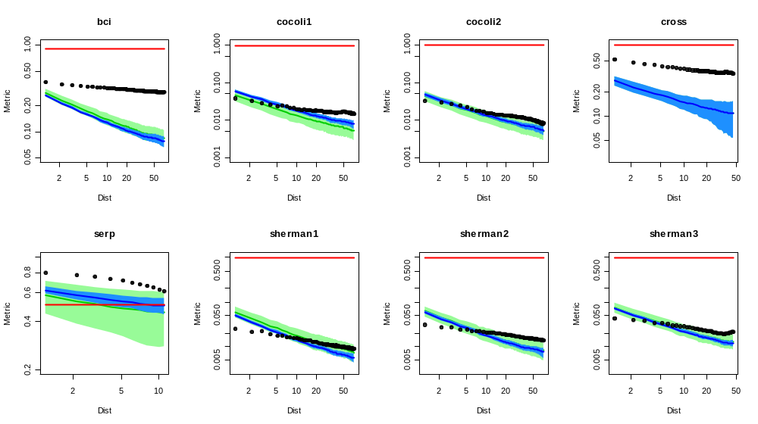
Pres/Abse Data

Slide 15
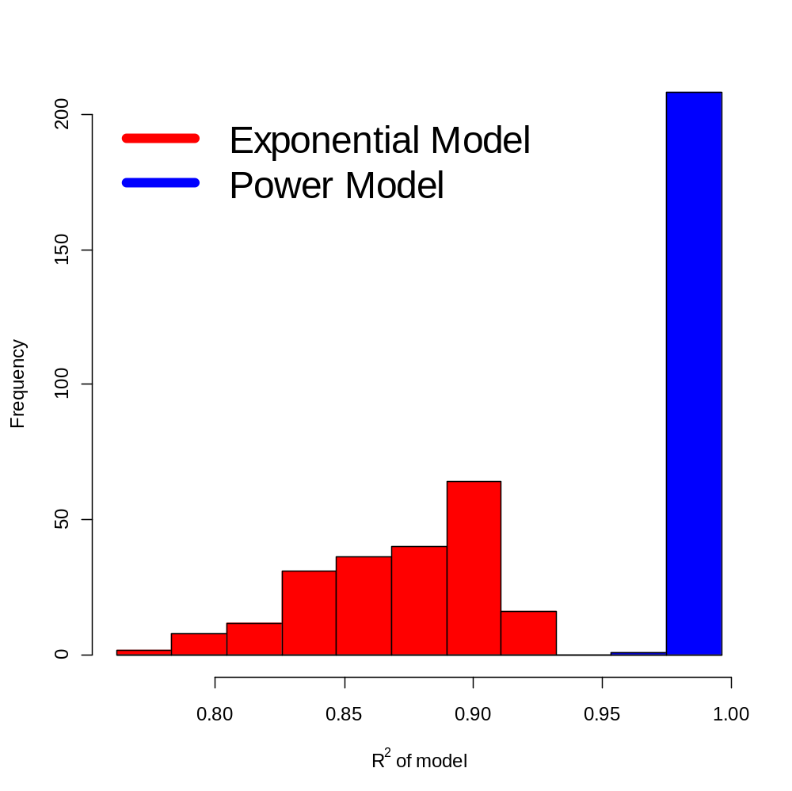
Exponential vs Power Model of DD

Slide 16
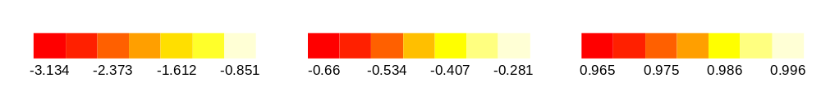
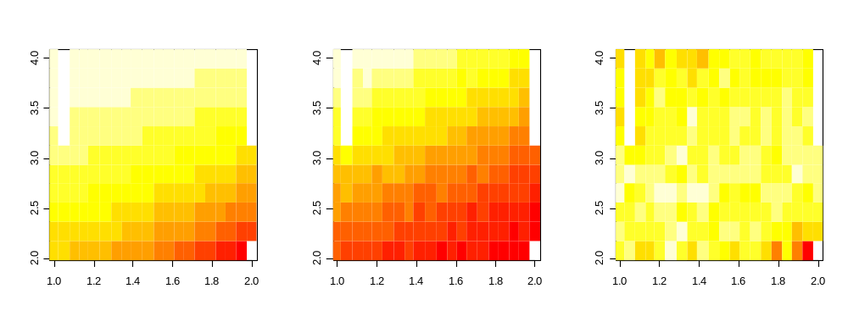
HEAP Spatial Scaling
intercept
slope
R²
log₁₀ N
log₁₀ S

Slide 17
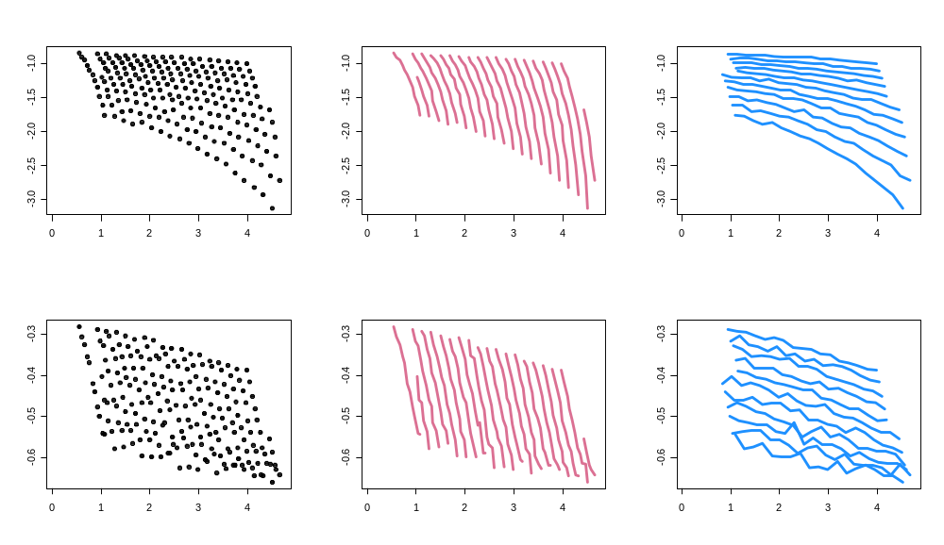
Heap Scaling
same S
same N
intercept
slope
log₁₀(N/S)

Slide 18
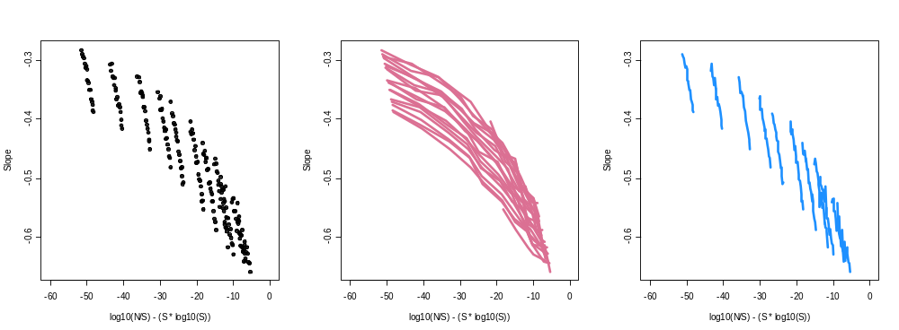
Slope Scale Collapse ?
log₁₀(N/S) – (S – log₁₀(S))

