Slide 1

Data Structures & Algorithms
Week-01

Slide 2
Week-01 Agenda
  Introduction to Data Structures and Algorithms
  Fundamental Concepts of Algorithm Analysis
  Time and Space Complexity
  Asymptotic Notations (Big O, Omega, Theta)

Slide 3
Introduction to Data Structures and Algorithms
Need for Data Structures:
  Data structures organize data ⇒ more efficient programs.
  More powerful computers ⇒ more complex applications.
  More complex applications demand more calculations.

Slide 4
Introduction to Data Structures and Algorithms
Organizing Data:
  Any organization for a collection of records that can be searched, processed in any order, or modified.
  The choice of data structure and algorithm can make the difference between a program running in a few seconds or many days.

Slide 5
Introduction to Data Structures and Algorithms
Efficiency:
  A solution is said to be efficient if it solves the problem within its resource constraints.
    Space
    Time
  The cost of a solution is the amount of resources that the solution consumes.

Slide 6
Introduction to Data Structures and Algorithms
Select a data structure as follows:
  Analyze the problem to determine the resource constraints a solution must meet.
  Determine the basic operations that must be supported.
  Quantify the resource constraints for each operation.
  Select the data structure that best meets these requirements.

Slide 7
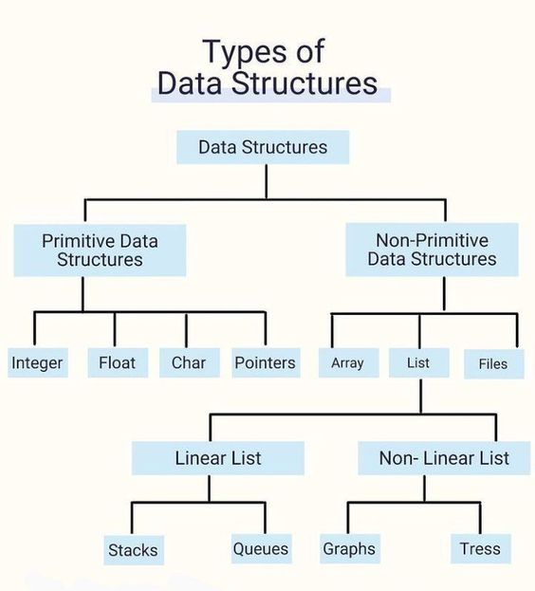
Introduction to Data Structures and Algorithms
Selecting a Data Structure

Slide 8
Introduction to Data Structures and Algorithms
Efficient Data Management:
  Data structures provide efficient ways to organize and manage data.
  They allow you to store, retrieve, and manipulate data in a manner that optimizes operations like searching, insertion, deletion, and traversal.
  Algorithm Design and Analysis:
  Data structures are closely related to algorithms.
  Efficient algorithms often rely on the use of suitable data structures.
Problem Solving and Problem-Specific Solutions:
  Data structures provide a way to model and represent real-world problems in software.
  They allow you to create organized, efficient, and maintainable code that can handle various types of data and tasks.

Slide 9
Fundamental Concepts of Algorithm Analysis
Algorithm analysis focuses on evaluating an algorithm's efficiency in terms of time and space complexity.
Time complexity measures how the runtime of an algorithm grows with the input size, often expressed using Big O, Omega, or Theta notation.
Space complexity assesses the memory usage of an algorithm relative to the input size.
Key concepts include best, worst, and average case scenarios, which help in understanding an algorithm's performance in different situations.
Additionally, recurrence relations is used to analyze the average performance over a sequence of operations or solve recursive algorithms, respectively.

Slide 10
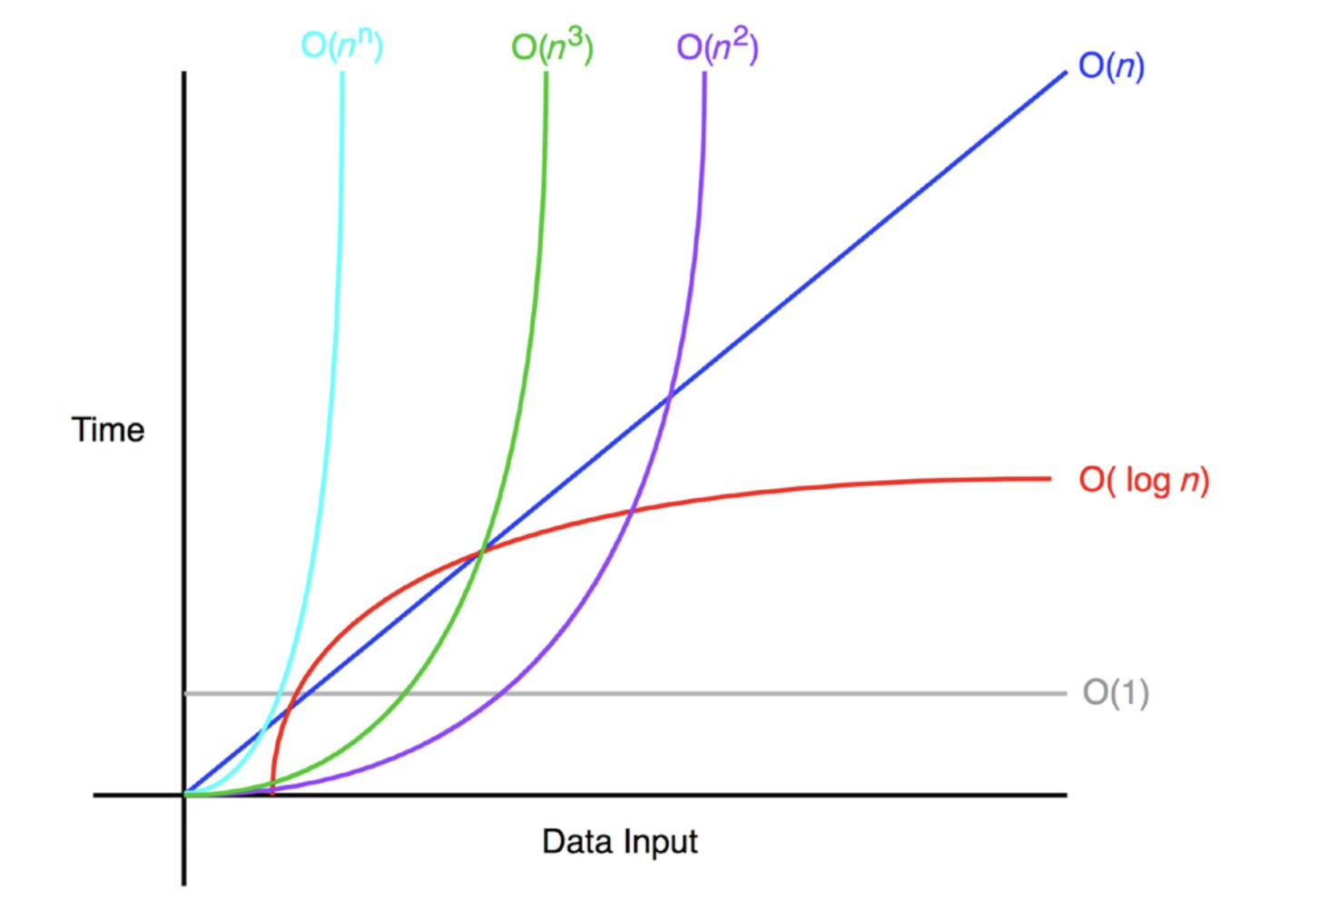
Time and Space Complexity
  Time Complexity - Measures the amount of time an algorithm takes to complete as a function of the input size n.
  Space Complexity - Measures the amount of memory an algorithm uses as a function of the input size n.

Slide 11
Time and Space Complexity
  Best Case: The minimum time or space required for the algorithm, considering the most favorable input.
  Worst Case: The maximum time or space required for the algorithm, considering the least favorable input.
  Average Case: The expected time or space required for the algorithm, considering a random input.

Slide 12
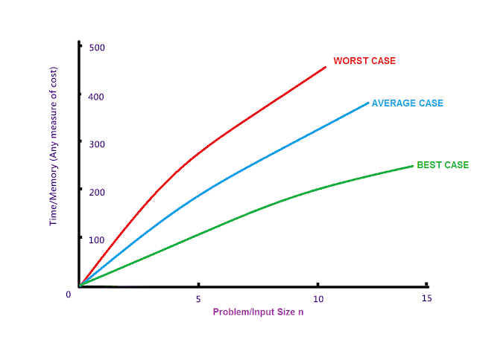
Time and Space Complexity

Slide 13
Asymptotic Notation
Asymptotic notation is used to describe the behavior of algorithms as the input size grows towards infinity.
It helps in analyzing and comparing the efficiency of algorithms.
Here are the most common types of asymptotic notation with a simple example:
  Big O Notation (O(n)): The time complexity is O(n) because the function performs one operation for each element in the list, so the time grows linearly with the size of the input list.
  Omega Notation (Ω(n)): In the best-case scenario, the function still needs to iterate through all n elements to compute the sum, so its time complexity is also Ω(n).
  Theta Notation (Θ(n)): Since the time complexity grows linearly with the size of the list and is bounded both above and below by a linear function, it is Θ(n).

Slide 14
Asymptotic Notation

Slide 15


