Slide 1

Data Structures & Algorithms
Week-02

Slide 2
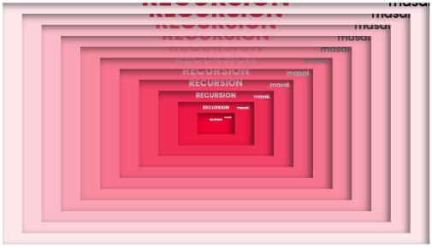

Week-02 Agenda
  Recursion and Recursive Algorithms
  Linear Data Structures: Arrays

Slide 3
Recursion
  Recursion is a process in which a function calls itself directly or indirectly.
  In recursion, a function or method has the ability to call itself to solve the problem.
  The process of recursion involves solving a problem by turning it into smaller varieties of itself.

Slide 4
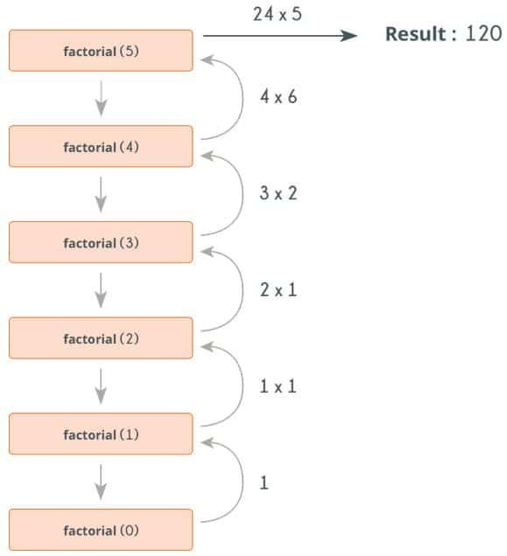
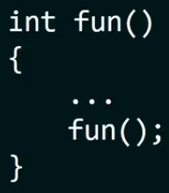
It is a function calling itself inside its own body as shown below:

Slide 5
Recursion
Recursion is a process in which a function calls itself directly or indirectly.
In recursion, a function or method has the ability to call itself to solve the problem.
The process of recursion involves solving a problem by turning it into smaller varieties of itself.
Recursion in the stack in data structure is when functions call themselves directly or indirectly.

Slide 6
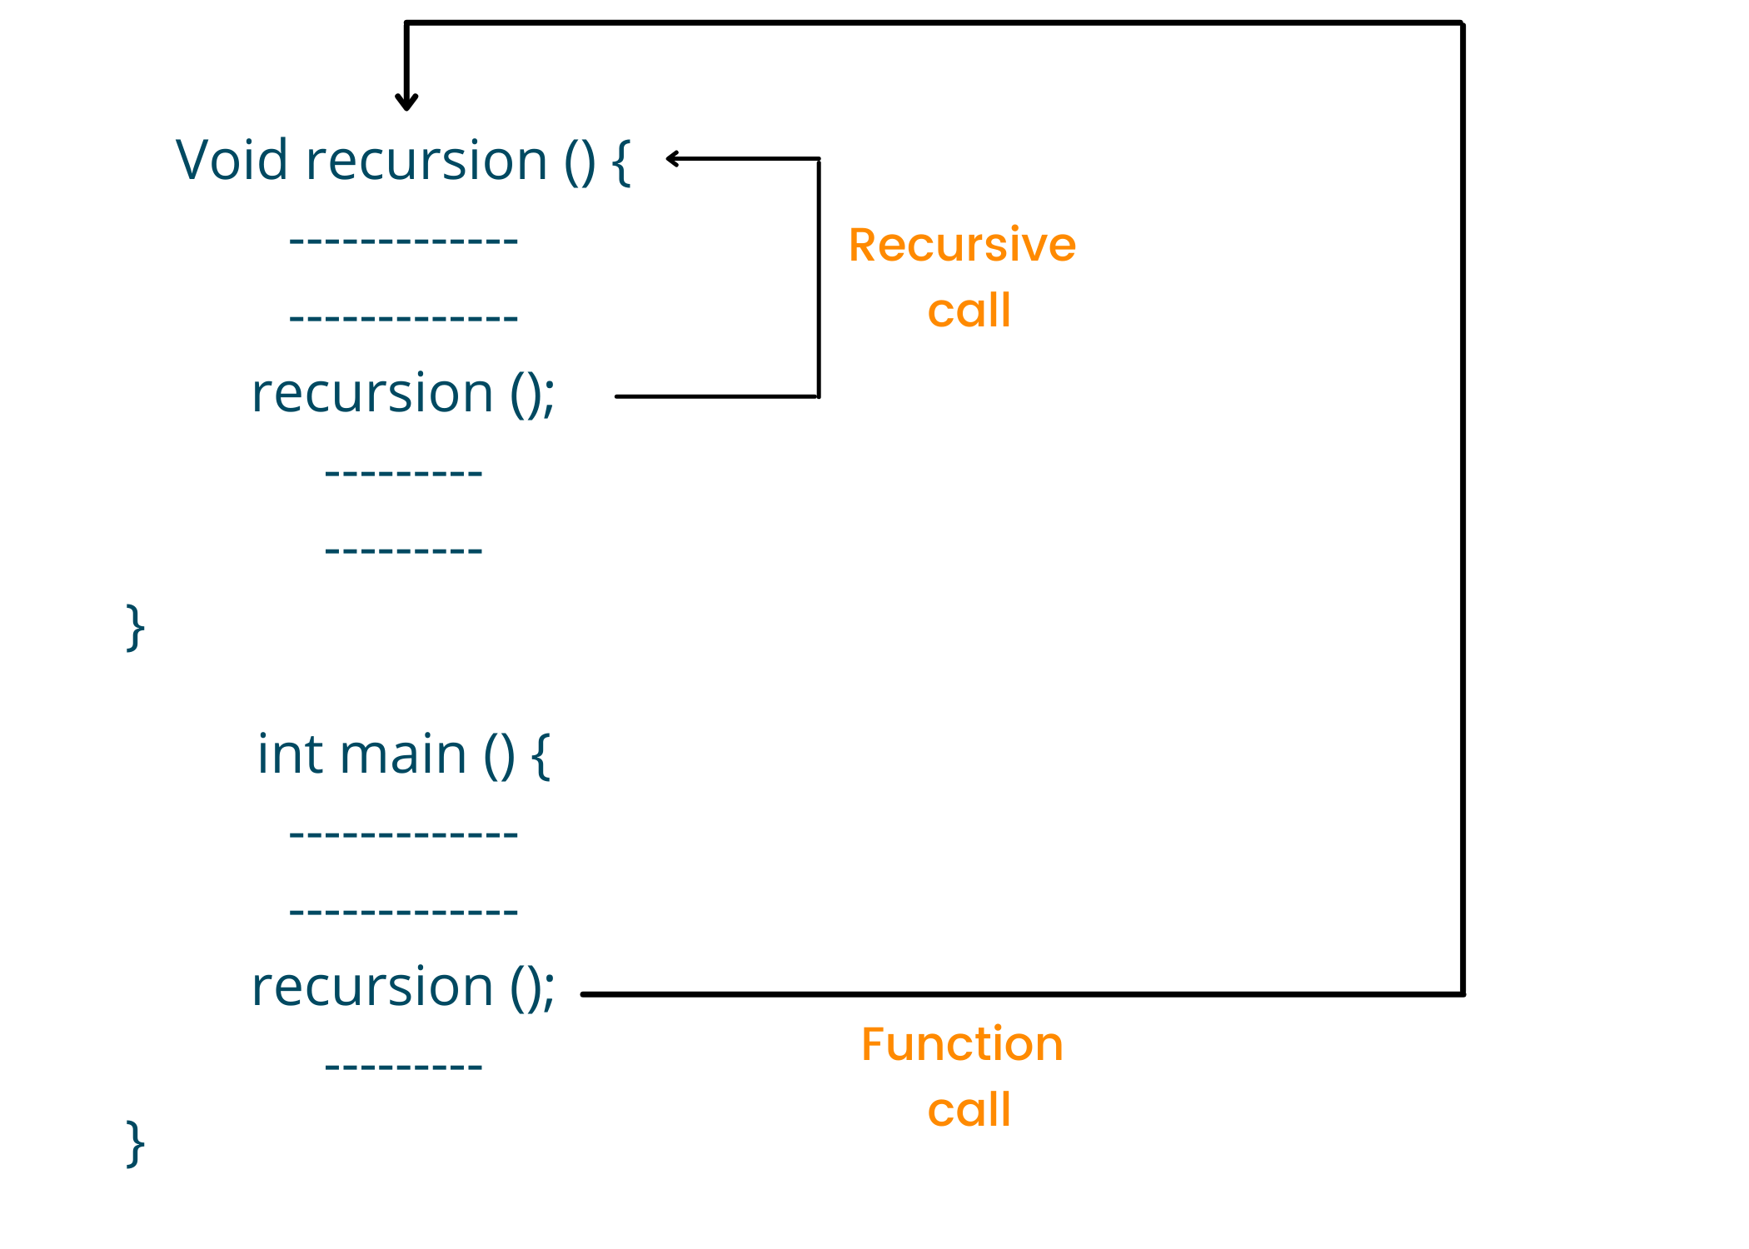
Recursion

Slide 7
Recursion

Slide 8
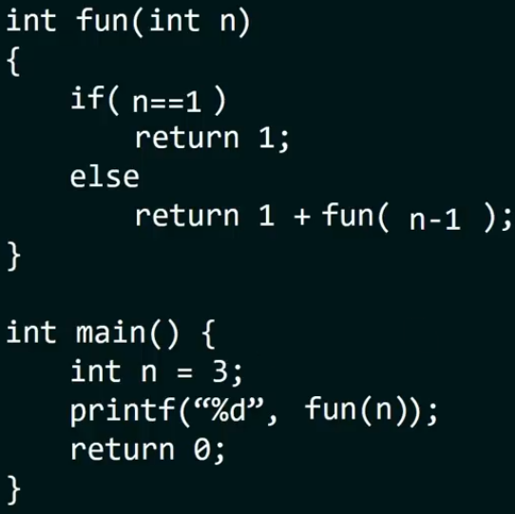
Recursion

Slide 9
Rules/Laws of Recursion
All recursive algorithms follow these three rules:
  A recursive algorithm must have a base case (stopping case).
  The algorithm must work towards the base case.
  A recursive algorithm must call itself, recursively.

Slide 10
Rules/Laws of Recursion
A recursion algorithm will always have a base case.
  The base case is nothing but the condition that helps initiate the process of returning to the original call function.
  It is also the condition because of which the algorithm is allowed to stop the recursion process.
  This process is also widely known as winding the stack.
  It is a crucial part of performing recursion in the stack data structure.

Slide 11
Rules/Laws of Recursion
To move toward the base case, the recursion algorithm must change its state.
  It is important that things be modified on subsequent calls so they can be moved closer to the base.
  Changing the state precisely means giving the algorithm modified data to use.
  In most cases, the data that indicates the problem gets smaller and smaller the closer it gets to the base.
  In algorithms like accumulate, where the primary data structure is a vector, focusing on state-changing efforts on the vector is very important.

Slide 12
Rules/Laws of Recursion
The recursive algorithm has to call itself.
  This is one of the properties of recursion that can be understood from the very definition of a recursive algorithm.
  The great thing about recursion is that it divides the big problem into smaller parts and then the programmer can solve each of them individually by writing a function for those smaller problems.
  However, when we have to solve a problem with functions, the function has to solve it by calling itself.

Slide 13
Recursion & Stack
Recursion in Computer Science is where a function calls itself.
When a function is called recursively an extra frame(layer) is added to the stack, with each subsequent frame being added on top.
Recursion will continue until the base case is reached, at which point the innermost call will return and the top frame removed from the stack.
When a method calls another method (even itself), an activation record is stored on the system stack.

Slide 14
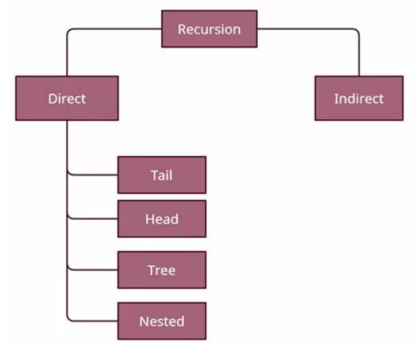
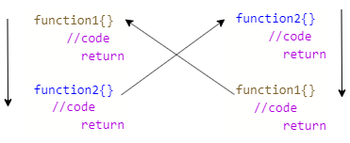
Types of Recursion

Slide 15
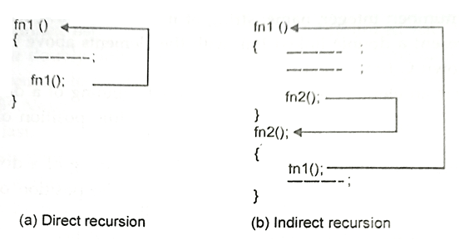
Types of Recursion

Slide 16
Types of Recursion
Direct Recursion
  Direct recursion occurs when a function calls itself, either directly or through a chain of function calls.
  In other words, a function directly references itself in its own definition.

Slide 17
Types of Recursion
Tail Recursion
  Tail recursion occurs when the recursive call is the last operation in a function.
  This allows for optimization in some programming languages where the compiler or interpreter can replace the recursion with an iterative loop.

Slide 18
Types of Recursion
Head Recursion
  Head recursion is the opposite of tail recursion. In head recursion, the recursive call is made before any other operation within the function.
Tree Recursion
  Tree recursion occurs when a function makes more than one recursive call within its body, typically forming a branching structure like a tree.

Slide 19
Types of Recursion
Nested Recursion
  Nested recursion occurs when a function calls itself, and that recursive call contains another call to itself.
Linear Recursion: Linear recursion is the simplest form of recursion, where a function calls itself only once in each recursive call.

Slide 20
Types of Recursion
Binary Recursion: Binary recursion involves a function calling itself twice. It's often used in problems that can be divided into two or more subproblems.
Multiple Recursion: Multiple recursion is a type of recursion where a function makes more than two recursive calls.

Slide 21
Types of Recursion
Indirect Recursion
  Indirect recursion occurs when multiple functions call each other in a circular manner.
  It is a sequence of function calls where one function indirectly calls another, which in turn may call the first function or other functions.
  Example in C (Indirect Recursion - Even and Odd Number Check):

Slide 22
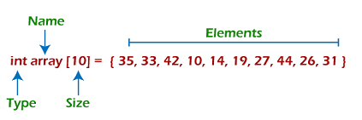
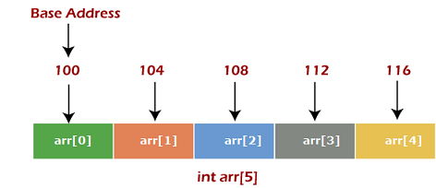
Linear Data Structures: Arrays
Arrays have constant-time access to elements by index but may have fixed sizes in some languages.

Slide 23
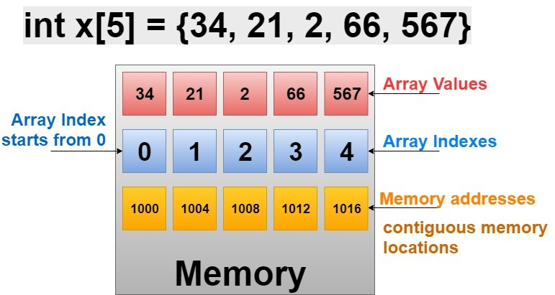
Linear Data Structures: Arrays
Arrays: An ordered collection of elements, where an index or a key identifies each element.

Slide 24
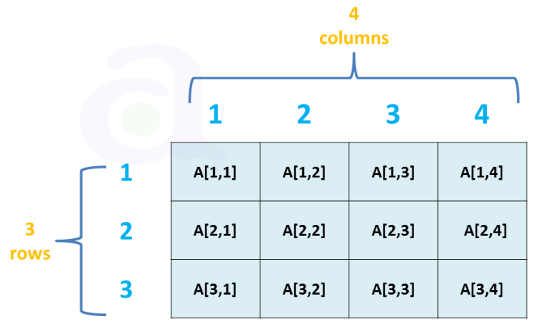
Linear Data Structures: Arrays
Two-dimensional Arrays

Slide 25
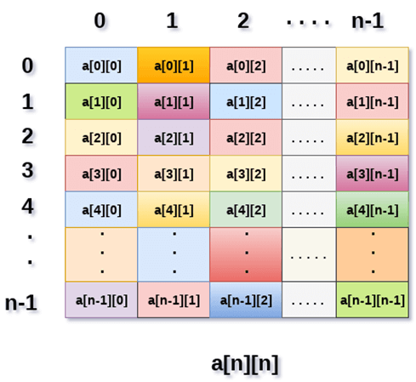
Linear Data Structures: Arrays
Two-dimensional Arrays

Slide 26
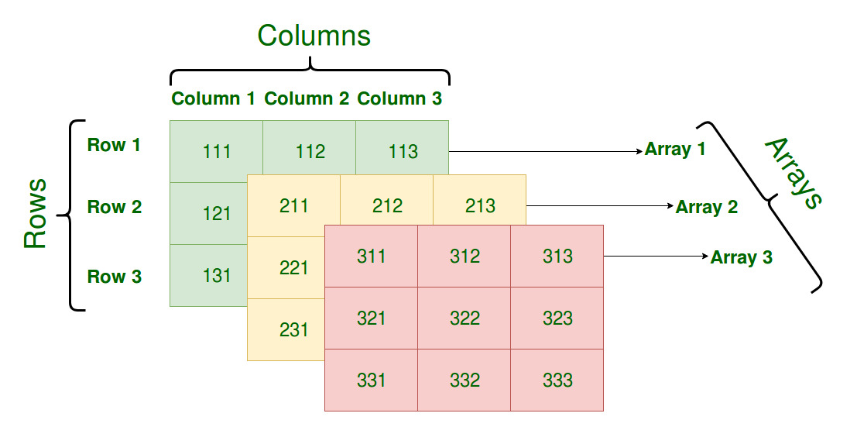
Linear Data Structures: Arrays
Multi-dimensional Arrays

Slide 27
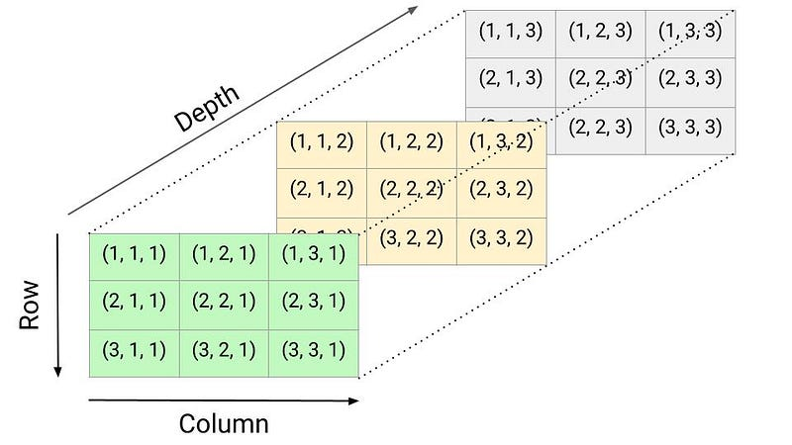
Linear Data Structures: Arrays
Multi-dimensional Arrays

Slide 28


