Slide 1

Data Structures & Algorithms
Week-04

Slide 2
Week-04 Agenda
Stacks
Queues

Slide 3
Stack
A Stack is a linear data structure that follows a particular order in which the operations are performed.
The order may be LIFO(Last In First Out) or FILO(First In Last Out).
LIFO implies that the element that is inserted last, comes out first and FILO means that the element that is inserted first, comes out last.

Slide 4
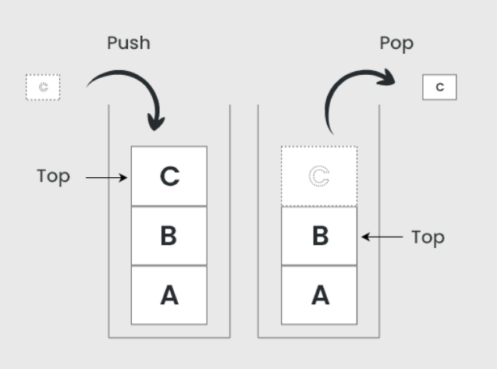
Stack

Slide 5
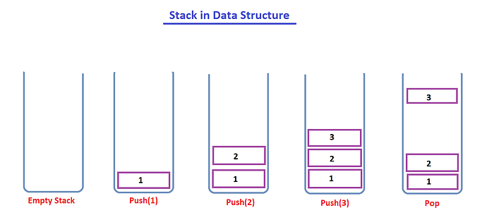
Stack

Slide 6
Implementation
Stacks can be implemented using:
  Arrays: Fixed size, easy to implement but limited in capacity.
  Linked Lists: Dynamic size, can grow as needed.

Slide 7
Operations
Push: Adds an element to the top of the stack.
Pop: Removes the top element from the stack.
Peek/Top: Returns the top element without removing it.
IsEmpty: Checks if the stack is empty.
Size: Returns the number of elements in the stack.

Slide 8
Complexity
Time Complexity:
  Push: O(1)
  Pop: O(1)
  Peek: O(1)
Space Complexity: O(n) where n is the number of elements in the stack.

Slide 9
Applications
Function call management (call stack).
Syntax parsing (e.g., in compilers).
Backtracking algorithms (e.g., maze solving).

Slide 10
Types
Static Stack: Implemented using arrays with a fixed size.
Dynamic Stack: Implemented using linked lists, allowing dynamic resizing.
Function Call Stack: Used in programming languages to manage function calls and local variables.

Slide 11
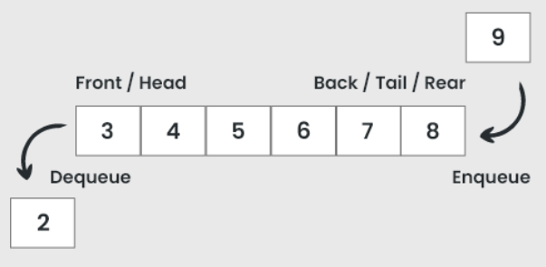
Queue
A queue is a linear data structure that follows the First In First Out (FIFO) principle.
This means that the first element added to the queue will be the first one to be removed.

Slide 12
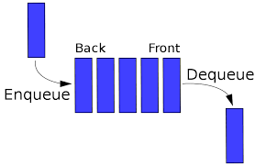
Operations
Enqueue: Adds an element to the back of the queue.
Dequeue: Removes the front element from the queue.
Front/Peek: Returns the front element without removing it.
IsEmpty: Checks if the queue is empty.
Size: Returns the number of elements in the queue.

Slide 13
Implementation
Queues can be implemented using:
  Arrays: Fixed size, easy to implement but can lead to inefficiency if not managed properly.
  Linked Lists: Dynamic size, more flexible.
  Circular Queues: Efficient use of space by wrapping around.

Slide 14
Types
Simple Queue: Standard FIFO queue.
Circular Queue: Connects the end of the queue back to the front to utilize space efficiently.
Priority Queue: Elements are dequeued based on priority rather than order.
Double-Ended Queue (Deque): Elements can be added or removed from both ends.

Slide 15
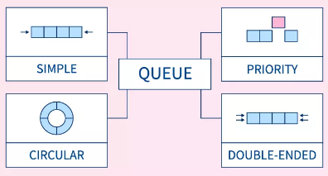
Types

Slide 16
Complexity
Time Complexity:
  Enqueue: O(1)
  Dequeue: O(1)
  Front: O(1)
Space Complexity: O(n) where n is the number of elements in the queue.

Slide 17
Simple Queue
In a simple queue, insertion takes place at the rear and removal occurs at the front.
It strictly follows the FIFO (First in First out) rule.

Slide 18
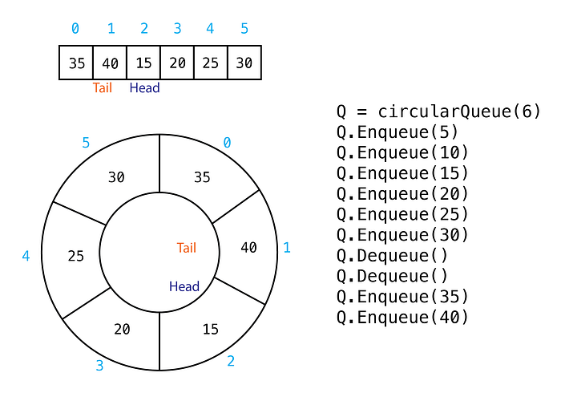
Circular Queue

Slide 19
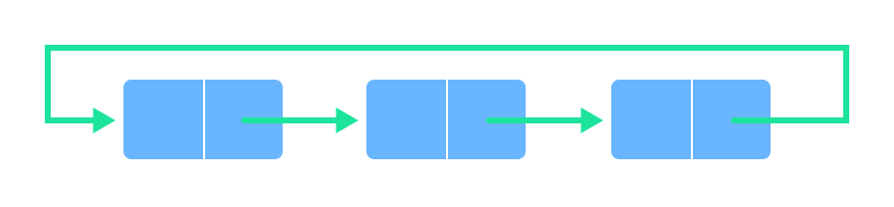
Circular Queue
In a circular queue, the last element points to the first element making a circular link.

Slide 20
Priority Queue
A priority queue is a special type of queue in which each element is associated with a priority and is served according to its priority.
If elements with the same priority occur, they are served according to their order in the queue.

Slide 21
Deque (Double Ended Queue)
In a double-ended queue, insertion and removal of elements can be performed either from the front or rear.
Thus, it does not follow the FIFO (First In First Out) rule.

Slide 22


