Slide 1

Data Structures & Algorithms
Week-05

Slide 2
Week-04 Agenda
Tree Data Structure

Slide 3
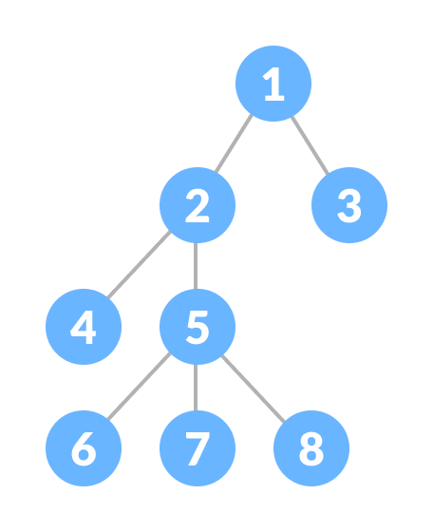
Hierarchical Data Structure
A Tree Data Structure:
A tree is a nonlinear hierarchical data structure that consists of nodes connected by edges.

Slide 4
Why Tree Data Structure?
Other data structures such as arrays, linked list, stack, and queue are linear data structures that store data sequentially.
In order to perform any operation in a linear data structure, the time complexity increases with the increase in the data size.
But, it is not acceptable in today's computational world.
Different tree data structures allow quicker and easier access to the data as it is a non-linear data structure.

Slide 5
Tree Terminologies
Node
A node is an entity that contains a key or value and pointers to its child nodes.
The last nodes of each path are called leaf nodes or external nodes that do not contain a link/pointer to child nodes.
The node having at least a child node is called an internal node.

Slide 6
Tree Terminologies
Edge
It is the link between any two nodes.

Slide 7
Tree Terminologies
Root
It is the topmost node of a tree.
Height of a Node
The height of a node is the number of edges from the node to the deepest leaf (ie. the longest path from the node to a leaf node).
Depth of a Node
The depth of a node is the number of edges from the root to the node.

Slide 8
Tree Terminologies
Height of a Tree
The height of a Tree is the height of the root node or the depth of the deepest node.
Degree of a Node
The degree of a node is the total number of branches of that node.

Slide 9
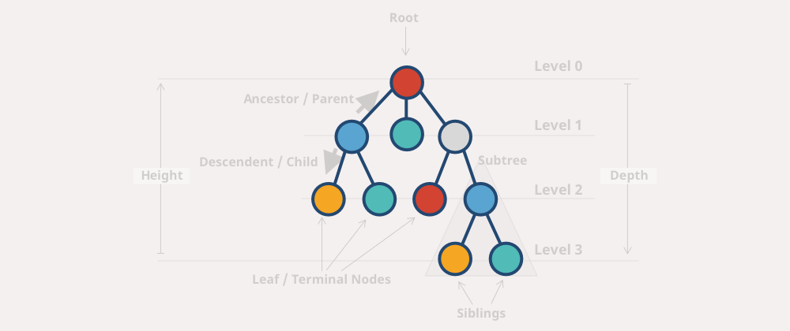
Tree Terminologies

Slide 10
Types of Tree
Binary Tree
Binary Search Tree
AVL Tree
B-Tree

Slide 11
Binary Tree
At most 2 children per node.
Can be empty (no nodes).
Can be filled or unfilled.
Representation
  Array Representation: Suitable for complete binary trees. The root is at index 0, left child at index 2*i + 1, and right child at 2*i + 2.
  Linked Representation: Each node is an object with properties for value and pointers to left and right children.

Slide 12
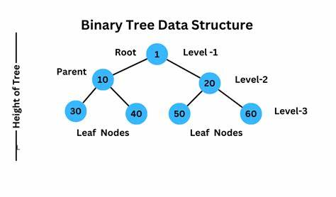
Binary Tree

Slide 13
Binary Tree
Traversal Methods
  Inorder (Left, Root, Right): Visit left subtree, root, right subtree.
  Preorder (Root, Left, Right): Visit root, left subtree, right subtree.
  Postorder (Left, Right, Root): Visit left subtree, right subtree, root.

Slide 14
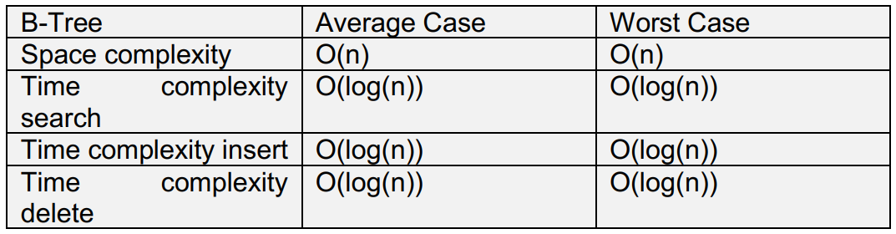
Binary Tree

Slide 15
Binary Search Trees
Efficient for searching, inserting, and deleting nodes.
Maintains sorted order.
Operations
  Insertion: Start at the root; if the value is less, go left; if greater, go right.
  Searching: Similar to insertion; traverse the tree based on the value.
  Deletion:
    If the node is a leaf, remove it.
    If it has one child, connect the parent to the child.
    If it has two children, find the in-order successor, replace the value, and delete the successor.

Slide 16
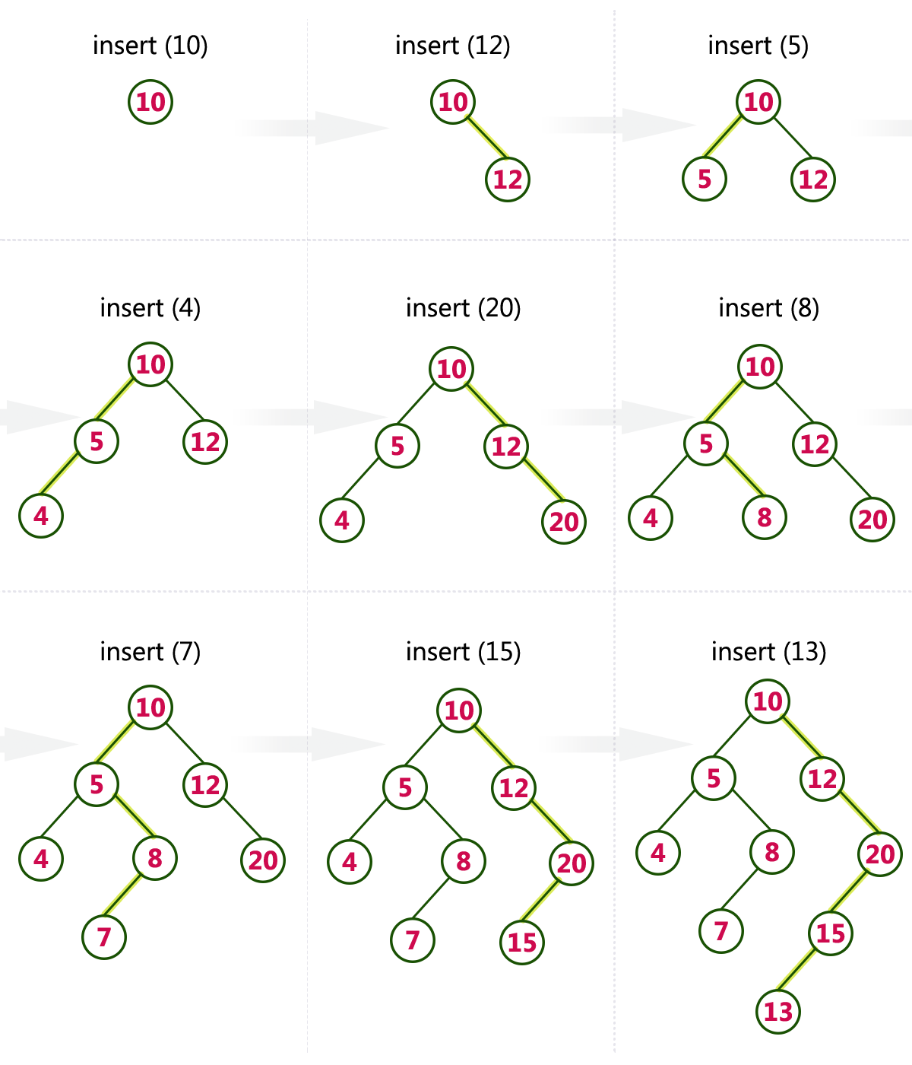
Binary Search Trees

Slide 17
AVL Trees
An AVL Tree is a self-balancing binary search tree where the difference in heights between the left and right subtrees (balance factor) is at most 1 for all nodes.
Balance Factor
Balance Factor (BF) = Height of left subtree - Height of right subtree
BF can be -1, 0, or 1 for a balanced AVL tree.
Rotations
  To maintain balance during insertion and deletion, AVL trees perform rotations:
  Right Rotation: Used when a left-left case occurs.
  Left Rotation: Used when a right-right case occurs.
  Left-Right Rotation: Used when a left-right case occurs.
  Right-Left Rotation: Used when a right-left case occurs.

Slide 18
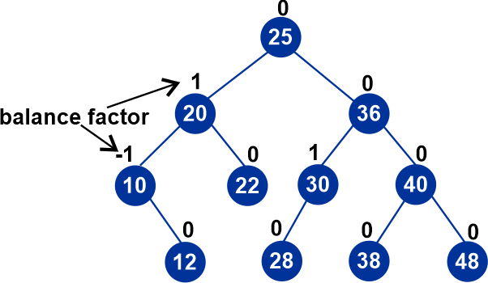
AVL Trees

Slide 19
AVL Trees
Insertion and Deletion
  Insert the node as in a BST.
  Update the heights and balance factors of nodes.
  Perform rotations if necessary to maintain balance.

Slide 20


