Slide 1

Data Structures & Algorithms
Week-06

Slide 2
Week-06 Agenda
Heap & Priority Queue

Slide 3
Heap - Definition
A Heap is a specialized binary tree-based data structure.
It satisfies the Heap Property:
  Max-Heap Property: For any given node, the value of the parent node is greater than or equal to the values of its children. The root node contains the largest value.
  Min-Heap Property: For any given node, the value of the parent node is less than or equal to the values of its children. The root node contains the smallest value.
It is a complete binary tree, meaning all levels are fully filled except possibly the last, which is filled from left to right.

Slide 4
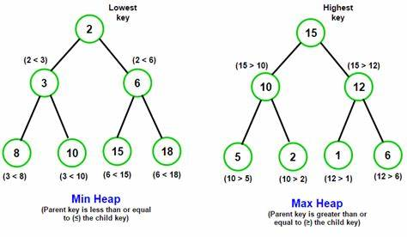
Types of Heap
A heap is a tree-based data structure where the tree is a complete binary tree that maintains the property that either the children of a node are less than itself (max heap) or the children are greater than the node (min-heap).

Slide 5
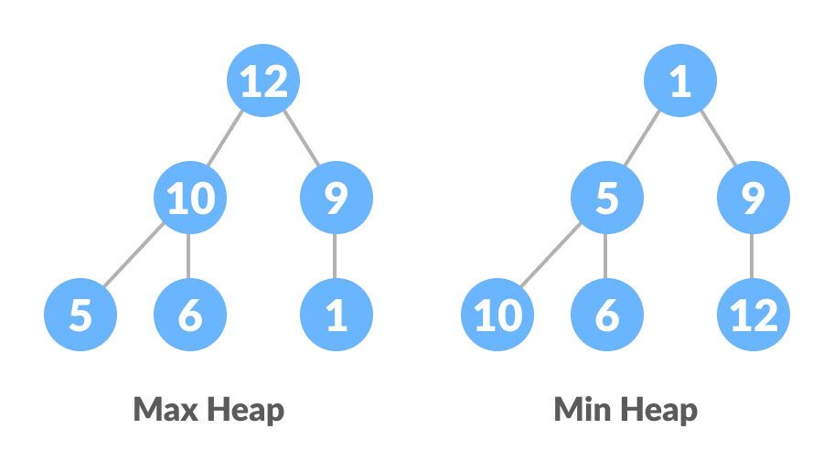
Types of Heap

Slide 6
Heap Operations
Insert
  Insert a new node at the end of the heap.
  Restore heap property by “bubbling up” or “percolating up.”
Delete (Extract Max/Min)
  Remove the root node (max for Max-Heap, min for Min-Heap).
  Replace the root with the last element and restore the heap property by “bubbling down” or “percolating down.”
Peek
  Returns the root element without removing it (i.e., the maximum element in a Max-Heap or minimum in a Min-Heap).

Slide 7
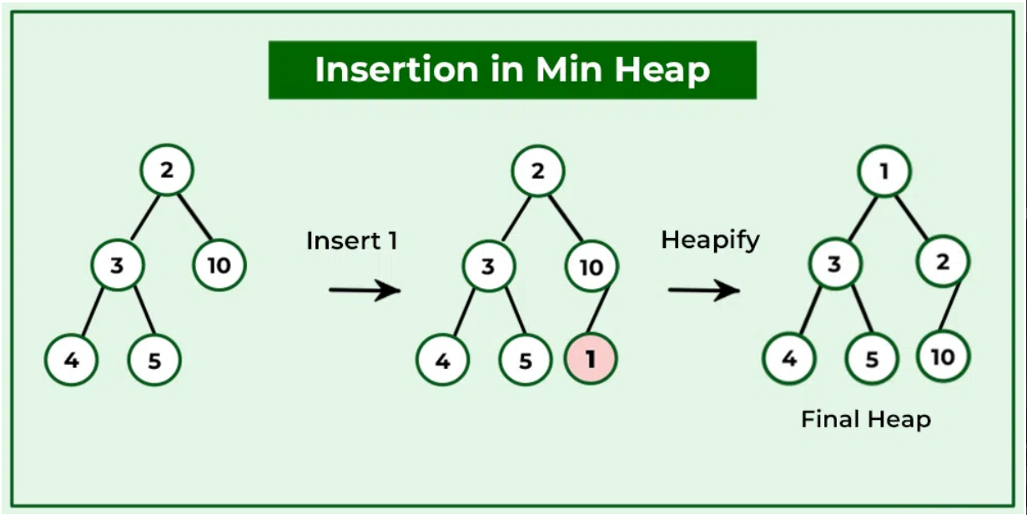
Min Heap - Insertion

Slide 8
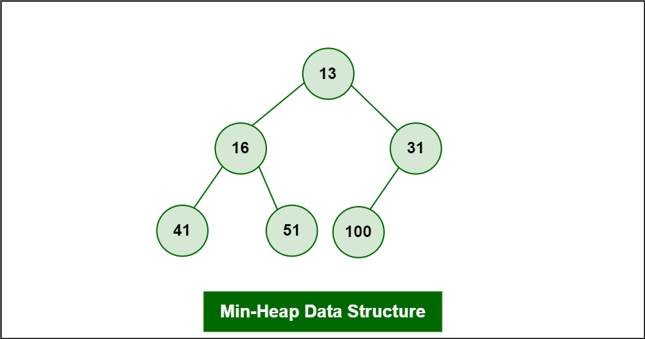
Min Heap - Deletion
Delete Root: 13

Slide 9
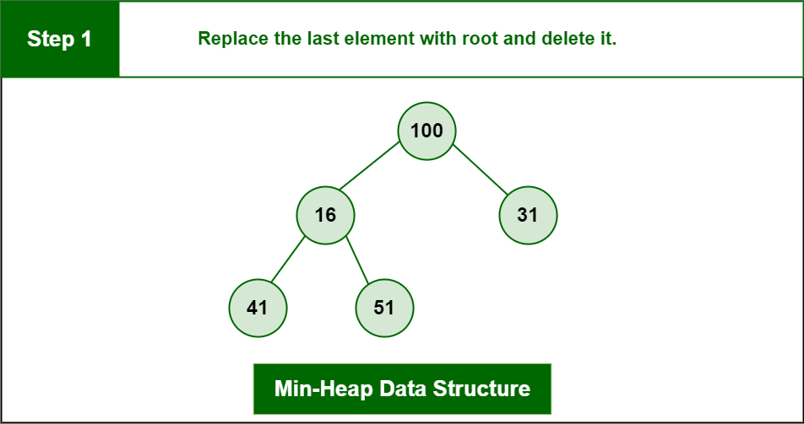
Min Heap - Deletion
Delete Root: 13

Slide 10
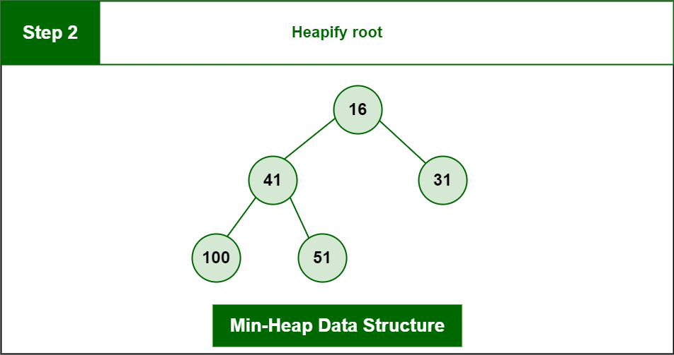
Min Heap - Deletion
Delete Root: 13

Slide 11
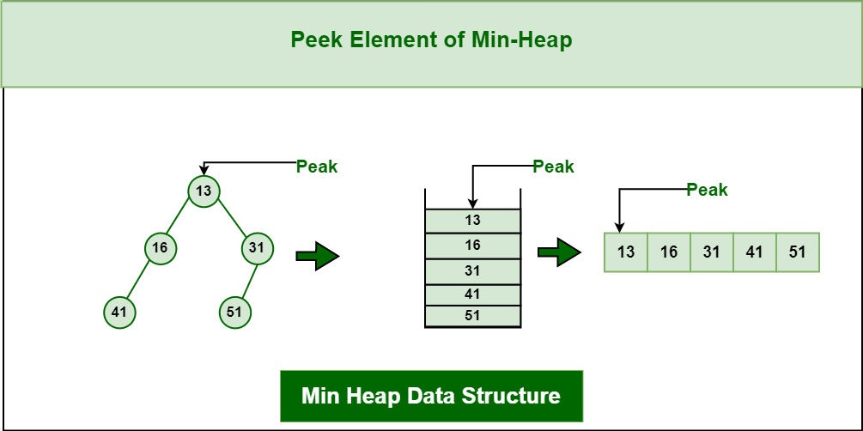
Min Heap - Peek

Slide 12
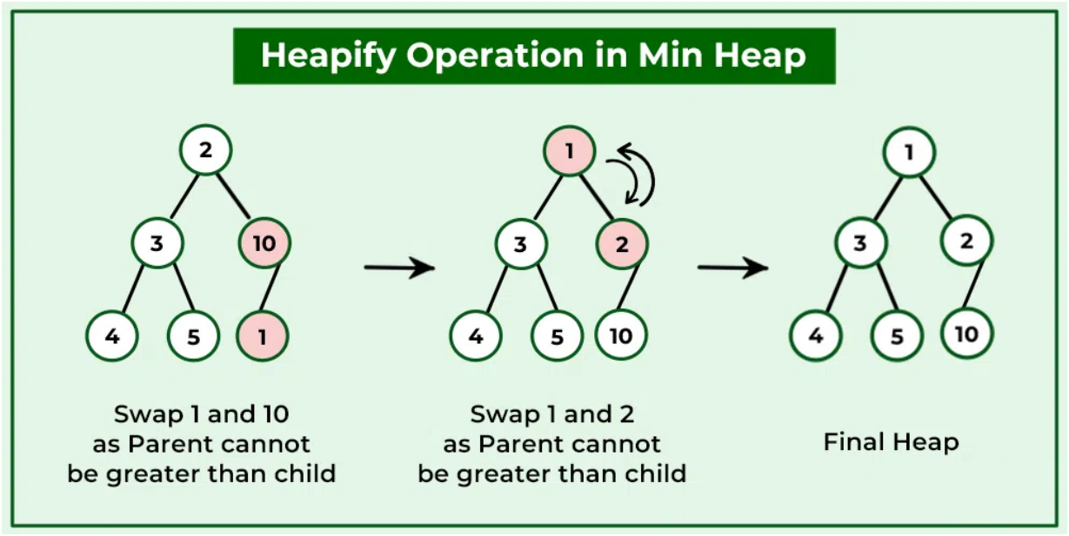
Min Heap - Heapify

Slide 13
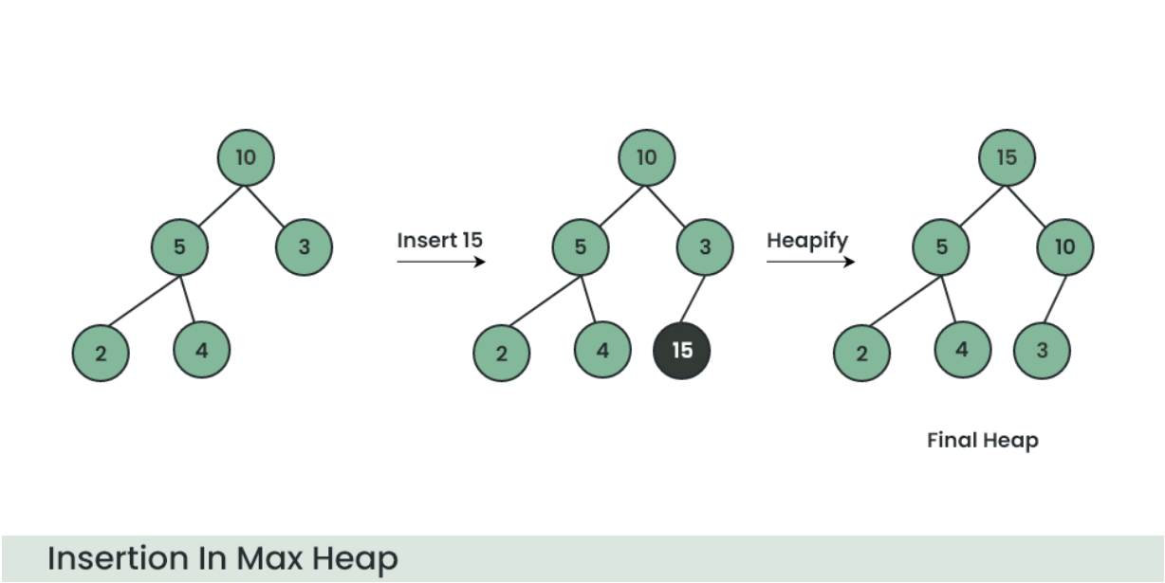
Max Heap - Insertion
Insert 15:

Slide 14
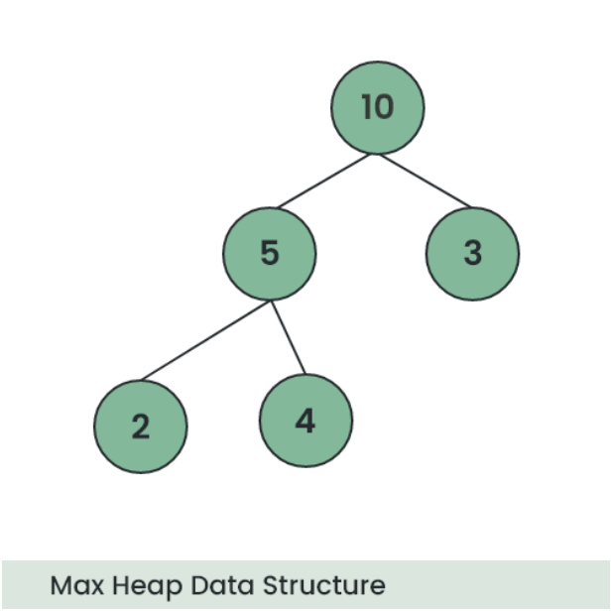
Max Heap - Deletion
Delete 10

Slide 15
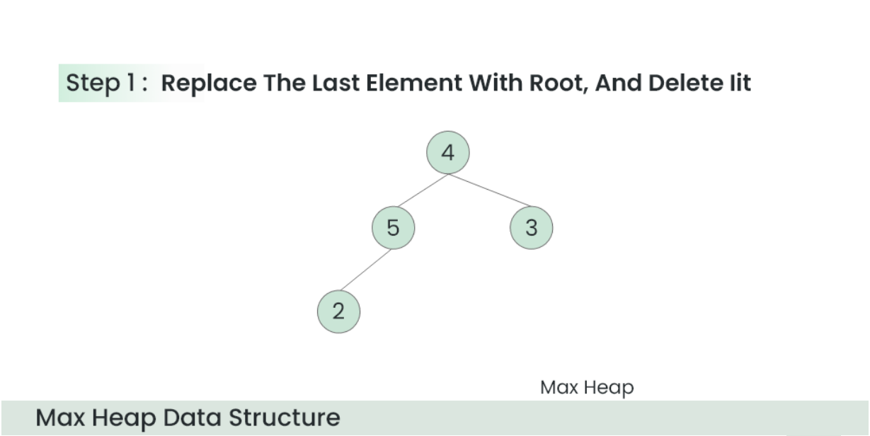
Max Heap - Deletion

Slide 16
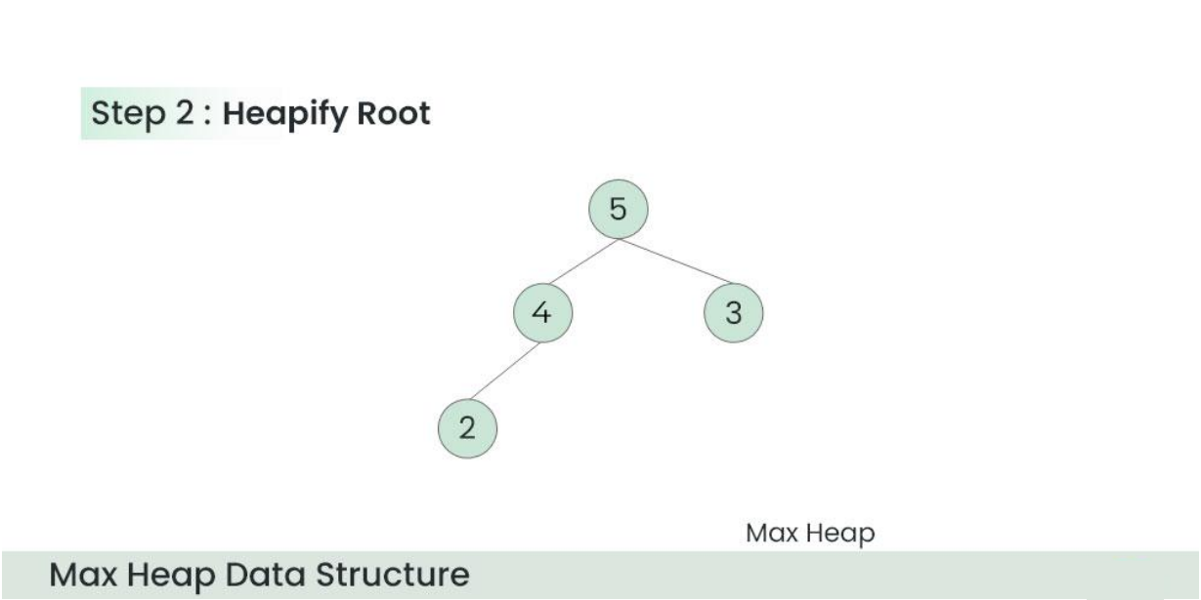
Max Heap - Deletion

Slide 17
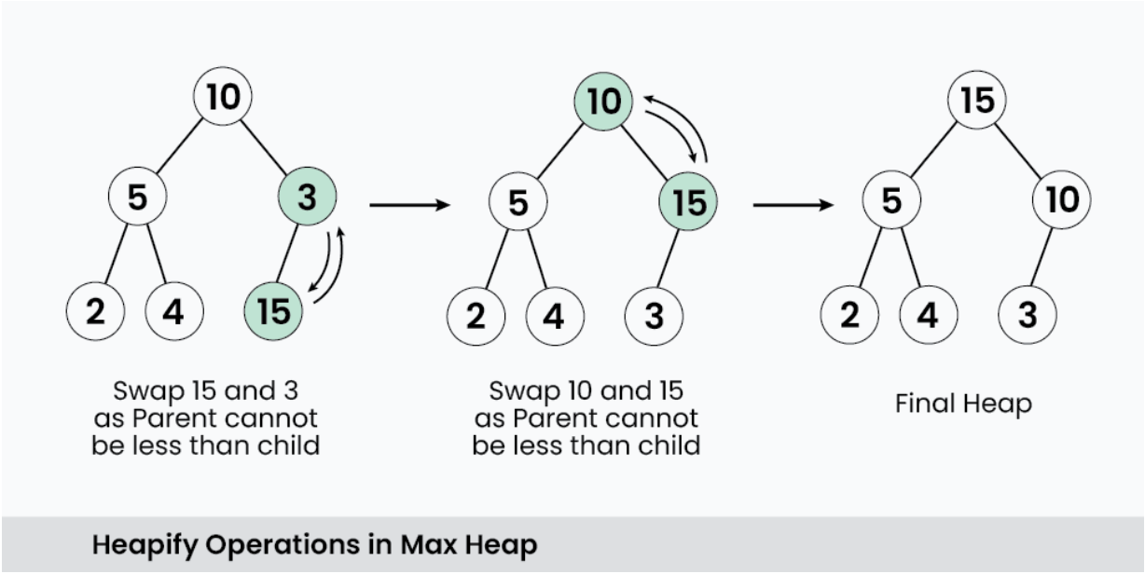
Max Heap - Heapify

Slide 18
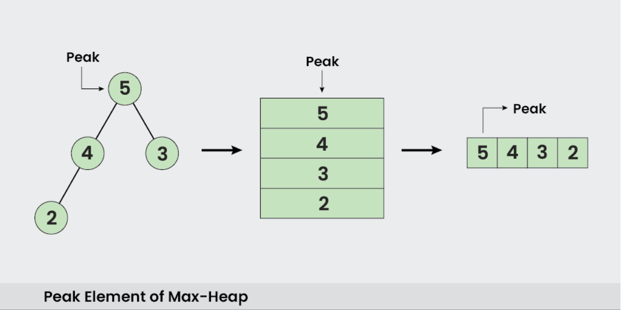
Max Heap - Peek

Slide 19
Heap Construction
Heapify: Process of converting a binary tree into a heap by adjusting the tree from the bottom-up.
Time Complexity:
  Inserting a node: O(log n)
  Deleting the root (Extract Max/Min): O(log n)
  Building a heap from an unsorted array: O(n)

Slide 20


