Slide 1
San Diego Audio Hackers
Spectrograms Explained
July 10, 2016
Nick Hilton

Slide 2
Outline
Time domain signals
Frequency domain
Heisenberg uncertainty principle
Spectrograms
How to make spectrograms

Slide 3
Outline
Time domain signals
Frequency domain
Heisenberg uncertainty principle
Spectrograms
How to make spectrograms

Slide 4
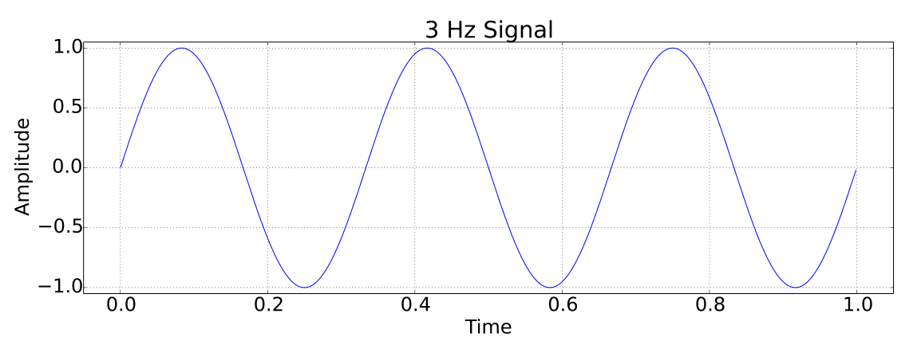
Time domain signals
List of values
  {time, amplitude}, {time, amplitude}, ...

Slide 5
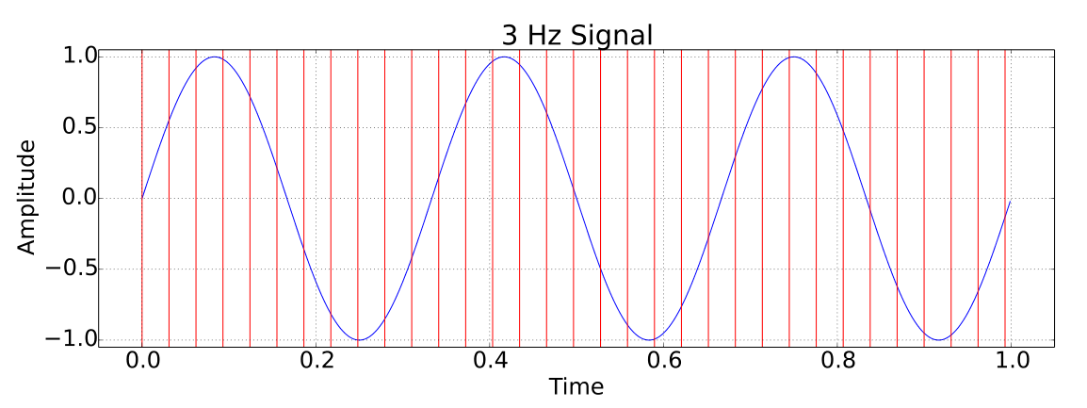
Time domain signals
List of values
  {time, amplitude}, {time, amplitude}, ...

Slide 6
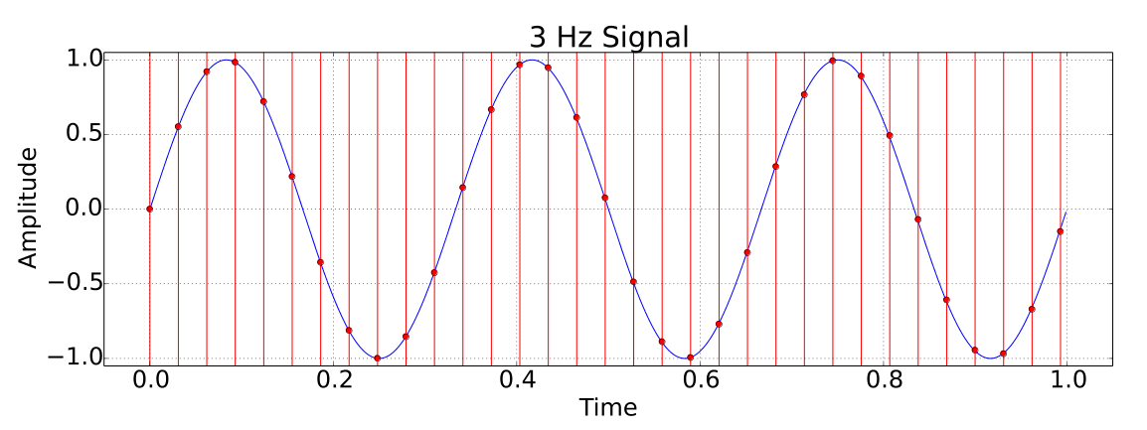
Time domain signals
List of values
  {time, amplitude}, {time, amplitude}, ...

Slide 7
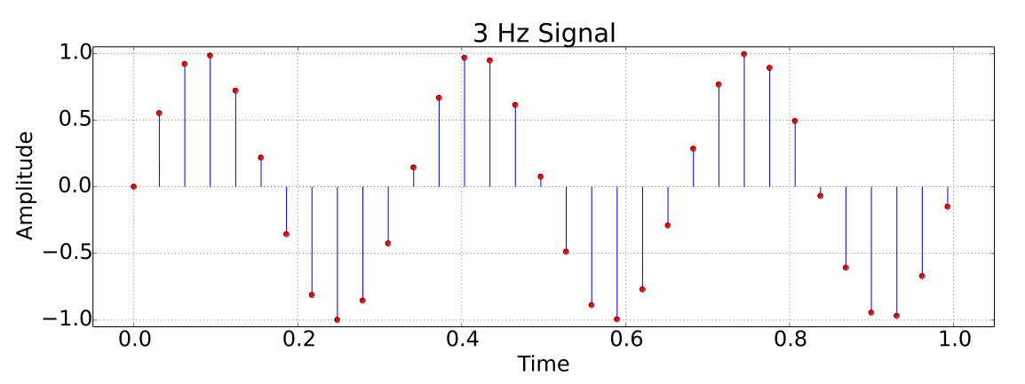
Time domain signals
List of values
  {time, amplitude}, {time, amplitude}, ...

Slide 8
Outline
Time domain signals
Frequency domain
Heisenberg uncertainty principle
Spectrograms
How to make spectrograms

Slide 9
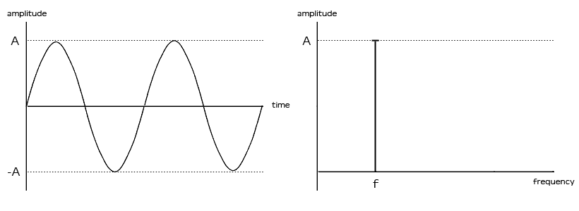
Frequency domain signals
List of values
  {frequency, amplitude}, {frequency, amplitude} ...

Slide 10
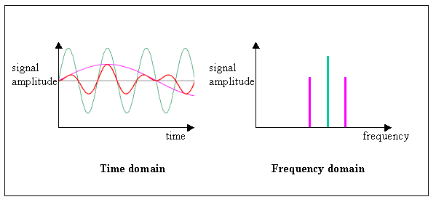
Frequency domain signals
List of values
  {frequency, amplitude}, {frequency, amplitude} ...

Slide 11
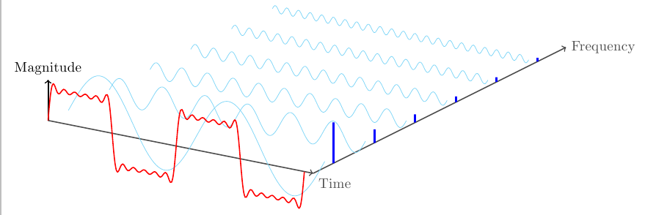
Frequency domain signals
List of values
  {frequency, amplitude}, {frequency, amplitude} ...

