Slide 1
San Diego Audio Hackers
Spectrograms Explained
July 10, 2016
Nick Hilton

Slide 2
Outline
Time domain signals
Frequency domain
How to make spectrograms
Heisenberg uncertainty principle
Spectrograms

Slide 3
Outline
Time domain signals
Frequency domain
How to make spectrograms
Heisenberg uncertainty principle
Spectrograms

Slide 4
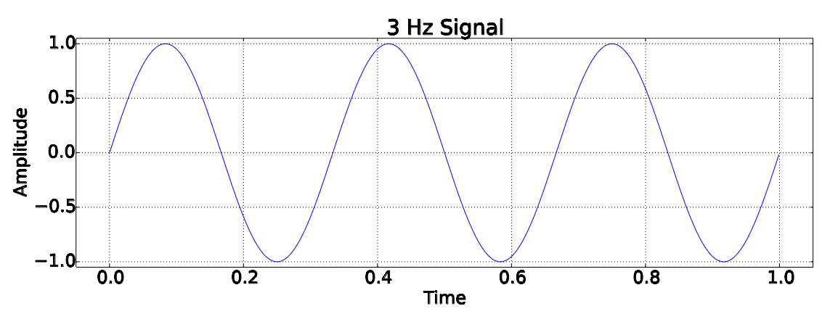
Time domain signals
List of values
  {time, amplitude}, {time, amplitude}, ...

Slide 5
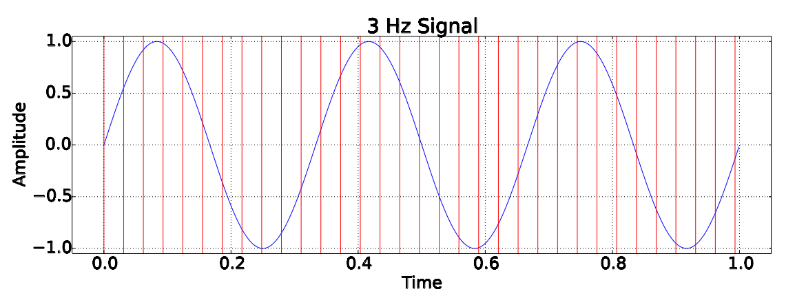
Time domain signals
List of values
  {time, amplitude}, {time, amplitude}, ...

Slide 6
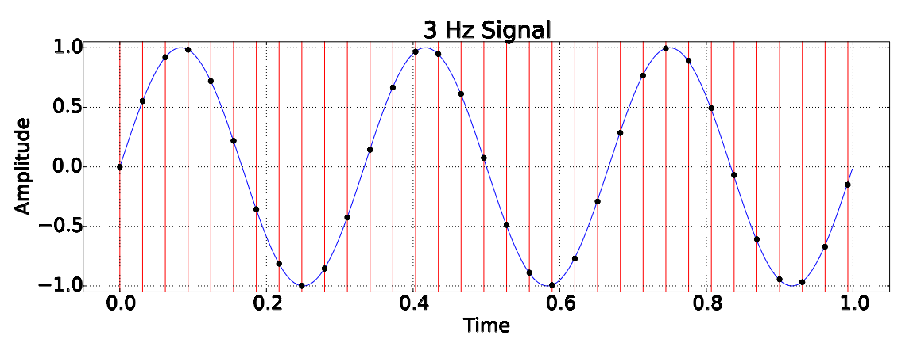
Time domain signals
List of values
  {time, amplitude}, {time, amplitude}, ...

Slide 7
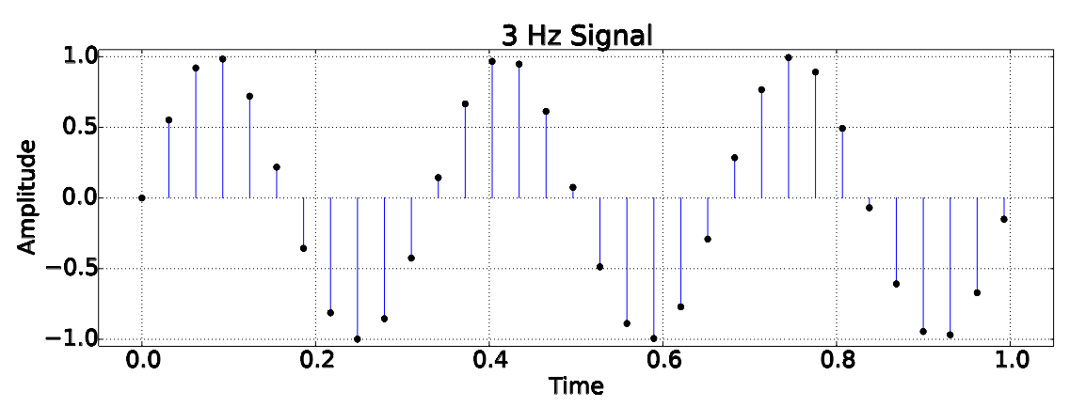
Time domain signals
List of values
  {time, amplitude}, {time, amplitude}, ...

Slide 8
Outline
Time domain signals
Frequency domain
How to make spectrograms
Heisenberg uncertainty principle
Spectrograms

Slide 9
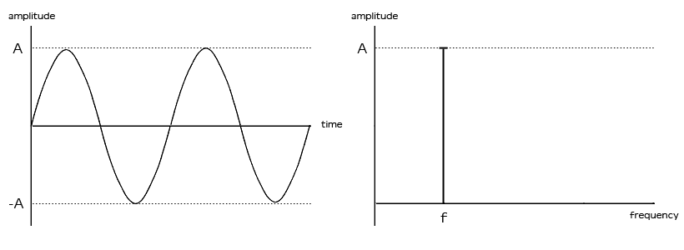
Frequency domain signals
List of values
  {frequency, amplitude}, {frequency, amplitude} ...

Slide 10
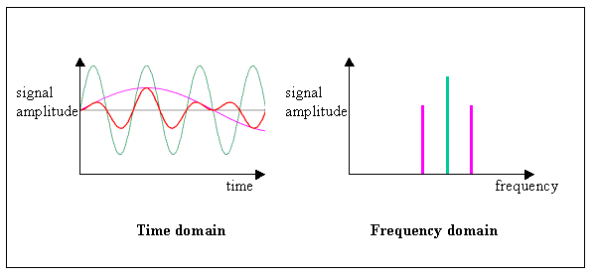
Frequency domain signals
List of values
  {frequency, amplitude}, {frequency, amplitude} ...

Slide 11
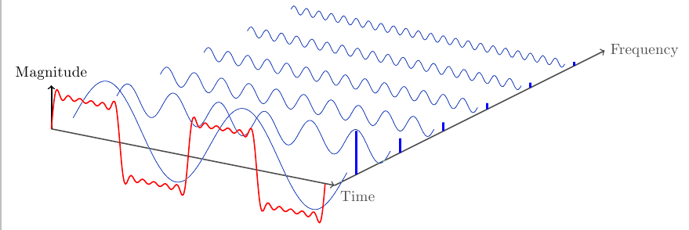
Frequency domain signals
List of values
  {frequency, amplitude}, {frequency, amplitude} ...

Slide 12
Outline
Time domain signals
Frequency domain
How to make spectrograms
Heisenberg uncertainty principle
Spectrograms

Slide 13
How to make spectrograms
Recipe
  Break up input signal into frames
  Apply a window to remove step function at edge
  Transform frame into frequency domain via FFT
  Place frequency domain frame into spectrogram matrix

Slide 14
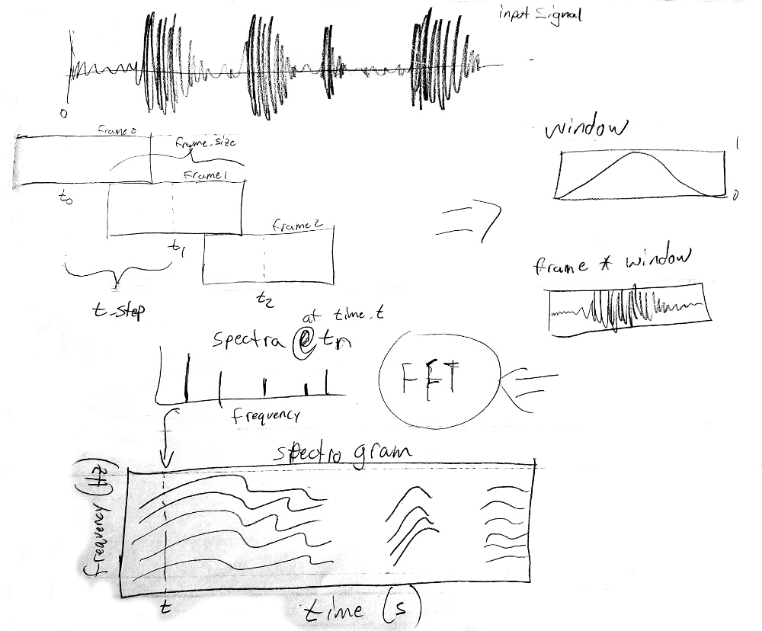
1
2
3
4

Slide 15
Outline
Time domain signals
Frequency domain
How to make spectrograms
Heisenberg uncertainty principle
Spectrograms

Slide 16
The Heisenberg uncertainty principle
Formula
Meaning for signal processing
  You can't know frequency & time precisely simultaneously

Slide 17
The Heisenberg uncertainty principle
When is the signal 3 Hz?

Slide 18
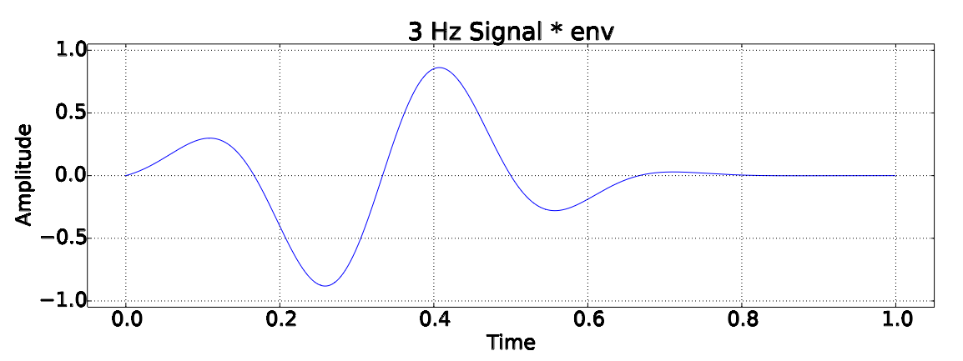
The Heisenberg uncertainty principle
When is the signal 3 Hz?

Slide 19
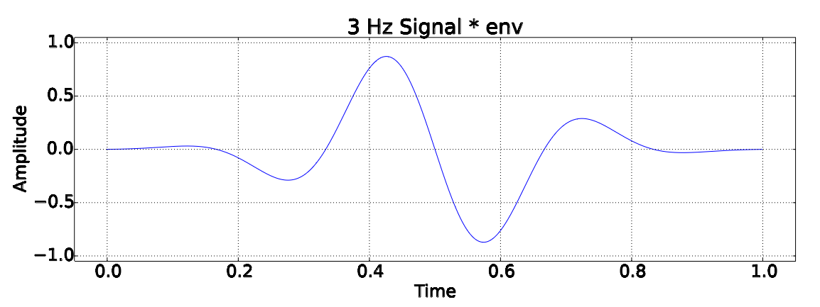
The Heisenberg uncertainty principle
When is the signal 3 Hz?

Slide 20
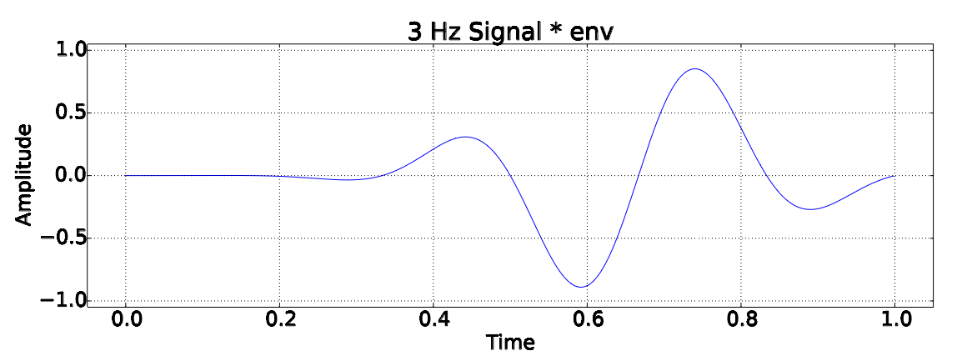
The Heisenberg uncertainty principle
When is the signal 3 Hz?

Slide 21
The Heisenberg uncertainty principle
We must process a finite duration of the signal
  So we reduce the amount memory used
  But more importantly, so we can know approximately when the signal contains which frequencies

Slide 22
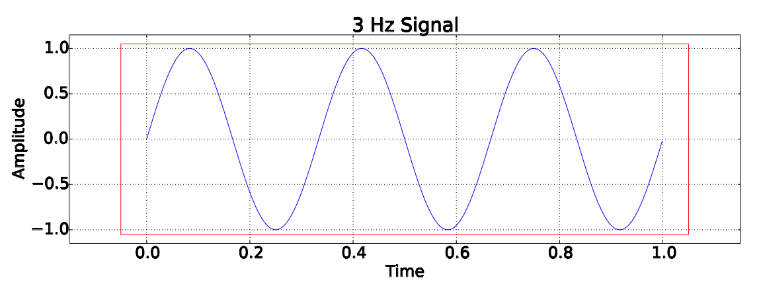
The Heisenberg uncertainty principle
Choosing a finite “window”
  Limits the minimal observable frequency

Slide 23
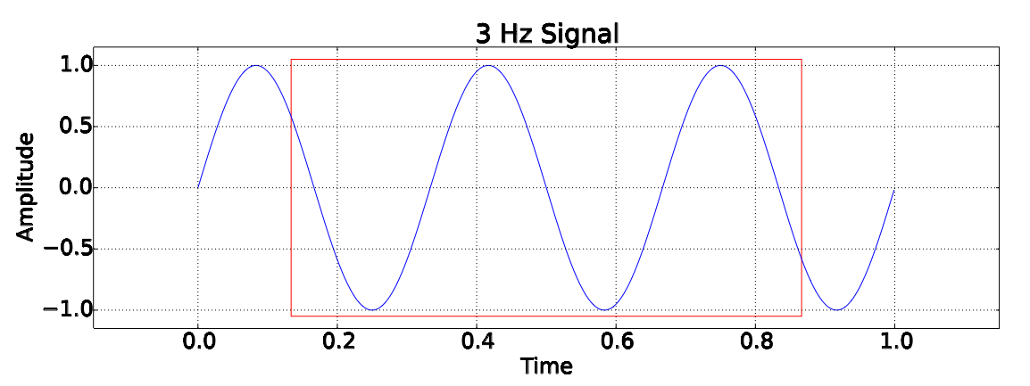
The Heisenberg uncertainty principle
Choosing a finite “window”
  Limits the minimal observable frequency

Slide 24
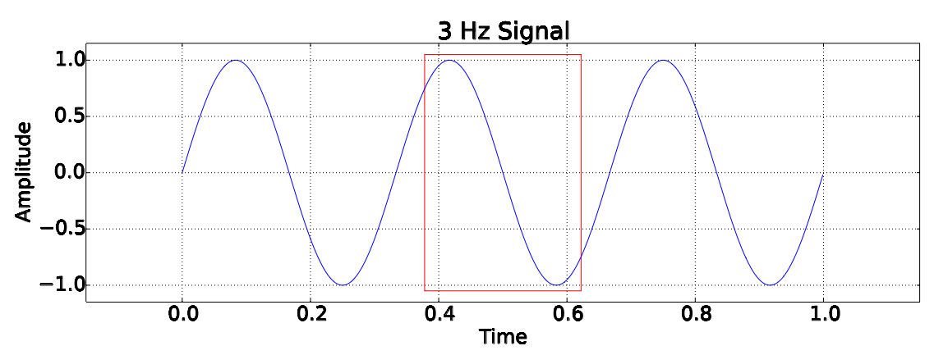
The Heisenberg uncertainty principle
Choosing a finite “window”
  Limits the minimal observable frequency

Slide 25
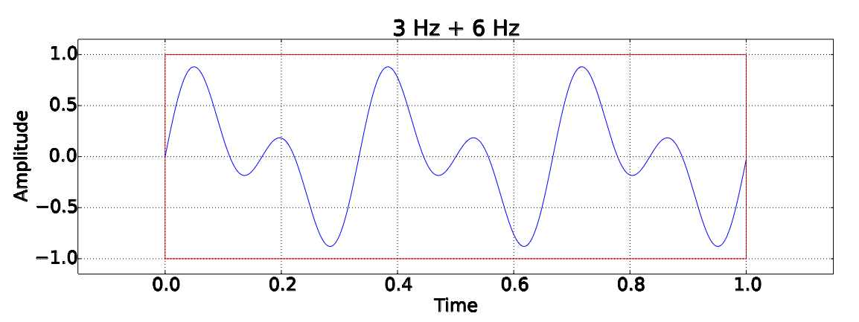
The Heisenberg uncertainty principle
Choosing a finite “window”
  Limits if two tones can be resolved

Slide 26
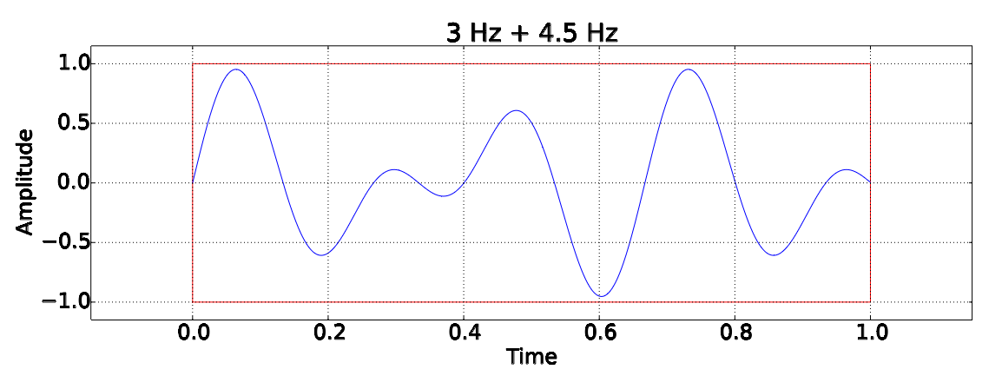
The Heisenberg uncertainty principle
Choosing a finite “window”
  Limits if two tones can be resolved

Slide 27
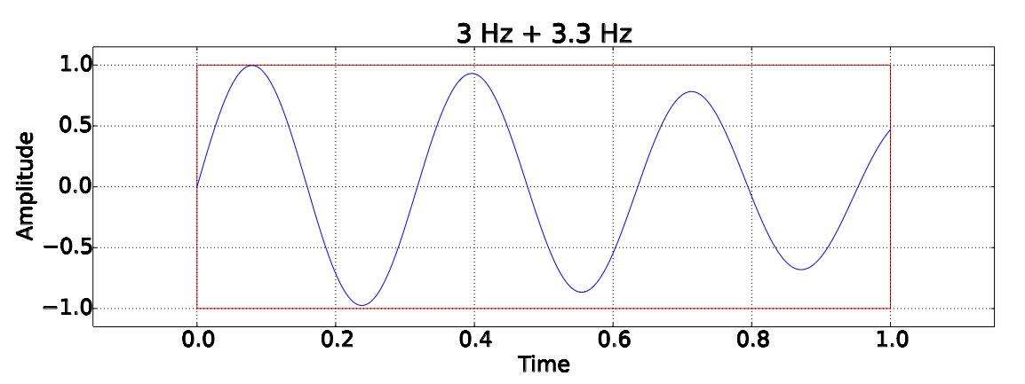
The Heisenberg uncertainty principle
Choosing a finite “window”
  Limits if two tones can be resolved

Slide 28
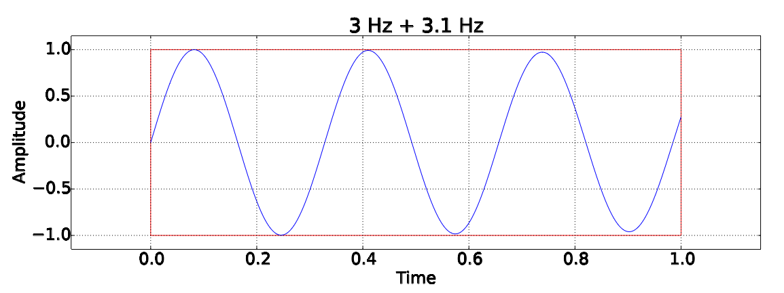
The Heisenberg uncertainty principle
Choosing a finite “window”
  Limits if two tones can be resolved

Slide 29
The Heisenberg uncertainty principle
A trade off must be made
  Time resolution
  Frequency resolution
  You can't have both!

Slide 30
Outline
Time domain signals
Frequency domain
How to make spectrograms
Heisenberg uncertainty principle
Spectrograms

Slide 31
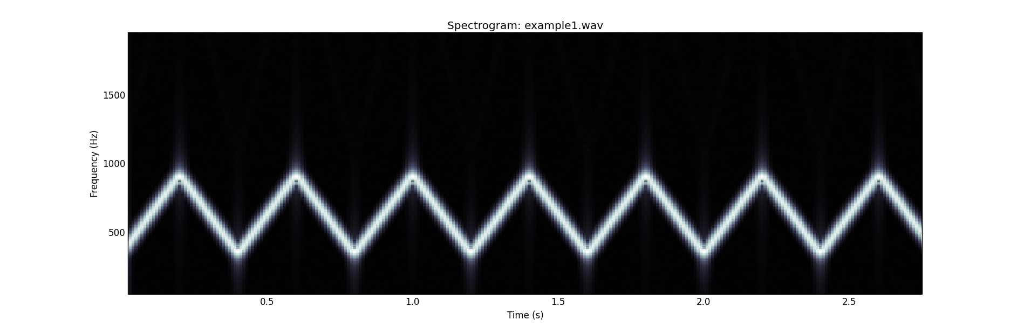
Spectrograms

Slide 32
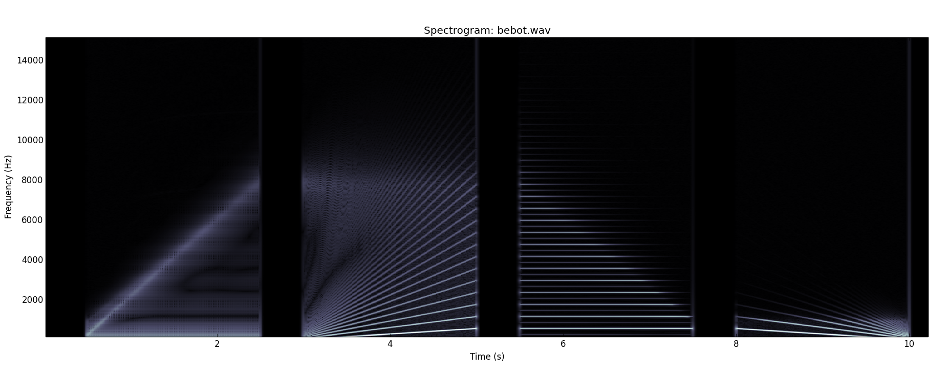
Spectrograms

Slide 33
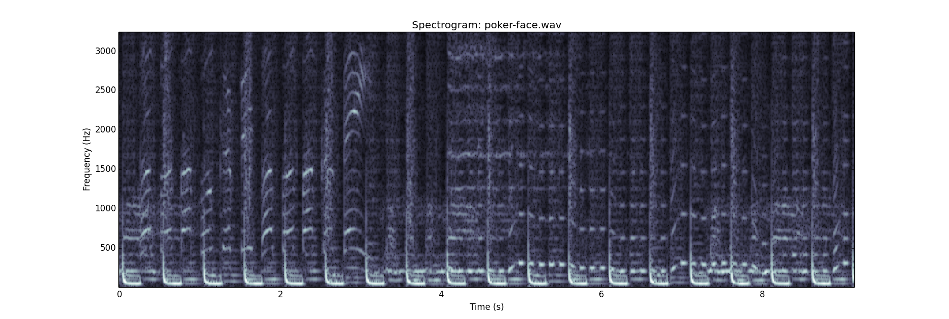
Spectrograms

Slide 34
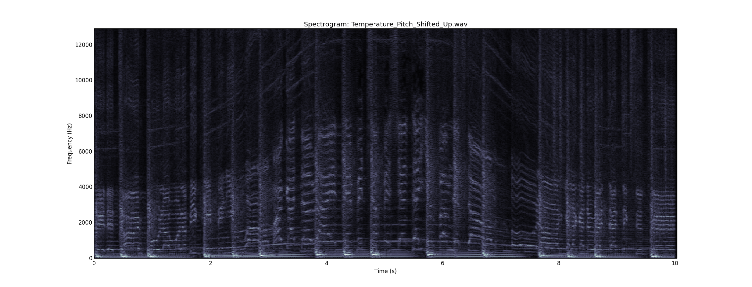
Spectrograms

Slide 35
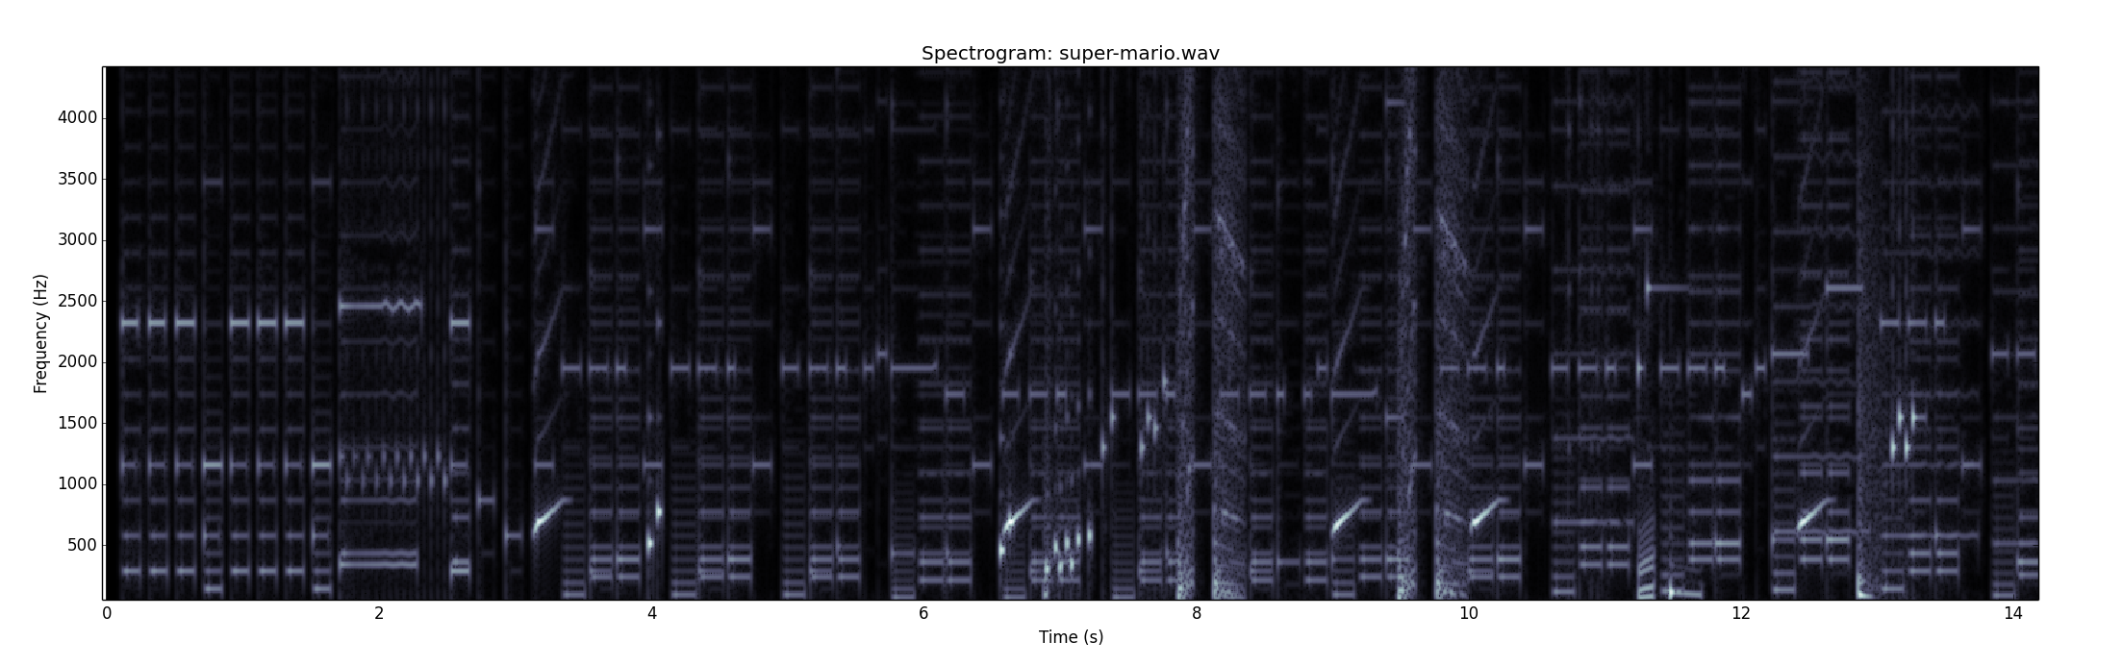
Spectrograms

