Slide 1
Polypharmacology:
Multitarget Drug Design
Presentation by Leonie Henschel, Olivier Morelle and Colin Birkenbihl
12. December 2017

Slide 2
Content
Introduction
  polypharmacology
  target selection
De novo multitarget drug design
  structure-based
  ligand-based
Virtual screening
  pharmacophore-based
  docking-based

Slide 3
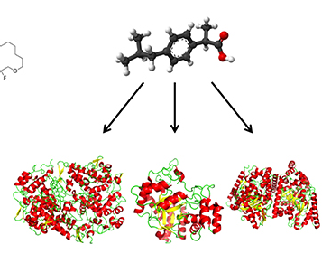
Definition polypharmacology
“Polypharmacology is the design or use of pharmaceutical agents that act on multiple targets or disease pathways.”
                - NCBI MeSH
(1)

Slide 4
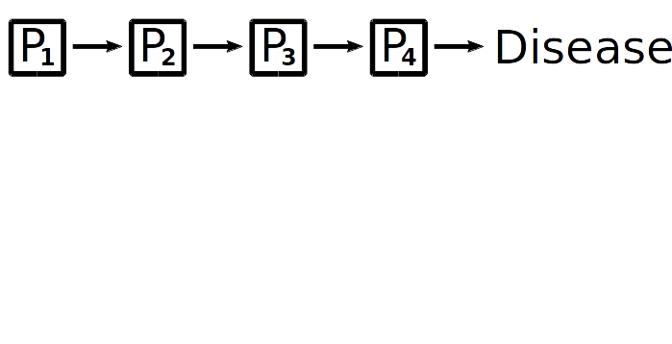
Pathway example
Notes:
Example:
Assume pathway

Slide 5
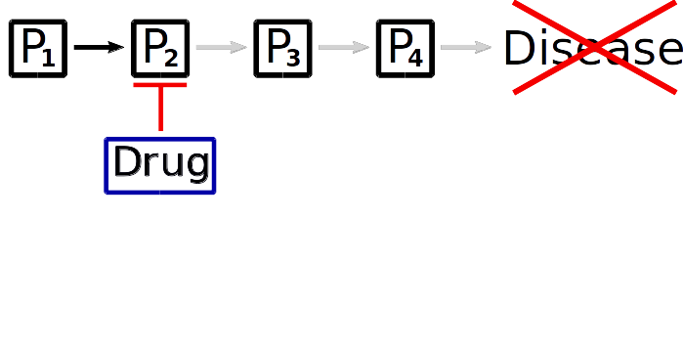
Pathway example: Single target drug
Inhibit target using a drug → prevent disease state

Slide 6
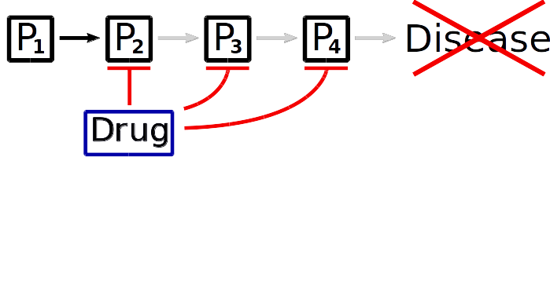
Pathway example: Multitarget drug
Higher binding probability → increased efficacy

Slide 7
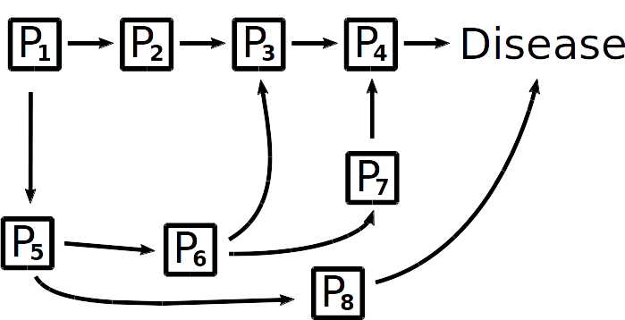
Network example

Slide 8
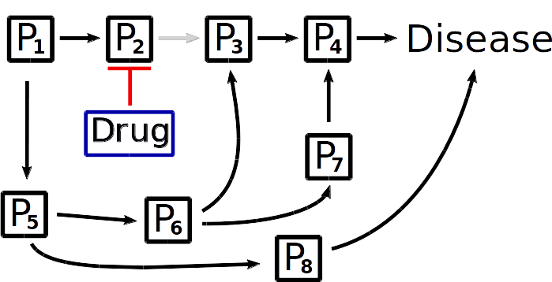
Network example: Single target drug

Slide 9
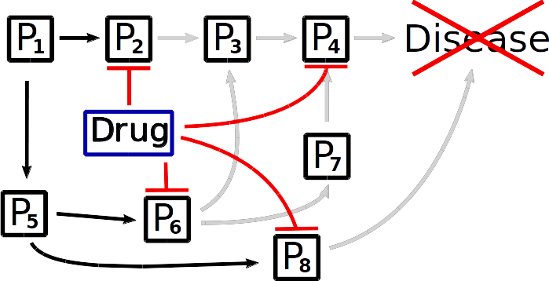
Network example: Multitarget drug
Notes:
Last time we saw examples for such biological processes (beta-blockers and so on)

Slide 10
Motivation for polypharmacology
Better efficacy
  for severe diseases treatment success is crucial
  → side effect play minor role
Less drugs to take → no drug interference
Circumvent drug resistance

Slide 11
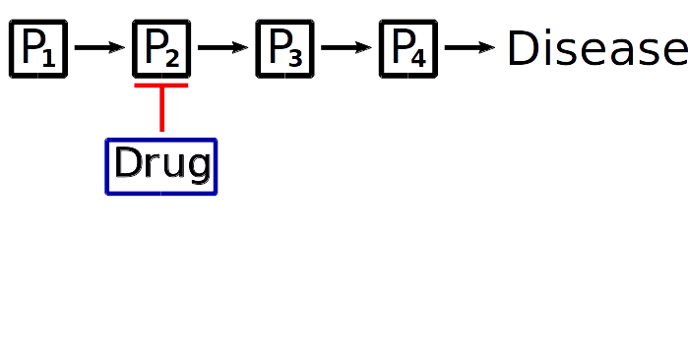
Motivation for polypharmacology
Better efficacy
  for severe diseases treatment success is crucial
  → side effect play minor role
Less drugs to take → no drug interference
Circumvent drug resistance

Slide 12
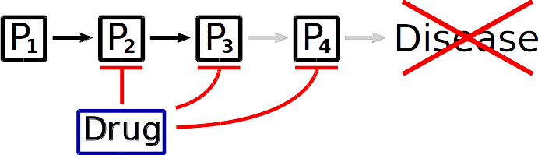
Motivation for polypharmacology
Better efficacy
  for severe diseases treatment success is crucial
  → side effect play minor role
Less drugs to take → no drug interference
Circumvent drug resistance

Slide 13
Multitarget drug design workflow
Step 1: Target Selection
  network analysis
  high throughput screening
  similartiy assessment

Slide 14
Target combination selection
Key aspect: identify a feasible target combination
  number of targets
  similarity of the targets
Chemically tractable targets
  binding site prediction/detection
  select targets with similar binding sites

Slide 15
Target combination selection
Systematic High throughput screening
Network analysis
  disease networks
  consider dynamics and topology
  simulate disease state (treatment success)
  algorithms to detect multiple targets in networks

Slide 16
Network: Target selection

Slide 17
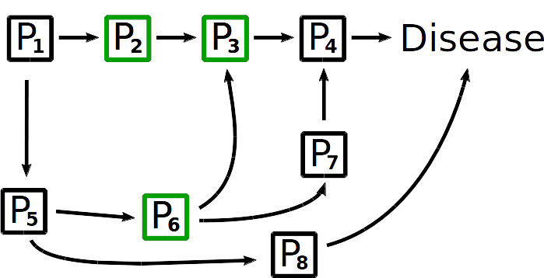
Network: Target selection

Slide 18
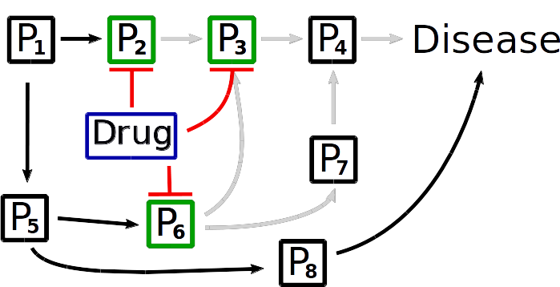
Network: State simulation

Slide 19
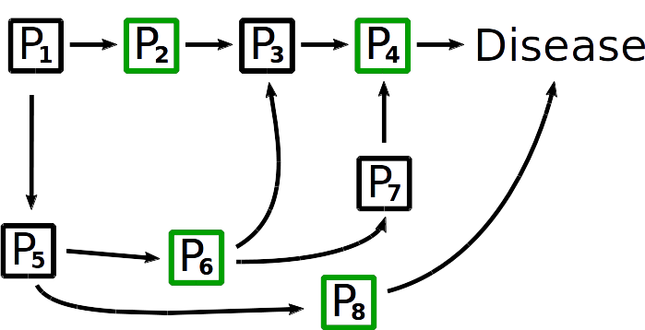
Network: Target selection

Slide 20
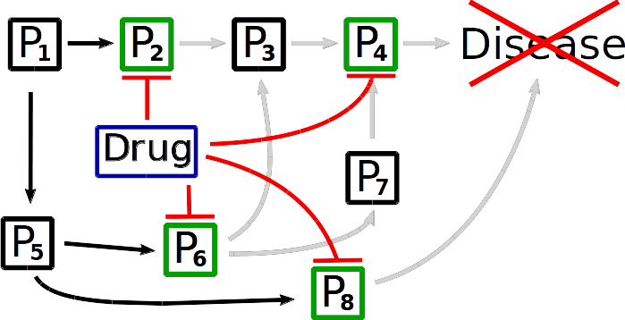
Network: State simulation

Slide 21
Multitarget drug design workflow
Step 1: Target Selection
  network analysis
  high throughput screening
  similartiy assessment
Step 2: multitarget drug design
  de novo
    ligand-based
    structure-based

Slide 22
De novo design
Construct new molecular entities from scratch
  design on demand
  design for dissimilar binding pockets
  synthesis needed afterwards
Ligand-based or structure-based

Slide 23
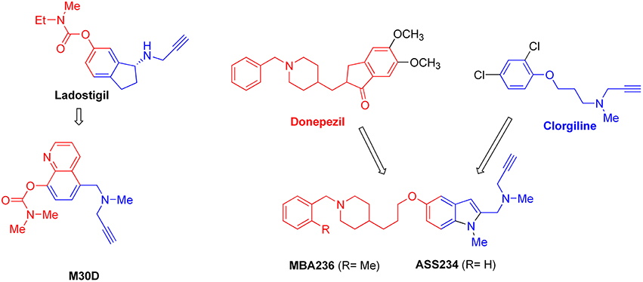
Ligand-based design
Starting template
(Known actives)
  All information contained in known ligands
Adapted from (1) and (2)
Notes:
Known actives = starting template or incorporation into training dataset (prediction model)
Candidate pool generation: use predefined transformation/growth scheme; determine fitness (e.g. interaction requirements → similarity-comparison of ML-methods)
Advance top-ranking compounds for another round until final criteria is met
Merging: https://www.frontiersin.org/files/Articles/198455/fnins-10-00265-HTML/image_m/fnins-10-00265-g002.jpg
Paper: https://www.frontiersin.org/articles/10.3389/fnins.2016.00265/full

Slide 24
Ligand-based design
Starting template
(Known actives)
Merging
Adapted from (1) and (2)
Notes:
Known actives = starting template or incorporation into training dataset (prediction model)
Candidate pool generation: use predefined transformation/growth scheme; determine fitness (e.g. interaction requirements → similarity-comparison of ML-methods)
Advance top-ranking compounds for another round until final criteria is met
Merging: https://www.frontiersin.org/files/Articles/198455/fnins-10-00265-HTML/image_m/fnins-10-00265-g002.jpg
Paper: https://www.frontiersin.org/articles/10.3389/fnins.2016.00265/full

Slide 25
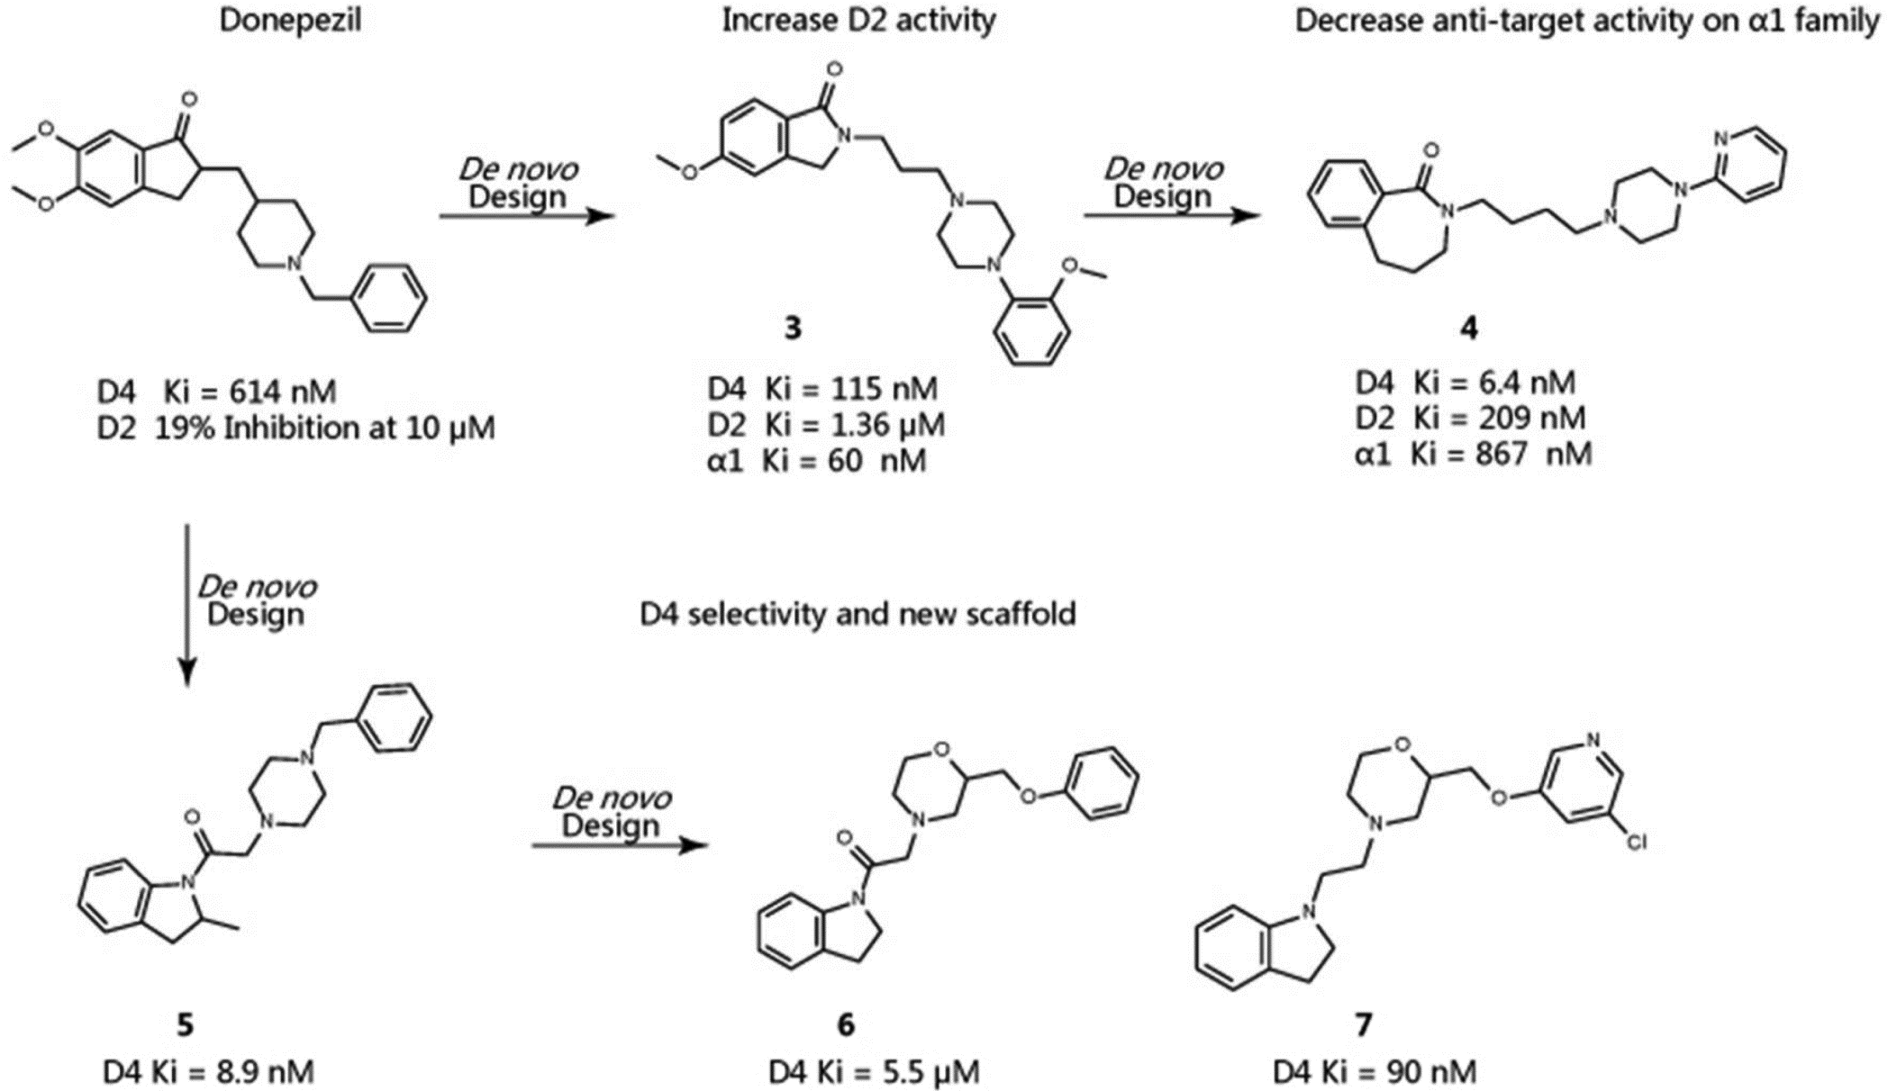
Ligand-based design
Starting template
(Known actives)
Candidate pool generation
Enumeration
of new structures
Merging
Chemical Transformation
  Rule-based
  Synthesis-based
  Knowledge-based
Adapted from (1) and (2)
Notes:
Known actives = starting template or incorporation into training dataset (prediction model)
Candidate pool generation: use predefined transformation/growth scheme; determine fitness (e.g. interaction requirements → similarity-comparison of ML-methods)
Advance top-ranking compounds for another round until final criteria is met
Merging: https://www.frontiersin.org/files/Articles/198455/fnins-10-00265-HTML/image_m/fnins-10-00265-g002.jpg
Paper: https://www.frontiersin.org/articles/10.3389/fnins.2016.00265/full

Slide 26
Ligand-based design
Starting template
(Known actives)
Candidate pool generation
Enumeration
of new structures
Merging
Fitness evaluation
Adapted from (1) and (2)
Notes:
Known actives = starting template or incorporation into training dataset (prediction model)
Candidate pool generation: use predefined transformation/growth scheme; determine fitness (e.g. interaction requirements → similarity-comparison of ML-methods)
Advance top-ranking compounds for another round until final criteria is met
Merging: https://www.frontiersin.org/files/Articles/198455/fnins-10-00265-HTML/image_m/fnins-10-00265-g002.jpg
Paper: https://www.frontiersin.org/articles/10.3389/fnins.2016.00265/full

Slide 27
Fitness evaluation
Optimal compound
Several optimal objective functions
  bioactivity
  bioavailability
  non-toxicity
  novelty
Objective 2
Objective 1
Adapted from (3)
Notes:
genetic algorithm-based growth scheme
determine fitness (e.g. interaction requirements → similarity-comparison of ML-methods)
Presentation by various descriptors, ranked by similarity
Alignments also possible (3D confi)

Slide 28
Fitness evaluation
Optimal compound
Several optimal objective functions
  bioactivity
  bioavailability
  non-toxicity
  novelty
Calculate Distance to each compound
A
a
Objective 2
Objective 1
Adapted from (3)
Notes:
genetic algorithm-based growth scheme
determine fitness (e.g. interaction requirements → similarity-comparison of ML-methods)
Presentation by various descriptors, ranked by similarity
Alignments also possible (3D confi)

Slide 29
Fitness evaluation
Optimal compound
Several optimal objective functions
  bioactivity
  bioavailability
  non-toxicity
  novelty
Calculate Distance to each compound
A
a
b
B
Objective 2
Objective 1
Adapted from (3)
Notes:
genetic algorithm-based growth scheme
determine fitness (e.g. interaction requirements → similarity-comparison of ML-methods)
Presentation by various descriptors, ranked by similarity
Alignments also possible (3D confi)

Slide 30
Fitness evaluation
Optimal compound
Several optimal objective functions
  bioactivity
  bioavailability
  non-toxicity
  novelty
Calculate Distance to each compound
A
a
b
B
c
Objective 2
C
Objective 1
Adapted from (3)
Notes:
genetic algorithm-based growth scheme
determine fitness (e.g. interaction requirements → similarity-comparison of ML-methods)
Presentation by various descriptors, ranked by similarity
Alignments also possible (3D confi)

Slide 31
Fitness evaluation
Optimal compound
Several optimal objective functions
  bioactivity
  bioavailability
  non-toxicity
  novelty
Calculate Distance to each compound
A
a
b
B
c
Objective 2
d
C
D
Objective 1
Adapted from (3)
Notes:
genetic algorithm-based growth scheme
determine fitness (e.g. interaction requirements → similarity-comparison of ML-methods)
Presentation by various descriptors, ranked by similarity
Alignments also possible (3D confi)

Slide 32
Fitness evaluation
Optimal compound
Several optimal objective functions
  bioactivity
  bioavailability
  non-toxicity
  novelty
Calculate Distance to each compound
  example: b<a<c<<d
  A, B, C advance to the next round
A
a
b
B
c
Objective 2
d
C
D
Objective 1
Adapted from (3)
Notes:
genetic algorithm-based growth scheme
determine fitness (e.g. interaction requirements → similarity-comparison of ML-methods)
Presentation by various descriptors, ranked by similarity
Alignments also possible (3D confi)

Slide 33
Ligand-based design
Starting template
(Known actives)
Candidate pool generation
Enumeration
of new structures
Merging
Fitness evaluation
Adapted from (1) and (2)
Notes:
Known actives = starting template or incorporation into training dataset (prediction model)
Candidate pool generation: use predefined transformation/growth scheme; determine fitness (e.g. interaction requirements → similarity-comparison of ML-methods)
Advance top-ranking compounds for another round until final criteria is met
Merging: https://www.frontiersin.org/files/Articles/198455/fnins-10-00265-HTML/image_m/fnins-10-00265-g002.jpg
Paper: https://www.frontiersin.org/articles/10.3389/fnins.2016.00265/full

Slide 34
Ligand-based design
Starting template
(Known actives)
Candidate pool generation
Enumeration
of new structures
Merging
Fitness evaluation
Adapted from (1) and (2)
Notes:
Known actives = starting template or incorporation into training dataset (prediction model)
Candidate pool generation: use predefined transformation/growth scheme; determine fitness (e.g. interaction requirements → similarity-comparison of ML-methods)
Advance top-ranking compounds for another round until final criteria is met
Merging: https://www.frontiersin.org/files/Articles/198455/fnins-10-00265-HTML/image_m/fnins-10-00265-g002.jpg
Paper: https://www.frontiersin.org/articles/10.3389/fnins.2016.00265/full

Slide 35
Ligand-based design
Starting template
(Known actives)
Candidate pool generation
Enumeration
of new structures
Merging
Fitness evaluation
Final selection
Experimental validation
Top-ranking compounds
Adapted from (1) and (2)
Notes:
Known actives = starting template or incorporation into training dataset (prediction model)
Candidate pool generation: use predefined transformation/growth scheme; determine fitness (e.g. interaction requirements → similarity-comparison of ML-methods)
Advance top-ranking compounds for another round until final criteria is met
Merging: https://www.frontiersin.org/files/Articles/198455/fnins-10-00265-HTML/image_m/fnins-10-00265-g002.jpg
Paper: https://www.frontiersin.org/articles/10.3389/fnins.2016.00265/full

Slide 36
Ligand-based design
Get set of known actives
Enumerate known structures
  rule-based, synthesis-based, knowledge-based
Evaluate fitness
  objective functions → distance to optimal compound
  retain optimal ones for next round
Iterate until final selection
Notes:
83: Shang et al. 2014: De Novo Design of Multitarget Ligands with an Iterative Fragment-Growing Strategy

Slide 37
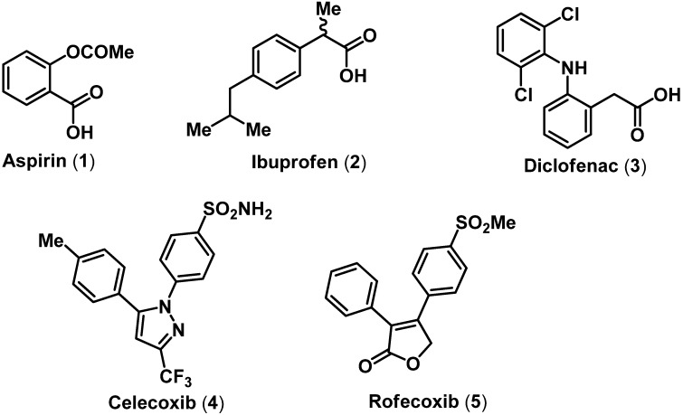
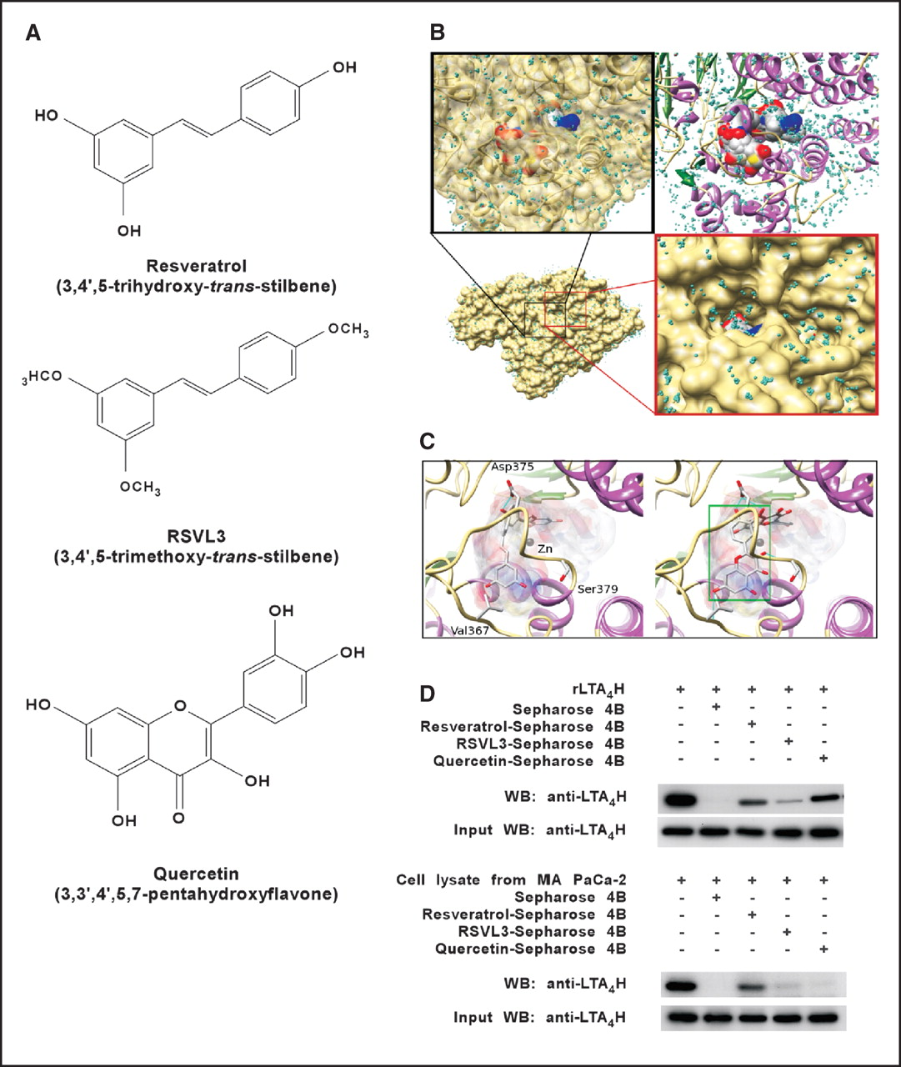
Structure-based design
Known actives of different targets
Adapted from (4), (5) and (6)
Notes:
Preserve all possible conformations compatible with the surrounding residues
Rank complexes by scoring functions based on force-field or empirical models
Step-wise group-activity achievement approach results in local minima→ systematically and automatically start from different global structures (multiple starting points)
Issue: Flexibility → static target = limited optimization
Use multiple target conformations to account for ligand flexibility
Directly consider interaction between ligand and multiple targets
Place seeds in proposed binding site (docking)
83: Shang et al. 2014: De Novo Design of Multitarget Ligands with an Iterative Fragment-Growing Strategy (http://pubs.acs.org/doi/pdf/10.1021/ci500021v; http://pubs.acs.org/doi/suppl/10.1021/ci500021v)
https://www.researchgate.net/figure/45267744_fig1_Chemical-structures-of-some-nonselective-and-selective-COX-inhibitors
http://cancerres.aacrjournals.org/content/70/23/9755
Lead structures: small fragments from known ligands of single targets
COX-2 and LTA4H → extract small fragments from known inhibitors
Molecular weight of screening fragments <=300 Da
Number of hydrogen bond acceptors and donors <=3
Number of rings >=1
Manual consideration of SAR of known ligands with their targets
Next: identify activity of fragments (~43% actives) → lead fragments
Next: dock into targets (lowest energy conformation; 50 conformations of 9 lead fragments → flexibility)
Next: optimize leads stepwise
Next: select active ligands for next round (synthesis and bioassay evaluation)

Slide 38
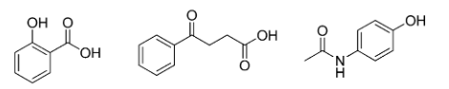
Structure-based design
Known actives of different targets
Fragmentation
Fragment library
Adapted from (4), (5) and (6)
Notes:
Preserve all possible conformations compatible with the surrounding residues
Rank complexes by scoring functions based on force-field or empirical models
Step-wise group-activity achievement approach results in local minima→ systematically and automatically start from different global structures (multiple starting points)
Issue: Flexibility → static target = limited optimization
Use multiple target conformations to account for ligand flexibility
Directly consider interaction between ligand and multiple targets
Place seeds in proposed binding site (docking)
83: Shang et al. 2014: De Novo Design of Multitarget Ligands with an Iterative Fragment-Growing Strategy (http://pubs.acs.org/doi/pdf/10.1021/ci500021v; http://pubs.acs.org/doi/suppl/10.1021/ci500021v)
https://www.researchgate.net/figure/45267744_fig1_Chemical-structures-of-some-nonselective-and-selective-COX-inhibitors
http://cancerres.aacrjournals.org/content/70/23/9755
Lead structures: small fragments from known ligands of single targets
COX-2 and LTA4H → extract small fragments from known inhibitors
Molecular weight of screening fragments <=300 Da
Number of hydrogen bond acceptors and donors <=3
Number of rings >=1
Manual consideration of SAR of known ligands with their targets
Next: identify activity of fragments (~43% actives) → lead fragments
Next: dock into targets (lowest energy conformation; 50 conformations of 9 lead fragments → flexibility)
Next: optimize leads stepwise
Next: select active ligands for next round (synthesis and bioassay evaluation)

Slide 39
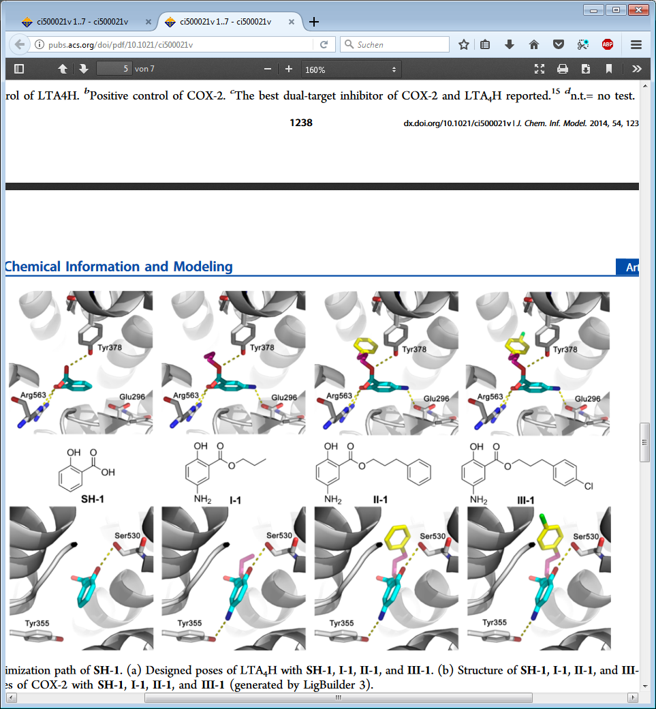
Structure-based design
Known actives of different targets
Target 1
Target 2
Docking
Fragmentation
Fragment library
Adapted from (4), (5) and (6)
Notes:
Preserve all possible conformations compatible with the surrounding residues
Rank complexes by scoring functions based on force-field or empirical models
Step-wise group-activity achievement approach results in local minima→ systematically and automatically start from different global structures (multiple starting points)
Issue: Flexibility → static target = limited optimization
Use multiple target conformations to account for ligand flexibility
Directly consider interaction between ligand and multiple targets
Place seeds in proposed binding site (docking)
83: Shang et al. 2014: De Novo Design of Multitarget Ligands with an Iterative Fragment-Growing Strategy (http://pubs.acs.org/doi/pdf/10.1021/ci500021v; http://pubs.acs.org/doi/suppl/10.1021/ci500021v)
https://www.researchgate.net/figure/45267744_fig1_Chemical-structures-of-some-nonselective-and-selective-COX-inhibitors
http://cancerres.aacrjournals.org/content/70/23/9755
Lead structures: small fragments from known ligands of single targets
COX-2 and LTA4H → extract small fragments from known inhibitors
Molecular weight of screening fragments <=300 Da
Number of hydrogen bond acceptors and donors <=3
Number of rings >=1
Manual consideration of SAR of known ligands with their targets
Next: identify activity of fragments (~43% actives) → lead fragments
Next: dock into targets (lowest energy conformation; 50 conformations of 9 lead fragments → flexibility)
Next: optimize leads stepwise
Next: select active ligands for next round (synthesis and bioassay evaluation)

Slide 40
Structure-based design
Known actives of different targets
Target 1
Target 2
Docking
Fragmentation
Multiple target conformations
Explicit ligand-target interaction
Ranking: scoring function
Fragment library
Adapted from (4), (5) and (6)
Notes:
Preserve all possible conformations compatible with the surrounding residues
Rank complexes by scoring functions based on force-field or empirical models
Step-wise group-activity achievement approach results in local minima→ systematically and automatically start from different global structures (multiple starting points)
Issue: Flexibility → static target = limited optimization
Use multiple target conformations to account for ligand flexibility
Directly consider interaction between ligand and multiple targets
Place seeds in proposed binding site (docking)
83: Shang et al. 2014: De Novo Design of Multitarget Ligands with an Iterative Fragment-Growing Strategy (http://pubs.acs.org/doi/pdf/10.1021/ci500021v; http://pubs.acs.org/doi/suppl/10.1021/ci500021v)
https://www.researchgate.net/figure/45267744_fig1_Chemical-structures-of-some-nonselective-and-selective-COX-inhibitors
http://cancerres.aacrjournals.org/content/70/23/9755
Lead structures: small fragments from known ligands of single targets
COX-2 and LTA4H → extract small fragments from known inhibitors
Molecular weight of screening fragments <=300 Da
Number of hydrogen bond acceptors and donors <=3
Number of rings >=1
Manual consideration of SAR of known ligands with their targets
Next: identify activity of fragments (~43% actives) → lead fragments
Next: dock into targets (lowest energy conformation; 50 conformations of 9 lead fragments → flexibility)
Next: optimize leads stepwise
Next: select active ligands for next round (synthesis and bioassay evaluation)

Slide 41
Structure-based design
Target 1
Target 2
Docking
Fragment growth
Adapted from (4), (5) and (6)
Notes:
Preserve all possible conformations compatible with the surrounding residues
Rank complexes by scoring functions based on force-field or empirical models
Step-wise group-activity achievement approach results in local minima→ systematically and automatically start from different global structures (multiple starting points)
Issue: Flexibility → static target = limited optimization
Use multiple target conformations to account for ligand flexibility
Directly consider interaction between ligand and multiple targets
Place seeds in proposed binding site (docking)
83: Shang et al. 2014: De Novo Design of Multitarget Ligands with an Iterative Fragment-Growing Strategy (http://pubs.acs.org/doi/pdf/10.1021/ci500021v; http://pubs.acs.org/doi/suppl/10.1021/ci500021v)
https://www.researchgate.net/figure/45267744_fig1_Chemical-structures-of-some-nonselective-and-selective-COX-inhibitors
http://cancerres.aacrjournals.org/content/70/23/9755
Lead structures: small fragments from known ligands of single targets
COX-2 and LTA4H → extract small fragments from known inhibitors
Molecular weight of screening fragments <=300 Da
Number of hydrogen bond acceptors and donors <=3
Number of rings >=1
Manual consideration of SAR of known ligands with their targets
Next: identify activity of fragments (~43% actives) → lead fragments
Next: dock into targets (lowest energy conformation; 50 conformations of 9 lead fragments → flexibility)
Next: optimize leads stepwise
Next: select active ligands for next round (synthesis and bioassay evaluation)

Slide 42
Structure-based design
Target 1
Target 2
Fragment growth
Adapted from (4), (5) and (6)
Notes:
Preserve all possible conformations compatible with the surrounding residues
Rank complexes by scoring functions based on force-field or empirical models
Step-wise group-activity achievement approach results in local minima→ systematically and automatically start from different global structures (multiple starting points)
Issue: Flexibility → static target = limited optimization
Use multiple target conformations to account for ligand flexibility
Directly consider interaction between ligand and multiple targets
Place seeds in proposed binding site (docking)
83: Shang et al. 2014: De Novo Design of Multitarget Ligands with an Iterative Fragment-Growing Strategy (http://pubs.acs.org/doi/pdf/10.1021/ci500021v; http://pubs.acs.org/doi/suppl/10.1021/ci500021v)
https://www.researchgate.net/figure/45267744_fig1_Chemical-structures-of-some-nonselective-and-selective-COX-inhibitors
http://cancerres.aacrjournals.org/content/70/23/9755
Lead structures: small fragments from known ligands of single targets
COX-2 and LTA4H → extract small fragments from known inhibitors
Molecular weight of screening fragments <=300 Da
Number of hydrogen bond acceptors and donors <=3
Number of rings >=1
Manual consideration of SAR of known ligands with their targets
Next: identify activity of fragments (~43% actives) → lead fragments
Next: dock into targets (lowest energy conformation; 50 conformations of 9 lead fragments → flexibility)
Next: optimize leads stepwise
Next: select active ligands for next round (synthesis and bioassay evaluation)

Slide 43
Structure-based design
Target 1
Target 2
Fragment growth
Repeat until final selection
Synthesis and Bioassay
Multi-target drug
Adapted from (4), (5) and (6)
Notes:
Preserve all possible conformations compatible with the surrounding residues
Rank complexes by scoring functions based on force-field or empirical models
Step-wise group-activity achievement approach results in local minima→ systematically and automatically start from different global structures (multiple starting points)
Issue: Flexibility → static target = limited optimization
Use multiple target conformations to account for ligand flexibility
Directly consider interaction between ligand and multiple targets
Place seeds in proposed binding site (docking)
83: Shang et al. 2014: De Novo Design of Multitarget Ligands with an Iterative Fragment-Growing Strategy (http://pubs.acs.org/doi/pdf/10.1021/ci500021v; http://pubs.acs.org/doi/suppl/10.1021/ci500021v)
https://www.researchgate.net/figure/45267744_fig1_Chemical-structures-of-some-nonselective-and-selective-COX-inhibitors
http://cancerres.aacrjournals.org/content/70/23/9755
Lead structures: small fragments from known ligands of single targets
COX-2 and LTA4H → extract small fragments from known inhibitors
Molecular weight of screening fragments <=300 Da
Number of hydrogen bond acceptors and donors <=3
Number of rings >=1
Manual consideration of SAR of known ligands with their targets
Next: identify activity of fragments (~43% actives) → lead fragments
Next: dock into targets (lowest energy conformation; 50 conformations of 9 lead fragments → flexibility)
Next: optimize leads stepwise
Next: select active ligands for next round (synthesis and bioassay evaluation)

Slide 44
Structure-based design: Workflow
Create fragment library from known actives
Dock fragments into binding pocket
Create Candidate pools through fragment-growth
  rank complexes by scoring functions
  retain optimal ones for next round
Iterate until final selection
Notes:
83: Shang et al. 2014: De Novo Design of Multitarget Ligands with an Iterative Fragment-Growing Strategy

Slide 45
De novo design: Method overview
Initial structure
L: Known actives
S: Known actives
fragment library,
target structures

Slide 46
De novo design: Method overview
Initial structure
New structure generation
L: Known actives
L: Chemical Transformation
S: Known actives
fragment library,
target structures
S: Fragment growth in binding pocket

Slide 47
De novo design: Method overview
Initial structure
New structure generation
L: Known actives
L: Chemical Transformation
S: Known actives
fragment library,
target structures
S: Fragment growth in binding pocket
Fitness evaluation
L: Objective functions
S: Docking and scoring functions

Slide 48
De novo design: Method overview
Initial structure
New structure generation
L: Known actives
L: Chemical Transformation
S: Known actives
fragment library,
target structures
S: Fragment growth in binding pocket
Fitness evaluation
L: Objective functions
S: Docking and scoring functions

Slide 49
De novo design: Method overview
Initial structure
New structure generation
L: Known actives
L: Chemical Transformation
S: Known actives
fragment library,
target structures
S: Fragment growth in binding pocket
Fitness evaluation
L: Objective functions
S: Docking and scoring functions
Synthesis
and
Bioassay

Slide 50
Multitarget drug design workflow
Step 1: Target Selection
  network analysis
  high throughput screening
  similartiy assessment
Step 2: Multitarget drug design
  de novo
  virtual screening
    pharmacophor-based
    docking-based

Slide 51
Finding a drug
Building the needed molecule → De novo design
Finding the needed molecule in a database → Virtual screening (VS)
  pharmacophore- or docking-based

Slide 52
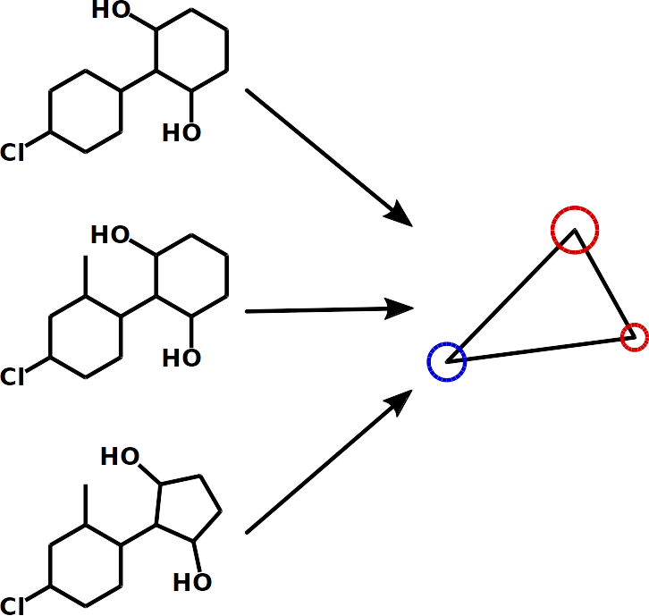
Definition pharmacophore
Definition:
Spatial arrangement of molecular features important for molecular recognition.

Slide 53
Aims of virtual screening (VS)
Reduction of the number of molecules
Ranked list of molecules
Enrichment of active molecules in top ranks

Slide 54
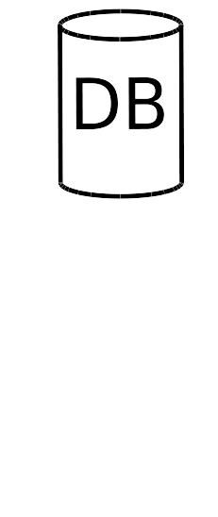
VS: Pharmacophore-based
Start with compound database

Slide 55
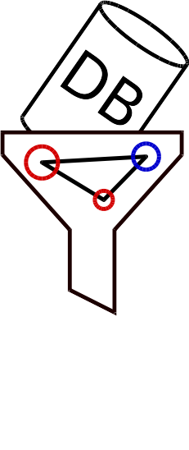
VS: Pharmacophore-based
Start with compound database
Use pharamacophore as filter
Quantify the fit of molecules to pharmacophore

Slide 56
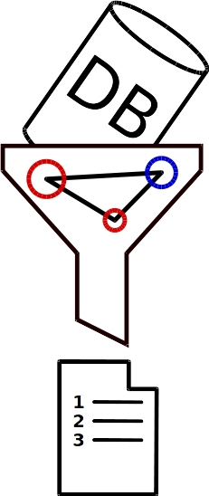
VS: Pharmacophore-based
Start with compound database
Use pharamacophore as filter
Quantify the fit of molecules to pharmacophore
Get a ranked list
Take the top ‘X’ percent

Slide 57

VS: Docking-based
Start with compound database

Slide 58
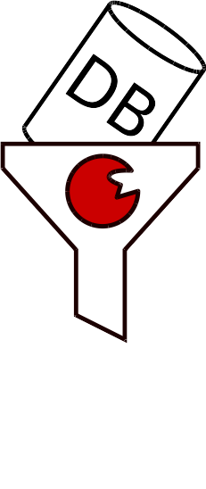
VS: Docking-based
Start with compound database
Use binding site as filter
Score binding of every molecule to binding site

Slide 59
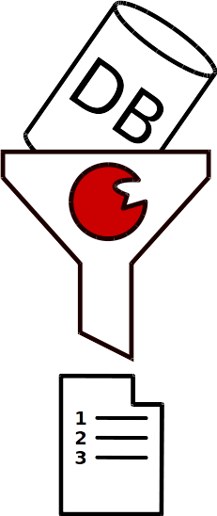
VS: Docking-based
Start with compound database
Use binding site as filter
Score binding of every molecule to binding site
Get a ranked list
Take the top ‘X’ percent

Slide 60
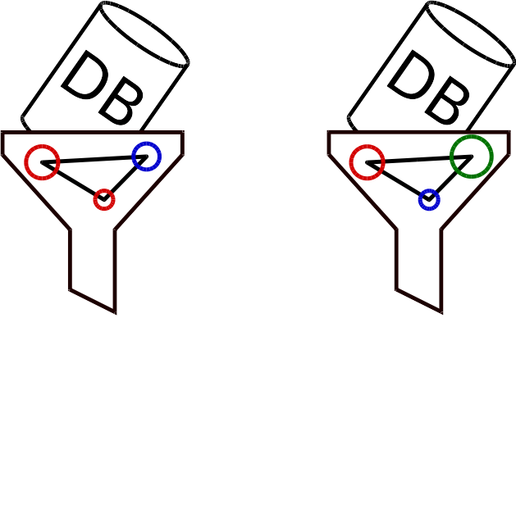
VS: Parallel approach

Slide 61
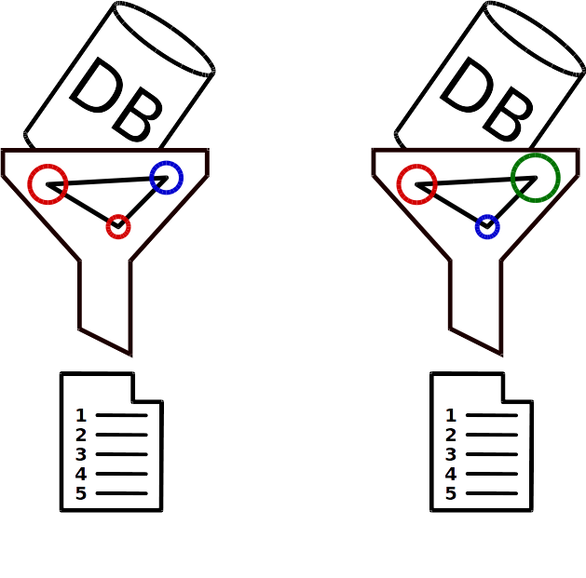
VS: Parallel approach

Slide 62
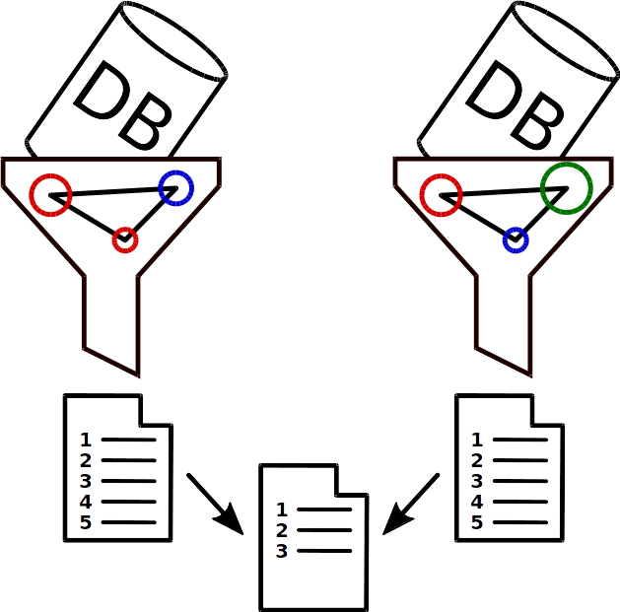
VS: Parallel approach

Slide 63
VS: Parallel approach - Drawbacks
Computationally expensive
Challenging to compare scores for different targets

Slide 64
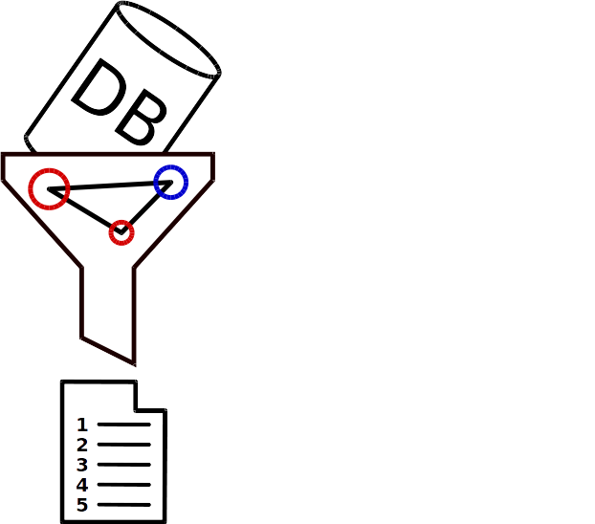
VS: Sequential approach

Slide 65
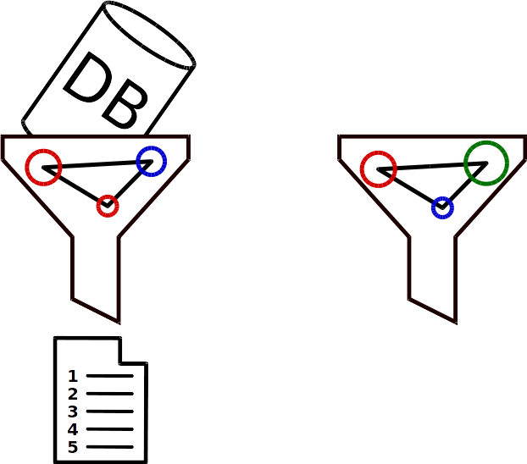
VS: Sequential approach

Slide 66
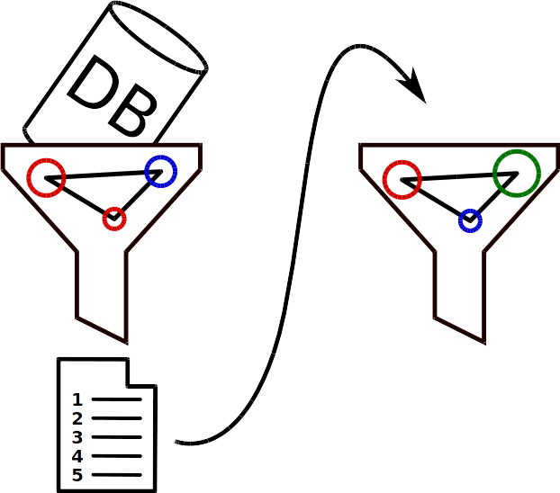
VS: Sequential approach

Slide 67
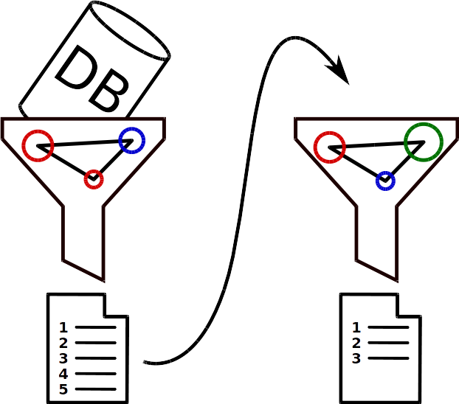
VS: Sequential approach

Slide 68
VS: Sequential approach - Drawbacks
Results depend on order of filters

Slide 69
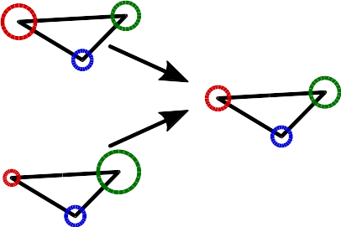
VS: Common pharmacophore
Merge pharmacophores to accelerate screening

Slide 70
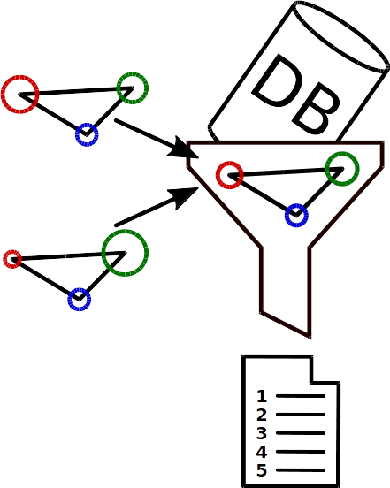
The common pharmacophore
Merge pharmacophores to accelerate screening
Applicable if ligand binds all targets with same features

Slide 71
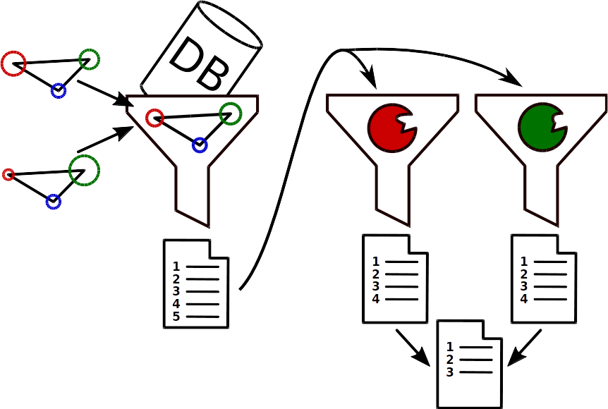
VS: Combined methods

Slide 72
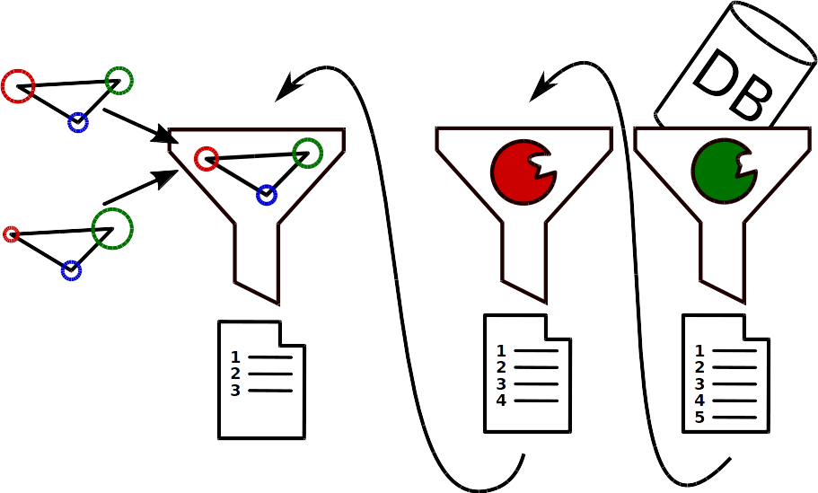
VS: Combined methods

Slide 73
Multitarget drug design workflow
Step 1: Target Selection
  network analysis
  high throughput screening
  similartiy assessment
Step 2: Multitarget drug design
  de novo
  virtual screening
Step 3: Evaluation and iteration

Slide 74
Conclusion
Polypharmacology leads to higher efficacy
Target selection
  key aspect of design process
Multitarget drug design methods
  de novo: Ligand-based and structure-based design
    design on demand, set of known actives needed
    ranking over objective functions or scoring functions
  virtual screening: Pharmacophore-based and docking-based
    pre-existing compound database needed
    sequential, parallel, common pharmacophore approach

Slide 75
References
Nikolai K, Mavridis L, Djikic T, Vucicevic J, Agbaba D, Yelekci K and Mitchell JB: Drug Design for CNS Diseases: Polypharmacological Profiling of Compounds Using Cheminformatic, 3D-QSAR and Virtual Screening Methodologies., in Front Neurosci., 10:265, 2016.
Zhang W, Pei J and Lai L: Computational Multitarget Drug Design., in J Chem Inf Model., 57:403-412, 2017.
Besnard J, Ruda GF, Setola V, Abecassis K, Rodriguiz RM, Huang XP, Norval S, Sassano MF, Shin AI, Webster LA, Simeons FRC, Stojanovski L, Prat A, Seidah NG, Constam DB, Bickerton GR, Read KD, Wetsel WC, Gilbert IH, Roth BL and Hopkins AL: Automated Design of Ligands to Polypharmacological Profiles., in Nature, 492:215-220, 2012.
Rao PP, Kabir SN and Mohamed T: Nonsteroidal Anti-Inflammatory Drugs (NSAIDs): Progress in Small Molecule Drug Development., in Pharmaceuticals (Basel), 3:1530-1549, 2010.
Oi N, Jeong CH, Nadas J, Cho YY, Pugliese A, Bode AM and Dong Z: Resveratol, a red wine polyphenol, suppresses pancreatic cancer by inhibiting leukotriene A4 hydrolase., in Cancer Res., 70:9755-9764, 2010.
Shang E, Yuan Y, Chen X, Liu Y, Pei J and Lai L: De novo design of multitarget ligands with an iterative fragment-growing strategy., in J Chem Inf Model., 54:1235-1241, 2014.
Anighoro A, Bajorath J and Rastelli G: Polypharmacology: Challenges and Opportunities in Drug Discovery., in J Med Chem., 57:7874-7887, 2014.

