Slide 1
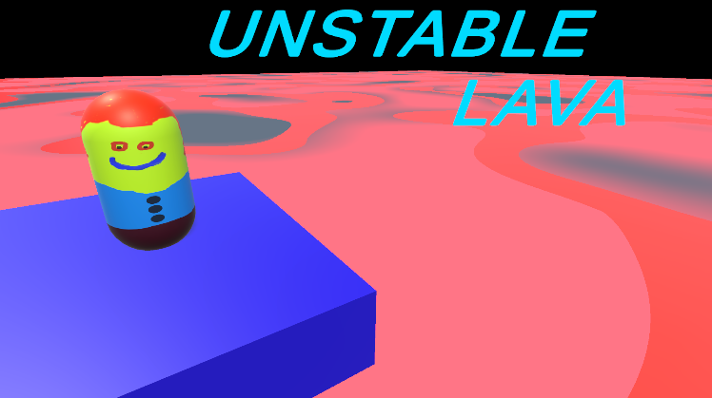

Slide 2
Legend:
Regular Floor
Unstable Floor
Maze Entrance/Exit
Treasure Chests
Doors

Slide 3

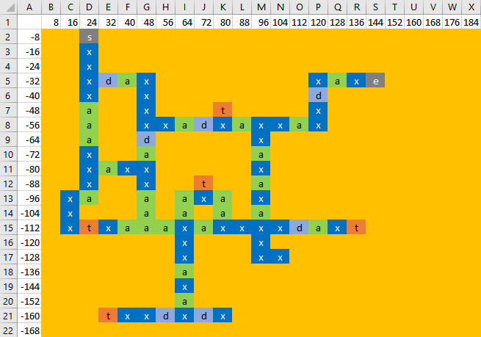
LEVEL 1 - SPOILERS

Slide 4
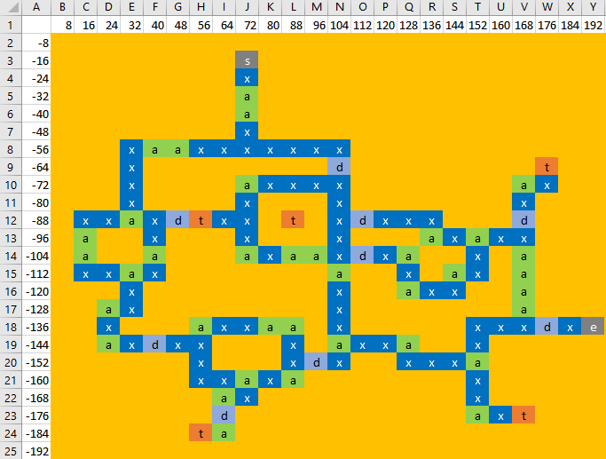
LEVEL 2 - SPOILERS

Slide 5
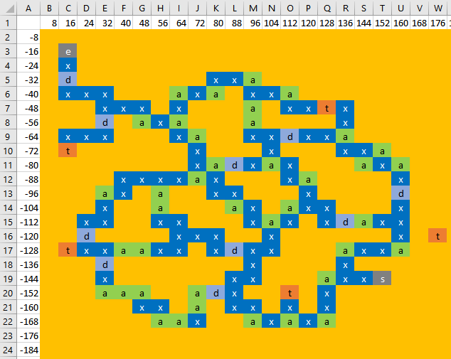
LEVEL 3 - SPOILERS

