Slide 1

.NET Memory Management 101
Remigiusz Cieslak remigiusz.cieslak@gmail.com

Slide 2
Agenda
Stack
Heap(s)
GC
Pitfalls
Tips

Slide 3
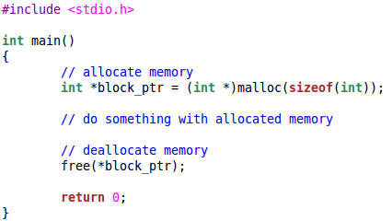
A long time ago ...

Slide 4
… in a galaxy far far away
Pros
Fast
Efficient (runtime)
Cons
Tedious
Inefficient (coding)
Easy to forget

Slide 5
The managed era
Stack
Tracks program execution and state
LIFO structure
Heap
Stores program data
Allocation – automatic when object is created
Deallocation – controlled by GC

Slide 6
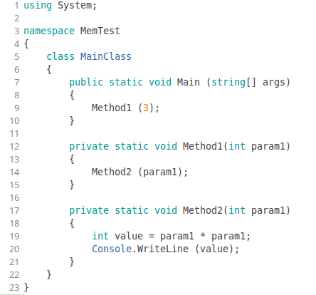
Stack
Method2:
int param1=3
int value=9
RET=14
Method1:
int param1=3
RET=9
MAIN:
OBJREF args

Slide 7
Stack
Tracks method execution and state
LIFO structure
Stores method data inside stack frames
Return
Parameters
Local variables
Only value types and object references

Slide 8
Value types – System.ValueType
Usually stored on the stack
Fall into two categories
Enumerations
Structs
Variables store value, assignment copies value
No null value, only default value
Low cost
Size - size of value
Time – no overhead for allocation

Slide 9
Reference types – System.Object
Stored on the heap
Instances of classes, delegates etc.
Variables store references, assignment copies reference
Null value
Higher cost
Size - size of object + object header (8B or 16B)
Time – overhead for allocation

Slide 10
Heap(s)
Object (GC) heaps
SOH
LOH
Loader heaps
High frequency
Low frequency
Stub
Code (JIT) heap
Process heap

Slide 11
Garbage Collection
Frees resources when no longer needed
Runs on a separate thread(s)
Has two phases
Mark – inspects the object heaps for objects that are no longer referenced
Sweep – releases memory used by not referenced objects

Slide 12
Garbage Collection – mark phase
Start points – GC roots
Stack
Globals and statics
CPU registers
Finalization queue
Interop

Slide 13
Garbage Collection – mark phase
Author
Post
List
Comment
Comment

Slide 14
Object heaps
Small Object Heap
Stores objects <= 85K
Compaction during GC – no fragmentation
Generational – G0, G1, G2
Large Object Heap
Stores objects > 85K
Free space tracking during GC - fragmentation

Slide 15
Small Object Heap - consecutive
SOH
SOH
Object 5
Object 7
Object 4
Object 6
Object 3
Object 4
Object 2
Object 3
Object 1
Object 1

Slide 16
Small Object Heap - generational
SOH
SOH
0
0
Object 5
Object 7
Object 4
Object 6
1
1
Object 3
Object 4
Object 2
2
Object 3
2
Object 1
Object 1

Slide 17
Small Object Heap – Gen 0
All new objects end up in Gen 0
Collection
~256K
Two options
Collect
Promote to Gen 1
Lowest cost

Slide 18
Small Object Heap – Gen 1
Survivors from Gen 0
Collection
~2M
Two options
Collect
Promote to Gen 2
Higher cost – includes both Gen 0 and Gen 1

Slide 19
Small Object Heap – Gen 2
Survivors from Gen 1
Collection – AKA Full GC
~10M
Two options
Collect
Leave as is
Highest cost – includes Gen 0, Gen 1 and Gen 2 (SOH + LOH)

Slide 20
Small Object Heap – segments
Two types of segments
Ephemeral
Always one
reserved for new objects (but can contain G2 and G1 as well)
Gen 2
Multiple – new appears when ephemeral is full
Contains only Gen 2 objects
Size – differs depending on GC configuration

Slide 21
Small Object Heap – segments
Gen 2
Gen 1
Gen 0
O1
O2
O3
O4
O5
O6
O7
O8
Gen 1
Gen 0
O7
O8
Gen 2
O1
O2
O3
O4
O5
O6

Slide 22
Large Object Heap – non-consecutive
LOH
LOH
Object 5
Object 5
Object 4
Object 6
Object 3
Object 3
Object 2
Free
Object 1
Object 1

Slide 23
Large Object Heap – free space table
LOH
Object 5
Free
From | To
389000 | 567000
98000 | 198000
Object 3
Free
Object 1

Slide 24
Large Object Heap - collection
Collection
Whenever Gen 2 is collected
Two options
Mark space as free in the free space table
Leave as is
Highest cost – includes Gen 0, Gen 1 and Gen 2 (SOH + LOH)
Fragmentation occurs

Slide 25
Garbage collection - types
Workstation – available everywhere
Non-concurrent
Concurrent
Background (4.0)
Server – available on multiprocessor machines
Non-concurrent
Background (4.5)

Slide 26
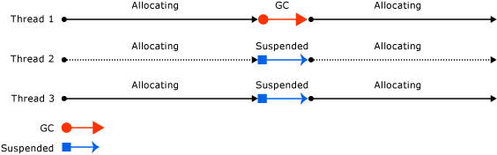
Workstation GC – non-concurrent
GC occurs on the thread that triggered it
Stops threads during GC

Slide 27
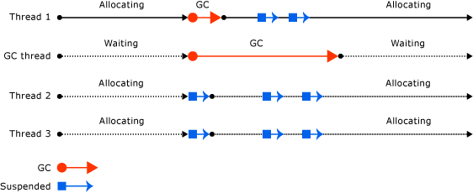
Workstation GC – concurrent
GC occurs on a separate thread
Stops threads during Gen 0 and Gen 1 collections
Stops threads during Gen 2 collection only if ephemeral segment is full

Slide 28
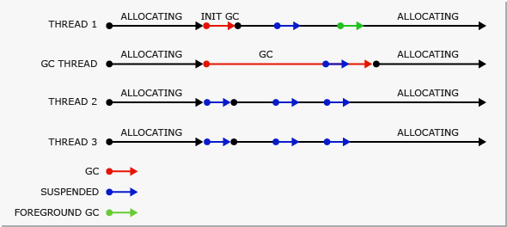
Workstation GC – background
GC occurs on a separate thread
Stops threads during Gen 0 and Gen 1 collections
Does not stop threads during Gen 2 collection if ephemeral segment is full – creates new segment

Slide 29
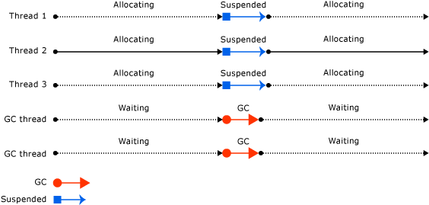
Server GC – non-concurrent
GC occurs on a separate thread
One GC thread per logical processor (core)
Stops threads during GC

Slide 30
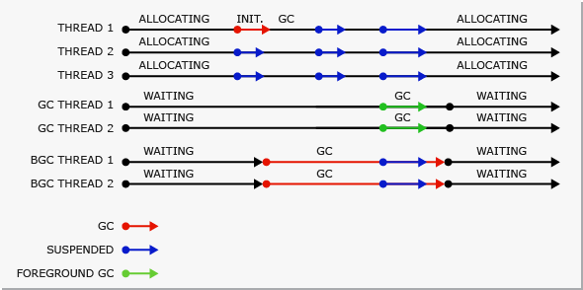
Server GC – background
GC occurs on a separate thread
Two GC threads per logical processor (core)
Combination of server and background workstation

Slide 31
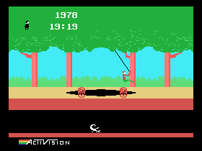
Pitfalls

Slide 32
Pitfalls – IDisposable
When does it happen?
When someone declares a finalizer and forgets to call GC.SuppressFinalize in Dispose
When someone throws an exception from Dispose without fully releasing resources
Why it's bad?
Promotes objects to older generation although there are no obvious references
Leaks resources

Slide 33
Pitfalls – IDisposable
O1
O1
O1
O2
O2
O2
O3
O4
O5
O5
O5
O6
O7
O8
O8
O8
Finalization list
Freachable queue
O1
O2
O5
O8
O1
O2
O3
O5
O6
O7
O8
Finalization list
Freachable queue
O1
O2
O5
O8

Slide 34
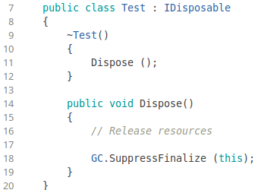
Pitfalls – IDisposable
How to avoid?
Implement IDisposable properly
Never throw exceptions from Dispose without fully releasing resources

Slide 35


Pitfalls – boxing/unboxing
When does it happen?
When casting value types to objects and vice versa
Why it's bad?
Additional allocation takes time
How to avoid?
Use generics

Slide 36
Pitfalls – string concatenation
When does it happen?
When using the “+” operator to construct complex strings
Why it's bad?
String is immutable, therefore, “+” always creates a new object
How to avoid?
Use StringBuilder to construct complex strings

Slide 37
Pitfalls – StringBuilder without capacity
When does it happen?
When creating very long complex strings using a StringBuilder created with default constructor
Why it's bad?
StringBuilder is backed by chunk arrays that have to be allocated when capacity is exceeded
How to avoid?
Define the target capacity when creating a StringBuilder object

Slide 38
Pitfalls – List without capacity
When does it happen?
When adding a lot of objects to a list without initial capacity set
Why it's bad?
List is backed by an array that has to be expanded if the size limit is reached
How to avoid?
Define the target capacity when creating a List object

Slide 39
Pitfalls – struct underuse
When does it happen?
When creating very small objects
Why it's bad?
The object header is 8B in size (4B for syncblock, 4B for method table reference)
How to avoid?
Use structs whenever the combined size of fields would be < 16B

Slide 40
Pitfalls – struct abuse
When does it happen?
When creating too many structs as method parameters and local variables
Why it's bad?
All value type params and locals end up on the stack, therefore, contribute to a possible stack overflow
How to avoid?
Limit the number of value type params and locals in your methods

Slide 41
Pitfalls – 64 bits
When does it happen?
When foolishly assuming that more bits always means better
Why it's bad?
Higher GC limits – collection less frequent but longer
Bigger object header – 16B
Bigger assemblies – more impact on loader heaps
Same SOH/LOH threshold
How to avoid? - never assume, always test

Slide 42
Pitfalls – debug
When does it happen?
When accidentally deploying a debug-compiled app
Why it's bad?
GC treats debug-enabled assemblies differently – less aggressive
How to avoid?
Ensure that you always deploy debug-disabled apps
For ASP.NET check that web.config has debug=false

Slide 43
Pitfalls – events, delegates, lambdas
When does it happen?
When not understanding that event subscriptions, delegates and lambdas may have a reference on the object that declares them
Why it's bad?
Promotes objects to older generations
Leaks memory

Slide 44
Pitfalls – events, delegates, lambdas
How to avoid?
Always unwire events
Use weak references
Look at what the compiler generates

Slide 45
Pitfalls – GC Impact
When does it happen?
Not realizing that GC might hinder performance
Why it's bad?
Increases latency
How to avoid?
Use GC Notifications to minimize the impact of an upcoming GC

Slide 46
Tips
Simpler object graphs – less work for the GC
Short lived objects improve GC performance
Understand the generated code
Understand the most common .NET internals
Use weak references
Use lazy initialization
Lazy<T>
Linq + yield

Slide 47
Tips
Choose the appropriate GC flavor
Use profilers to track down problems
Heap sizes and growth over time
Generation sizes
LOH fragmentation
GC behavior over time
Avoid GC.Collect

Slide 48
Recommended reading
CLR via C#, J. Richter
Under the Hood of .NET Memory Management, C. Farrell, N. Harrison
Fundamentals of Garbage Collection, MSDN
Garbage Collection, MSDN

Slide 49
Questions?

