Slide 1
Free Form Design
Ruiqi
May 1 2023

Slide 2
Catch-up
Computing Gradient
Notes:
Computation
parallelization, memory efficiency
More parallelization (per TMM)

Slide 3
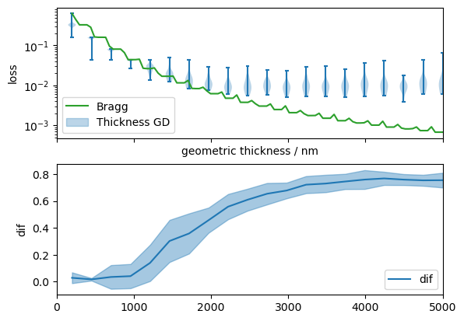
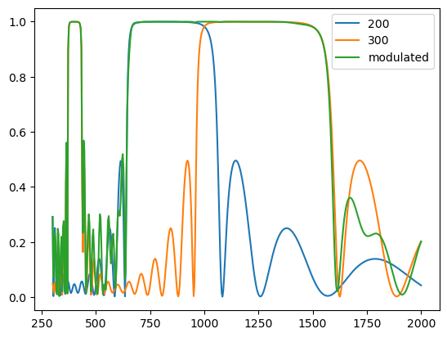
Catch-up
Bragg Back-reflector and Global Optim
Free Form cmp. w. Bragg
Notes:
Global optim
1. Bragg as upper bound of global optim. Blue is thickness optimize result
2. Stacked DBR are serial OR gates when looking at R; while serial AND gate when T.

Slide 4
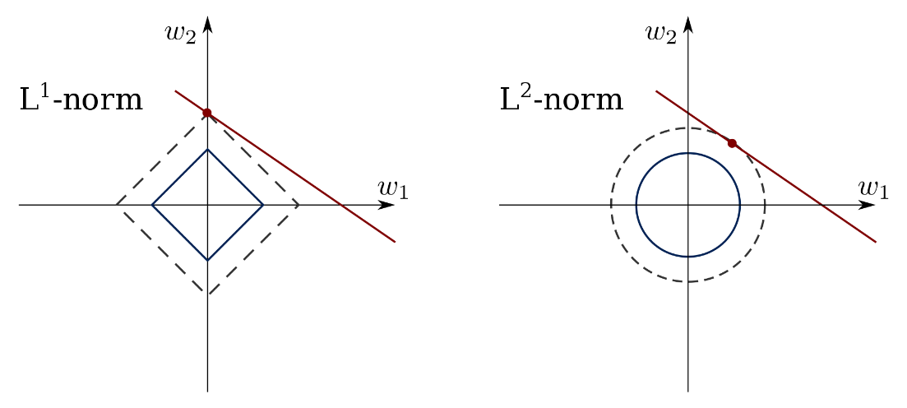
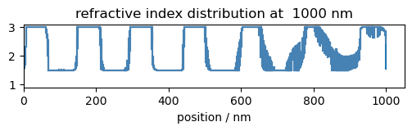
Sparsity
Lasso
Free Form Design
Notes:
Introduce my definition of sparsity in thin film design. Consider subdivided \vec{n}, want neighboring n to have similar (or same) value.

Slide 5


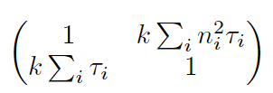
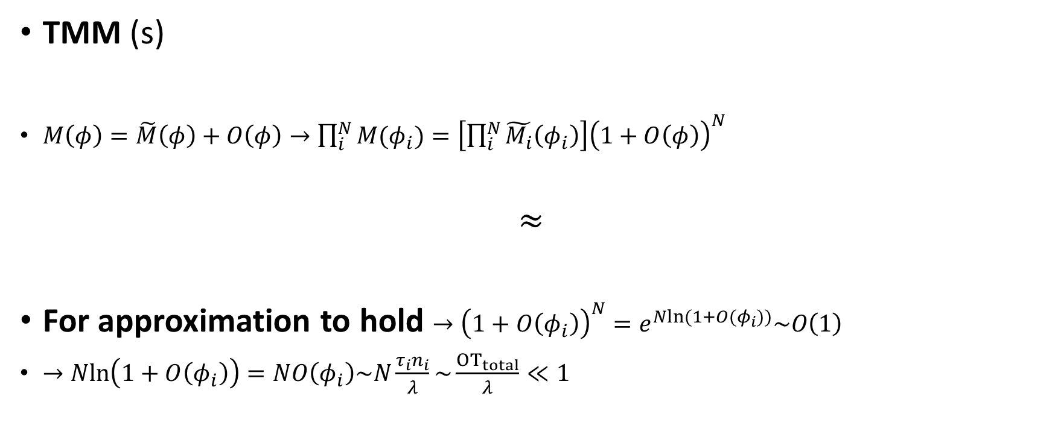
Why?
TMM (s)
$M\left(φ\right)=\tilde{M}\left(φ\right)+O\left(φ\right)→\prod_{i}^{N}{M(φ_{i})}=\left[\prod_{i}^{N}{\tilde{M_{i}}\left(φ_{i}\right)}\right]{\left(1+O\left(φ\right)\right)}^{N}$
$$≈$$
For approximation to hold $→{\left(1+O\left(φ_{i}\right)\right)}^{N}=e^{Nln(1+O(φ_{i}))}\sim O\left(1\right)$
$→Nln\left(1+O\left(φ_{i}\right)\right)=NO\left(φ_{i}\right)\sim N\frac{τ_{i}n_{i}}{λ}\sim \frac{{OT}_{total}}{λ}≪1$
Notes:
Can always do a variable substitution (n -> cos\theta n) but for mixed polarization seems to beak…
But anyway, only consider normal incidence now
Note that after each multiplication we can safely discard O(\phi) by absorbing it to the residual.
Finally we have the result: equivalent to one single layer, with n^2 = \sum_i^N n_i^2 / N; \tau_i = \sum_i \tau_i
NOTE: \tau is geometrical thickness

Slide 6
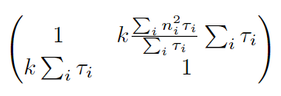

Why? (Cont.)
Our approx.
$\tilde{n}≈\sum_{i=1}^{N}{n_{i}^{2}}$
when given $τ_{i}, N$.
Radius of hypersphere!
We can visualize projection on 2D plane

Slide 7
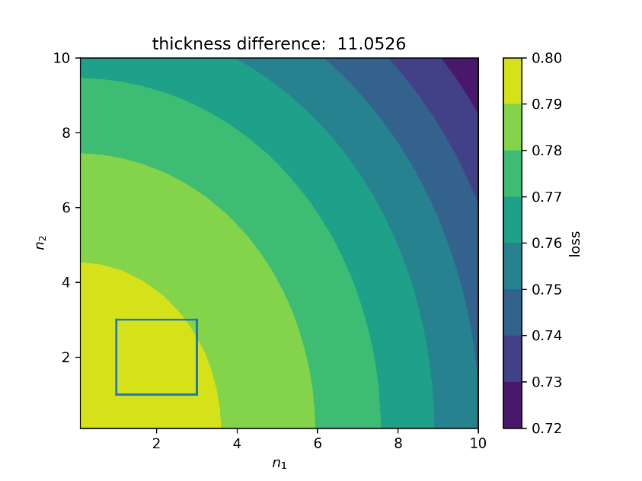
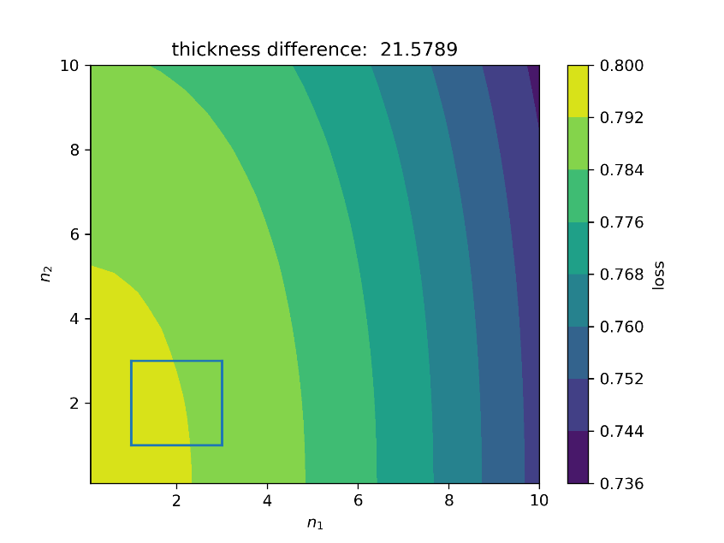
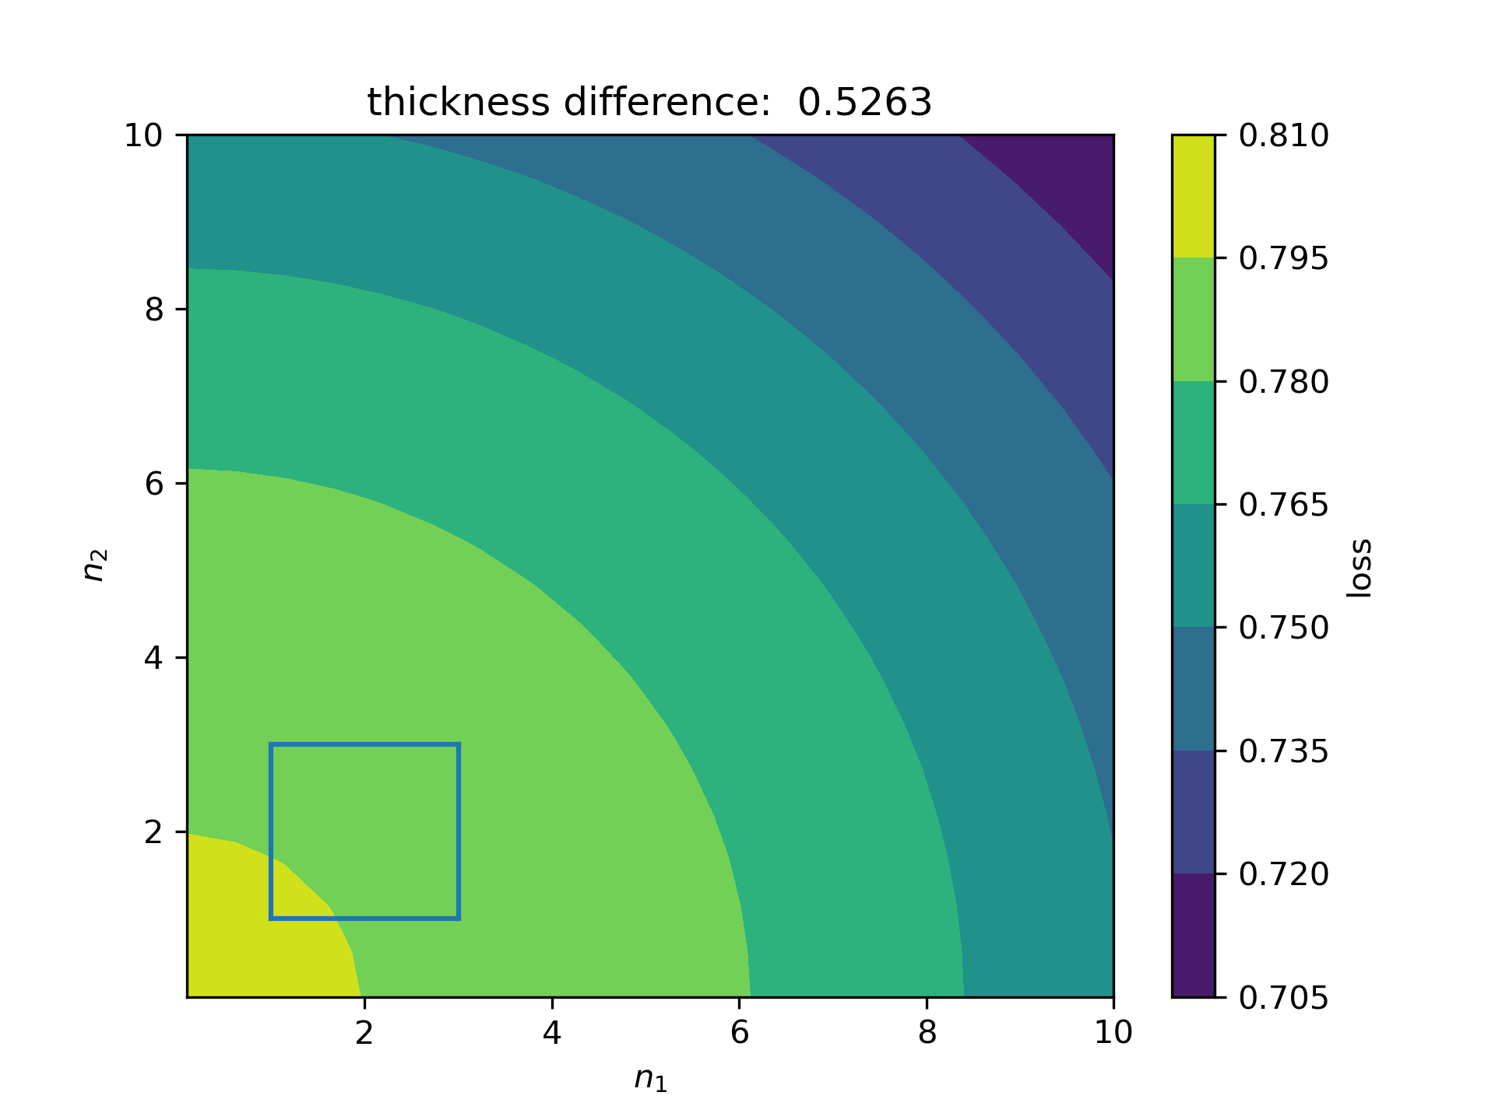
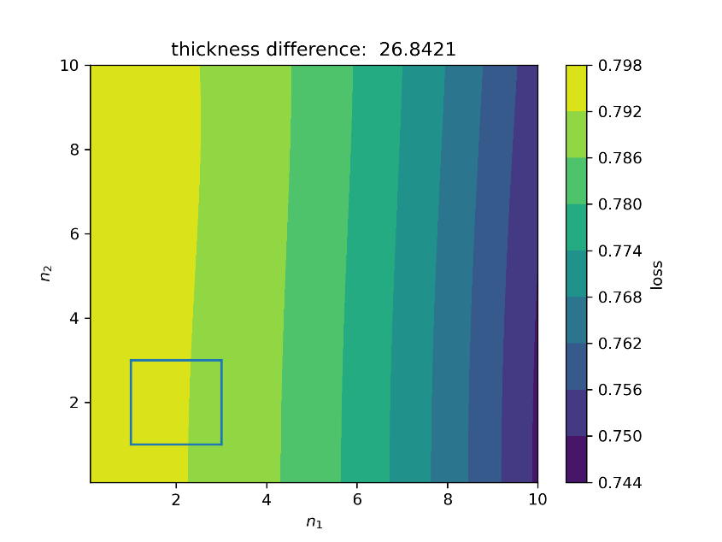
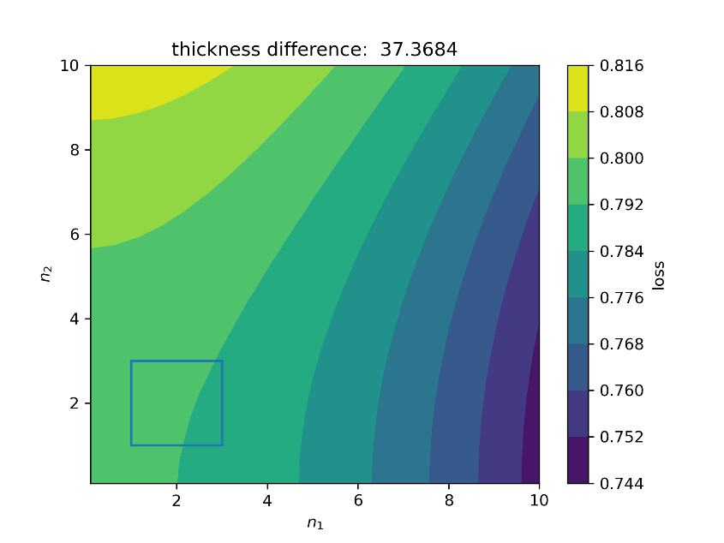

Why? (Cont.)
“Correlation” Decreases
11 nm
21 nm
Experiments:
Vary $n_{i}$ and $n_{i+k}$, show $L$
(Subsequent layers)
26 nm
37 nm

Slide 8
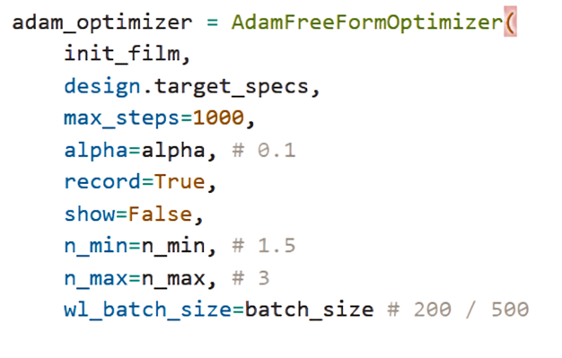
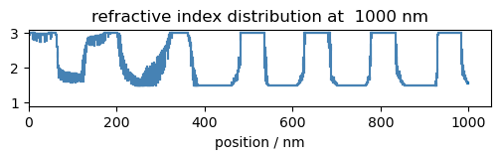
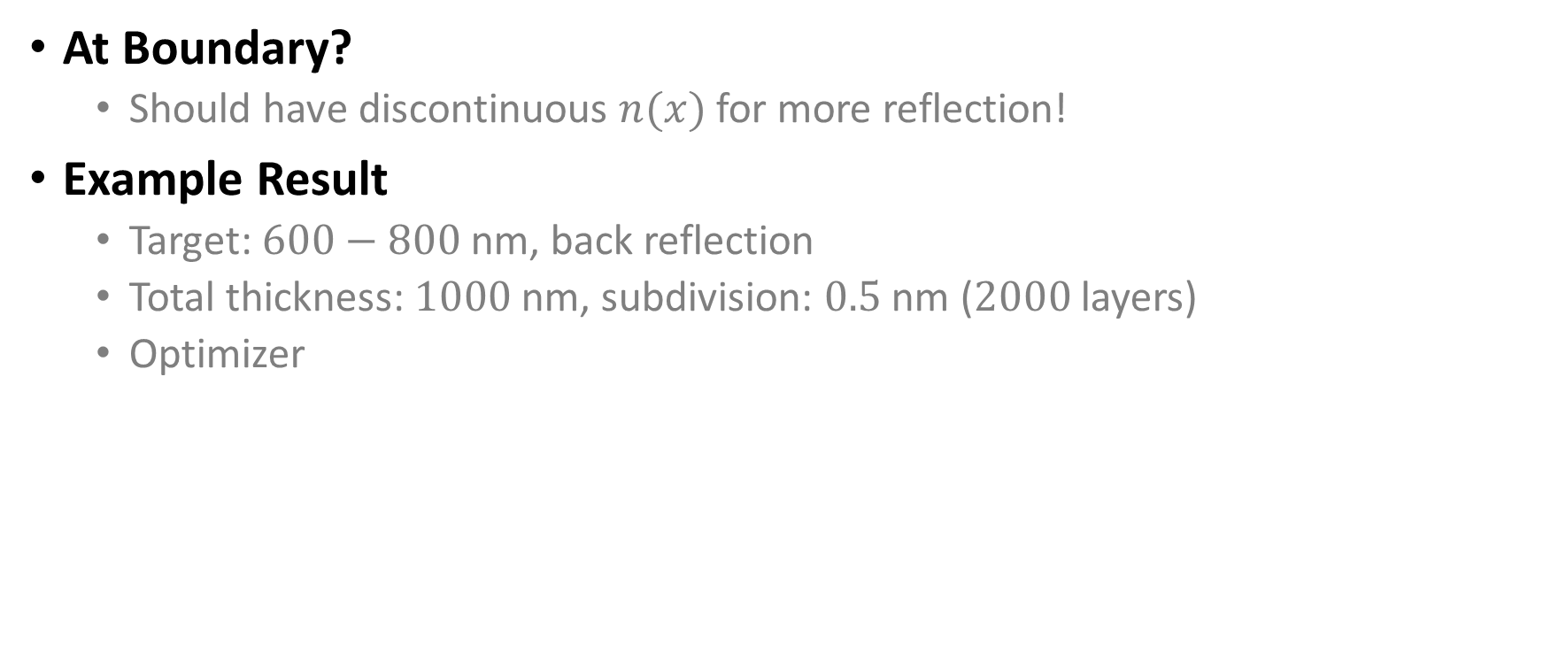
Flip
At Boundary?
Should have discontinuous $n(x)$ for more reflection!
Example Result
Target: $600−800$ nm, back reflection
Total thickness: $1000$ nm, subdivision: $0.5$ nm ($2000$ layers)
Optimizer

Slide 9
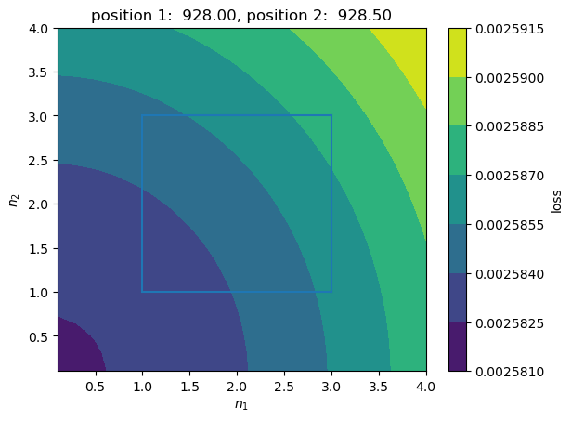
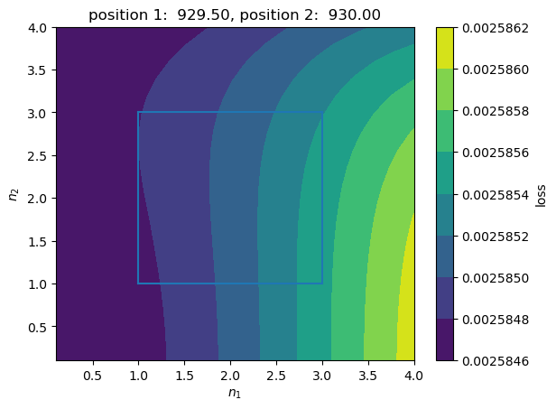
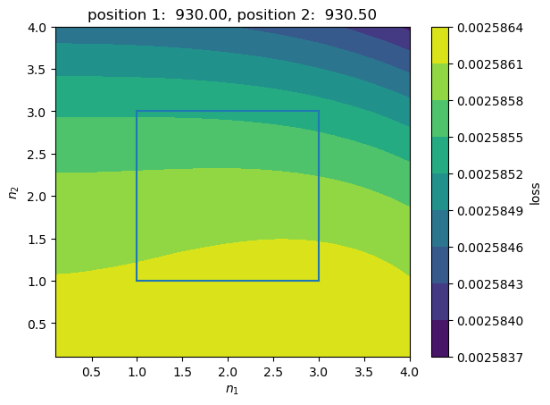
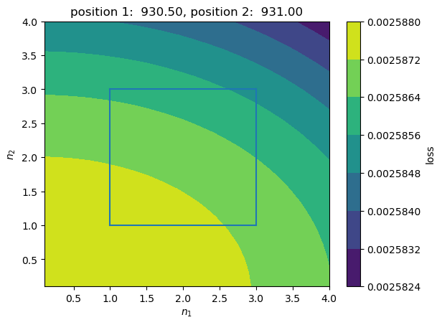
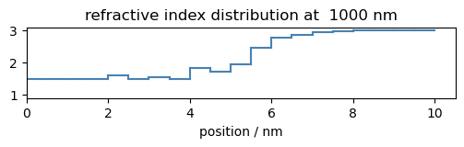
Flip
1
+-9e-6
2
+-2e-6
Similar position
+-3e-6
+-6e-6
3
4
923
933

Slide 10

Fourier Transform
Same OT each layer
Total OT $→$ high freq. components
Continuously varying $n$

Slide 11
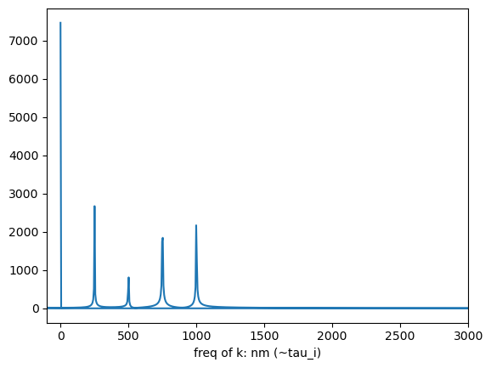
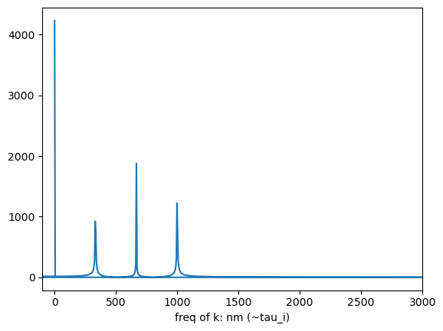

Fourier Transform
Exp: same layer OT
$N_{δ}=N_{layer}$
Notes:
Here the design is: FT spec adopting periodic BC (thus more constraint). Discard high frequency components (thus error)
If not periodic: simply conv. In freq domain with sinc and match convoluted target.
Not sure how to analyze though… My understanding is that, boundary of rect mask contributes high freq. components.
NOTE that there is no requirement on substrate (can be different from inc. Does not contribute e^i\phi after all)

Slide 12
Fourier Transform

Slide 13
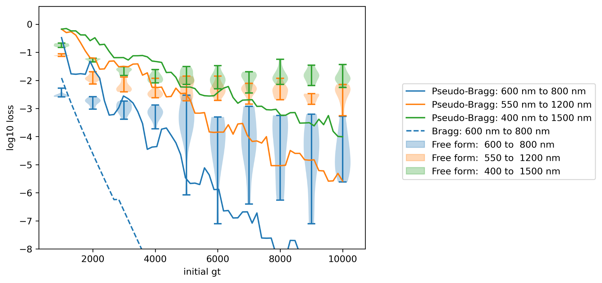
Global Optimum
Global Optimum vs Performance of a model
GD cmp. w. Bragg
Notes:
One should not draw a conclusion that “harder target, large OT does not help.” though it may seem so for free form.
NOTE that Bragg is not optimized. Tuned only for bandgap to cover the target range. Pseudo means periodicity (center of bandgap) changes.
Answers to OT:
OT as a hyperparameter probably does not have an optim value – optimal loss monochronically depends on OT (both from exp and supported by Fourier).
Local optim some methods can reach, however, may have an optim OT value, but is subject to other not-so-physical settings such as the steplength of the optimizer.
This problem could be coped with super good optimizer!
Should the value of free form be: when looking at the best / average result, our technique outperforms GD / needle?

Slide 14
Questions
Write in review?

Slide 15
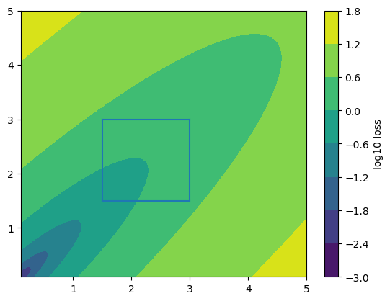
Only Thin Layer not Adequate
Is the analysis redundant?
One may wonder what we can achieve by merely utilizing the permutation symmetry of neighboring thin films.
In fact that is not enough (I believe) for sparsity
Left is a made-up loss function’s landscape

Slide 16
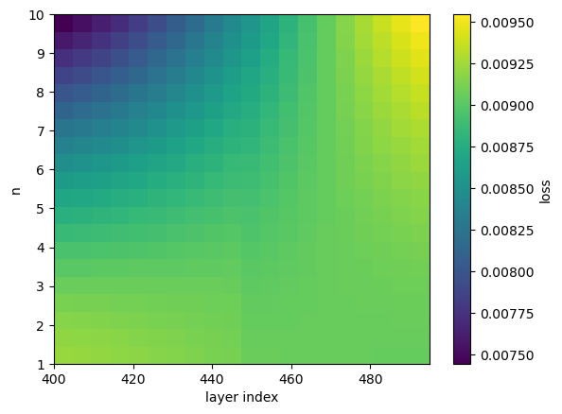
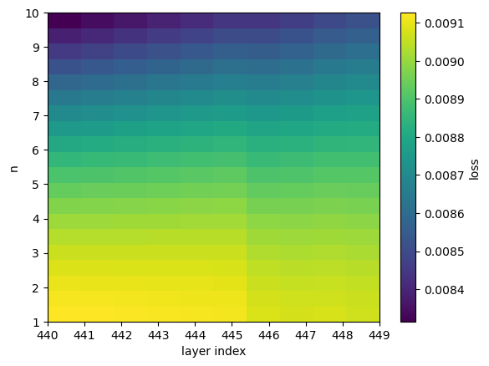
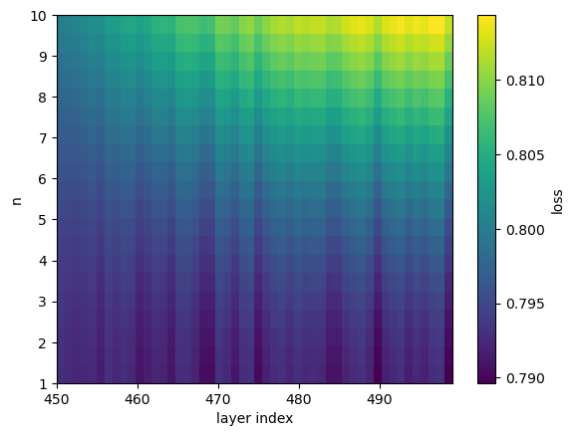
Only Thin Layer not Adequate
Loss function landscape: permutation symmetry
Edge filter large range
Edge filter small range
Edge filter large range
Random film

Slide 17
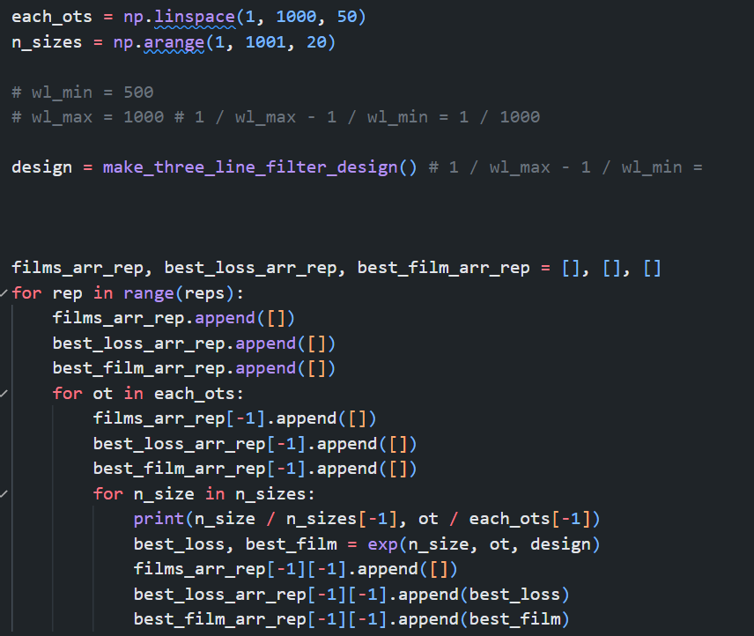
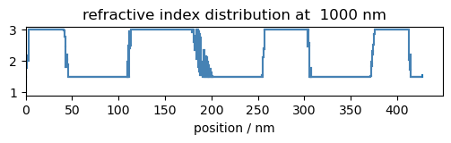
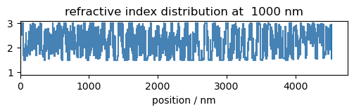
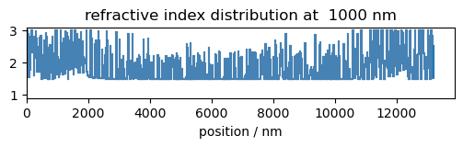
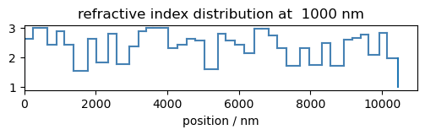
Verify Thin Layer Approximation
When thickness each layer is larger, no better.
Sparsity defect

Slide 18
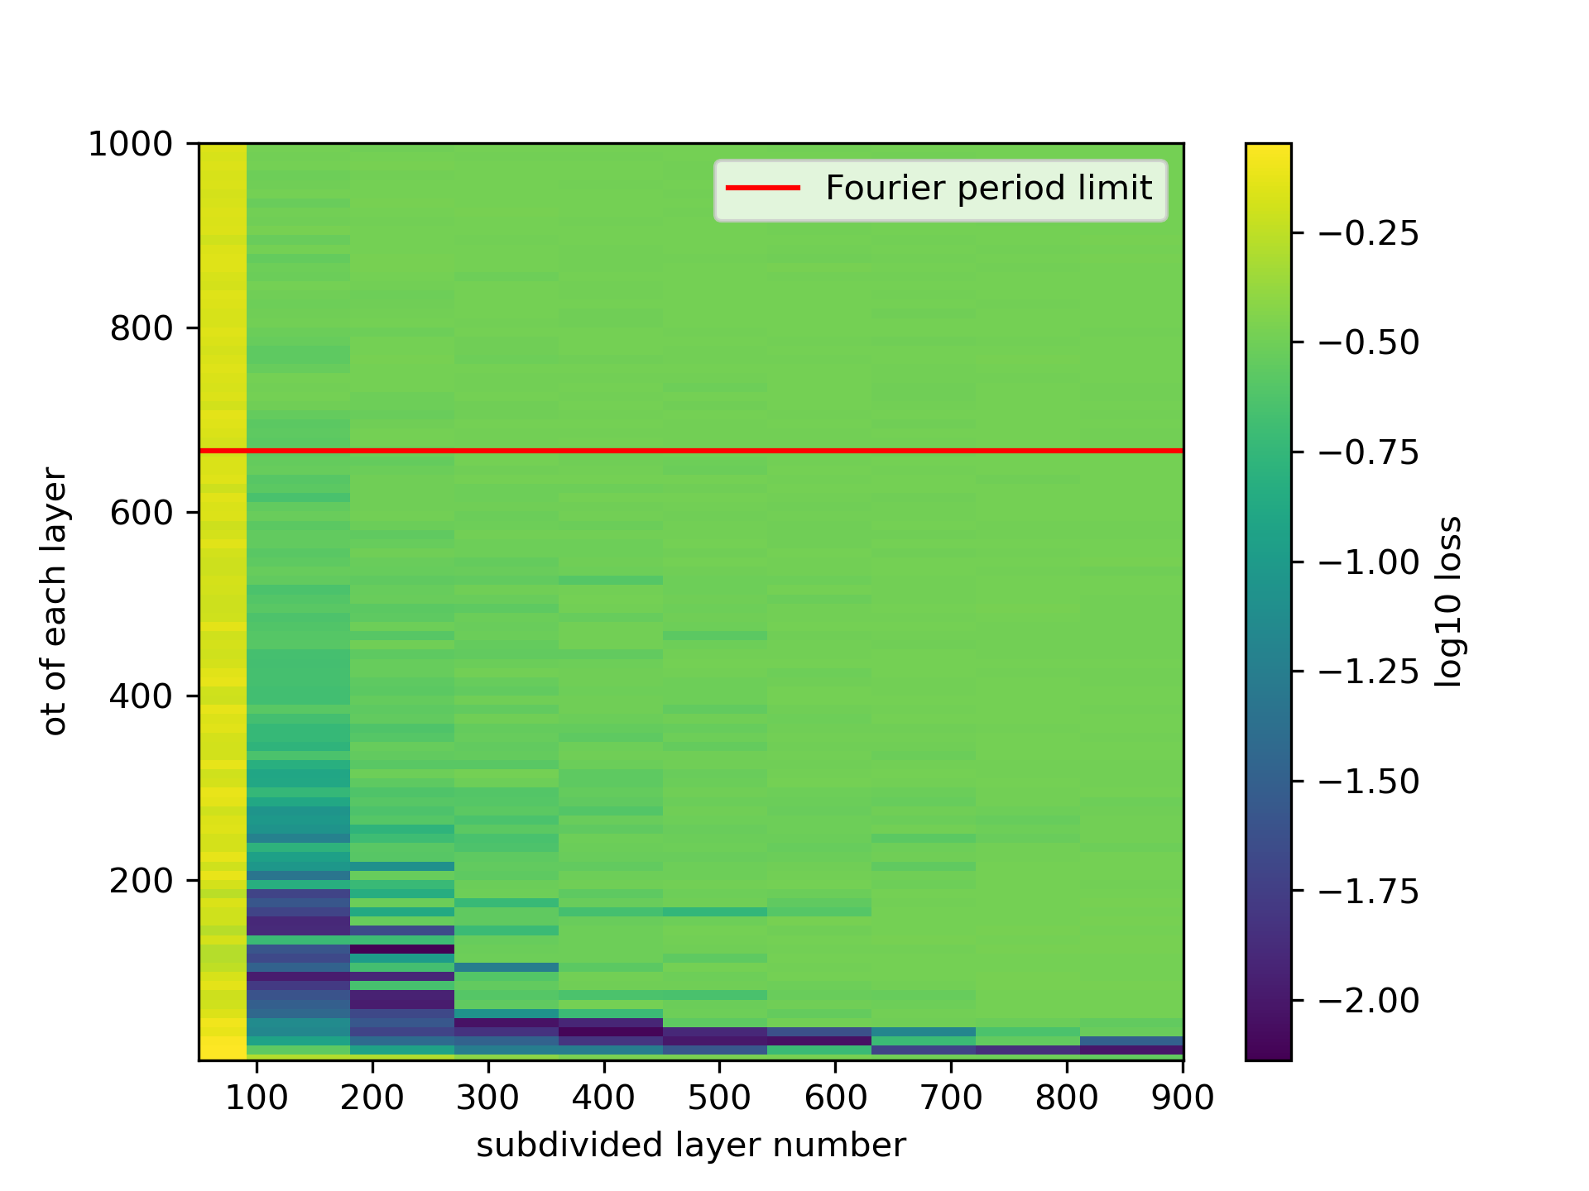
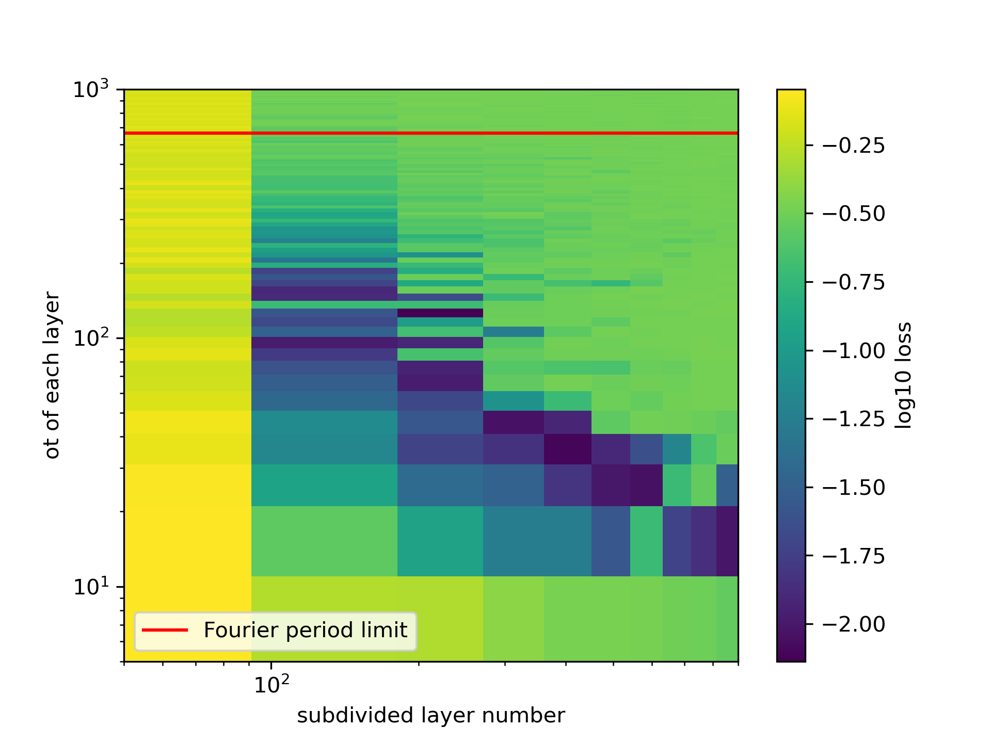
Verify Thin Layer Approximation
When thickness each layer is larger, no better.
Sparsity defect

