Slide 1
Thin Film Design
Ruiqi Feng
Mar. 12 2023

Slide 2
To be adapted from prev. talks

Slide 3
Demo: loss – “accuracy”

Slide 4
Needle-TFNN
Motivation (for design, unknown init structure and thus rough landscape in the solution space)
Scheme

Slide 5
Iterative design
Appending
Turns out not ideal (not jumping into “near” minimum but those with larger OT)
Substitution
Fix problem of impractical layers
Search for global optima

Slide 6
To be adapted from prev. reports
Anything I forgot??

Slide 7
Over fitting?
Large OT, bad generalization (different perform as true spec)
Not of concern when target film is artificially designed
Somehow useful when trying to characterize real film structure
Use two inc. angles
Better generalization but rel. higher loss (as expected)
If target film simpler, may have good result (not yet implemented)

Slide 8
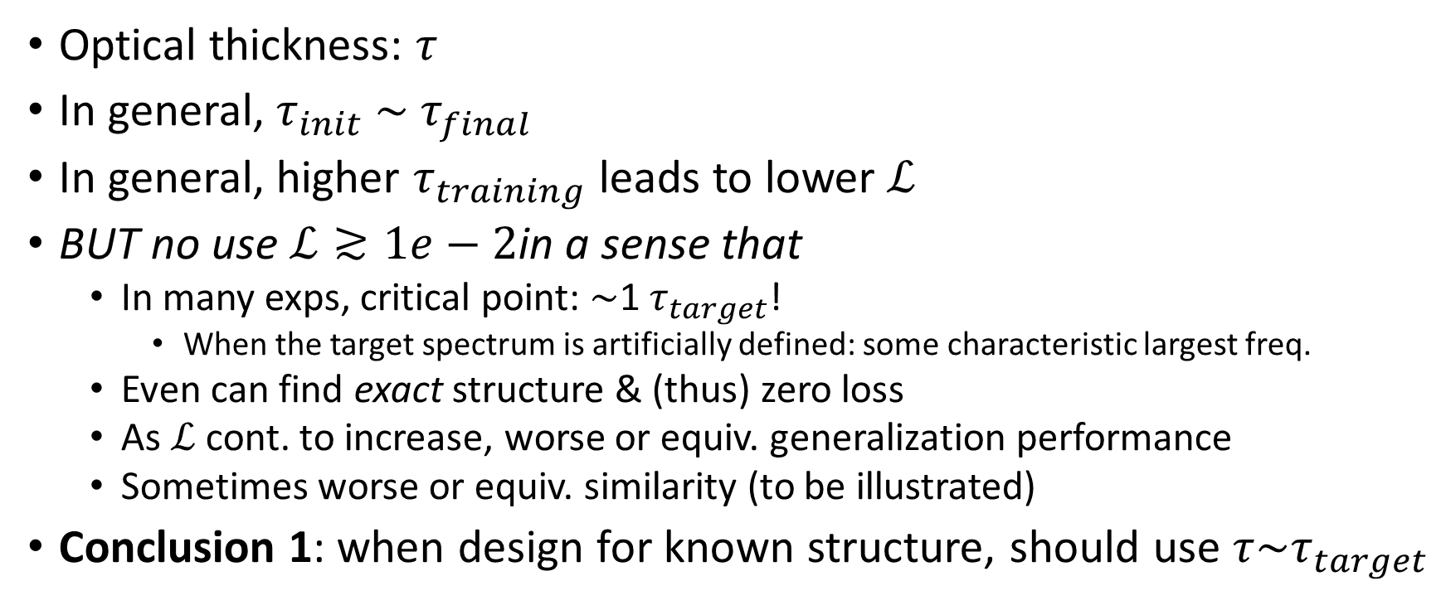
Loss-OT
Optical thickness: $τ$
In general, $τ_{init}$ $\sim τ_{final}$
In general, higher $τ_{training}$leads to lower $ℒ$
BUT no use $ℒ≳1e−2$in a sense that
In many exps, critical point: $\sim$1 $τ_{target}$!
When the target spectrum is artificially defined: some characteristic largest freq.
Even can find exact structure & (thus) zero loss
As $ℒ$ cont. to increase, worse or equiv. generalization performance
Sometimes worse or equiv. similarity (to be illustrated)
Conclusion 1: when design for known structure, should use $τ\sim τ_{target}$

Slide 9
Similarity
Definition of metric

Slide 10
Setup of experiment
Materials
Dispersion
GD method
Needle insertion thickness

Slide 11
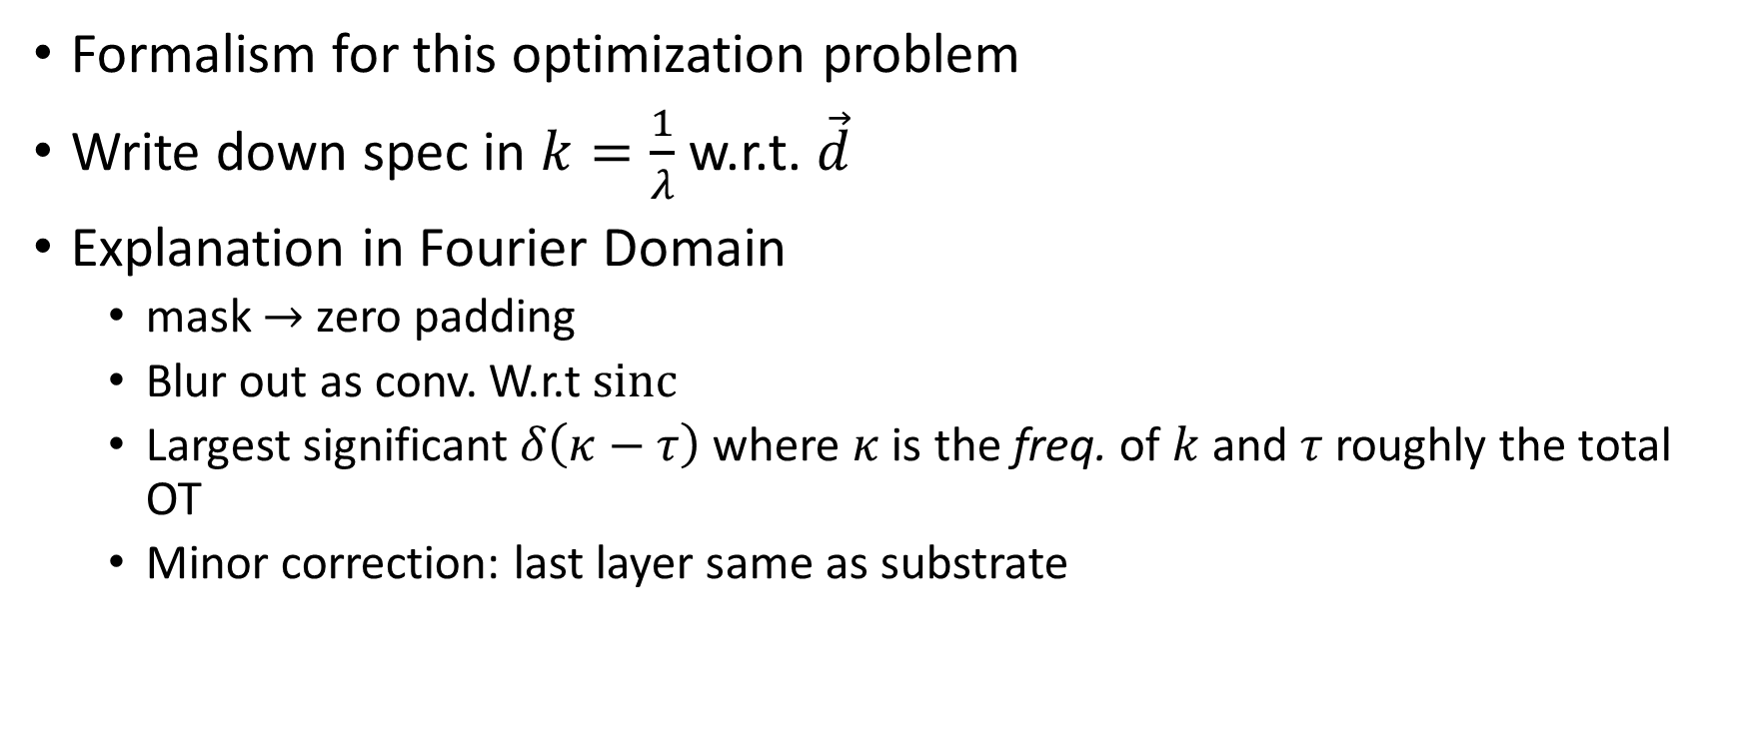
Theory
Formalism for this optimization problem
Write down spec in $k=\frac{1}{λ}$ w.r.t. $\vec{d}$
Explanation in Fourier Domain
mask $→$ zero padding
Blur out as conv. W.r.t $sinc$
Largest significant $δ\left(κ−τ\right)$ where $κ$ is the freq. of $k$ and $τ$ roughly the total OT
Minor correction: last layer same as substrate

Slide 12
Parallelism
CPU
GPU with CUDA (numba)

