Slide 1
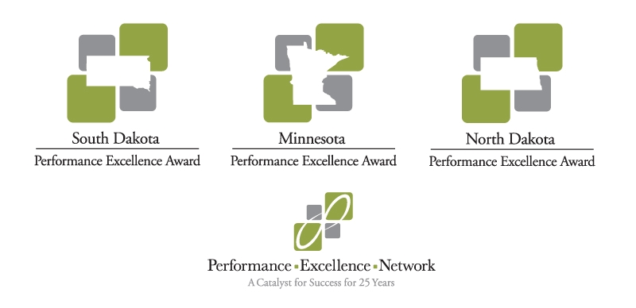
Tools to Achieve Performance Excellence

Slide 2


PDCA
“A Place to (Re)Start”
Pat O’Boyle owner of Fire-Formed Consulting

Slide 3


Introductions
Name:
Organization:
Background:
Pat O’Boyle owner of Fire-Formed Consulting

Slide 4

PDCA Cycle is the basis for all improvement
Lean
Baldrige
Act
Plan
Shewhart or Deming Cycle
Risk Analysis
Six Sigma
Check (Study)
Do
Planning.
ISO
Etc. Etc. Etc. Etc. Etc. Etc.

Slide 5

PDCA or (PDSA)
Act:
Evaluate
Standardize
Next steps
Plan:
Current State
Measure
Est. a target (goal)
Communicate
Check:
Review results
Trends
improvements
Do:
Implement the plan
Collect data
ID problem areas

Slide 6

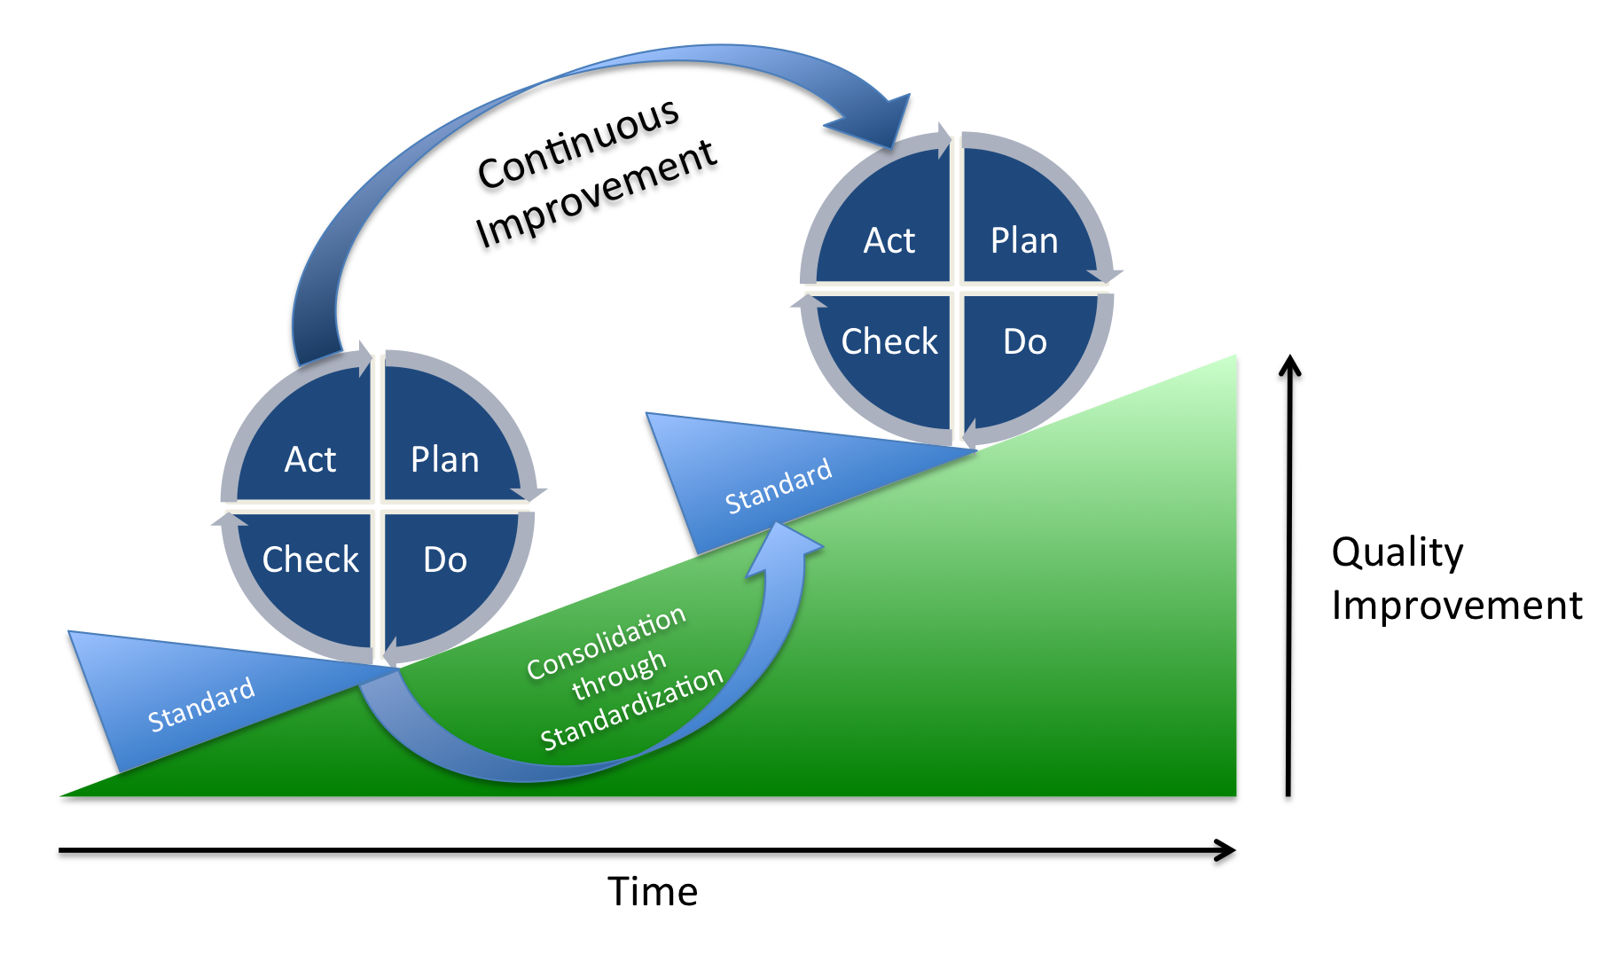

Slide 7
Transition Framework
Concern/Issue/Need:______________________
Plan
  What are we trying to accomplish (results focused)
  How will we know what to change (current process)
  Select the right people (customer, stakeholder involvement)
  Get everyone on the same page (communicate)
Do
  the actions, how will we accomplish it (put the plan into action)
Check (study) pilot first (test run)
  Review outcome, trends, side effects, improvements, etc.
Act
  Examine & re-examine process
  Standardize improvement
  Adjust as needed, and establish future plans

Slide 8
PDCA Class Exercise
List 1 example of where PDCA was used successfully
________________
List a case where it should have been used
________________
List one or more examples where it could be used
____________________________________________________________________________________________________________

Slide 9

Does PDCA have a place in your future?
Without continual growth and progress, such words as improvement, achievement, and success have no meaning.
Benjamin Franklin

Slide 10
What Are & Why Would You Use A Cross Functional Team?
Mary Larweck RN, MS, CPHQ, CIC
President, Emerald Quality Services

Slide 11


Has This Happened to You?
You’re on a new team and the outcome has already been determined…
Conflict among team members makes it hard/impossible to accomplish the project

Slide 12

…
Everybody thinks it’s a great idea but no one wants to do it
You want to participate but you haven’t been given the “tools” to be successful…

Slide 13
What are Cross-functional Teams?
A group of people with:
  a clear purpose representing a variety of skills
  a diverse knowledge set within an organization
  This method works well in organizations that are :
  -trying to change/work to focus on
    The employee
    The customer
  -The production

Slide 14
Processes vs. Functions
Function
Function
Function
Function
Engineering
Purchasing
Manufacturing
Quality
Process
Process Design and Improvement Teams
Cross Functional Teams are best-suited to
design and improve processes

Slide 15

The Advantages of
Cross-Functional Teams
Faster improvement
Ability to work with complexity
Recognize the need for customer focus
Enhanced creativity
Take advantage of the skills & knowledge of the employees

Slide 16

The Right Reasons to Be a
Cross-functional Team Member:
Skills
Knowledge of processes
Desire to be on a team to help
improve what we do

Slide 17

The Wrong Reasons to be Chosen as a Cross Functional Team Member
The person(s):
Have time available
Are new
Are not on other teams

Slide 18

Team Size
3-6 people on a team is best, 10 is maximum
The team interaction change each time a member changes or does not attend a meeting
Large size is the biggest reason teams fail!

Slide 19

Team Leaders:
Coach
Champion
Teacher
So we can do our best and be successful!

Slide 20
Short 5 Minute Activity
1-Quckily form a group of ~4
2-Identify the 2-3 items your group could do to improve team function in your organizations by effectively using cross-functional teams
3-Share your 2-3 items with the larger group

Slide 21
What
Great Reference:
- Cross-Functional Teams: Working with Allies, Enemies & Other Strangers, Glen Parker, Jossey-Bass, San Francisco, 2003.
*

Slide 22


Here’s to a great result on
your next team assignment,
using a cross-functional team!

Slide 23


