Slide 1
“Ask your employees…
If you owned this company what would you do to improve it?”
Jack Simms, The idea generator

Slide 2

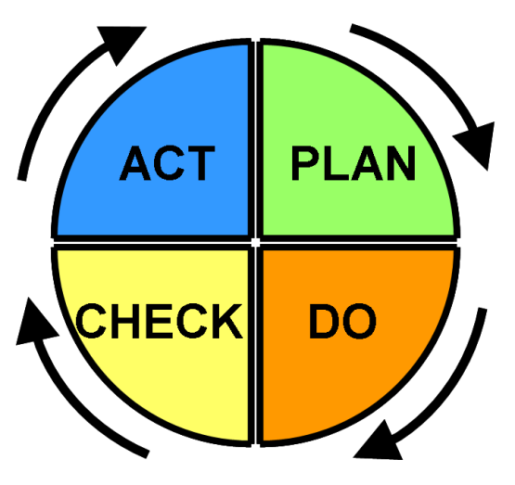
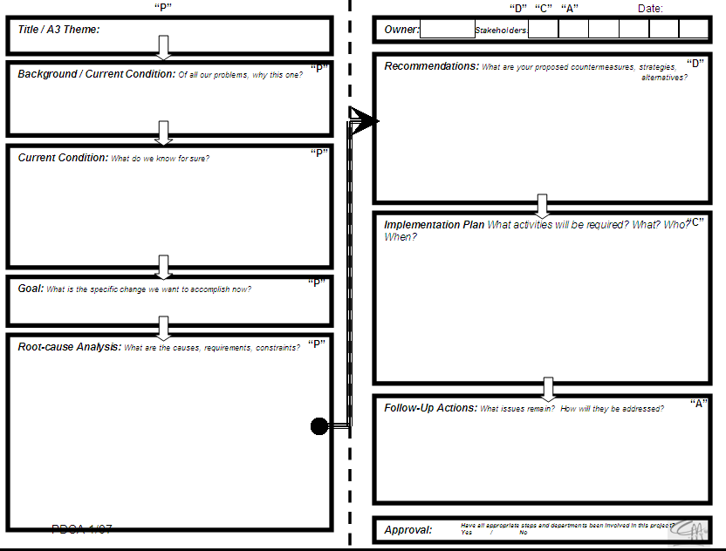
Plan-Do-Check-Act
Problem-Solving Process and
Using the A3 Template for Problem Identification
+

Slide 3
Agenda
Introduction / background
Exercise 1: what do you “see”?
PDCA Cycle
Problem solving tools
Exercise 2: Group Dynamics
A3 Report
Exercise 3: Problem Statement
Exercise 4: Group Practical Exercise

Slide 4
Background:
Features and Benefits
PDCA & A3 problem-solving are tools which:
Efficiently lead to the identification of a root cause,
Evaluate various candidate countermeasures that can be applied to mitigate a problem.
When practically applied, PDCA can guide a person or organization as they
Define the root cause of a problem,
Build consensus and support among stakeholders
Capture and communicate the resulting actions and decisions and their logic.

Slide 5
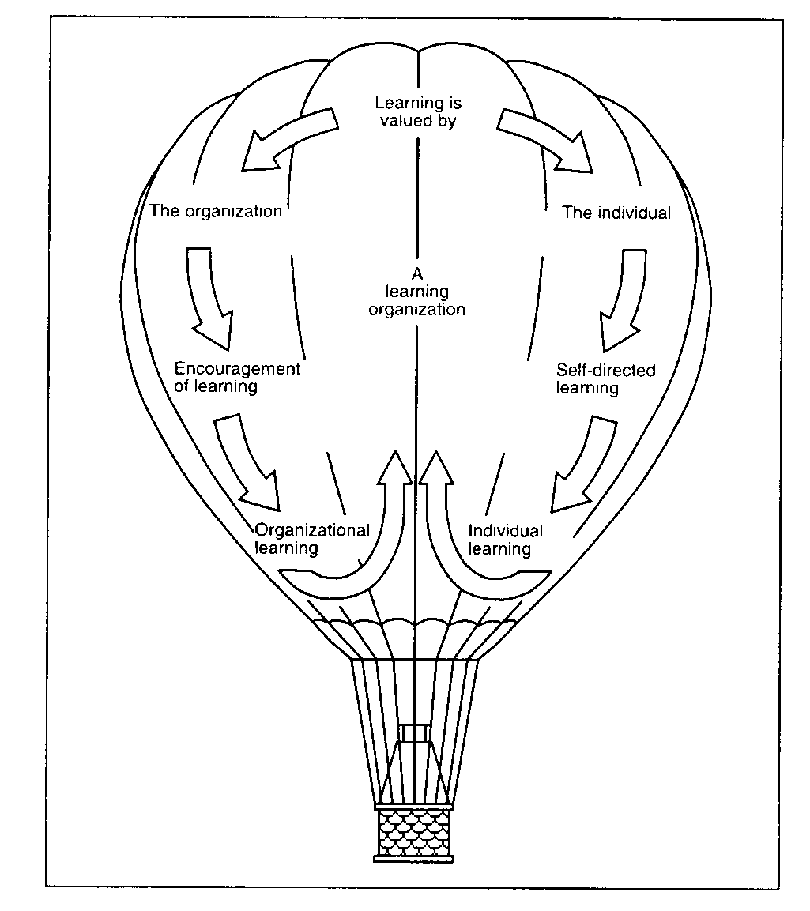
Background:
Features & Benefits
When an organization understands Problem-solving principles:
Move FROM: fire-fighting culture
TO: individual responsibility in solving problems at their root cause, sharing & Organizational Learning
When fully adopted,
  Individuals distinguish symptoms from root causes so they can effectively analyze problems and evaluate countermeasures.
  Cross-functional groups begin capturing the knowledge generated while solving a problem
  Communicate learning to appropriate colleagues and management.

Slide 6
Let’s see how you “see”

Slide 7
Exercise 1: It’s all in the details!
From memory, draw the front side of a penny
…include all of the details
10 minutes
Notes:
Teacher’s Key:
Every Detail Correct: +1 point
Every Detail Missed /Wrong: - 1 point:
Face Facing?: Left or Right
Left = -1
RIGHT = +1
“USA?”: YES = -1
“E Pluribus Unum?”:
YES = -1
“In God We Trust?”:
Yes = +1
Location: “I.G.W.T?”:
Top = +1
Anywhere else= -1
Date?: No = -1
Yes = +1
Date Location?
Left = -1
Bottom Right = +1
Mint Letter: None = -1
Yes = +1
Mint Location:
Left = -1
Under date: = +1
“One cent”: Yes = -1
No = +1
“Liberty?”: No = -1
Yes = +1
Liberty Location:
Right = -1
Left = +1

Slide 8
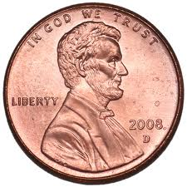
Teacher’s Key:
Every Detail Correct: +1 point
Every Detail Missed /Wrong: - 1 point:
Face Facing?: Left or Right
Left = -1
RIGHT = +1
“USA?”: YES = -1
“E Pluribus Unum?”: YES = -1
“In God We Trust?”: Yes = +1
Location: “I.G.W.T?”:
Top = +1
Anywhere else= -1
Date?: No = -1
Yes = +1
Date Location? Left = -1
Bottom Right = +1
Mint Letter: None = -1
Yes = +1
Mint Location: Left = -1
Under date: = +1
“One cent”: Yes = -1
No = +1
“Liberty?”: No = -1
Yes = +1
Liberty Location:
Right = -1
Left = +1
“What we know” and “what we think we know” are two very different things…

Slide 9
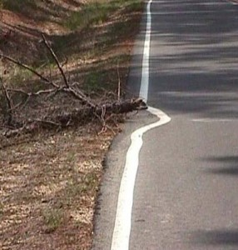
“Seeing” Problems
People come to work to add value but often don’t see the details to make the job easier…

Slide 10
Identifying a Problem
“problems are golden nuggets”
Define: What is the problem; what is the pain?
  How does it make your job difficult?
  Why does it matter?
  Who does it affect / does not affect.
  What does it effect / does not affect.
  How does it effect / does not affect.
  When is it a problem / is not a problem.
  Where is it a problem / is not a problem.
How will we know that a change is an improvement?
What change will we make that will result in an improvement?

Slide 11
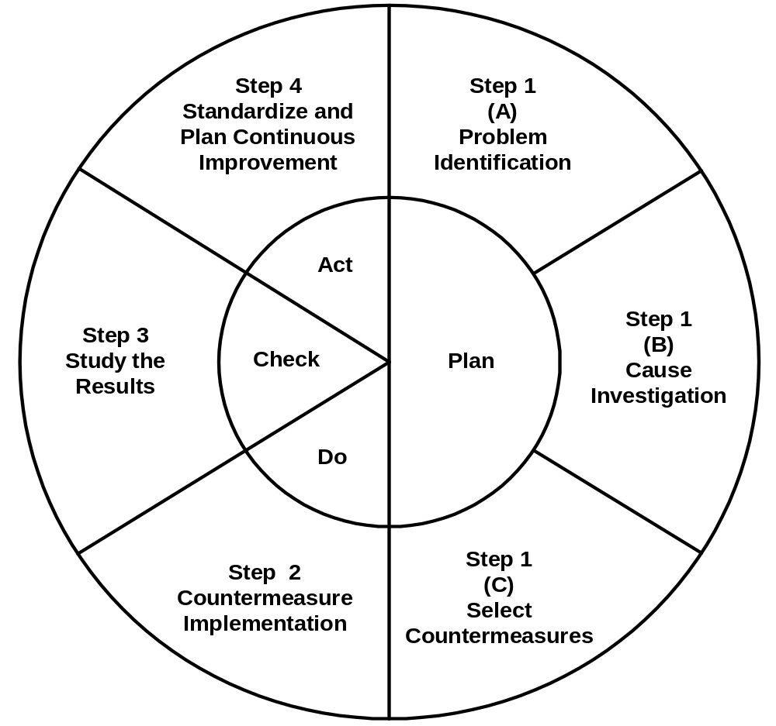
PDCA Steps
Step 1: (Hypothesis) “Plan”
  Identify problem
  Investigate root cause
  Select appropriate countermeasures
Step 2: (Try) “Do”
  Implement countermeasures
Step 3: (Reflect) “Check”
  Study the Results
Step 4: (Adjust/) “Act”
  Standardize and Plan Continuous Improvement

Slide 12
Step 1A: “Plan”
Problem Identification
Step 1A: “Plan”
Problem Identification
Determine the problem area
Define the standard
Define the current situation
Determine the inconsistency
Select a measurable goal
State the problem in a “Problem Statement” form in order to brainstorm potential causes
Determine the problem area
Define the standard
Define the current situation
Determine the inconsistency
Select a measurable goal
State the problem in a “Problem Statement” form in order to brainstorm potential causes

Slide 13
Step 1B: “Plan”
Cause Investigation
Brainstorm potential causes of the problem
Collect and analyze data related to the problem
Challenge the data with facts
Select most likely causes
Establish a cause/effect relationship
Determine root/driver cause

Slide 14
Step 1C: “Plan”
Select Countermeasures
Brainstorm for countermeasures to address root cause
Select proper countermeasure based upon criteria
Coordinate/gain approval of leadership to implement countermeasure

Slide 15
Step 2: “Do” Implement Countermeasures
Develop a plan to implement the countermeasure(s) selected
Are they temporary?
Assign tasks
Communicate the plan
Execute pilot Implementation Plan with timelines and establish a tracking method

Slide 16
Step 3: “Check”
Study the Results
Monitor progress of pilot Implementation Plan
Gather/analyze additional data if necessary
Modify implementation plan if necessary, based upon results
Monitor results of the specific countermeasure(s) that addressed the root cause

Slide 17
Step 4: “Adjust / Act” Standardize and improve
Evaluate the results
Standardize the effective countermeasure(s) to prevent recurrence
Share success with other affected areas
Plan on-going monitoring of the solution
Start the PDCA process again to refine the countermeasure or if the results are uneven
Continue with other improvement opportunities

Slide 18
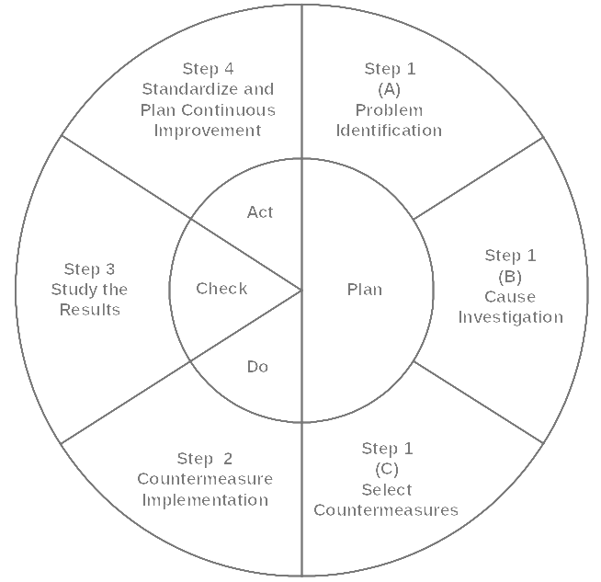
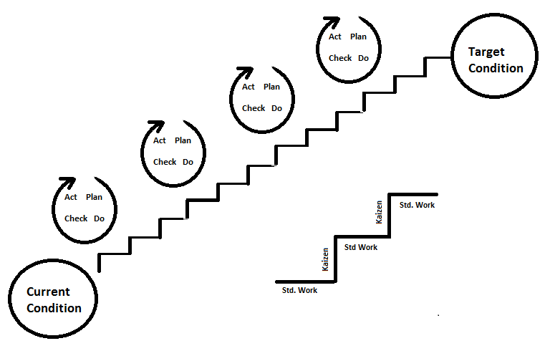
Step 5:
“Continuous Improvement”!

Slide 19
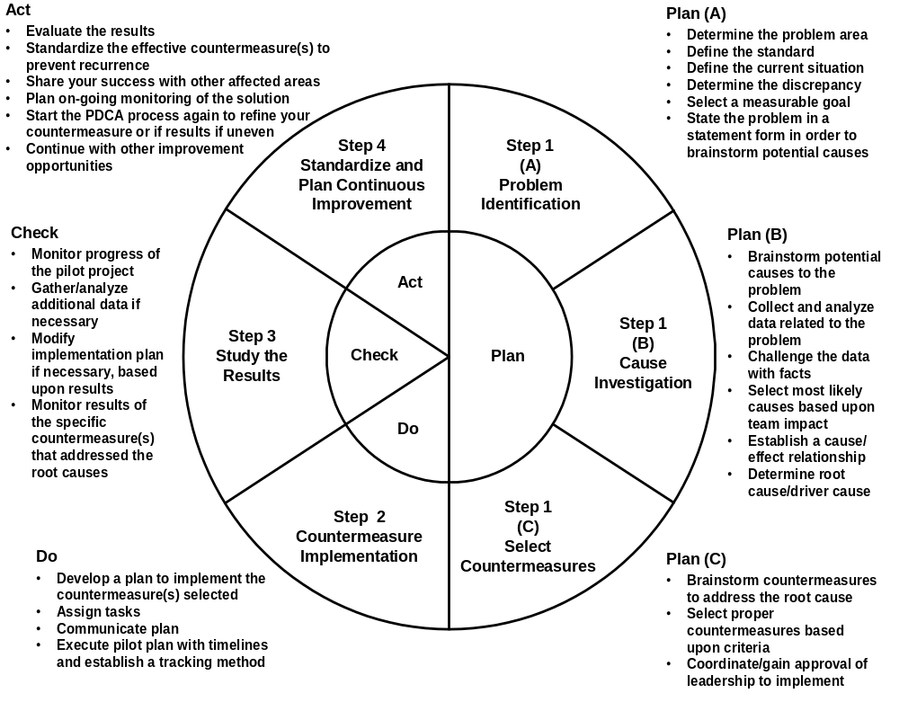
Summary of PDCA Steps
Handout

Slide 20
Group Dynamics Exercise 2
5 Brain Teasers:
How successful solving by yourself?
How successful solving as a Team?

Slide 21
Tools for Step 1A: Problem Identification
Tools to clarify information
for problem identification:
  Check sheet
  Line graph
  Pareto Chart
  Flowchart
  Affinity diagram
Keep? Omit?
Or move to X?

Slide 22
Tools for Step 1B: Cause Investigation
Tools to identify the most likely
causes of the problem:
  Cause and Effect (Fishbone) diagram
  Affinity diagram
  Interrelationship diagram
Keep? Omit?
Or move to X?

Slide 23
Tools for Step 1C: Select Countermeasures
Tools to select countermeasures:
  Criteria matrix
  Force field analysis
Keep? Omit?
Or move to X?

Slide 24
Tools for Step 2: Implement Countermeasures
Tools to implement countermeasures:
  Implementation Plan / Gantt chart
  Action Plans
  Flowchart
Keep? Omit?
Or move to X?

Slide 25
Tools for Step 3: “Check”
Study the Results
Tools for determining
effectiveness of countermeasures:
  Data collection
  Check sheet
  Line graph
  Histogram
  Pareto
  Flowchart
Keep? Omit?
Or move to X?

Slide 26
Tools for Step 4:
“Adjust / Act” Standardize
Tools for planning and
implementing standardized processes:
  SOPs
  Visual Controls
  Force field analysis
  Criteria matrix
  Radar chart
  Flow chart
Keep? Omit?
Or move to X?

Slide 27
Tools for Problem Solving
5W-1H
Cause and effect diagram (Fishbone Diagram)
Pareto chart
Flowchart

Slide 28
5-Why + (1-How) Analysis
The 5 ‘Whys’ and 1 ‘How’
Define the problem
  What fails?
  Where does the failure occur?
  When does it occur?
  How does it occur
Then ask ‘why’ five times until root cause(s) are identified or ignorance is reached
Once the root cause(s) is identified, ask, ‘How do I correct it?’
PDCA 1/07

Slide 29
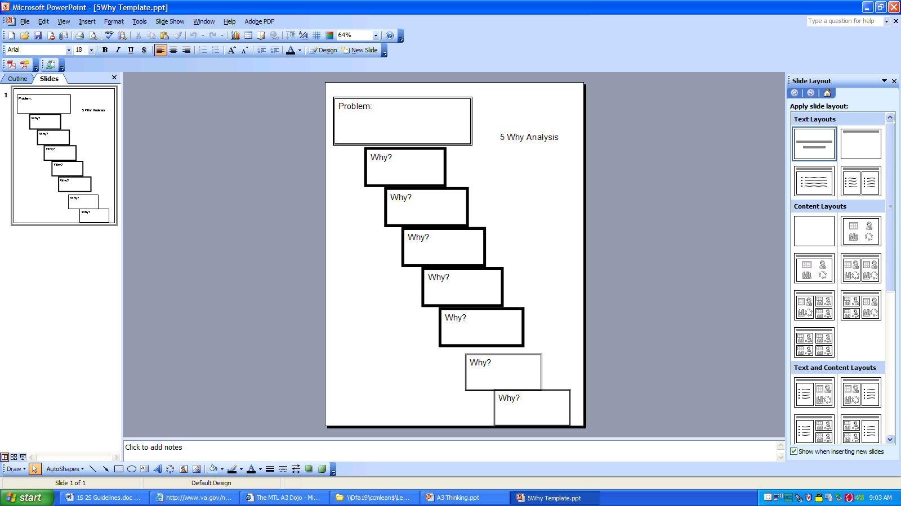
5 Why Analysis
Problem Identification:
What’s the problem/failure?
Where does it occur?
When does it occur?
How does it occur?
Cons:
Stakeholders not always involved
Not data driven, not repeatable
Easy to bias results ...
Relies on personal experience...
  -go and investigate...go and see
Doesn't account for multiple cause factors
Non-date analysis of simple issues,
  -important problems need data analysis
Pros:
East to use
Introduces problem solving methods
Prevents band-aid solutions (rush to judgment)
How?

Slide 30
5-Whys Exercise
To be refined
Habitually late for work:
Why is the employee late? Because she woke up late.
Why did she wake up late? Because she slept late last night.
Why did she stay up too late? Because she watched a late night show on TV.
Why did she watch TV late in the night? Because she can’t sleep.
Why can’t she sleep? Because she has insomnia.
Why is she insomniac? Because she is worrying.
Why is she worried? Because she’s thinking that she might lose her job.
Why is she worried of losing her job? Because she’s not getting any feedback from her boss regarding her work.
Keep? Omit?
Or move to X?

Slide 31
Tools for Problem Solving
5W-1H
Cause and effect diagram (Fishbone Diagram)
Pareto chart
Flowchart

Slide 32
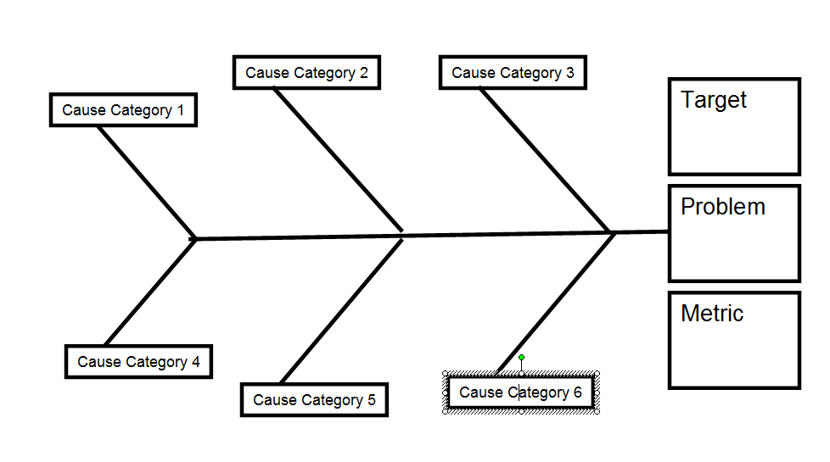
Fishbone Diagram (Ishikawa diagram) Problem-Solving Analysis Instructions
Cause
Effect
Refer to the Toolkit

Slide 33
Fishbone Diagram Problem-Solving Analysis Instructions
Materials
People (Manpower)
Measurements
Vendor-supplied
Attention
Test results
Age
Training
Process Temperature
Recipe / VC
Work Balance
Strength
Skills
Contamination
Technique
Calibration
Humidity
Machine Temp
Order of work
Ambient Temp
Settings
Timing
Accuracy
Environment
Adjustments
Reliability
Equipment (Machines)
Methods
Cause
Effect

Slide 34
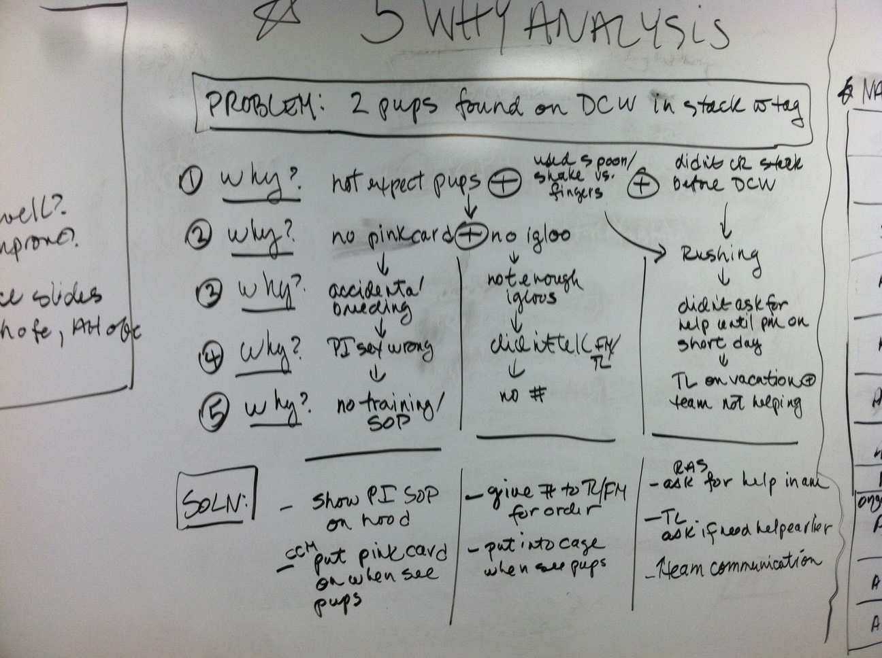
Simches 5-Whys Example

Slide 35
Creating a Fishbone Diagram
Step 1: Clarify the characteristics of the problem and write a title
Step 2: Write in the effect characteristics and draw the spine
Step 3: Clarify the factors affecting the characteristics
Step 4: Check for omitted factors
Step 5: Identify factors that strongly affect the characteristic
Step 6: Write in related information

Slide 36
Tools for Problem Solving
5W-1H
Cause and effect diagram (Fishbone Diagram)
Pareto chart
Flowchart

Slide 37
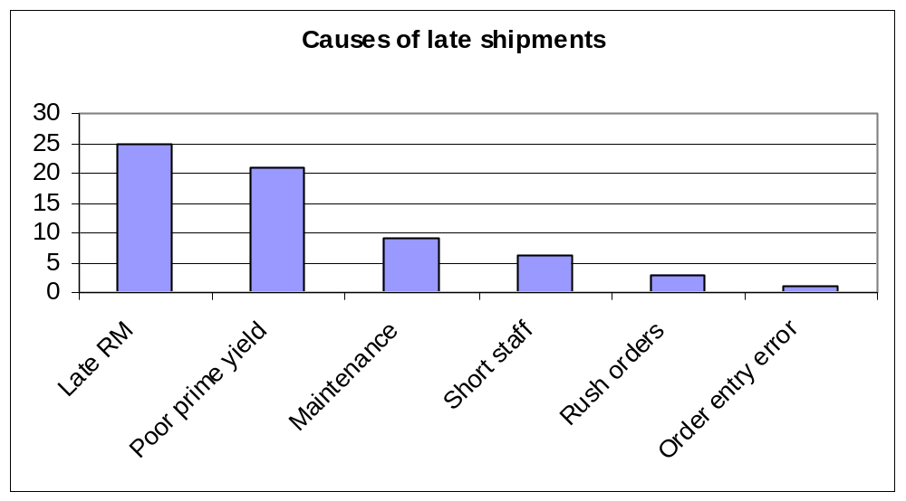
Pareto Charts
Used to show relative frequency or magnitude of events or issues, to identify the most important.

Slide 38
Creating a Pareto Chart
Step 1: Decide which items to study and collect data
  Content categories
  Cause categories
  Select the data collection time period
Step 2: Tabulate data and calculate the cumulative number
  Arrange items in order
  Use of “Other” category

Slide 39
Creating a Pareto Chart
Step 3: Draw the vertical and horizontal axes
Step 4: Display the data as a bar graph
Step 5: Drawing a cumulative curve
Step 6: Create a percentage scale on a vertical axis on the right side
Step 7: Label the diagram
Step 8: Examine the diagram

Slide 40
Tools for Problem Solving
5W-1H
Cause and effect diagram (Fishbone Diagram)
Pareto chart
Flowchart

Slide 41
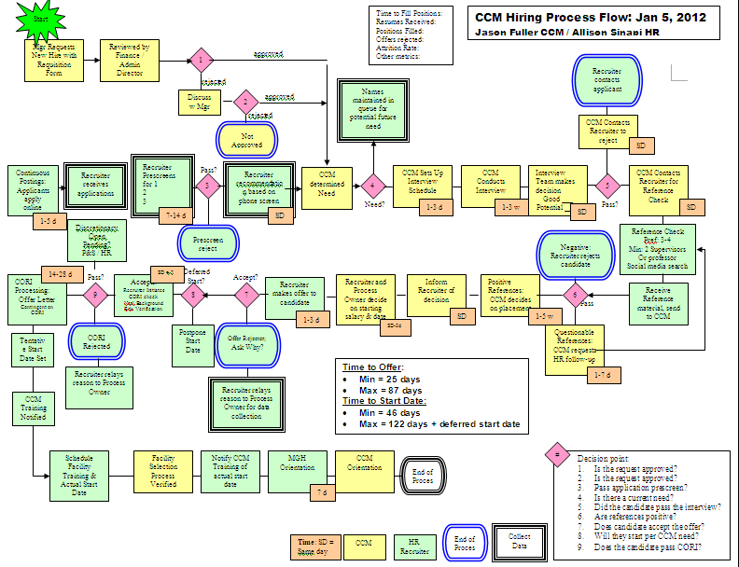
Flowchart
Purpose:
A graphical description of the steps in a task or process.
“See” duplication, complexity waste & bottlenecks

Slide 42
PDCA + A3 =
Model for Improvement
+
=
PDCA + A3 = Model for Improvement
“What are you trying to accomplish?
“How will we know that a change is an improvement?
What change can we make that will result in an improvement?

Slide 43
A3 or
Mini-Kaizen
Problem-solving Storyboard:
“A3”
Hand-written
Simple and easy to read / relate to
Dynamic

Slide 44

“P”
“D” “C” “A”
Date:
Title / A3 Theme:
Owner: Stakeholders:
Recommendations: What are your proposed countermeasures, strategies, alternatives?
“P”
“D”
Problem Statement: Of all our problems, why this one?
“P”
Current Situation: What do we know for sure?
Implementation Plan What activities will be required? What? Who? When?
“C”
“P”
Goal: What is the specific change we want to accomplish now?
Root-cause Analysis: What are the causes, requirements, constraints?
“P”
“A”
Follow-Up Actions: What issues remain? How will they be addressed?
Approval:
Have all appropriate steps and departments been involved in this project? Yes / No

Slide 45
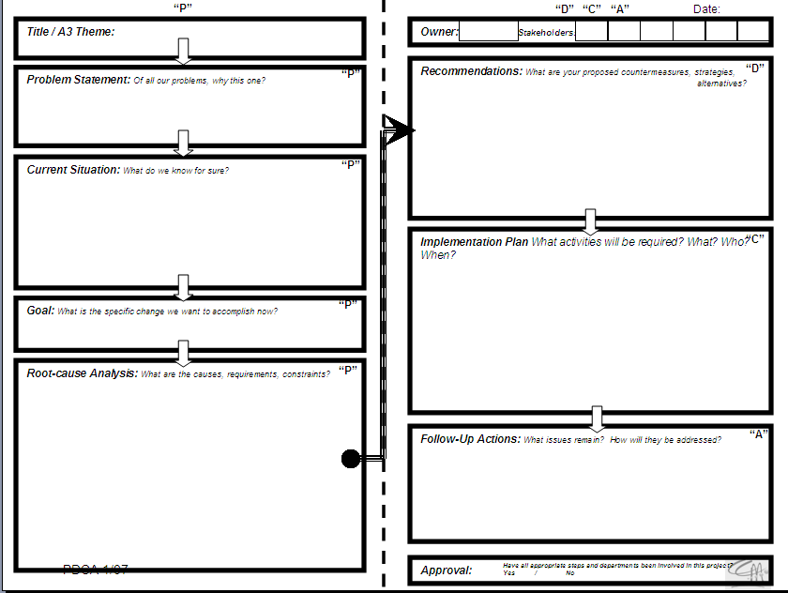
A-3 Report – Administrative Data
Title of project
Name, title, date
Team / stakeholders
Approval Authorities

Slide 46
Problem Description Statement
The Issue / Problem
  Sounds easy; the most difficult
  What REALLY is the problem?
What is the REAL PAIN the Team is experiencing?
  Leaders may need to coach and “mentor” the problem-solver to revisit the problem as the progress through the Mini Kaizen and start analyzing the real problem!

Slide 47
A Good “Problem Statement” test:
What is the problem?
Why is it a problem?
How important is it? (how does it tie to the CCM business objectives/Mission Statement)
How can you measure the problem?
What are the FACTS?

Slide 48
Exercise 3:
Problem Statement
Escalator Video
http://www.youtube.com/watch?v=47rQkTPWW2I
  Materials
  Manpower
  Methods
  Mother Nature
  Machines
  Measure
Notes:
Escalator Video
What’s the problem?
What are the facts?
What are the improvement opportunities?
Walk up stairs
Walk down stairs
Is it cost-effective to stay on the escalator?
Waiting for help to arrive
Contingency Plan?
Obstacles: Unexpected Learning; becoming stairs
Lazy?
Unwilling?
Big Decision?
Which One are you?
What does a broken escalator cost?

Slide 49
Current Situation
Determine the Problem
  Background of issue
  Context
  Business impact
Standard
Current Situation or Performance
Discrepancy – Current versus Ideal
Extent or Duration
Rationale (Reason to Improve)
Goal Statement

Slide 50
Goal
What is the specific change we want to accomplish now?
What is the ideal state?
What will a “perfect” situation look like?
Does this goal support the CCM Mission?
Has leadership approved of the Goal?

Slide 51
Identifying Causes and Solutions
Problem Statement
  Revisit & review
5-Whys
Potential Causes
After Fishbone Categorization
Analyze Root Causes
Prioritize
Countermeasure(s) Brainstormed

Slide 52
Solutions /
Countermeasures
Countermeasures selected
How will they eliminate root causes?
How will we communicate the countermeasures?
How will we monitor the countermeasures?

Slide 53
Implementation
Plan
What will be done?
Who will do?
Where will it be done?
By when will it be done?

Slide 54
Following Up
What will be checked?
How will it be checked?
When will it be checked?
What next steps are recommended?
  New improvement?
  New problem?

Slide 55

A3 Group Exercise 4:
Titanic (or next slide)

Slide 56
A3 Group Exercise 4:
“Poor Alice”
Team Lead candidate
Attendance issues: corrective action
Competing priorities
Family dynamics
Household flow

Slide 57
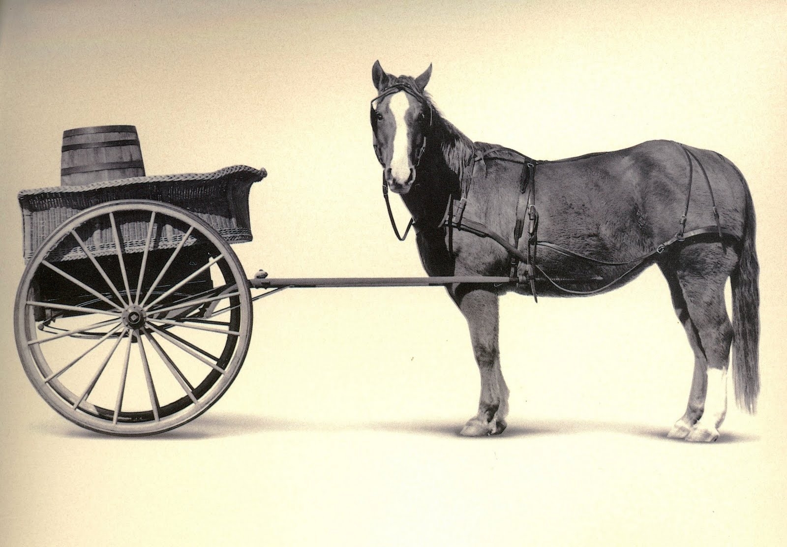
JDIs: (…failure to plan is planning to fail…)
Proceed with Caution!
“PDCA is destroyed in the reverse order it is built…”
Beware of justifying a solution without analyzing the problem…
Leaders should ask:
What problem are they trying to solve?
Did they test / document it?
How will they know the condition improved?

Slide 58
Mini-Kaizen / JDI Plaque
Recognize improvements
Track Improvements
Stimulate TEE involvement

Slide 59

Feedback?
What made sense?
What needs more clarification?
How will you use PDCA / A3?
When will you use PDCA / A3?

Slide 60
Extra Slides

Slide 61
Problem Solving Methods & Tools
Coaching
  Campus managers
  Facility managers
  Program managers
Observation
  Data collection
Brainstorming
  All Roles
VSM
  Flow Charts
5 Whys
Fishbone Diagram

Slide 62
PDCA cycle
Problem-Solving Model
Adjust / Act
Hypothesis
Reflect
Try
“Scientific Method”

