Slide 1
Captcha Identify
group3
1091734 陳孟淵

Slide 2
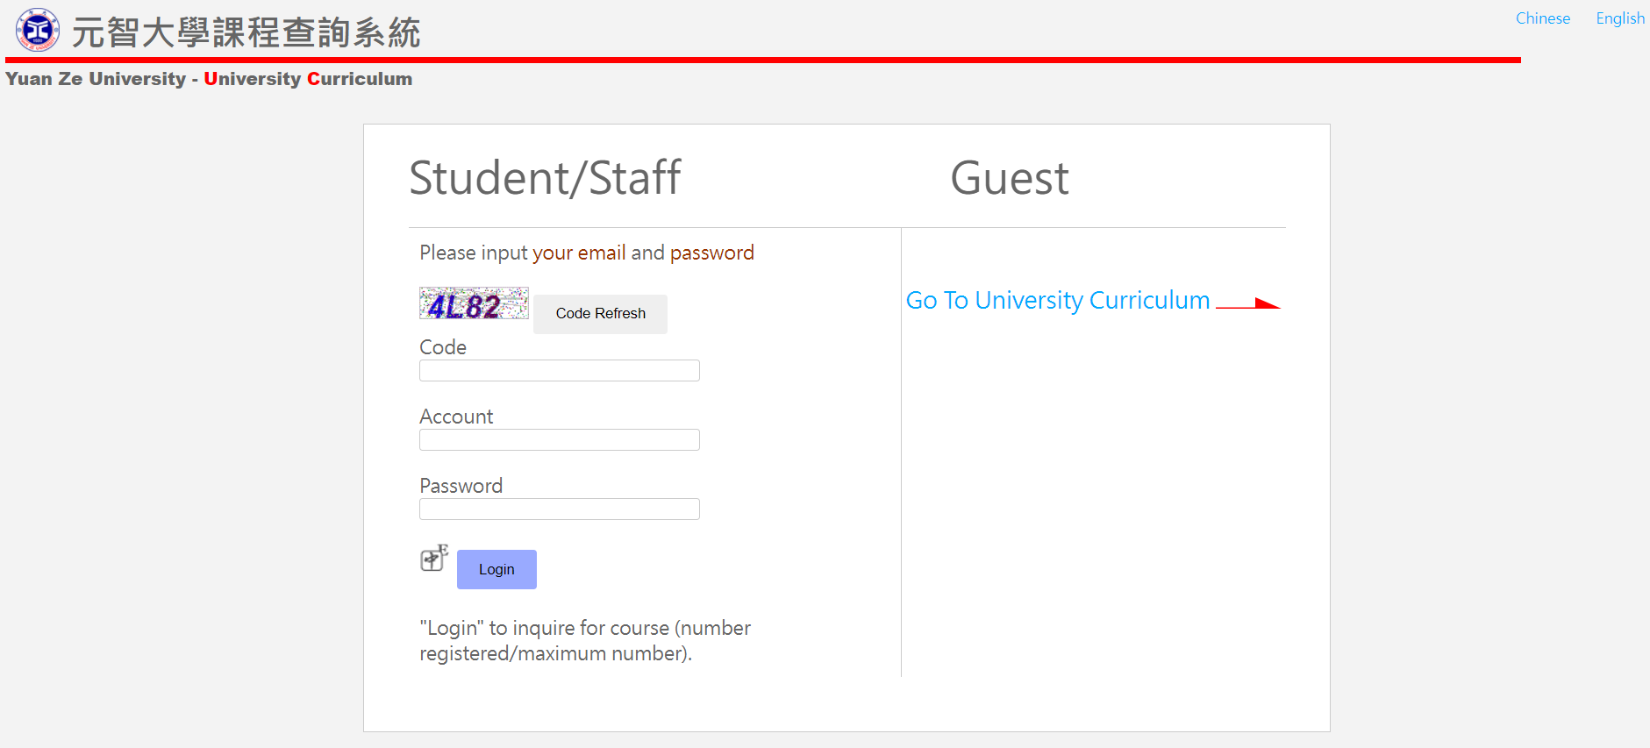
Web spider
https://portal.yzu.edu.tw/cosSelect/Login.aspx?Version=EN

Slide 3
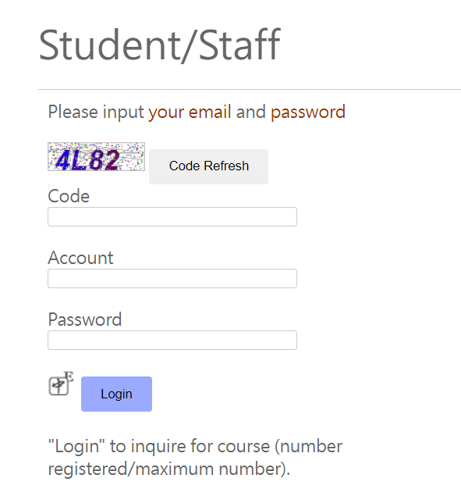
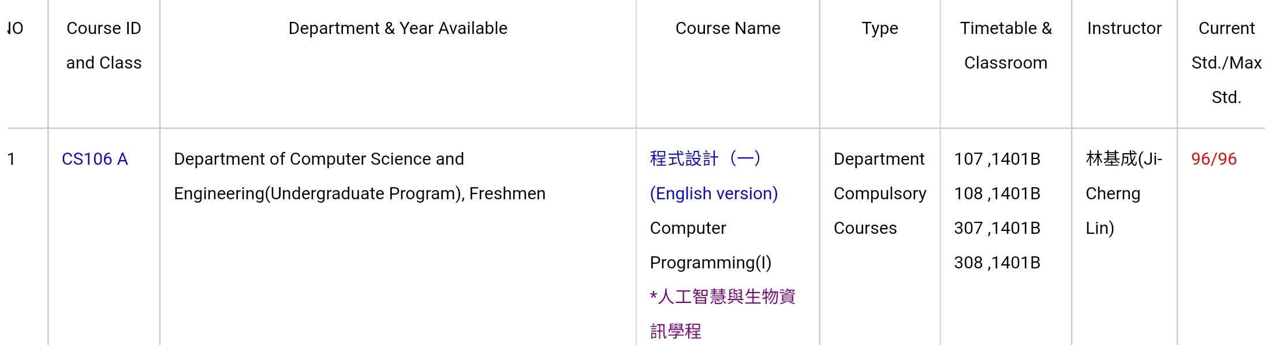
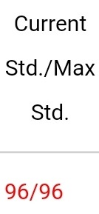
=>
Login

Slide 4
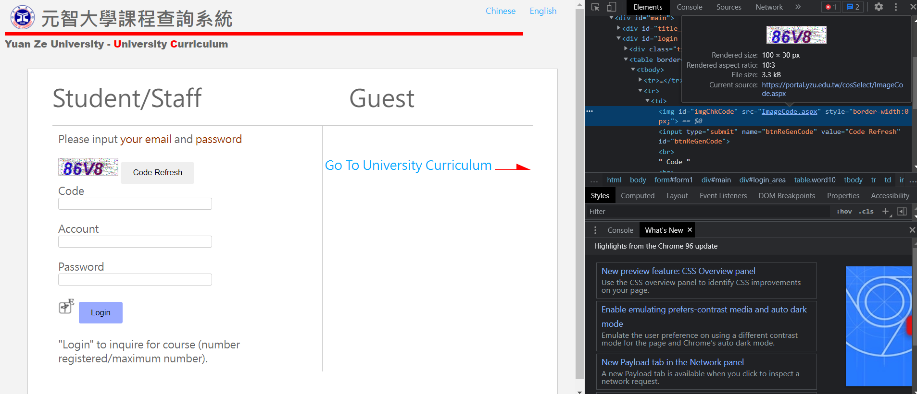
https://portal.yzu.edu.tw/cosSelect/ImageCode.aspx

Slide 5
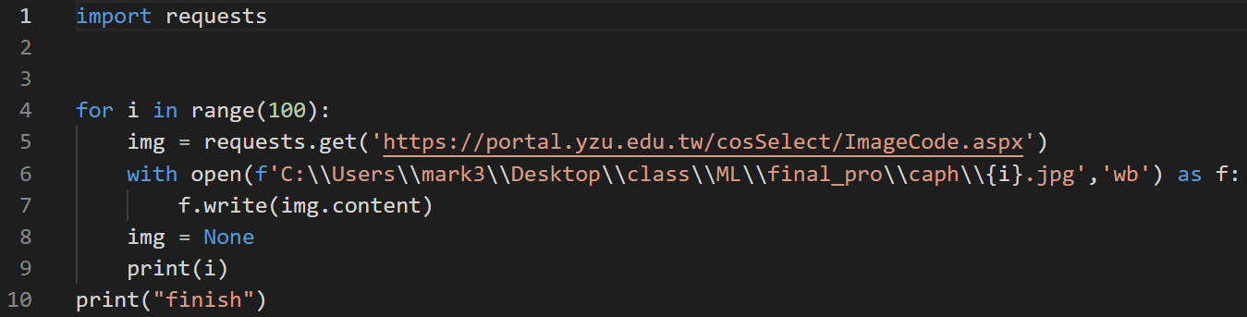
Step1. Get date

Slide 6
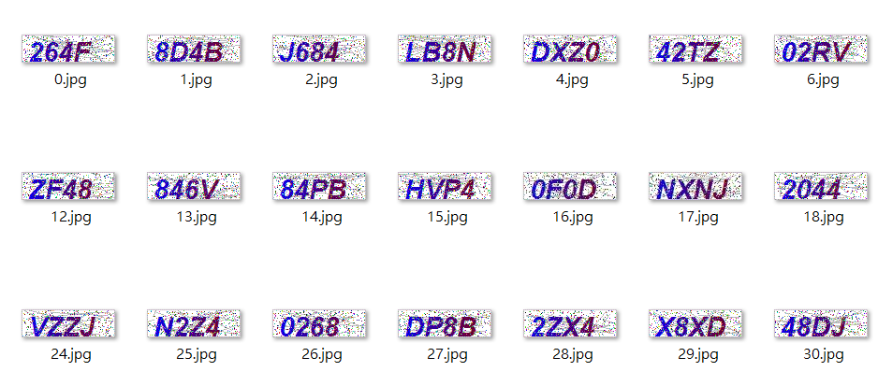
Original data

Slide 7
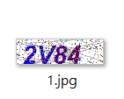

Step2. Handle image
rename

Slide 8
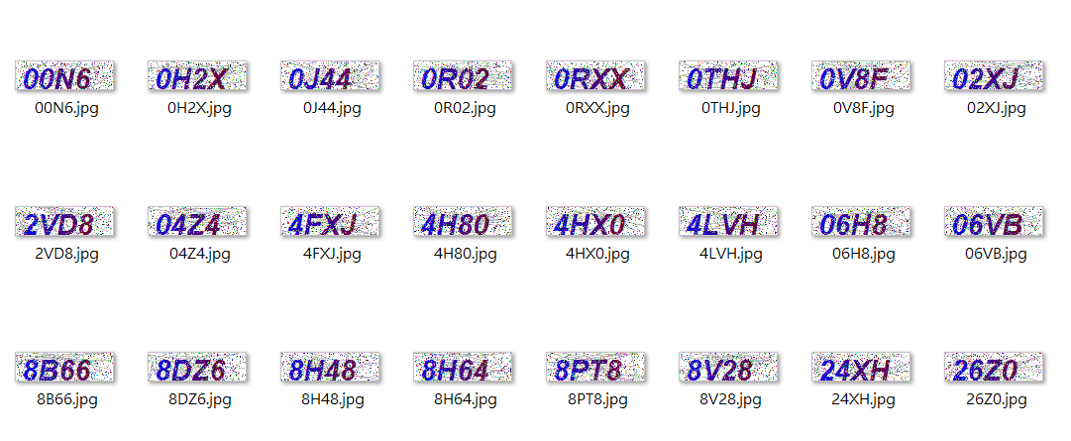
Image dataset

Slide 9
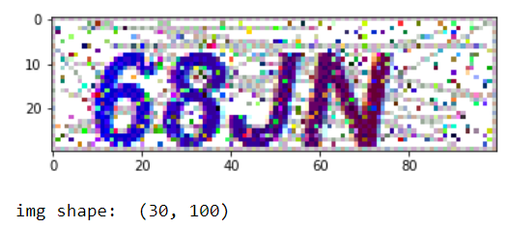
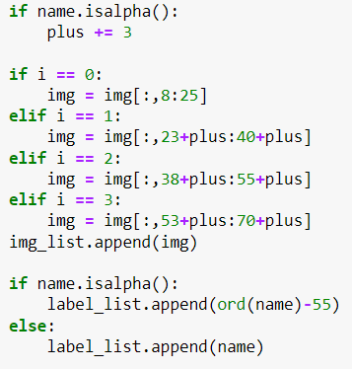
separate image

Slide 10
Step4. data preprocessing
# Code:
img=img.convert('L’) #gray
img=np.asarray(img) # turn into numpy array
imgnp = imgnp.reshape(400, 30, 17, 1) # ori.shape:400,30,17
imgnp = imgnp.astype('float32')/255 # turn it into 0-1
labelnp = keras.utils.to_categorical(label_list, num_classes=36) # 0-9, A-Z(10-35)

Slide 11
# Code:
train_img = imgnp[0:300]
test_img = imgnp[300:350]
img_val = imgnp[350:400]
All image: 100*4 = 400
Train: 300
Test: 50
validation: 50

Slide 12
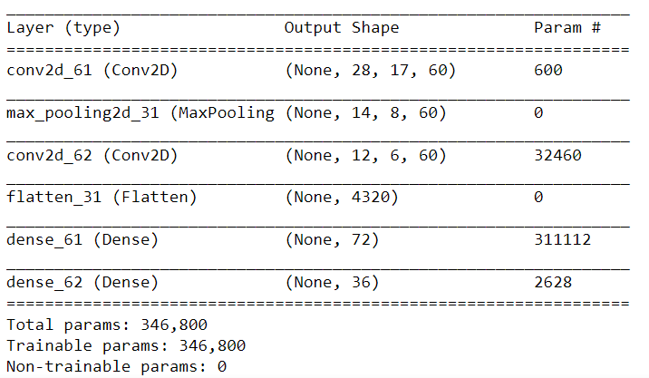
Model
Optimizer=‘rmsprop’ loss='categorical_crossentropy'

Slide 13
Step5. request and try
Run the program

Slide 14
Some problems may happen
Dataset is too short => overfitting
Alphabet and number have different size => wrong data
Dataset hasn’t been filter => wrong data
Too same, like 2 and Z => wrong data

Slide 15
Thanks

