Slide 1
RESUME/CV WRITING

Slide 2

Are they Even Looking
A potential employer looks at your resume/CV very quickly
  15 – 20 seconds minimum
  45 seconds maximum

Slide 3

Why do you need a resume/CV?
A marketing tool
To obtain an interview, not a job
Requirement of many organizations

Slide 4
Sections of a Resume/CV

Slide 5
The Header
What should be included?
  Name
  Permanent and present address
  E-mail address
  Telephone number
Where should contact information go?
  Top of the page

Slide 6
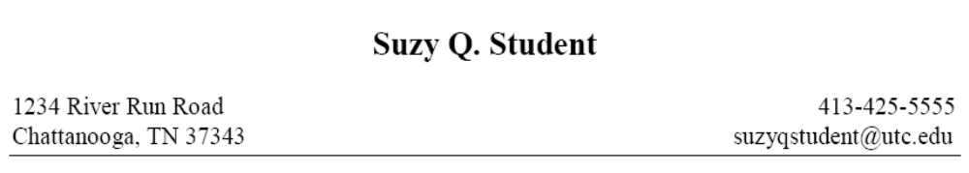

Slide 7
Profile
Purpose
  A brief summary of yourself and some of your strengths
  Elevator pitch
  Optional
    If you have more experiences related to the job you’re applying for, then list those rather than adding a profile
Length
  Should only be two to three sentences long
    Maybe four if you can fit it

Slide 9
Education
Name of Institution
  Include city and state if its not part of the title
    Include it if you’re applying to a different country
Name of your degree and major
  Bachelor of _________ in ___________
    Bachelor of Science in Business Administration: Accounting

Slide 10
Education
Date or expected date of graduation
  Graduation Date: May 2014
  Expected Graduation Date: May 2015
Grade Point Average
  You might not need this but its good to have
  Most grading systems here in spain are based on a 4 or 10 point grading system
  If you apply to another country and you need to convert your GPA to that country you should be able to find a calculator online

Slide 11
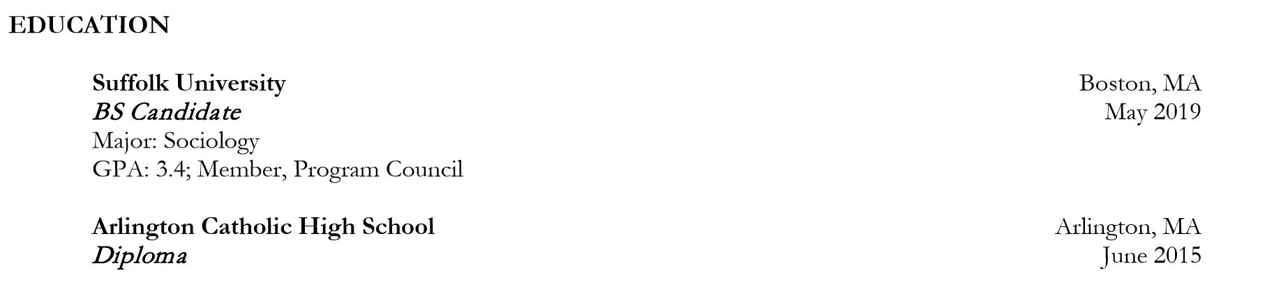

Slide 12
Experience
Use the term "experience" as a label
  What is considered experience?
    Full and part-time jobs
    Self-employment
    Volunteer work
    Practicum, field, and cooperative education
  Information to include
    Job Title
    Dates of employment
    Company name
    City & State

Slide 13
Listing Responsibilities
Use bullet points
Start of each line with an action verb
  Present tense if currently employed
  Past tense if no longer employed
  Vary your choice of verbs
Tailor skills and experiences to the position for which you are applying
Be concise while providing enough detail
Use specific amounts

Slide 14
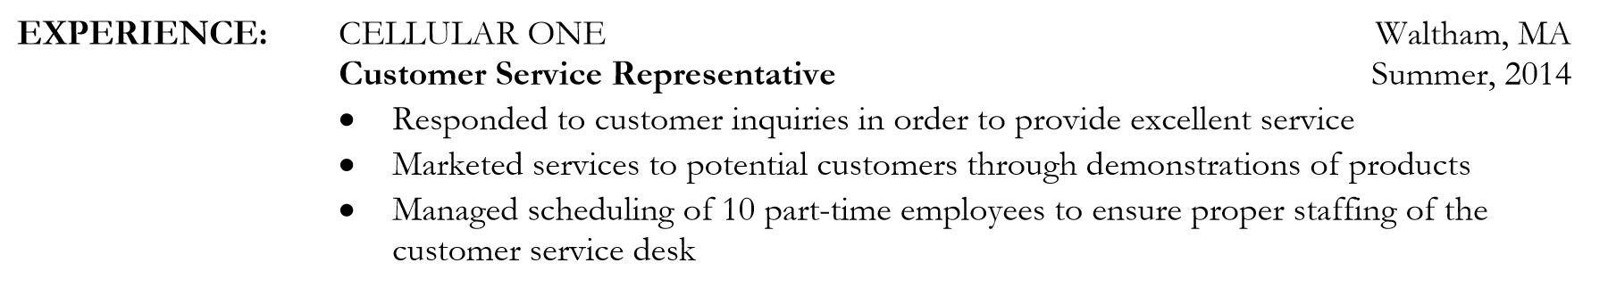

Slide 15
Honors & Awards
Order by dates
  Reverse chronological
Rank order by importance to the career objective

Slide 16
Professional Affiliations & Activities
Rank order by importance to the career objective
Emphasize your leadership roles
Spell out the organization’s name:
  Do not use abbreviations or acronyms

Slide 17
Languages
Add in the languages you know and what you levels are.
If you don’t know your exact level, you can put what you think you level is, take the self assessment test on the Europass website,or take an official assessment

Slide 18
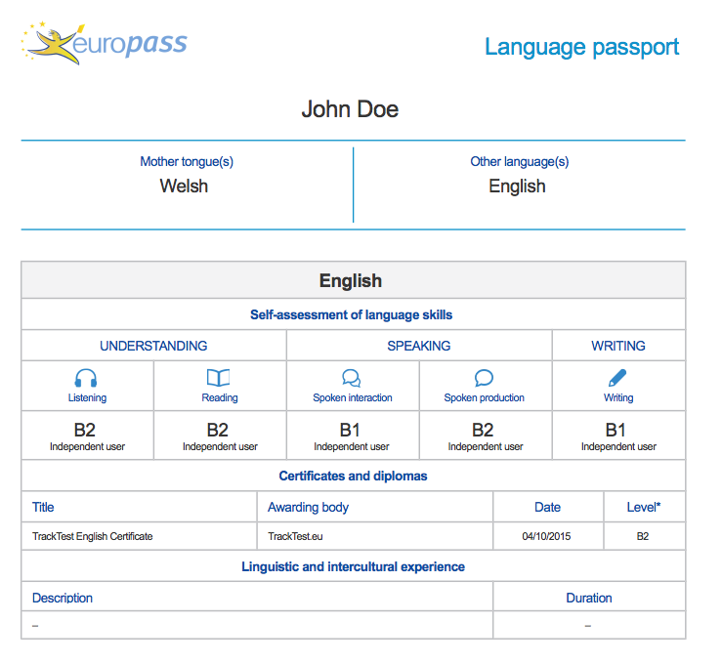

Slide 19
Resume Do’s
Use action verbs
Use short, concise sentences
Use #, %, € amounts
Keep resume easy to read
Keep resume about one page

Slide 20
Resume Don’ts
Do not use the pronouns such as I, me, my, etc.
Do not include references
Do not clutter your resume with nonessential information
Do not include personal information
  SSN, age, sex, height, weight, marital status, photograph, etc.

