Slide 1

G20 Mohotsav-
Skill Expo
By-
Vignesh Gunjal – Grade 12
Vyom Bhatt – Grade 10

Slide 2

G20
Energy Sathi
Empowering Energy Efficiency

Slide 3
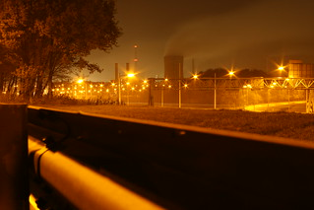
The Problem
In this leading technological world, consumption of energy at ground root levels has suffered drastically with respect to it’s efficient usage.
This is mainly due to high greenhouse gas emissions, overutilisation of energy resources like fossil fuels and electricity.
The project aims to minimise the energy consumptions of a building to conserve our resources and promote sustainable development.
Inefficient energy consumption in a locality by buildings causing a lot of pollution-

Slide 4
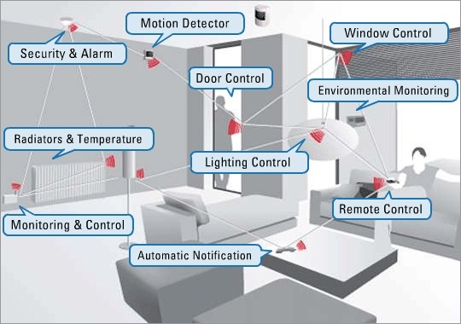
How do we approach the problem?
Need to
  measure the energy usage .
  monitor other parameters that relate to the problem.
  change circumstances automatically by prediction.
  automate HVAC systems by prediction.
How to execute?
Measure energy usage- Measuring the total energy consumed using Energy=Voltage * Current * Time.
Other parameters- Light levels, Carbon Dioxide levels, Humidity, Temperature, Motion detection
Change circumstances automatically by prediction- Using AI and blended machine learning using python.
automate HVAC systems by prediction- Taking inputs from AI to power the ac, lights, fans using relays and opening the windows for ventilation with motors.

Slide 5
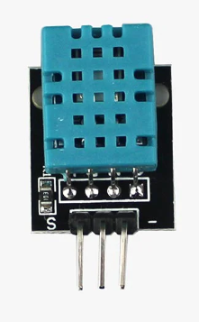
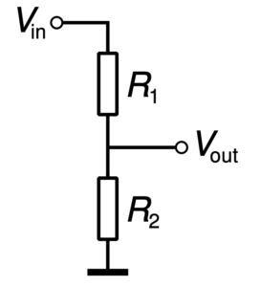
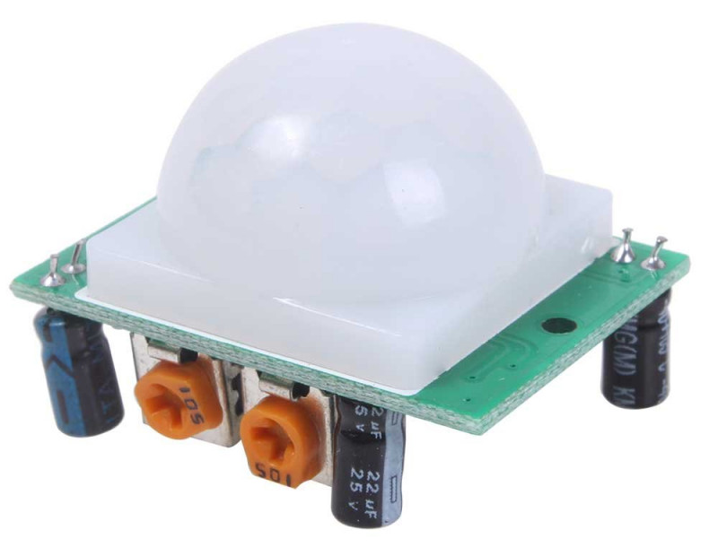
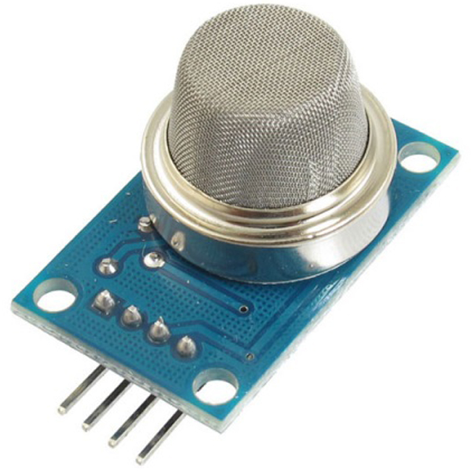
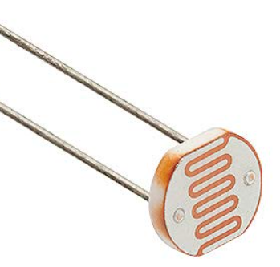
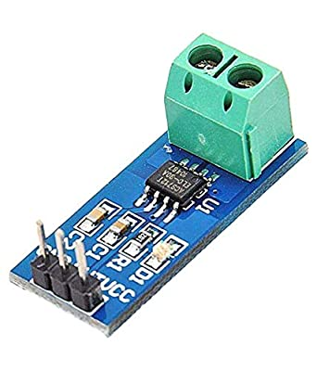
What components we are using?
A voltage divider circuit to measure the voltage, ACS712 dc current Hall effect sensor 5A range and adding the time factor in python code for energy.
Photoresistor for measuring light levels, MQ135 gas sensor for CO2 levels, DHT11 sensor for temperature and humidity and PIR sensor for motion detection.
Python script for prediction , collection and Estimation to reduce energy consumption.
According to the python AI suggestions using a relays and motors to control the HVAC systems.
Voltage divider
Circuit
PIR motion sensor
ACS712 Current sensor
DHT11
Sensor
MQ-135 gas sensor
Photoresistor

Slide 6
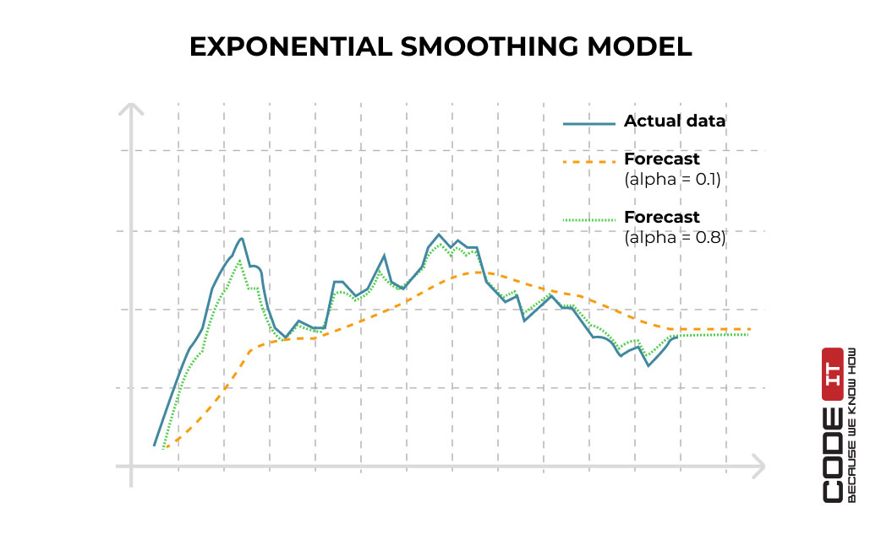
Use of Machine Learning
Predict Energy Consumption : Machine learning will be used to analyse sensor data received to analyse previous data usages along with relevant weather conditions like humidity, time of day to predict future energy consumptions.
Detecting Anomalies : After learning and predicting future consumptions, abnormal energy usages will be reported if they don’t match predictions, which may be due to inefficient energy consumption or equipment malfunction.
Giving Feedback : In case energy consumption is very inefficient and can be adjusted to lower consumptions, machine learning can give feedback to help adjust energy consumptions based on real time energy demands and weather conditions.

Slide 7
Associated G20 and FLN Principles
The G20 principles our project abides by are:
  Sustainable Development : Reducing energy consumption in buildings, contributing to environmental conservation and long-term resource sustainability is a basic aim of the project.
  Energy Efficiency : We aim to optimize energy usage in buildings through innovative technologies and strategies, reducing light and greenhouse gas emissions.
  Technological Innovation: Integrating machine learning and IoT technologies into the project aligns with the G20 principle of fostering technological innovation. These technologies enable data-driven decision-making and advanced control systems, enhancing energy efficiency in buildings.
The FLN principles our project abides by:
  Safe Data Collaboration : Different buildings can share their energy consumption data for analysis without sharing raw data, ensuring data privacy while collectively working towards energy optimization.
  Knowledge Sharing : Collective insights gained from multiple buildings' data can contribute to a shared knowledge base, facilitating the development of energy-saving strategies and best practices.
We want to use sustainable development, energy efficiency, and collaboration towards a common goal of minimizing energy consumption in buildings

Slide 8

15 % to 30 %

Slide 9
Future Enhancements
In hardware : Adding more parameters like :
Measuring water consumption
Measuring equipment efficiency
Measuring solar radiations around building
In software : Improving it by :
Including factors like recommended energy consumption from G20 and FLN
Improving our AI and ML algorithms

Slide 10


