Slide 1
Code Generation Update
Andy Edmunds
University of Southampton
ae2@ecs.soton.ac.uk

Slide 2
Since the last RUDW
  Concluded industrial collaboration,
    Improvements to translator.
    Java interface for the Environment.
  Templates and code-injection.
  Event-B to FMI-C translation,
    for use in co-simulation.
  Theory + Java Code for Implementable Sets and Functions.

Slide 3
Improvements to Translators
  Generally,
    Automatic flattening of invariants, and events.
    Automatic inference of typing annotations and parameter directions.
    … means fewer steps to generate code from an appropriately constructed model.
  For Java integration with Event-B projects,
    To use Java Nature and Java Builder (JDT).

Slide 4
Some Items on the To-do List
  But, we are still short of the goal, in terms of usability, and features.
  Validation and feedback.
  Translation of nested state-machines.
  Synchronization between events of a state-machine
  (Other than the current between-cycles approach).

Slide 5
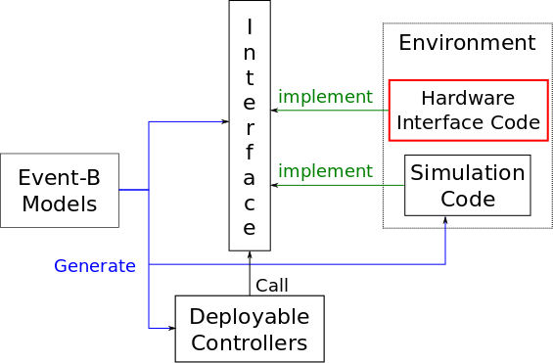
New: A Java Interface for the Environment
Hardware Interface – most likely manually coded.
Simulation Code – can be auto-generated.

Slide 6
New: Templates and Code Injection
  Short paper in ABZ2014.
  Arose out of Thales' request to think about
  customisation for deploying on different targets.
  Boilerplate code with injection points.
  Injected code is generated from an Event-B model,
    using a 'generator' extension point.

Slide 7
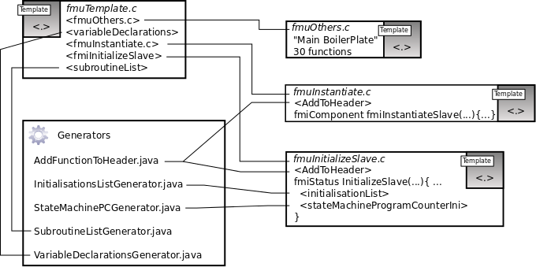
Templates (for the FMI Translator)

Slide 8
New: Event-B to C, for Co-simulation
  For Advance EU FP7, uses FMI.
  The objective is to test the generated code in a simulation of its environment.
  Master and Slaves communicate through API.
  Slaves are FMUs.

Slide 9
Event-B to C, for Co-simulation
  The master is cyclic; slaves are initialized,
  … then master does simulate-update cycle.
  We can generate an FMU from an Event-B machine and component diagram.
  We can replace the machine, with the FMU, in the component diagram, and simulate/test with that.
  We can also import FMUs into other simulators.

Slide 10
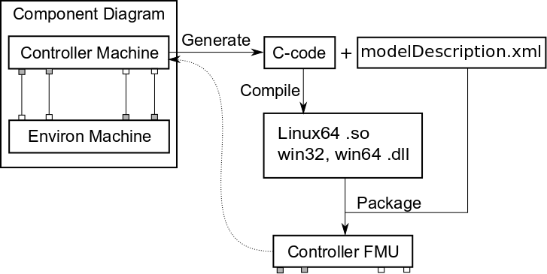
  FMUs from Machines

Slide 11
  Current Status
  Event-B to C code generator – Working.
  FMU packager – Working.
  Examples pass FMU checkers/simulators
    Win32
    Linux64
  Component simulation – not yet working.
  Dymola Simulator import – not yet working.

Slide 12
NEW: Implementable Sets and Functions
  Translate Sets and Functions to code.
    Uses the Theory plug-in.
  Depends on target language API,
    Java HashSet and HashMap.
    Function - domain elements map to keys,
    Range elements map to values.
  Still experimental.
  Used in PRIME project.

Slide 13
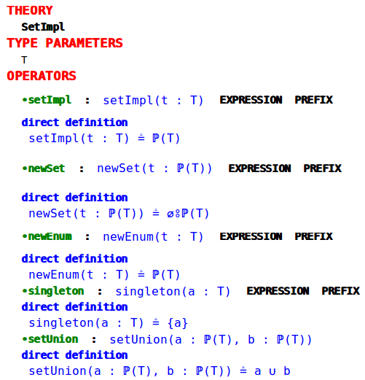
Implementable Sets

Slide 14
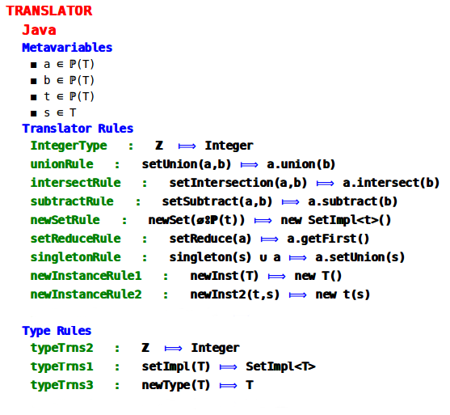
  Translation Rules

Slide 15
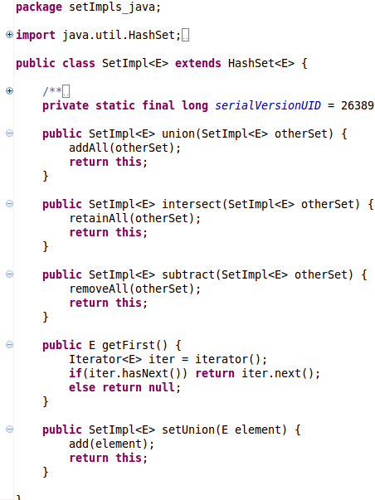
Java Set Implementation

Slide 16
  Questions:
  How to improve plug-in development when much of it is engineering, not research?
    Academia v Industry: bridging the gap?
    Providing a platform to 'sell' Event-B?
    Day-to-day,
    Keeping up with (communicating) changes?
    Compatibility issues?
    ...

