Slide 1
Templates for Event-B Code Generation
Andy Edmunds
University of Southampton
ae2@ecs.soton.ac.uk

Slide 2
Code Generation with Tasking Event-B
  Tasking Event – B is
    an extension to Event-B.
    flow control language and annotations.
  Tasking Machines (1) map to task implementations.
  Shared Machines map to protected objects,
    provide monitor-style protection.
  Environ Machines (2) map to tasks for simulation.

Slide 3
Code Generation with Tasking Event-B
  Tasking/Environ machines have 'Task Bodies'
    to describe program flow.
    which map to program statements.
  Program flow such as,
    IF event1 ELSE event2 END
    event1 ; event2
  Events 'populate' sequences, branches, loops, actions, procedures, procedure calls.

Slide 4
Why Templates?
  Configuration of code generation targets.
    'Templates' can be used for configuration,
    and avoids hard-coding it in the translators.
    Templates are re-usable.
    But, Acceleo / JET – more than we need?
  Reuse of the generated code,
    The same Event-B model can be used to generate simulation code and deployable code.
  Used on the Advance project for FMI-C generation.

Slide 5
Co-simulation with FMI
  Master and Slaves communicate through API.
    Enables Discrete/Continuous Simulation.
    Slaves are FMUs.
    The master is cyclic; slaves are initialized, then does simulate-update cycle.
  We can generate an FMU from a machine.
    But, tasking machines map to protected objects,
    … because of the 'hidden' master.
  Simulation uses a 'component diagram'.
    We can replace the Event-B Machine in a diagram, with an FMU and simulate/test with executable code.

Slide 6
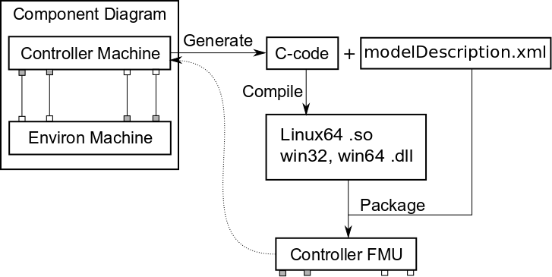
FMUs from Machines
API for FMU:
Get Values
Set Values
Query Status
Instantiation
Initialisation
Simulation Step

Slide 7
Using Templates for FMI-C
  The initial idea: Some code needs configuration, depending on the target;
    e.g. FMI life-cycle functions.
    but doesn't need to be modelled formally.
    and is re-usable.
  The code generated from Event-B models should be the 'critical' code.
    Can be sent to different targets.
  Some merging of the two is needed.

Slide 8
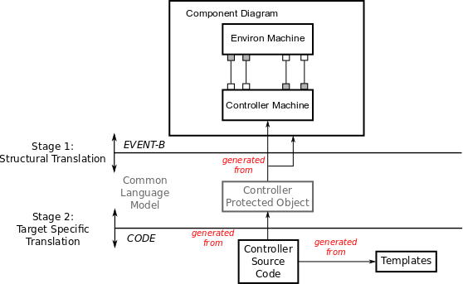
FMI With Templates

Slide 9
Template Tags
  Tags facilitate:
    code injection points, and use of generators.
    further template expansion.
    production of meta-data, using generator.
  The notation:
    //## <name>
    where name identifies a template or generator name.
  Generators are stored internally in a map of name to class.

Slide 10
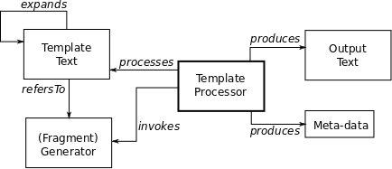
Template Processor Architecture

Slide 11
An Example Templates
//## <addToHeader>
fmiStatus fmiInitializeSlave(fmiComponent c,
fmiReal tStart, fmiBoolean StopTimeDefined,
fmiReal tStop) {
ModelInstance* comp = (ModelInstance*) c;
//## <initialisationsList>
//## <stateMachineProgramCounterIni>
return fmiOK;
}

Slide 12
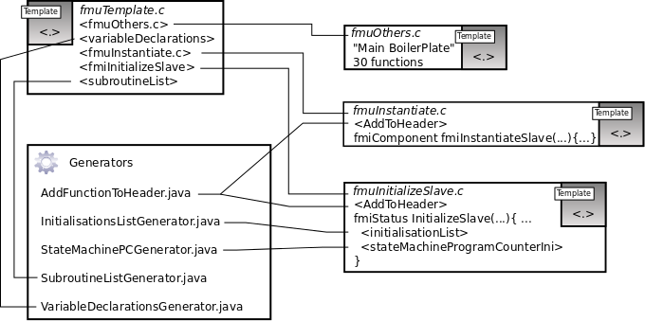
The Other Templates

Slide 13
The IGenerator Interface
  Extend this to provide a new generator,
    uses the extension point
      org.eventb.codegen.templates.generator.
    then implement the method,
      public List<String> generate(IGeneratorData data).
      and supply any necessary data using IgeneratorData.
  A Tag string can be specified; so that it matches the comment characters of a target language.

Slide 14
Translating...
  TemplateHelper.generate(“fmiInitialiseSlave”)
    finds the generator, and calls it.
    For fmiInitialiseSlave it does the following,
public List<String> generate(IGeneratorData data){
//(1) Un-pack the generator data.
//(2) for each protected object...
translate each variable declaration/initialisation.
//(3) Return the new code listing.
}

Slide 15
Resulting Code
fmiStatus fmiInitializeSlave(fmiComponent c,
FmiReal tStart, fmiBoolean StopTimeDefined, fmiReal tStop) {
ModelInstance* mc = (ModelInstance*) c;
// Generated By InitialisationsListGenerator
mc->i[c_level_ControllerImpl_] = 100;
mc->b[c_pumpOnReq_ControllerImpl_] = fmiFalse;
…
return fmiOK;
}

Slide 16
Summary
  Templates could be used to replace much of the hard-coding that exits in the current translators.
  A GUI could assist with target configuration, and produce a template.
  The principle may be of use to others working on similar activities.

