Slide 1
Code Generation Update
Andy Edmunds
University of Southampton
ae2@ecs.soton.ac.uk

Slide 2
Since the last RUDW
  Concluded Industrial Collaboration,
    Improvements to Java Translator.
    Java Interface for the Environment.
    Templates and Code Injection.
  C Translation, for use in Co-simulation.
  Generated code for implementable Sets and Functions.

Slide 3
  Improvements to Translators
  For Java Integration with Rodin.
    Java Nature and Java builder. (JDT)
  Generally,
    Automatic flattening of invariants, and events.
    Automatic inference of typing annotations and parameter directions.
    … means fewer steps to generate code from an appropriately constructed model.
  But, we are still short of the goal, in terms of usability, and features.

Slide 4
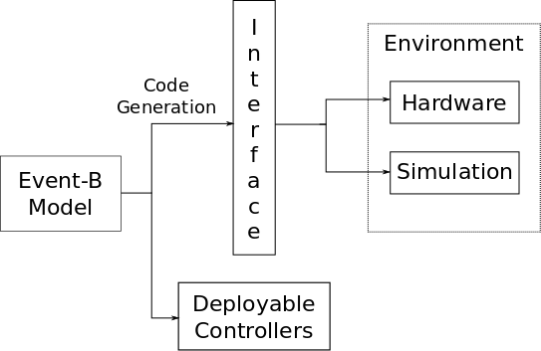
  A Java Interface for the Environment

Slide 5
  Templates and Code Injection
  Short Paper in ABZ2014.
  Arose out of Thales' request to think about
  customisation for deploying on different targets.
  Boilerplate code can have injection points.
  Injected code is from the Event-B model
  using generators.

Slide 6
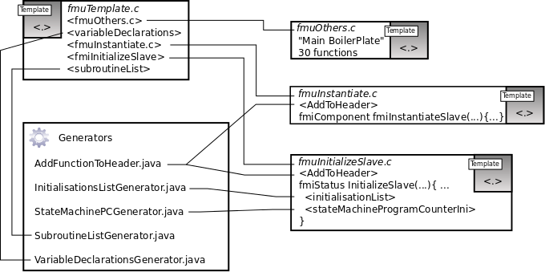
Templates, were used for the FMI Translator

Slide 7
  C Translation, for use in Co-simulation
  For Advance EU FP7
  The Objective is to test the executing code in a simulation of its environment.
  Master and Slaves communicate through API.
  Slaves are FMUs.

Slide 8
  C Translation, for use in Co-simulation
  Master is cyclic, slaves are initialized
  … then master does simulate-update cycle.
  We can generate an FMU from a machine.
  We can replace the Event-B Machine Component
  in the component diagram, and simulate/test with that.
  We can import FMUs into other simulators.

Slide 9
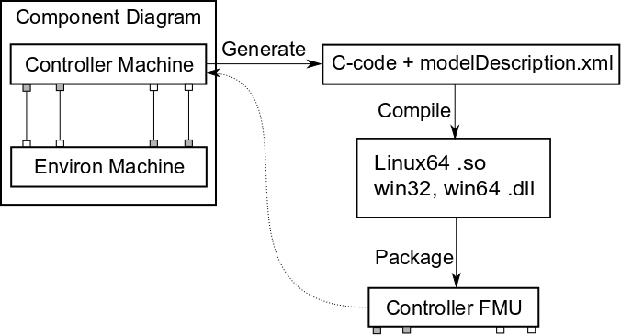
  FMUs from Machines

Slide 10
  Implementable Sets and Functions
  Translate Sets and Functions using Theories.
  Depends on target language API,
    Java HashSet and HashMap.
    Function - Domain Elements map to keys,
    Range Elements map to values.
  Still Experimental.
  Used in PRIME.

Slide 11
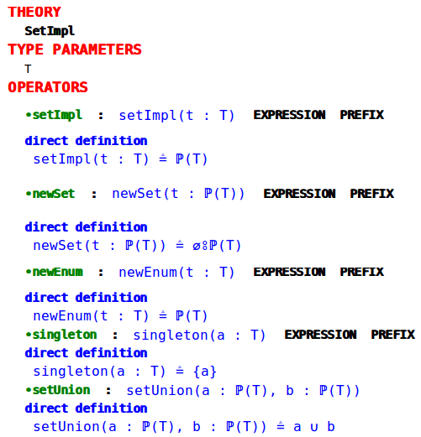

Slide 12
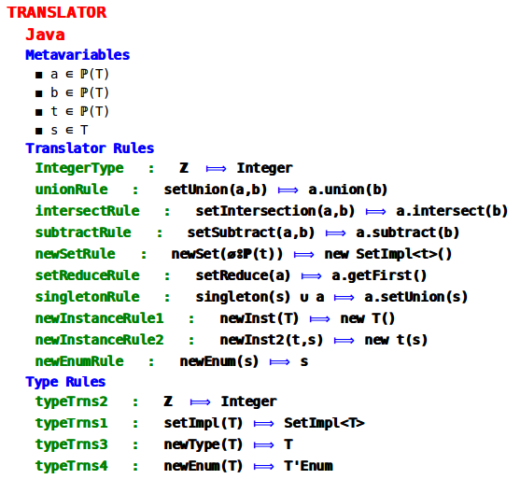

Slide 13
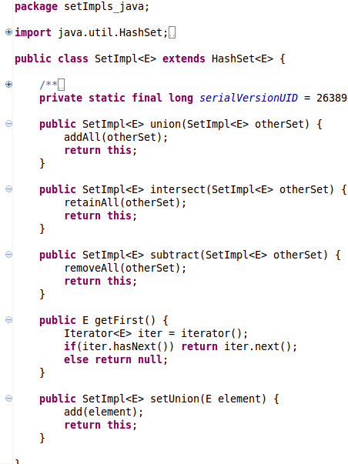

Slide 14
  Questions:
  How to improve plug-in development when much of it is engineering, not research?
    Academia v Industry: bridging the gap?
    Providing a platform to 'sell' Event-B?
    Day-to-day,
    Keeping up with (communicating) changes?
    Compatibility issues?
    ...

