Slide 1

Anomaly Detection in Network Traffic with K-means Clustering
Big Data Analytics
Alt Thibaud & Bueche Lucas

Slide 2


Summary
The goal is to detect anomalous behavior in the network traffic of an organization.
Anomalous behavior can point to things like intrusion attempts, denial-of-service attacks, port scanning, etc.

Slide 3
The dataset
Raw data connections dump from the U.S. Air Force Local-Area Network
Feature extraction was already run on the data
Used during the 1999 KDD Cup
Very large: 743 MB of data, 4.9 millions of network connections
Each connection contains 42 characteristics like : duration, protocol, flag…
Notes:
The KDD Cup dataset comes from Lincoln Laboratories, who set up an environment to simulating a typical US Air Force LAN and acquire nine weeks of raw TCP dump data. The Laboratories operated the LAN as if it were a real Air Force environment, but subjected it to multiple attacks.
A connection is a sequence of TCP packets starting and ending at defined times, between which data flows to and from a source IP address to a target IP address, according to a well-defined protocol. Each connection is labelled either as normal or as an attack, with exactly one specific type of attack.

Slide 4
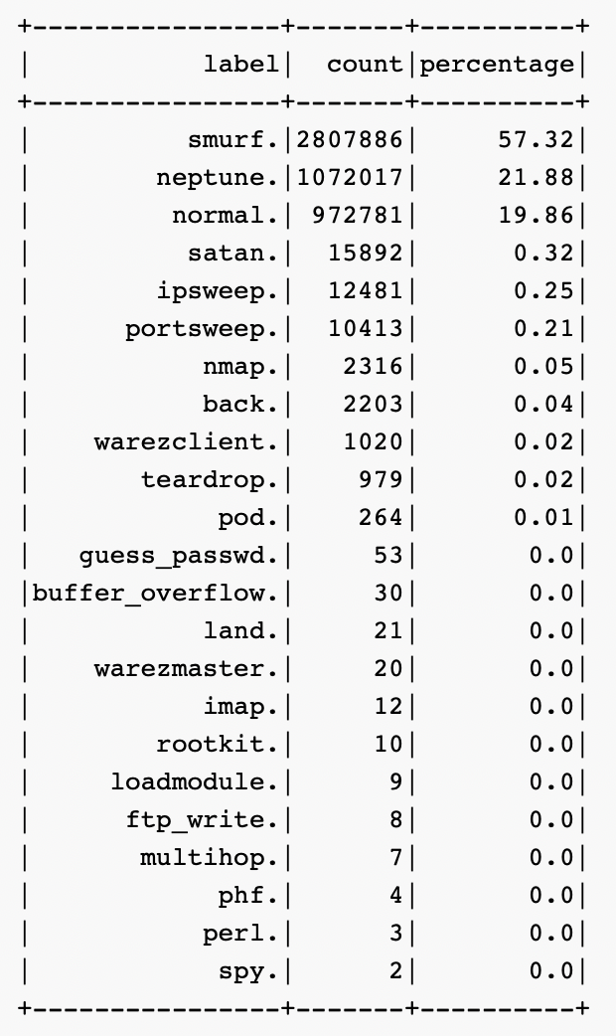
The dataset - Labels
The label value can be one of 23 possibilities :
back, buffer_overflow, ftp_write, guess_passwd, imap, ipsweep, land, loadmodule, multihop, neptune, nmap, normal, perl, phf, pod, portsweep, rootkit, satan, smurf, spy, teardrop, warezclient, warezmaster.
In the dataset, ~20% of connections are labeled normal.
Notes:
The most frequent labels on our data, by far, are : smurf (~57%) and neptune (~22%). Interestingly, the connections identified as normal, which are not anomalies, represent just under 20% of our dataset. All other labels are very poorly represented (less than 1%).

Slide 5
The dataset - Pre-processing
Fextraction was already done
Already 38 numeric features that we can exploit
Other features (non-numeric) will be one-hot encoded to be usable
Notes:
We have three columns (in addition to the labels) that contains non-numeric values : protocol_type, service, and flag. In the initial stages, these features will not be explored.
These non-numeric features can be represented using “one- hot encoding”, which can then be considered as numeric dimensions.

Slide 6
Algorithm
An unsupervised learning algorithm is applied: K-means clustering.
The idea is to let the clustering discover normal behavior.
Connections that fall outside of clusters are potentially anomalous.

Slide 7
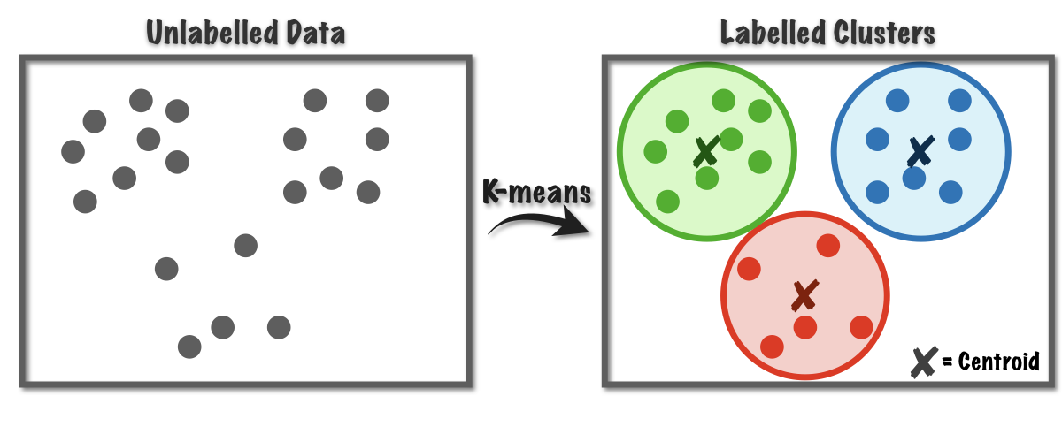
K-means
What’s is customizable ? Hyperparams ? K, Max iter, tolerance

Slide 8
Analysis questions
What are the characteristics and features that define an anomaly ?
How to find the optimal value of the hyperparameter K of the K-means clustering ?
What is the distribution of attacks on each protocol (TCP, UDP, ICMP…), by which service (port) were they carried out, what type of attacks are they and what was the final purpose of the attack ?

Slide 9
1. What are the characteristics and features that define an anomaly ?

Slide 10
Define an anomaly
Multiple attack types:
DoS (Denial of Service) : smurf, neptune
Overflows traffic
Denies other requests
R2L (Root to Local) : warezclient, guess_pwd
Seek vulnerabilites
Illegal local access
U2R (User to Root) : buffer_overflow, rootkit
Memory manipulation
Access to root user
Probe : ipsweep, portsweep
Finds vulnerable ports
Gate to other attacks

Slide 11
Anomaly characteristics
DoS:
A lot of request of very small size
R2L
More normal sized requests
U2R
More normal sized requests
Probing
Bigger requests, in particular for the portsweep attack

Slide 12
2. How to find the optimal value of the hyperparameter K of the K-means clustering?

Slide 13
The optimal K value - Steps
The beginning
Max iteration and tolerance
=> Values used
Normalization
Non-numeric features
Entropy

Slide 14
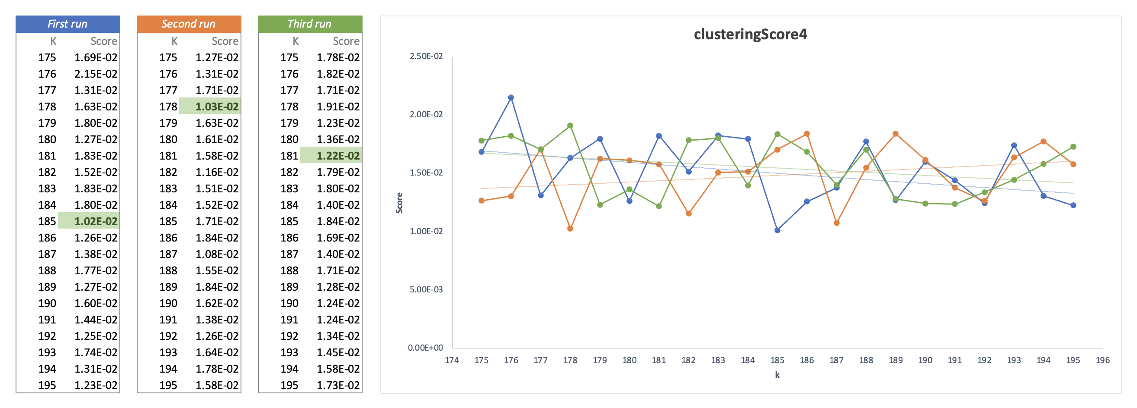
The optimal K value - Steps

Slide 15
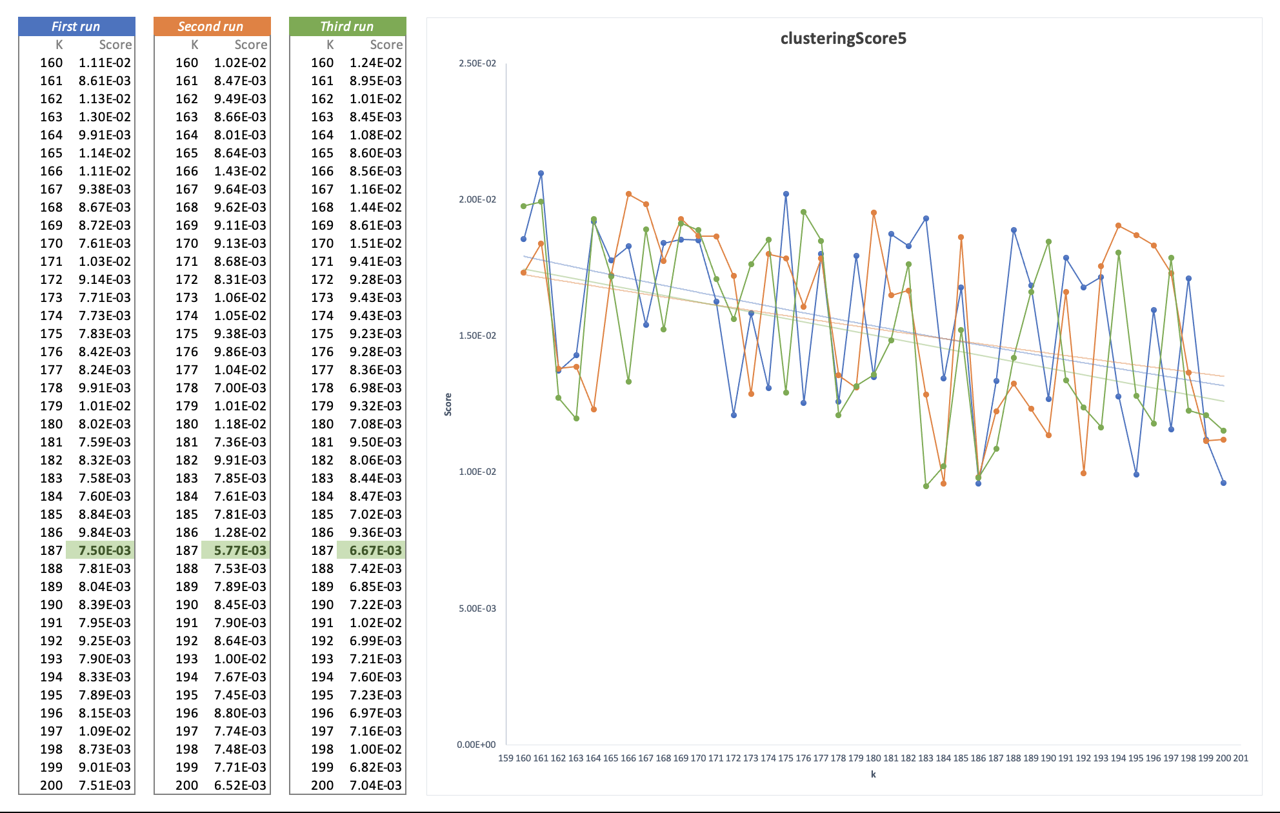
The optimal K value - Improvements
Cosine distance measure

Slide 16
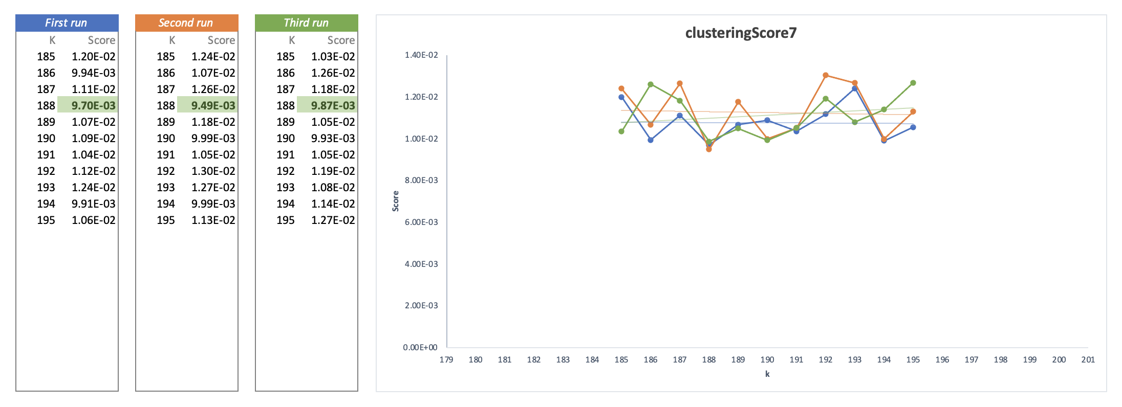
The optimal K value - Improvements
Bisecting K-means

Slide 17
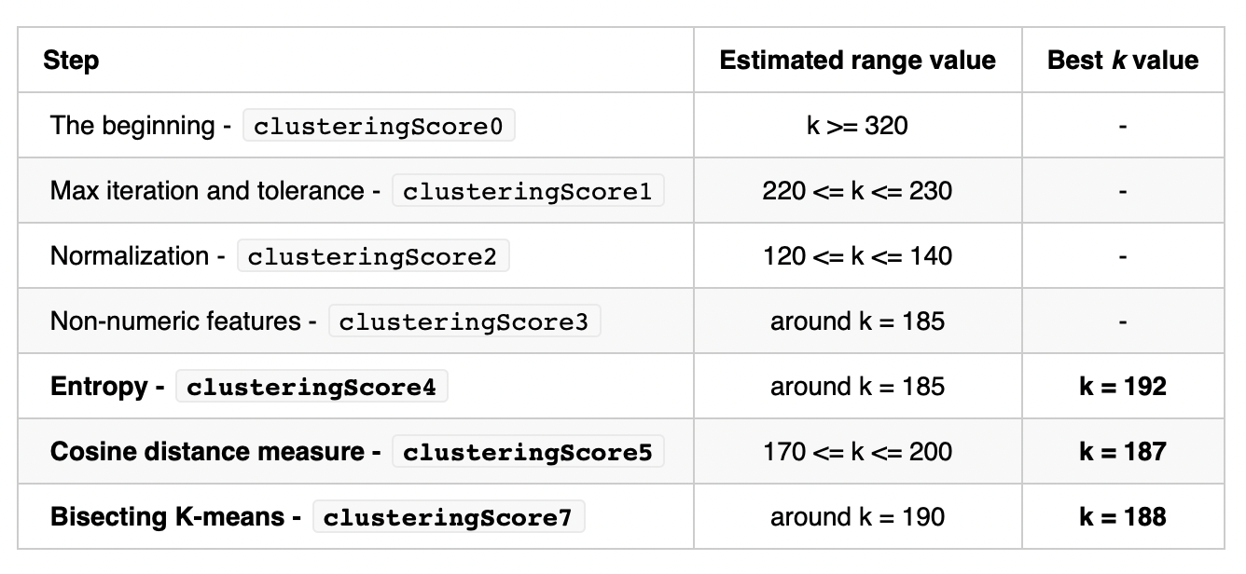
The optimal K value - Results

Slide 18
3. What is the distribution of attacks on each protocol (TCP, UDP, ICMP…), by which service (port) were they carried out, what type of attacks are they and what was the final purpose of the attack ?

Slide 19
Distribution of protocol

Slide 20
Distribution of attacks by protocol

Slide 21
Conclusion

Slide 22

Questions ?

