Slide 1
Where should USD 4.7B of SAF plant go in Kalimantan?
The user A SAF network planner choosing sites before engineering starts
Today A few hand-drawn layouts in a spreadsheet, with no proof of quality and no view of where a plan breaks
The cost of error A misplaced large refinery fixes USD 765M of capital and its haulage for 20 years
6,800 kt
1,200 kt
biomass at 80 sites
SAF, four airports
6,000 kt
20 years
biomass needed
CapEx life
Biomass sites
Depots
Refineries
Airports
Notes:
Meet the SAF network planner. They must pick refinery and depot sites before engineering starts. Today that means a few hand-drawn layouts in a spreadsheet. Kalimantan has 6,800 kilotonnes of biomass at 80 sites, and four airports each want 300 kilotonnes of SAF. A large refinery fixes USD 765 million of capital for 20 years, so a wrong site is expensive and hard to undo.

Slide 2
One browser app, from inputs to an audited network
A
B
C
D
E
Map
Engine
Simulator
Decision support
Evidence
All 80 sites, flows and costs, click any route
Rust solver with a proven bound
Change any input, rerun for real
Answers from solver records only
Baselines, audit, report, failures
Official inputs
Rust engine in the browser
Independent audit
Planner decides
Hosted on GitHub Pages. No server, no account, no API key.
Notes:
Everything sits in one web page. The map shows the network, the engine finds it, the simulator reruns it, decision support explains it, and the evaluation shows the evidence. The solver is Rust compiled to WebAssembly, so it runs inside the browser from GitHub Pages. There is no server and no API key.

Slide 3
The engine proves how close it is to the best network
1
Bound
Independent check on the same model
Lagrangian relaxation splits the model by site
 | Rust engine | HiGHS
Annual cost, USD M | 890.32 | 890.32
Proven lower bound | 883.60 | 866.74
Gap, time | 0.75%, 60 s | 2.65%, 480 s
2
Search
Branch-and-bound over refinery sites and sizes
3
Price
Exact min-cost flow for every design
Both solvers reached the same cost. On 5 smaller cases solved by HiGHS, the Rust bound was valid every time.
4
Refine
Move plants to the geometric median, on land
Notes:
The model is a four-tier facility location problem. We split it by site with Lagrangian relaxation, which gives a true lower bound, and branch-and-bound closes the gap. Min-cost flow prices each design exactly. To check ourselves, we exported the model and solved it in HiGHS, a separate open-source solver. It reached the same cost, and our bound is tighter: 0.75 percent in 60 seconds against 2.65 percent in 480. On smaller cases HiGHS proves optimal, our bound stays valid every time.

Slide 4
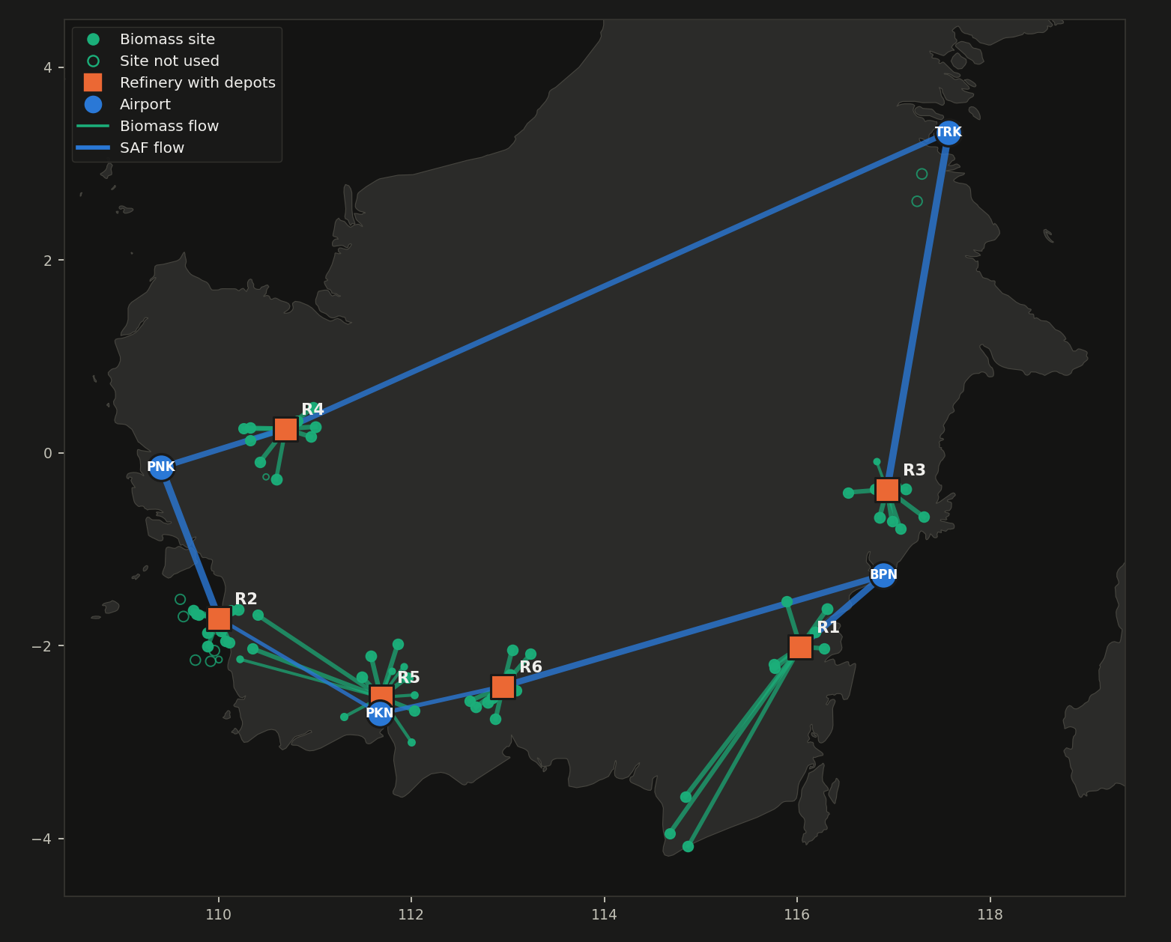
Six large refineries, inside the biomass clusters
USD 890.1M
per year, all costs
USD 742/t
SAF, before feedstock
23 depots
all at refineries
71 of 80
sites used
Notes:
Here is the result on the official inputs. Six large refineries, USD 890 million a year, USD 742 per tonne before feedstock. Nine sites are left unused. Depots sit at the refineries, because the second leg costs more per tonne-kilometre and depots lose no mass, so a field depot can only add cost. In the app every site, route and facility is clickable.

Slide 5
Measured gains, and where the plan breaks
Fails, and says why, when
+13.3%
demand beyond feedstock
< 0.176
yield, inside the allowed 15 to 25%
5 plants
or fewer cannot take 6,000 kt
Notes:
Against two rule-of-thumb networks on the same basis, we save USD 61 to 77 million a year. Those are simple planner rules, not a claim about industry practice. Moving depots to the field costs USD 22.6 million more but cuts truck kilometres by 25 percent, and that is the planner's call. The plan fails if demand rises more than 13 percent, if yield falls below 0.176, or with five refineries or fewer, and the app says exactly why.

Slide 6
The planner stays in control, and can check every number
Trust
Impact
No language model, so no invented numbers
Each answer lists the solver fields it read
What-if questions rerun the real solver
Questions outside the model are declined with a reason
A separate audit recomputes 11 checks from raw flows
USD 61M to 77M per year
saved against rule-of-thumb layouts, measured
Reality check
Official demand is about 12 times today's real jet use at these airports, so this is a hub-scale plan. Site moisture data is the next thing to test.
Notes:
Decision support uses no language model, so it cannot invent a figure. It answers from solver records, reruns the solver for what-ifs, and declines anything the model cannot know, like lifecycle carbon. One honest warning: official demand is about twelve times today's real jet use at these airports, so this is a hub-scale plan. At today's volumes and a 5 percent blend the same model gives about USD 10 thousand per tonne. The next step is real moisture data, because that decides whether depots belong in the field. Thank you.

