Slide 1








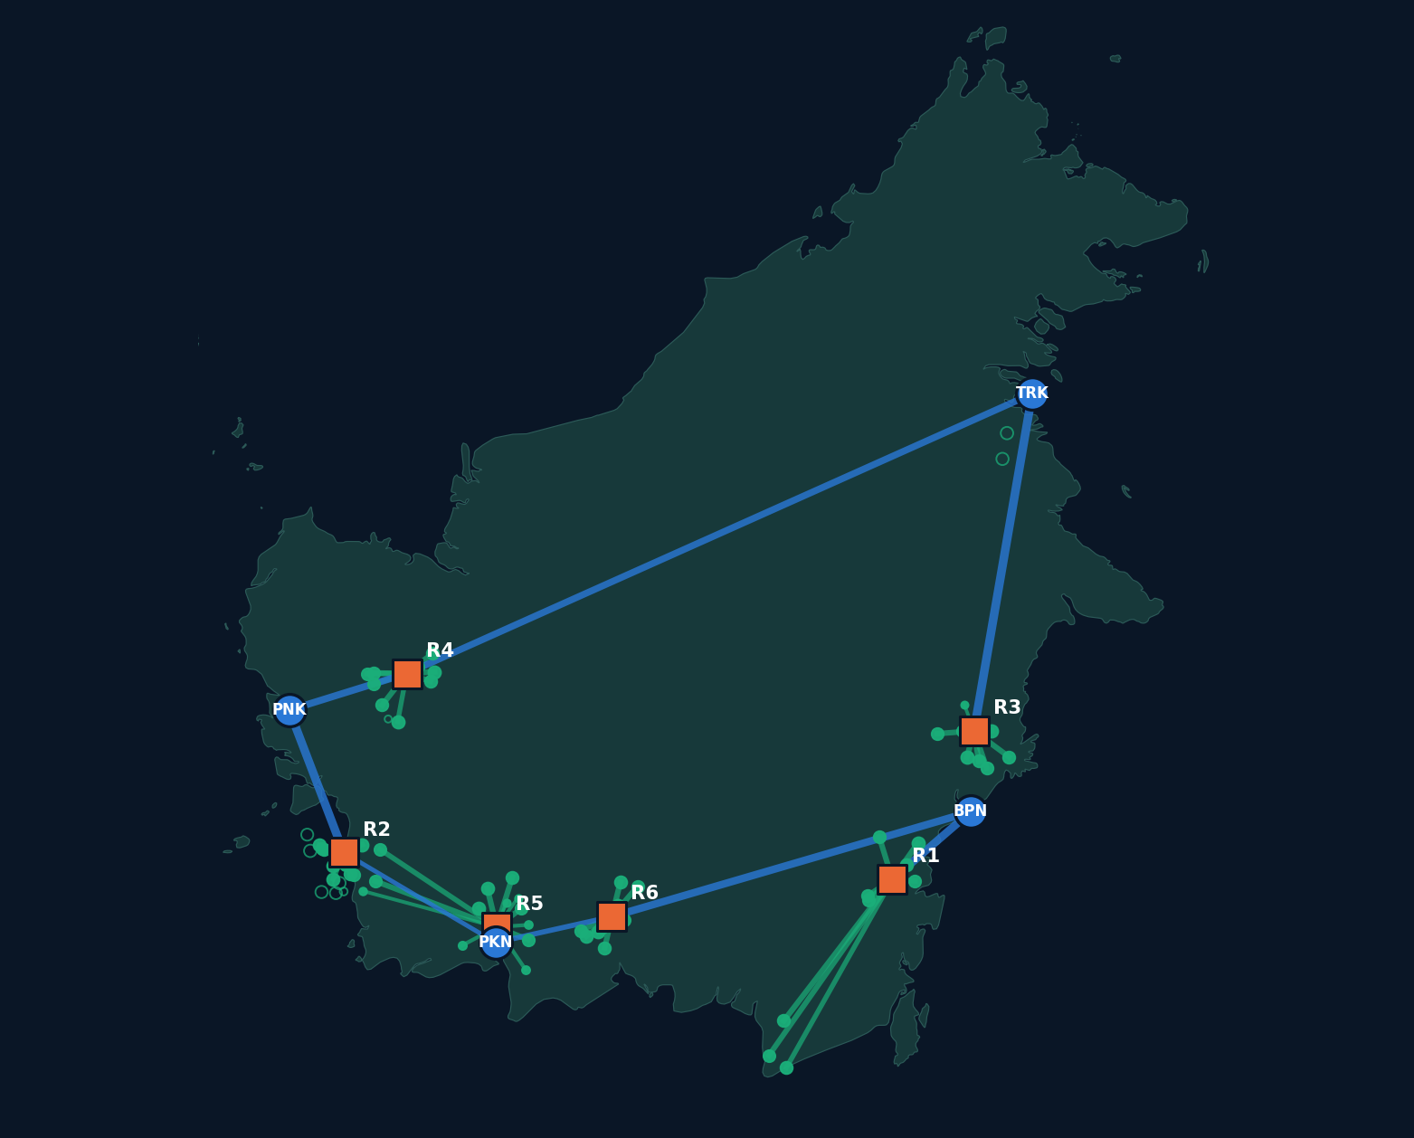








Organised by
Supported by
Powered by
Hosted at
National University
of Singapore
A U T O N O M O U S S G H A C K A T H O N 2 0 2 6
AI & AEROSPACE TRACK | AIRBUS CHALLENGE #3
Kalimantan SAF Supply Chain Optimiser
AI-Driven Optimisation for a More Sustainable Aviation Future
Solved base case
Pontianak (PNK)
Pangkalan Bun (PKN)
Balikpapan (BPN)
Tarakan (TRK)
LOCAL BIOMASS
OPTIMAL FACILITIES
EFFICIENT LOGISTICS
SUSTAINABLE AVIATION
6 refineries
1,200 kt SAF
USD 890.1M a year
Wee Zhern Ray
23 depot modules
demand met at four airports
modelled network cost
Presenter
Illustrative background image, not a modelled location. Map shows KASCO's solved network. Logos from the event poster, shown for event context, with no endorsement implied.
Notes:
I'm Wee Zhern Ray, and this is KASCO, the Kalimantan SAF Supply Chain Optimiser, delivering explainable, data-driven decision intelligence for Airbus Challenge 3.

Slide 2
Scaling SAF is a siting problem as much as a fuel problem
0.6%
80 sites
USD 765M
4 airports
SAF share of jet fuel, 2025
6,800 kt biomass, challenge data
one large refinery
1,200 kt SAF demand
Decarbonisation Aviation needs far more SAF than it has today
Dispersed feedstock Biomass is scattered, and hauling it costs money
Fixed capital A plant locks in site, scale and routes for 20 years
Real interest Airbus and IPB University were reported studying Indonesian biomass logistics and factory siting
Sources: IATA, 9 Dec 2025; QC Intelligence and Biofuels Digest, Aug 2025 (secondary reports); Airbus official update, 31 Oct 2026.
Notes:
Aviation is a hard-to-abate sector on the road to net zero, yet sustainable aviation fuel was only about 0.6 percent of jet fuel in 2025. The bottleneck is the feedstock-to-flight value chain. In Kalimantan, the challenge inputs spread biomass over 80 sites, and four airports each need 300 kilotonnes. One large refinery costs USD 765 million, so this is a high-stakes capital allocation decision before engineering starts. Airbus itself was reported studying biomass logistics in Indonesia with IPB University.

Slide 3
KASCO turns one planning question into an audited network
Biomass
Depots
Refineries
Airports
Mathematical optimisation
Geospatial analysis
Scenario simulation
Explainable decision support
Rust solver with a proven lower bound
Interactive map of every site and route
Change inputs and rerun the real solver
Answers from solver records, or a refusal
Runs in the browser from GitHub Pages. No server, no API key.
Notes:
KASCO is an end-to-end optimisation platform from biomass through depots and refineries to airports. A high-performance Rust engine, compiled to WebAssembly, runs mixed-integer optimisation in the browser, using Lagrangian bounds and exact min-cost flow. Planners get scenario intelligence and solver-grounded explanations. There is no black box: it uses no language model, so it cannot invent a number, and every result passes an independent audit.

Slide 4
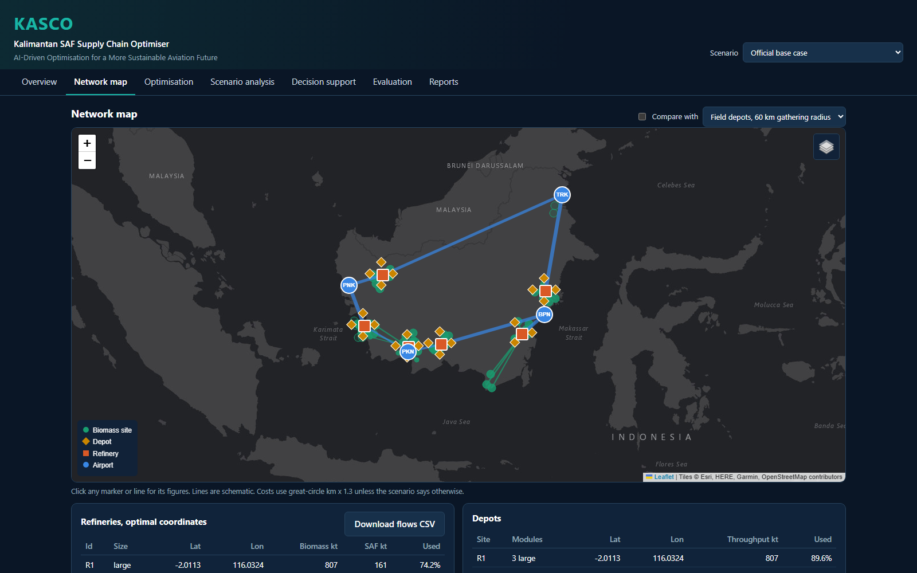
A working prototype, live now
Interactive map
Facility selection
Scenario controls
Solver outputs
Explainable answers
weewzr.github.io/airbustrack3ray
Genuine screenshot of the KASCO website, official base case.
Notes:
This is the live, working MVP. You get an interactive geospatial network: click any site or route, switch scenarios, rerun the solver in seconds, and ask why a refinery was chosen. It is human-in-the-loop: if a question is unclear or outside the model, it refuses rather than guesses.

Slide 5
Modelled impact on the official inputs
USD 890.1M
annual cost, modelled
6 + 23
refineries + depot modules
1,200 kt
SAF demand met, 100%
USD 61M to 77M a year below two simple heuristics, modelled
Same cost from HiGHS, 11 of 11 audit checks pass
K-means given our fleet also reaches this network, so value lies in the proof and limits
0.75%
proven gap, candidate sites
Notes:
On the official inputs, the base case costs USD 890 million a year, with six large refineries and 23 depot modules delivering 100 percent demand fulfilment across 1,200 kilotonnes. That is USD 61 to 77 million below two simple heuristics. For honest evaluation, a strong k-means benchmark given the same fleet reaches our network, so the real value is the optimality proof and the fleet choice in each scenario. HiGHS, an independent solver, reached the same cost, and we prove a 0.75 percent optimality gap on candidate sites.

Slide 6
Real-world relevance, and its limits
Why it matters
What we do not claim
Southeast Asian feedstock could yield about 45.7 Mt of SAF a year by 2050
Fischer-Tropsch ranks among the most viable routes for regional wastes
Indonesia's 1% from 2027 covers Jakarta and Bali departures
Decision limit: past 1,304 kt of SAF, one more kt adds about USD 30M a year
Official demand is about 12 times today's estimated real jet use at these airports
The 80 biomass points are modelling inputs, and 13 lie off the coast
Sites are screened only: tenure, peat and forest status are unchecked
Depot layout depends on zero mass loss, and real moisture could change it
Sources: RSB and Boeing, Sep 2024; GHD ASEAN study; Fuels and Lubes, Jul 2026; KASCO reality-check scenarios. Full references in the technical report.
Notes:
Regional studies support waste-based residues as a SAF feedstock, and palm residues are named for Kalimantan. Two honest limits: official demand is about twelve times today's real jet use here, so this is a hub-scale plan, and the 80 sites are modelling inputs. KASCO also surfaces capacity thresholds: past 1,304 kilotonnes a seventh plant is needed, and one more kilotonne adds about USD 30 million.

Slide 7


About Me: Wee Zhern Ray
Wee Zhern Ray
Year 3 Chemical Engineering
National University of Singapore
Minor in Hydrogen and Low Carbon Technologies
Specialisation in Safety and Sustainability
in
linkedin.com/in/wee-zhern-ray
Notes:
I'm a third-year Chemical Engineering student at NUS, minoring in Hydrogen and Low Carbon Technologies, with a specialisation in Safety and Sustainability, working where the energy transition meets applied optimisation.

Slide 8
From Hackathon MVP to Scalable SAF Decision Intelligence
Stage 1
Stage 2
Stage 3
Stage 4
Current MVP
AI enhancement
Real-world validation
Commercial potential
Mathematical optimisation
Interactive geospatial network
Scenario simulation
Explainable decision support
Secure LLM integration
Natural-language scenarios
Possible ML site shortlisting
Evidence-grounded reports
Road and port data
Industrial site screening
Feedstock-quality variability
Robust optimisation, stakeholders
Airlines, SAF producers
Fuel distributors, airports
Engineering consultancies
Government planning agencies
Stages 2 to 4 are future possibilities, not established results or commercial achievements.
Notes:
KASCO is a prototype today, with a scalable roadmap. Next comes a secure LLM layer, with the solver still in charge of every number. Then real-world validation with logistics and feedstock data, plus robust optimisation under uncertainty. The B2B opportunity spans SAF producers, airlines, fuel distributors, airports, consultancies and planning agencies. Thank you.

