Slide 1
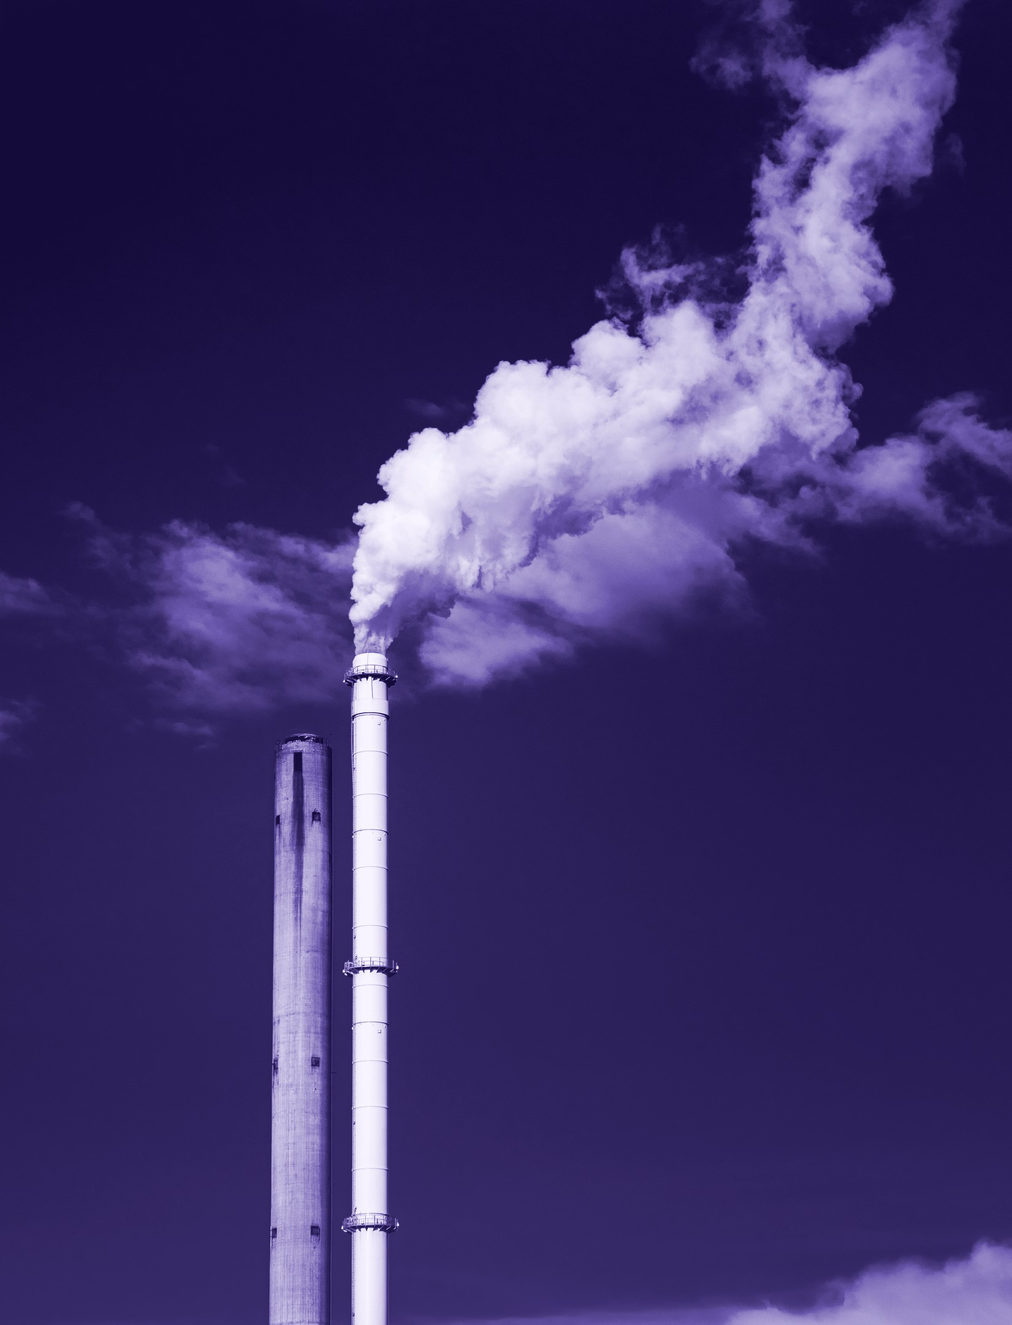
Switch on a light tonight
THE PROBLEM
94%
Natural gas in Singapore’s electricity fuel mix, 2024.
Source: EMA, Our Energy Story; EMA, Singapore Energy Statistics 2025
NUS-H2
1
Notes:
Switch on a light in Singapore tonight. In 2024, natural gas made up 94 percent of the fuel behind that electricity, and we import all of it.

Slide 2
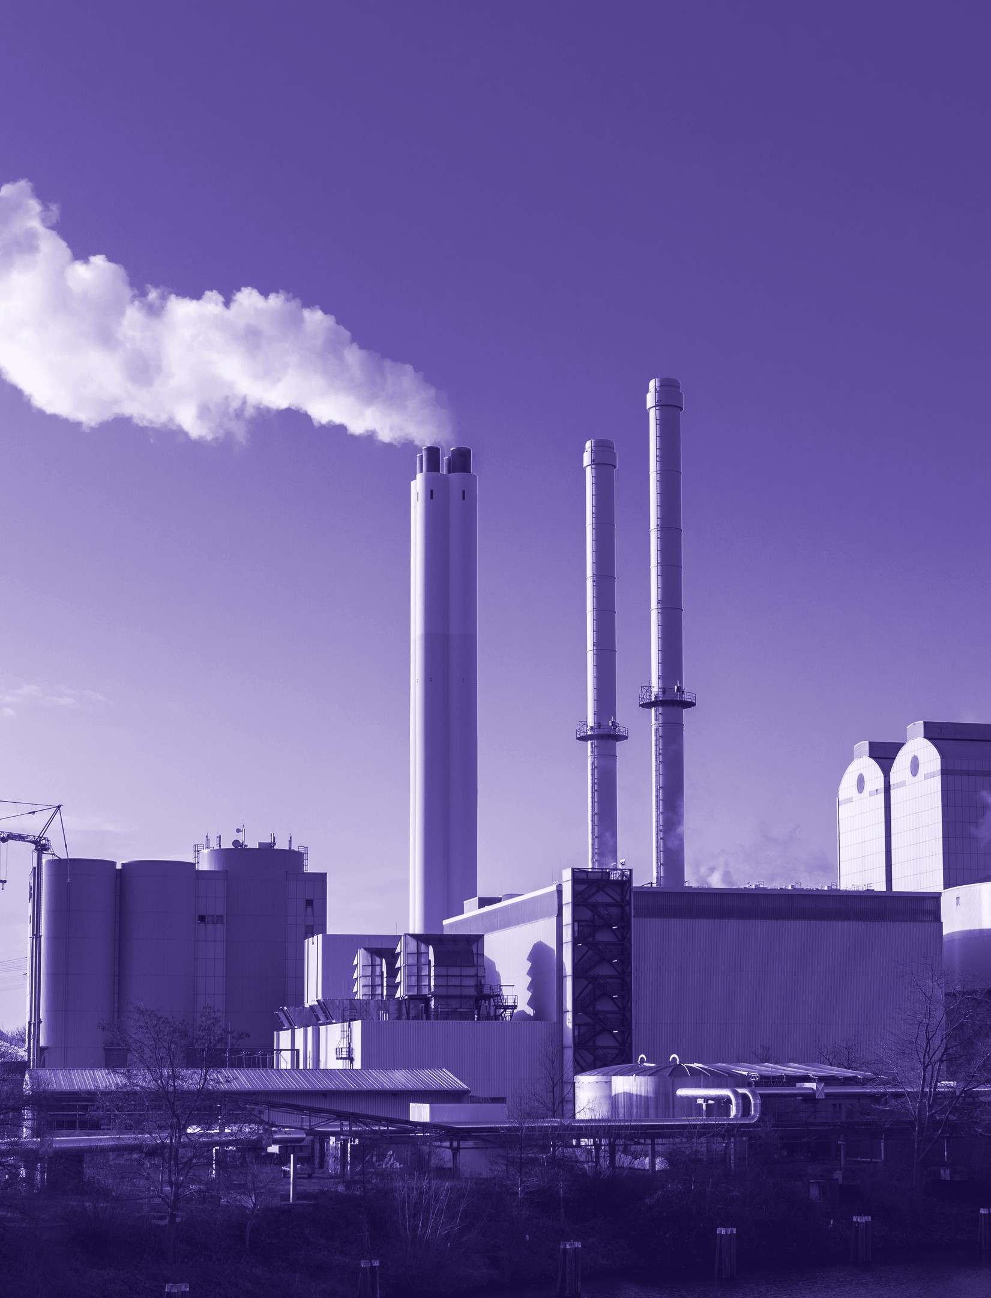
Hydrogen could carry up to half
THE PROBLEM
Up to
50%
Low-carbon hydrogen, a possible share of power needs by 2050.
Source: METI, Hydrogen
NUS-H2
2
Notes:
The national hydrogen strategy points one way out. Low-carbon hydrogen could supply up to 50 percent of our power needs by 2050. Everything then rests on the word low-carbon.

Slide 3
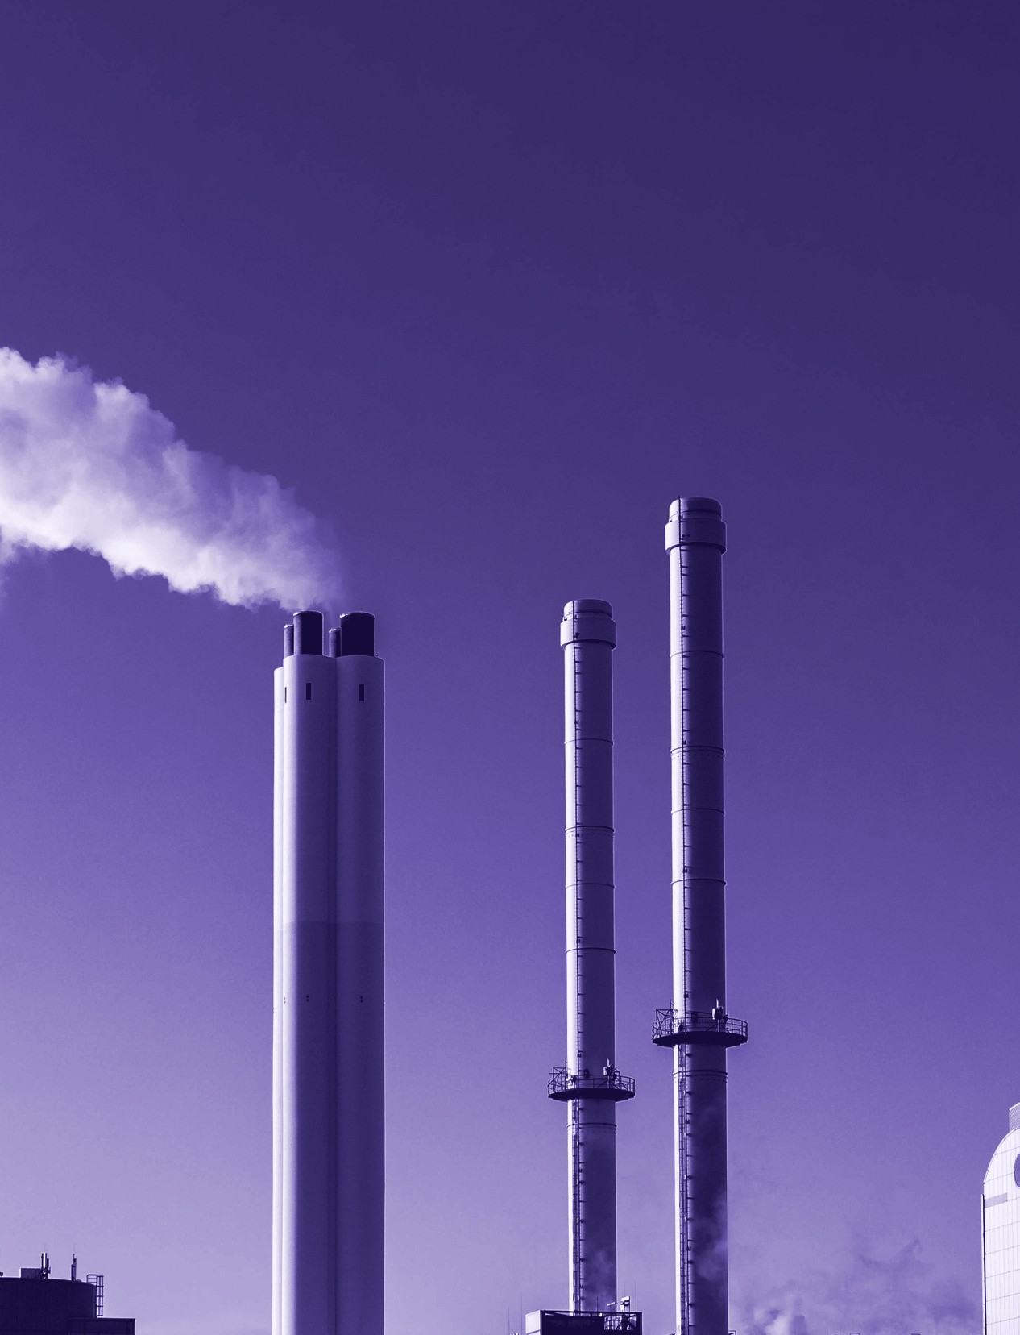
Today’s hydrogen carries a carbon bill
THE PROBLEM
9.21
kg CO₂ per kg H₂
Direct emissions of an unabated steam methane reformer, INL basis.
Source: INL TEV‑953 Table 2, PDF p30. Status: reduced-order balances anchored on INL cases.
NUS-H2
3
Notes:
Steam methane reforming is the established route. It burns gas for heat, and it strips carbon from the gas it converts. On Idaho National Laboratory’s numbers, every kilogram of hydrogen leaves 9.21 kilograms of CO₂ in the air.

Slide 4
NUS-H2
PROJECT
Nuclear‑Upgraded Steam Methane Reforming with Carbon Capture for Low‑Carbon Hydrogen in Singapore.
Wee Zhern Ray
NUS-H2
4
Notes:
This is NUS-H2: Nuclear-Upgraded Steam Methane Reforming with Carbon Capture, for low-carbon hydrogen in Singapore. I am Wee Zhern Ray, and the question here is how far a conventional reformer can go once a reactor replaces its furnace.

Slide 5
Two targets, one straight answer
SCOPE AND LIMITS
Net abatement
met
0.250
S$100/t
Result 0.578 Mt CO₂e/y, target above 0.250
Abatement cost
missed
Mt CO₂e/y net abatement
abatement cost
Abatement target: met. Cost target: missed.
Result S$165.6 to S$277.9/t, target under S$100
Source: Project statement. Status: reduced-order balances anchored on INL cases.
NUS-H2
5
Notes:
The project sets two tests for a solution at scale in Singapore: abate more than 0.250 million tonnes of CO₂e a year, at under S$100 a tonne. Here is the answer up front. The abatement target is met. The cost target is missed at central inputs. The rest of this talk shows by how much, and what would close the gap.

Slide 6
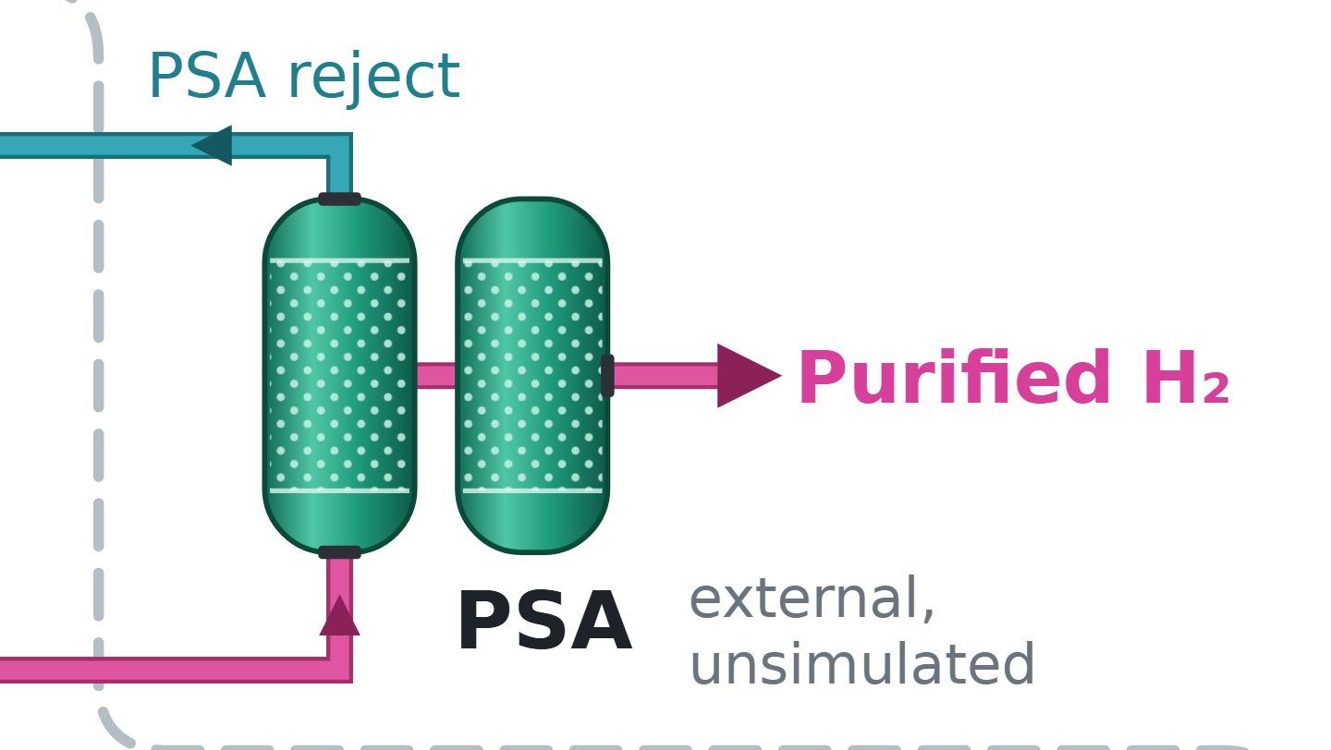
One plant at real industrial scale
SCOPE AND LIMITS
100,000
Nm³/h of purified hydrogen
66,925 t H₂/y at 85% availability. PSA reject returns across the boundary.
Source: Air Liquide 2008; Air Liquide 2011; Decisions D04, D05. Status: reduced-order balances anchored on INL cases.
NUS-H2
6
Notes:
I size one new-build plant at 100,000 normal cubic metres of hydrogen an hour, the scale of SOXAL’s plant on Jurong Island, used for size only. At 85 percent availability that is 66,925 tonnes a year. The model is steady state. The PSA stays an external, unsimulated block, and its reject returns across the boundary as a stream.

Slide 7
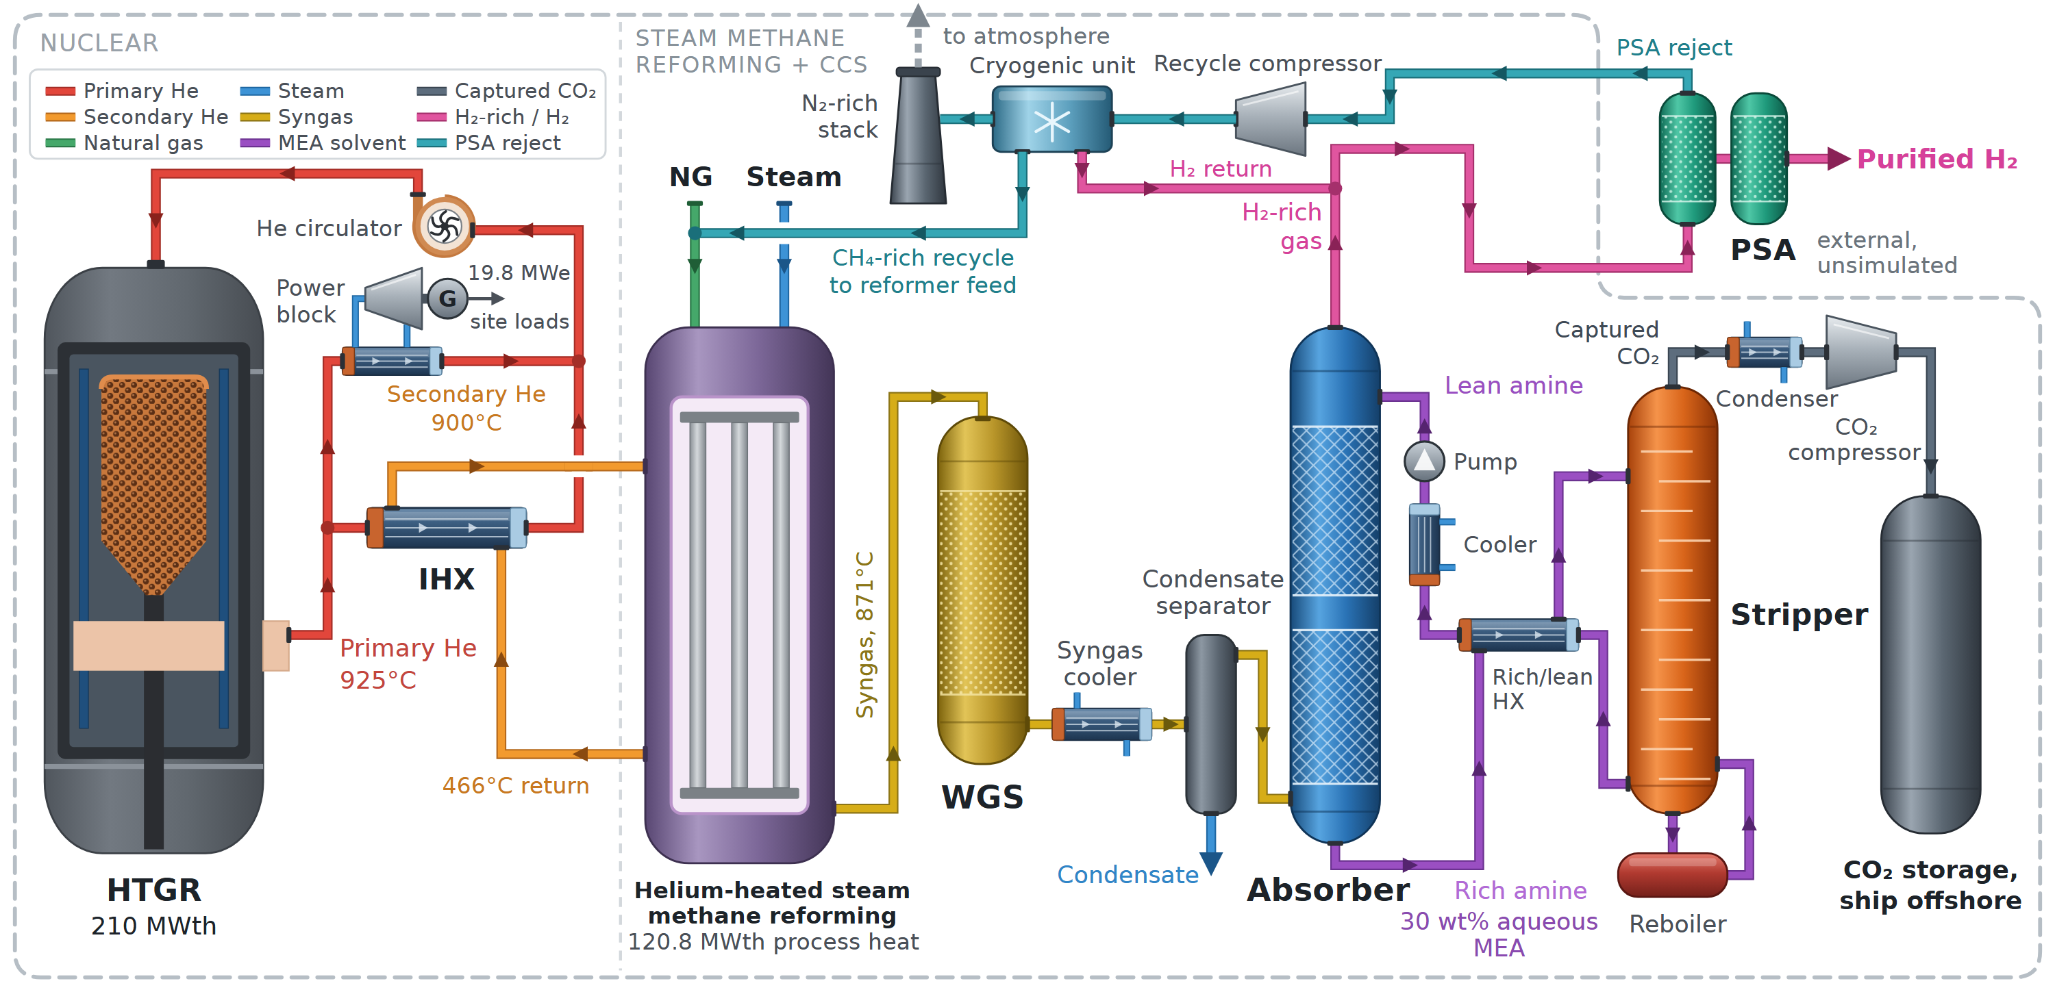
A reformer heated by helium
PROPOSED SOLUTION
210 MWth
Generic HTGR, helium-heated steam methane reforming, MEA capture, ship offshore storage.
Reactor rating
NUS-H2
Source: INL TEV‑961 Table 2; Decisions D06, D23. Status: reduced-order balances anchored on INL cases.
7
Notes:
Here is the plant. On the left, a generic high-temperature gas-cooled reactor rated at 210 megawatts thermal, with helium leaving at 925 degrees. An intermediate heat exchanger, the IHX, passes that heat to a separate helium loop at 900 degrees, which heats the reformer tubes. Shift and MEA capture follow, then CO₂ compression and ship offshore storage. The PSA sits outside the dashed line.

Slide 8
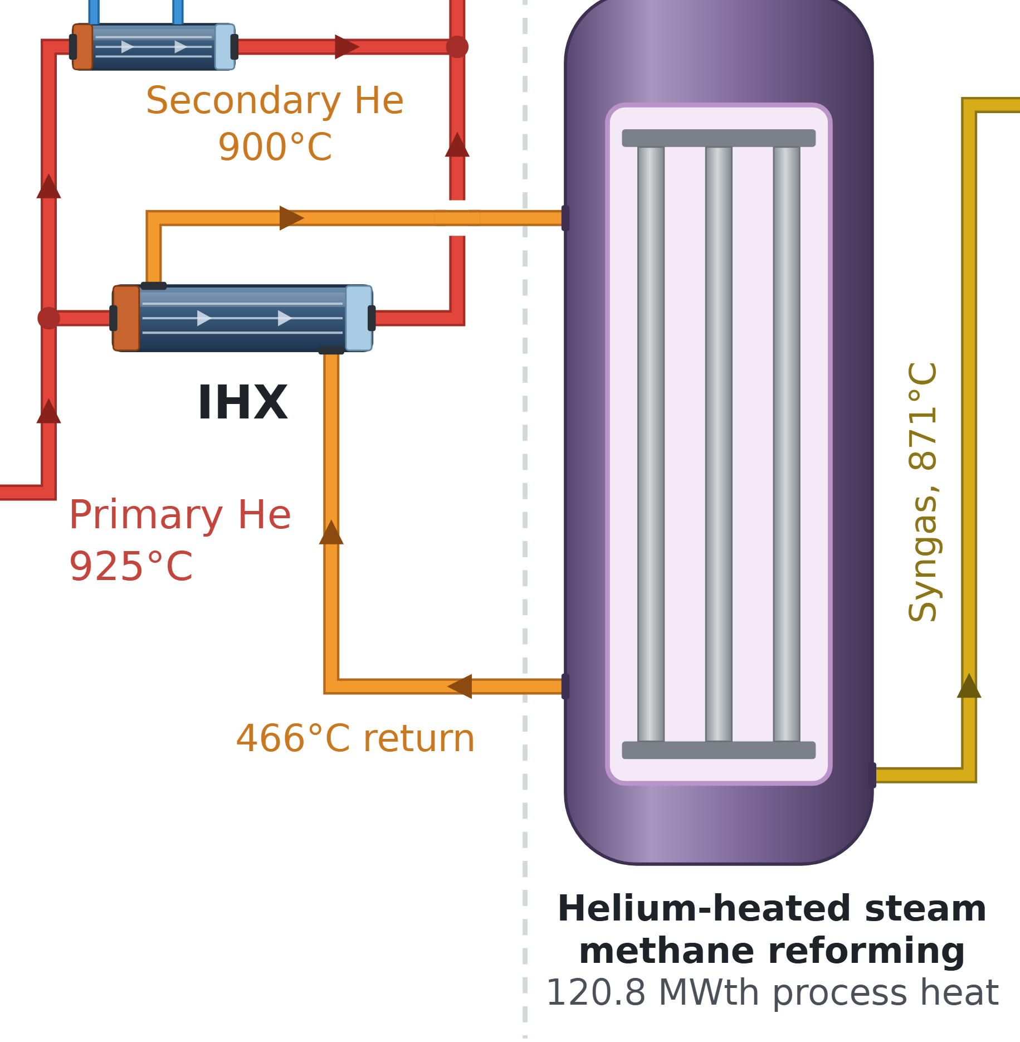
Helium heat replaces the furnace
PROPOSED SOLUTION
120.8
MWth at 900 °C
Covers reforming and preheat. Helium returns at 466 °C.
Source: INL TEV‑961 printed p12 to p13, p21, PDF p14. Status: reduced-order balances anchored on INL cases.
NUS-H2
8
Notes:
First proof point. The process needs 120.8 megawatts of heat, covering reforming and preheat, at 900 degrees. In INL’s study, 925 degrees is the only case that removes the fired stage. The reformer outlet of 871 degrees is INL’s equilibrium assumption, and I disclose it as one.

Slide 9
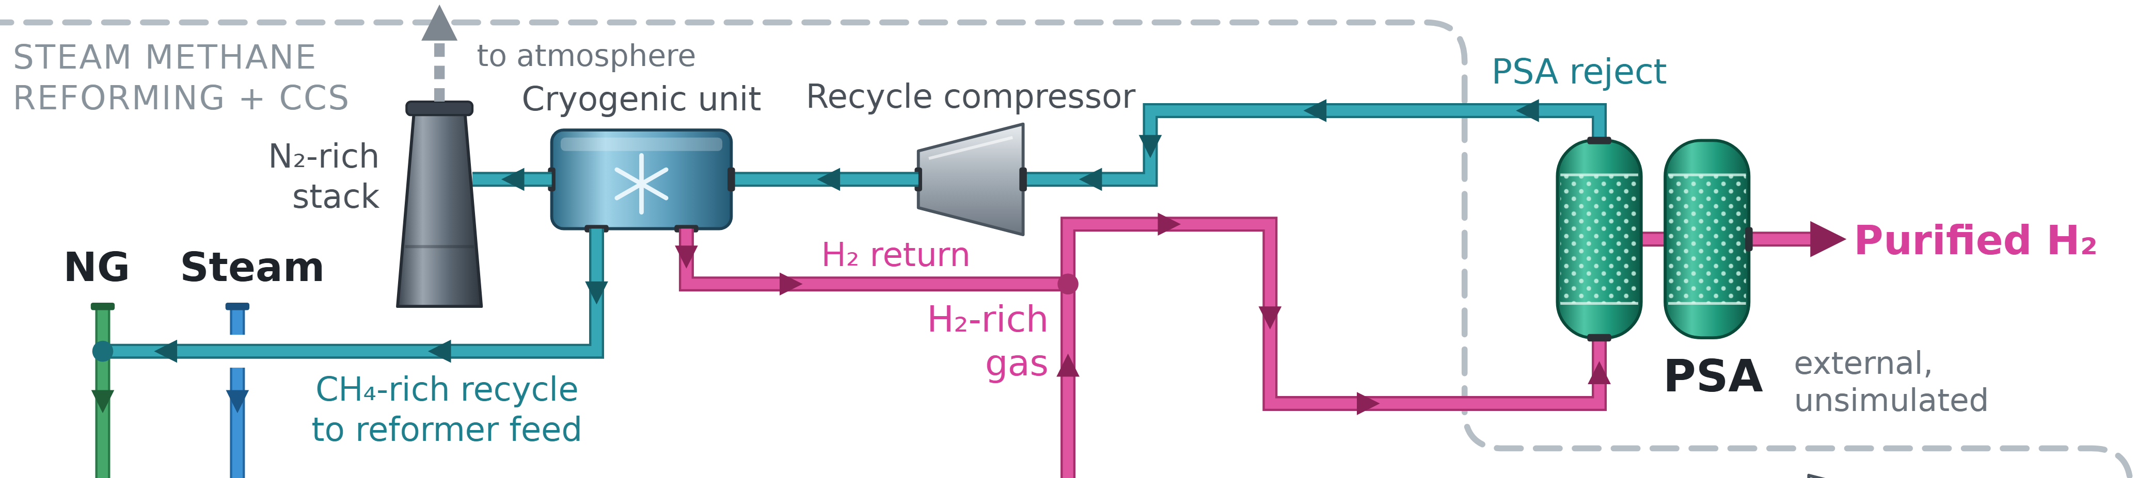
Less gas for the same hydrogen
PROPOSED SOLUTION
23.2
35.9
Gas saving from published flows
INL basis
35.2%
Ahn and Lee
18.8%
12.6 MMSCFD saved. Depends on recycle transferring from Selexol to MEA.
MMSCFD, NUS-H2
MMSCFD, unabated steam methane reforming
Source: INL TEV‑953 Table 2, PDF p30; Ahn and Lee 2026; Decision D33. Status: reduced-order balances anchored on INL cases.
NUS-H2
9
Notes:
Second proof point. A same-size unabated reformer takes 35.9 million standard cubic feet of gas a day. NUS-H2 takes 23.2, because no gas burns for reforming heat and PSA reject recycles. The published evidence disagrees on this saving: 35.2 percent on INL’s basis, 18.8 percent in Ahn and Lee. INL also never modelled recycle with MEA, and I come back to that.

Slide 10
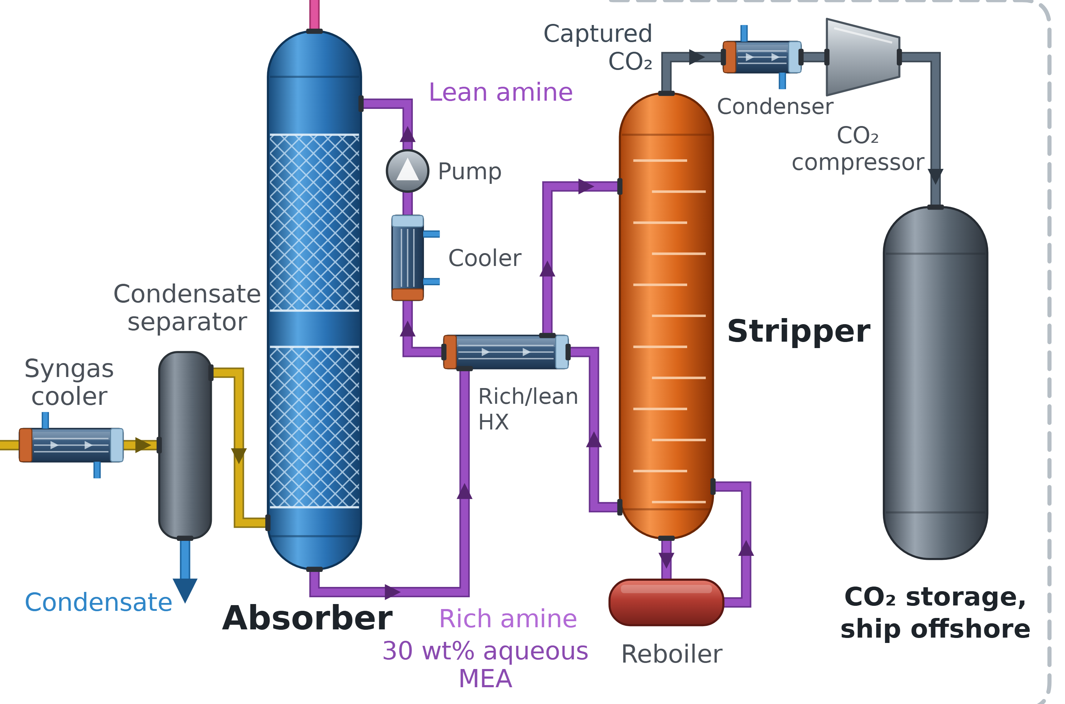
Capture, counted two ways
PROPOSED SOLUTION
90%
90.4%
per pass
of plant carbon
30 wt% MEA. 0.360 Mt CO₂/y to storage. Per-pass value is a project assumption.
Source: Decisions D07, D25; IEAGHG 2022‑07 PDF p44. Status: reduced-order balances anchored on INL cases.
NUS-H2
10
Notes:
Third proof point. The absorber takes 90 percent of the CO₂ on each pass, a project assumption, using 30 weight percent MEA. Absorber slip recycles through the reformer, so the whole plant captures 90.4 percent of its carbon. I print both numbers together so the two never get mixed up.

Slide 11
In INL’s own words
PROPOSED SOLUTION
“
Increasing the HTGR ROT significantly reduces natural gas consumption
30.9%
less gas than INL’s conventional plant with capture, at 925 °C
R. Wood, INL TEV-961, 2010, Executive Summary
INL has not reviewed NUS-H2.
Source: INL TEV‑961 Executive Summary, PDF p5
NUS-H2
11
Notes:
You need not take my word for this. INL modelled reactor heat for reforming in 2010, and the line on screen is theirs. At 925 degrees they found 30.9 percent less gas than a conventional plant with capture. INL used Selexol, and it has never reviewed NUS-H2. I borrow its method as the anchor, along with its limits.

Slide 12
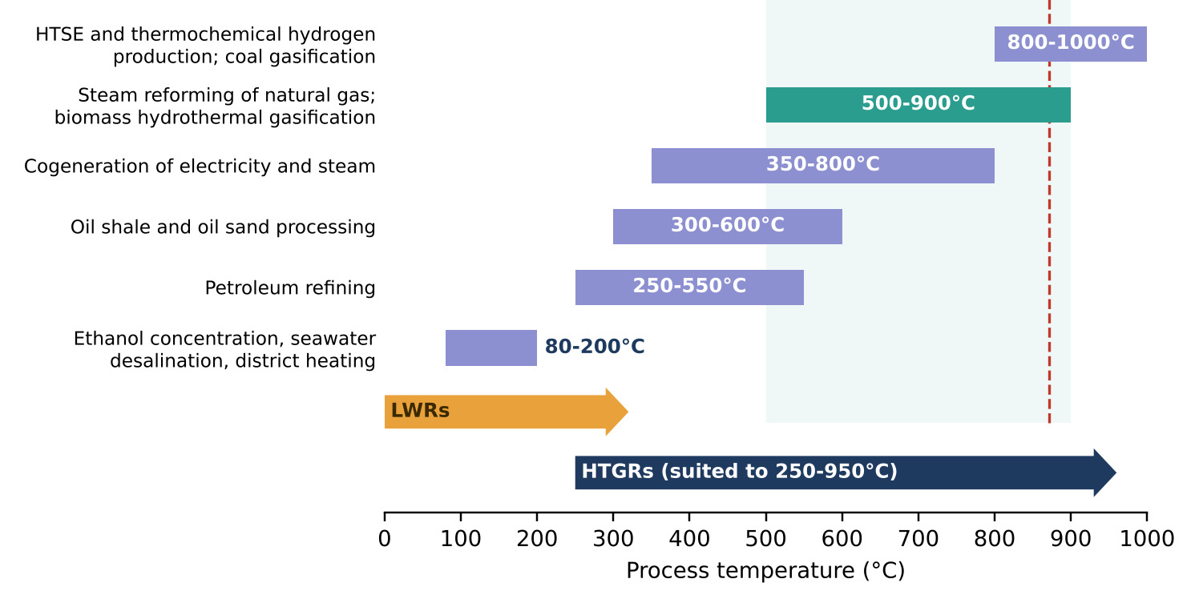
Why nuclear: the temperature fits
WHY NUCLEAR
925 °C
Reformer outlet 871 °C
reactor outlet
Reformer outlet 871 °C. Only test reactors have run this hot.
Source: Mears 2010; Nelson et al. 2011 PDF p9, p21; IAEA NP‑T‑4.3 printed p23; JAEA, HTTR; WNN 2023
NUS-H2
12
Notes:
Why nuclear? Reforming sits in the hot band on this chart. Light-water reactors stop far short of it, which is why the design uses a gas-cooled reactor in place of a PWR. INL’s yield optimum is 875 degrees with a fired stage kept, and 925 is its only case without one. The catch: only test reactors of 46 megawatts or less have run this hot, and commercial HTR-PM runs near 750.

Slide 13
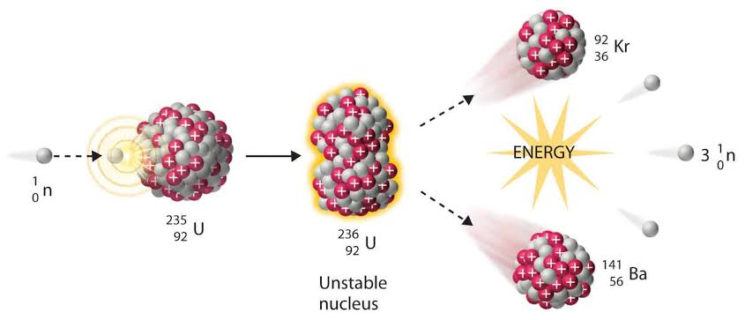
Heat and power from one reactor
WHY NUCLEAR
19.8
Site electrical load, MWe
MWe site load, grid import 0
12.33
7.45
Process loads 12.33 MWe. Helium circulators add 7.45 MWe.
Process loads
Helium circulators
Source: Nuclear‑Power.com; Decision D24; Integrated_Energy_Balance.csv. Status: reduced-order balances anchored on INL cases.
NUS-H2
13
Notes:
Fission gives heat with no combustion at the reformer. The same reactor also runs the site: a small power block supplies 19.8 megawatts electric for process loads and helium circulators, so grid import at rated size is 0.

Slide 14
INL reference: Case A
BASIS AND SIZING
Natural gas
34.0 MMSCFD
HTGR-integrated steam methane reforming
925 °C reactor outlet
900 °C helium supply
Hydrogen
130 MMSCFD
Nuclear heat
176.8 MWth
Steam
83.7 MMBtu/h
130
Nuclear electricity
17.3 MWe
CO₂ captured
1,927 st/d
Water
743 gpm
CO₂ emitted
142 st/d
MMSCFD hydrogen, INL reference
INL reference. Separate from the proposed 210 MWth design.
Case A, INL reference (Wood, 2010)
Source: INL TEV‑961 Table 2; Decision D03. Status: reduced-order balances anchored on INL cases.
NUS-H2
14
Notes:
Sizing starts from INL’s Case 6, at 130 million standard cubic feet of hydrogen a day. I call it Case A, and it stays a reference, separate from the design. With MEA and recycle, Case A would need 260.7 megawatts thermal, 50.7 above the rating. So I size the plant to fit.

Slide 15
The walk to 178.5 MWth
BASIS AND SIZING
Reactor need, MWth
210 MWth rating
First sum, Case A scale
206.0
Scaled to Case B
140.8
178.5
Purge load restored
150.6
Losses
154.3
Circulators
165.9
MWth needed, range 155.8 to 214.1
Selexol swapped for MEA
166.2
Reboiler gap
179.0
SRD of 3.8 GJ/t is an assumption with no syngas measurement.
Syngas heat, gated model
178.5
Source: Design decisions section 5; Decisions D24, D26; Validation_Results.csv sizing walk rows. Status: reduced-order balances anchored on INL cases.
NUS-H2
15
Notes:
So I scale to Case B and walk the reactor size. The first sum was 206.0 at Case A scale, which is 140.8 at Case B scale. Restoring the purge load and counting losses and circulators brings it to 165.9. MEA’s reboiler gap gives 179.0, and syngas heat on its gated model brings the need to 178.5. That reboiler demand, 3.8 gigajoules per tonne, has no syngas measurement behind it.

Slide 16
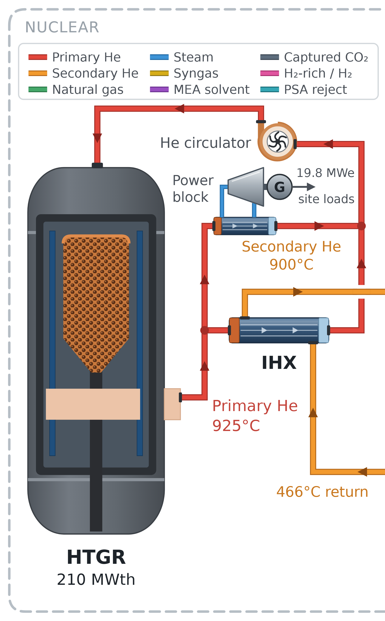
A margin that earns nothing
BASIS AND SIZING
31.5
MWth spare, no revenue
6.5 MWth on Ahn and Lee’s heat basis. 4.1 MWth short at the adverse corner.
Source: Decisions D03, X6, X7; Ahn and Lee 2026 Table 6. Status: reduced-order balances anchored on INL cases.
NUS-H2
16
Notes:
I keep the 210 megawatt rating, so 31.5 megawatts sit spare and earn nothing. They are still paid for: full cost is S$189.7 a tonne as charged, against S$161.2 sized to need. The margin is also thin. On Ahn and Lee’s heat basis it falls to 6.5, and at the adverse corner the need reaches 214.1.

Slide 17
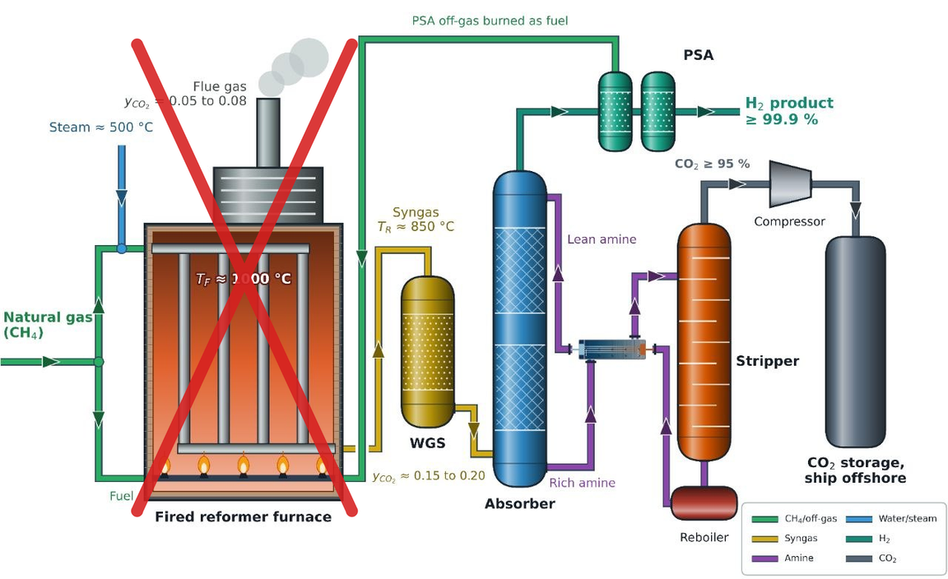
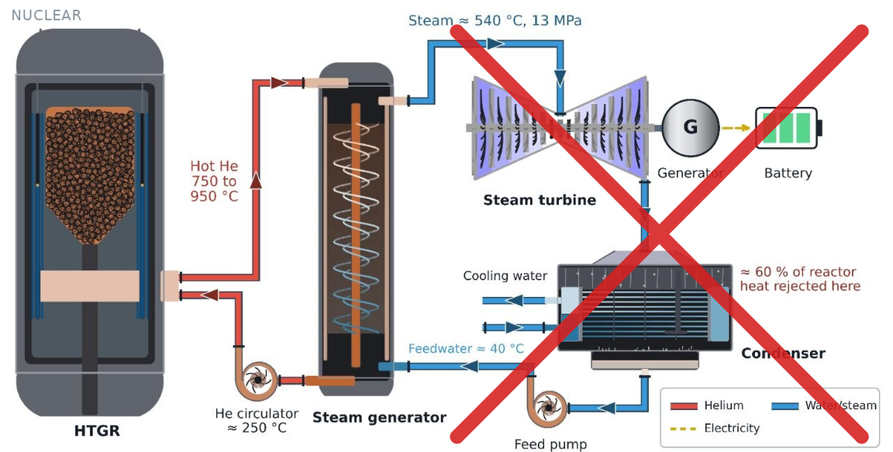
Integration removes equipment
BENEFITS OF INTEGRATION
218,274
t CO₂/y never formed
The fired furnace goes. So does the large condensing power plant.
Condensing power plant removed. A small power block stays for site loads.
Source: INL TEV‑961; Decision X12; Emissions_Ledger.csv. Status: reduced-order balances anchored on INL cases.
NUS-H2
17
Notes:
Join the two plants and each one sheds equipment. The reformer loses its fired furnace. The reactor loses its large condensing power plant and keeps a small power block for site loads. With the furnace gone and fuel gas recycled, 218,274 tonnes of baseline CO₂ a year never forms.

Slide 18
TRISO: the first barrier
RISKS: SAFETY
Outer pyrolytic carbon
Silicon carbide
1,600 °C
Inner pyrolytic carbon
Porous carbon buffer
fuel limit
Fuel kernel
TRISO coatings are the first barrier to fission product release, provided fuel stays below about 1,600 °C.
Source: IAEA‑TECDOC‑1236 printed p14, p24, p54, p104; INL, TRISO fuel qualification
NUS-H2
18
Notes:
Now the risks, starting with safety. TRISO coatings are the first barrier to fission product release, provided fuel stays below about 1,600 degrees. HTTR counts four barriers: coatings, pressure vessel, containment and reactor building. Tritium is the known exception, since it can leave cracked coatings and also forms in graphite.

Slide 19
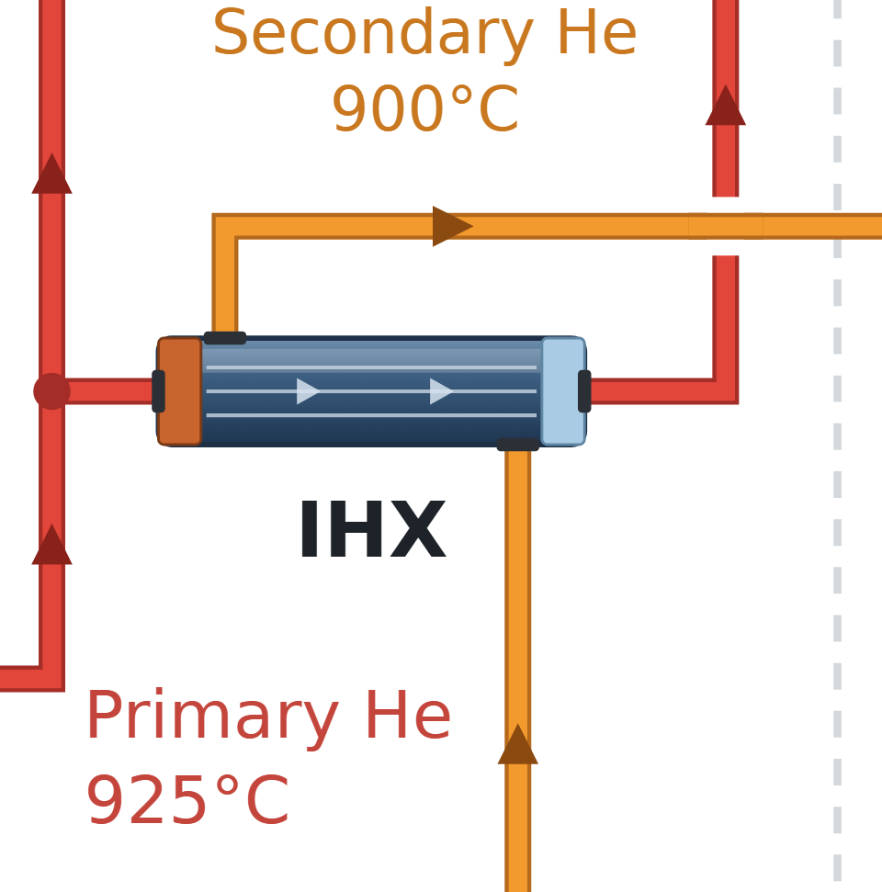
The IHX: the boundary to isolate
RISKS: SAFETY
First boundary
Secondary helium held slightly above primary pressure. Isolation valves are required and the figure omits them.
Source: IAEA NP‑T‑4.3 printed p11, p33; IAEA‑TECDOC‑1382 printed p4; IAEA‑TECDOC‑1236 printed p54 to p55, p59; Tochio and Nakagawa 2011 PDF p9; Sato et al. 2006 PDF p11
NUS-H2
19
Notes:
The IHX is the first boundary between the nuclear island and the process loop. Its tubes are a pressure boundary, and they remove nothing. Secondary helium is held slightly above primary pressure, so a leak runs towards the reactor. Purification and monitoring manage tritium permeation. Isolation needs a high-temperature emergency shutoff valve, which the figure omits. A thermal buffer for a reformer trip is also still open in the design.

Slide 20
900 °C helium is still unproven
RISKS: SAFETY
859 °C
900 °C
measured
needed
25 K approach is INL’s assumption. At 50 K the reformer pinch falls to 4 K.
Source: IAEA NP‑T‑4.3 printed p14; Tochio and Nakagawa 2011 PDF p4, p8; INL TEV‑961 printed p10; Sato et al. 2006 PDF p1. Status: reduced-order balances anchored on INL cases.
NUS-H2
20
Notes:
This is the largest technical gap. The highest measured IHX secondary temperature in the sources I hold is 859 degrees, on a 10 megawatt HTTR unit. The design needs 900 degrees at an IHX duty of 121.7 megawatts, and no source I hold shows an IHX heating a chemical plant. The 25 kelvin approach is INL’s assumption. At 50 kelvin, the IAEA’s typical value, the reformer pinch falls from 29 to 4 kelvin, and the no-furnace claim is at risk.

Slide 21
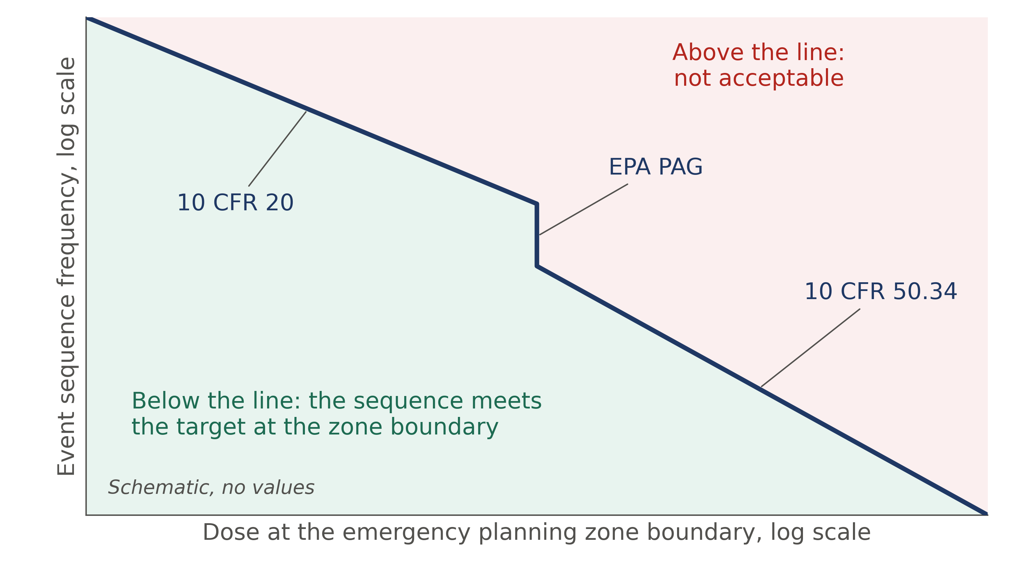
Emergency zone: set by a safety case
RISKS: SAFETY
No distance claimed
A low-power TRISO HTGR may justify a smaller EPZ, subject to a design-specific safety case.
Schematic of the method in the Xe-100 application, with no values. The Q&A backup slides show the plotted target in rem.
Source: IAEA NP‑T‑4.3 printed p18, p32 to p35; SingStat; Long Mott application, Xe‑100 EPZ report
NUS-H2
21
Notes:
Emergency planning matters most in a country our size. A low-power TRISO HTGR may justify a smaller emergency planning zone, subject to a design-specific safety case. The zone follows source term and dose, so I claim no distance. The same case must also cover process hazards beside the reactor, such as fire and toxic release.

Slide 22
Singapore is building capability
RISKS: REGULATION
May 2026
Singapore announces the IAEA INIR review
2027
26 October 2026
METI and EMA launch manpower schemes
INIR Phase 1 assessment, tentative date, 19 areas
2027
Singapore has made no decision on nuclear energy.
INIR Phase 1 assessment, tentative date
Source: METI, 19 May 2026; EMA and METI, 26 October 2026; Singapore Energy Lecture 2026 para 50
NUS-H2
22
Notes:
On regulation and people, Singapore is building the capability to decide. The IAEA’s INIR Phase 1 assessment is tentatively set for 2027 and covers 19 areas. On 26 October 2026, METI and EMA launched manpower schemes for public officers and selected companies. Government is clear that no decision on nuclear energy has been made.

Slide 23
Acceptance has to be earned
RISKS: COMMUNITY
NOW
SNRSI public lectures
Open to anyone, including students
Public understanding comes before any site decision.
BEFORE ANY SITE
Public understanding
SNRSI public lectures are open to anyone, including students.
Needed ahead of any site decision
Source: SNRSI Lectures; The Straits Times, 18 May 2026; IAEA NG‑G‑5.1
NUS-H2
23
Notes:
Public acceptance is a precondition. The Singapore Nuclear Research and Safety Institute runs public lectures open to anyone, including students. That outreach has to run long before any site decision.

Slide 24
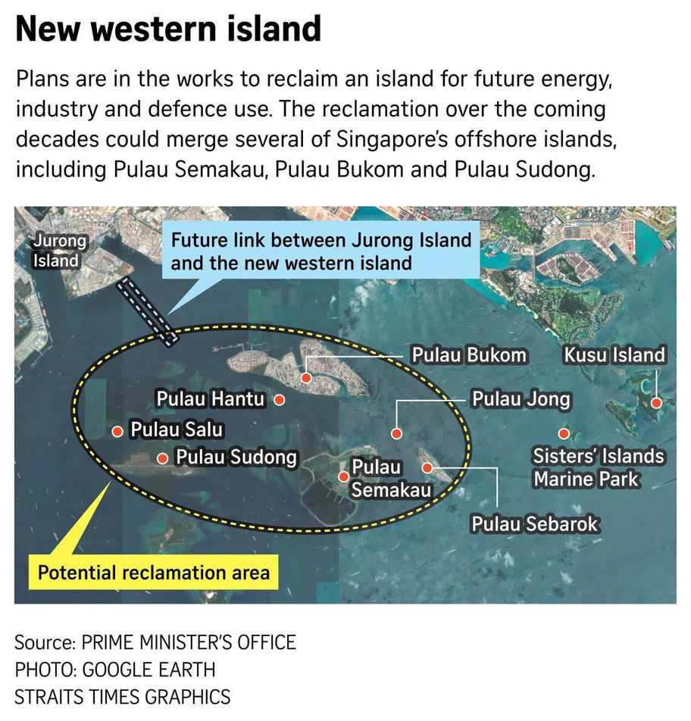
Proposed site: Western Island
IMPLEMENTATION LOCATION
The author’s proposal. No official approval.
Links to the island are unpriced. Land may not exist at the milestone dates.
Source: gov.sg NDR 2026; BritCham Singapore 2026; Decisions D05, X15
NUS-H2
24
Notes:
My proposed site is the new western island from the 2026 National Day Rally, linked to Jurong Island’s industry. This is my proposal. It has no official approval, and the government page does not mention nuclear. Reclamation runs over coming decades, so land may not exist at the milestone dates, and the links to the island are unpriced.

Slide 25
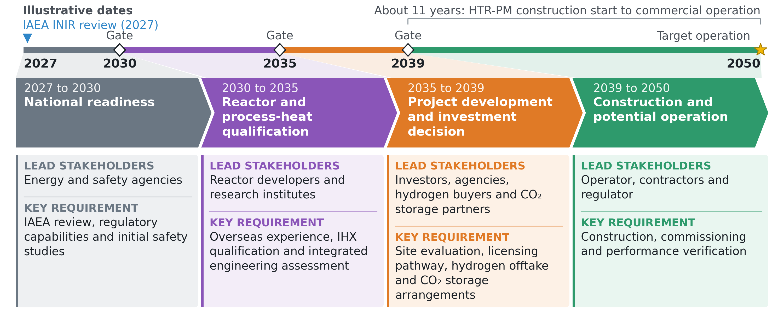
2027 to 2050, every date illustrative
IMPLEMENTATION ROADMAP
2050
Potential operation, illustrative
Illustrative dates.
Source: World Nuclear Association, HTR‑PM; METI, 19 May 2026; Singapore Energy Lecture 2026
NUS-H2
25
Notes:
The roadmap runs from 2027 to 2050 in four stages, and every date is illustrative. National readiness comes first, then reactor and process-heat qualification, then project development and an investment decision, then construction. The 2039 start leans on the 11 years HTR-PM took from construction to commercial operation. Each gate opens only if the stage before it delivers.

Slide 26
Where the boundary runs
EMISSIONS BOUNDARY
Inside: reactor to ship offshore storage. Outside: PSA, upstream gas, construction.
NUS-H2
Source: Decisions D06, X10; METI, 13 June 2025. Status: reduced-order balances anchored on INL cases.
26
Notes:
Emissions now, and the boundary comes first. Inside the dashed line sit the reactor, helium loops, reformer, shift, capture, compression and ship offshore storage. The PSA sits outside, with its reject crossing back in. Upstream gas and construction are excluded. Abatement counts at the Singapore stack. Storage abroad rests on the Singapore-Indonesia arrangement, and its accounting is unresolved.

Slide 27
Same hydrogen, two plants
EMISSIONS METHOD
A = E_{base} − E_{atm}
616,361
Net abatement equals baseline emissions less emissions to atmosphere
t CO₂/y baseline
0.578 = 0.616 − 0.038 Mt CO₂e/y
9.21 kg/kg on INL’s basis, bounded by 8.996 and 9.35.
Source: INL TEV‑953 Table 2, PDF p30; Cho et al. 2022; IEAGHG 2017‑02 Table 2; Decisions D05, D07. Status: reduced-order balances anchored on INL cases.
NUS-H2
27
Notes:
The method is a mass balance at equal hydrogen. The comparator is a same-size new-build unabated steam methane reforming plant at 9.21 kilograms per kilogram, or 616,361 tonnes a year. Cho’s 9.35, from 33 US plants, and IEAGHG’s 8.996 bound it. Net abatement is that baseline less what reaches the atmosphere, and hydrogen runs only in the 85 percent availability hours.

Slide 28
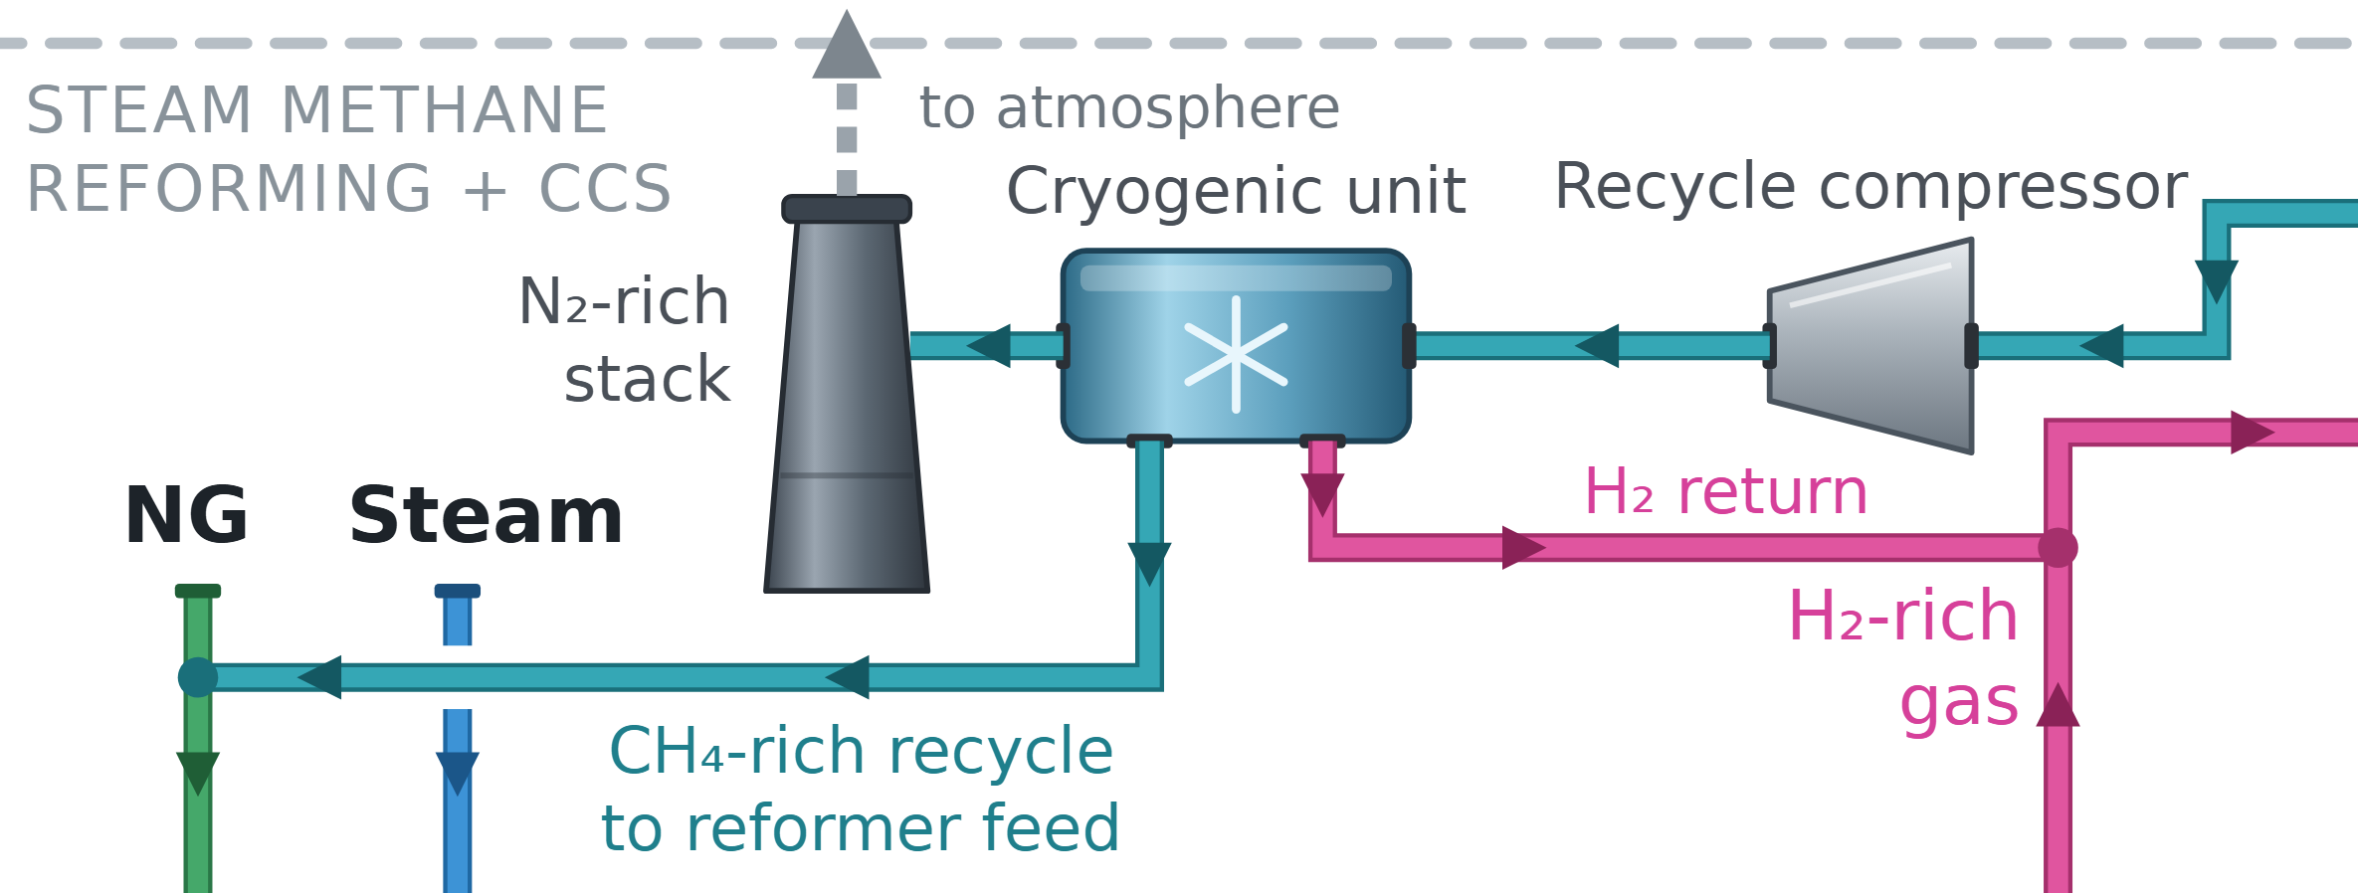
What still reaches the air
EMISSIONS RESULT
38,309
Where the baseline carbon goes, t CO₂/y
359,777
218,274
t CO₂/y to atmosphere
To storage
Never formed
0.57 kg CO₂ per kg H₂. 359,777 t/y goes to storage.
To air
38,309
Source: Emissions_Ledger.csv; Decision D04. Status: reduced-order balances anchored on INL cases.
NUS-H2
28
Notes:
Absorber slip recycles through the reformer, so the residual comes from one place: the burned nitrogen-rich cut at the cryogenic unit. That stack emits 38,309 tonnes a year, 0.57 kilograms per kilogram of hydrogen. Another 359,777 tonnes goes to storage.

Slide 29
Net abatement clears the target
EMISSIONS RESULT
Mt CO₂e/y
Target 0.250
Unabated steam methane reforming
0.616
0.578
NUS-H2 to atmosphere
0.038
Net abatement
0.578
Mt CO₂e/y, 93.8% below unabated steam methane reforming
0.569 Mt/y with the storage chain burden charged. Target 0.250 Mt/y: met.
Source: Emissions_Ledger.csv; NCCS 2035 NDC; Decisions X9, X14. Status: reduced-order balances anchored on INL cases.
NUS-H2
29
Notes:
Baseline less residual gives 0.578 million tonnes a year, a 93.8 percent cut against that unabated plant. That is 2.3 times the target of 0.250. Charge the storage chain’s burden and it reads 0.569. For scale only, the result equals 1.2 to 1.3 percent of Singapore’s 2035 target level.

Slide 30
Stress tests hold above target
SENSITIVITY
Net abatement, Mt/y
Target 0.250
Central
0.578
Cho baseline
0.587
0.442
IEAGHG baseline
0.564
80% per-pass capture
0.564
65% availability
0.442
Lifecycle burdens
0.566
Mt/y at 65% availability
Lifecycle, saved upstream gas
0.616
One input at a time. Corner runs carry no probability.
Lost steam export counted
0.528
Source: Sensitivity_Results.csv; Emissions_Ledger.csv; IAEA NP‑T‑4.3 printed p38. Status: reduced-order balances anchored on INL cases.
NUS-H2
30
Notes:
I stressed one input at a time. At 80 percent per-pass capture, abatement is 0.564. At 65 percent availability, 0.442. Lifecycle burdens give 0.566, and counting lost steam export gives 0.528. All clear the target. These corner runs carry no probability, and 85 percent has no measured HTGR record behind it.

Slide 31
The assumption that matters most
SENSITIVITY
0.467
Target 0.250 Mt/y
Central
0.578
Recycle fails
0.467
Capture offline
0.218
Mt/y if recycle fails
Gas rises to 30.4 MMSCFD. With capture offline, only 0.218 Mt/y remains.
Source: Decision X20; Sensitivity_Results.csv tail gas rows. Status: reduced-order balances anchored on INL cases.
NUS-H2
31
Notes:
One assumption matters most. If recycle fails to transfer from INL’s Selexol case to MEA, with hydrogen output held, abatement falls to 0.467 and gas rises to 30.4. That still clears the target. With capture offline, only the carbon that never forms counts, 0.218, which misses it. So capture has to work.

Slide 32
What the market compares NUS-H2 with
ECONOMICS
S$/t CO₂e on one scale
Target S$100
Carbon tax, 2026 to 2027
S$45
S$45/t
Stated view by 2030
S$50 to S$80
NUS-H2, BOAK, 25 y
S$189.7
carbon tax, 2026 to 2027
A stated view of S$50 to S$80/t by 2030. No offtake is contracted.
Source: NCCS Carbon Tax; Air Liquide and Aster 2025. Status: reduced-order balances anchored on INL cases.
NUS-H2
32
Notes:
What does the market compare NUS-H2 with? Singapore’s carbon tax is S$45 a tonne in 2026 and 2027, with a stated view to S$50 to S$80 by 2030. Tax is a transfer, so it stays outside the cost metric. No hydrogen offtake is contracted, and there is competition: Air Liquide and Aster have an MoU on autothermal reforming with up to 99 percent capture here.

Slide 33
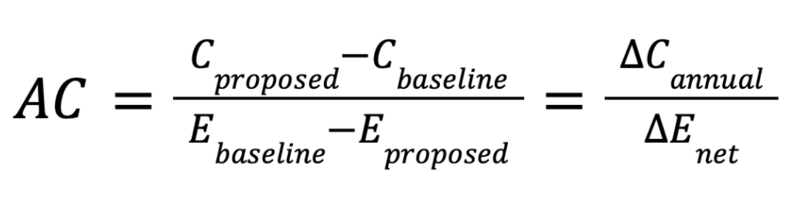
Cost, rebuilt two ways
ECONOMICS METHOD
AC, abatement cost
0.47%
Annual ledger
Each cost difference against unabated steam methane reforming, levels L0 to L5
largest gap between the methods, over all 72 points
Discounted cash flow
Both plants, year by year, at equal hydrogen output
0.2% on the headline grid. Equal hydrogen output, 8% real discount rate. Shared inputs, so agreement tests the arithmetic.
Source: Decision D08; Economic_Ledger.csv. Status: reduced-order balances anchored on INL cases.
NUS-H2
33
Notes:
Now the cost. I use two methods at equal hydrogen output. An annual ledger adds each cost difference against the unabated steam methane reforming plant. A discounted cash flow runs both plants year by year at 8 percent. They differ by at most 0.47 percent over all 72 points. Both share one set of inputs, so that agreement tests the annualisation and does not validate the inputs.

Slide 34
The inputs that drive cost
COST ASSUMPTIONS
S$15/GJ
Gas, the largest credit
Input | Low | Central | High | Unit
Gas | 10 | 15 | 20 | S$/GJ
Transport and storage | 23.2 | 60 | 112 | S$/t
Reactor capital | 1,456 | 2,184 | 2,548 | US$/kWt
Source: INL/RPT‑23‑72972 PDF p47; IEAGHG 2017‑02 Tables 2, 3; IMF via FRED, PNGASJPUSDM; ERIA 2024; METI PQ, 8 April 2025; Decision D10, X18, X19
NUS-H2
34
Notes:
These inputs drive the result. Gas is S$15 per gigajoule. Transport and storage is S$60 a tonne, between S$23.2 and S$112, and no Singapore-Indonesia tariff has been published. Reactor capital is US$2,184 per kilowatt thermal. Capture capital is bottom-up on an aMDEA basis, so an MEA plant could cost more. The full table is in backup.

Slide 35
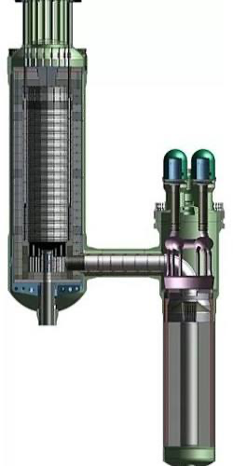
Reactor capital: first plant against later plants
REACTOR COST
S$1,188M
S$743M
BOAK
S$743M
S$1,188M
FOAK
Generic HTGR. Xe-100 is an analogue only, with no vendor quotation.
Analogue only
BOAK
FOAK
Source: INL/RPT‑23‑72972 Table 1, PDF p5, p47; X‑energy; Decisions D09, D23, X4. Status: reduced-order balances anchored on INL cases.
NUS-H2
35
Notes:
I price a generic 925 degree HTGR on INL’s recipe, charged at 210 megawatts. BOAK is INL’s term for a build between a first and an Nth of a kind, and it gives S$743 million. A first of a kind, FOAK, carries a 1.6 times premium, S$1,188 million, and that is what a single plant would be. The Xe-100 shown is an analogue only, with a 750 degree outlet and no vendor quotation.

Slide 36
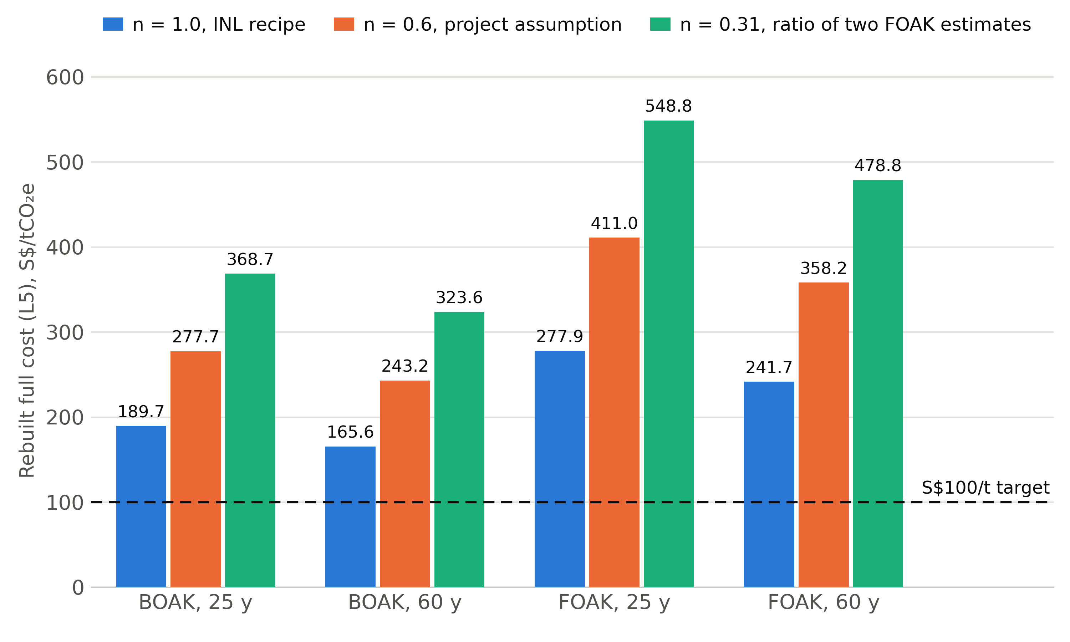
The scale law moves everything
REACTOR COST
S$189.7
n = 1.0, INL recipe
S$277.7
n = 0.6, project assumption
S$368.7
n = 0.31, ratio of two FOAK estimates
per tonne at BOAK, 25 y
Source: INL/RPT‑23‑72972 PDF p25, p27, p39, p45; Decisions D09, X5. Status: reduced-order balances anchored on INL cases.
NUS-H2
36
Notes:
How a 600 megawatt estimate scales down to 210 is uncertain, so I print three treatments at equal size. n of 1.0 is INL’s recipe and the central case. n of 0.6 is a project assumption. n of 0.31 is the ratio of two first-of-a-kind estimates. At BOAK and 25 years, full cost runs from S$189.7 to S$368.7 a tonne.

Slide 37
Hydrogen cost, both plants
HYDROGEN COST
Unabated steam methane reforming
NUS-H2 BOAK
NUS-H2 FOAK
6.02
5.71
5.26
5.05
S$3.62/kg
unabated steam methane reforming
3.62
3.62
S$5.26/kg
NUS-H2, BOAK, 25 y
FOAK S$6.02/kg. At 60 y: BOAK S$5.05/kg, FOAK S$5.71/kg.
25 y
60 y
Levelised cost of hydrogen, S$/kg
Source: Economic_Ledger.csv cash flow rows; IEAGHG 2017‑02 Tables 3, 4, PDF p17, p18. Status: reduced-order balances anchored on INL cases.
NUS-H2
37
Notes:
Here is the money. Unabated hydrogen costs S$3.62 a kilogram. Over 25 years NUS-H2 costs S$5.26 at BOAK and S$6.02 at FOAK. Over 60 years, S$5.05 and S$5.71. That is a BOAK premium of S$1.64 a kilogram, which a buyer would have to carry. Both plants carry the same reformer island from IEAGHG, on the assumption that reformer differences cancel.

Slide 38
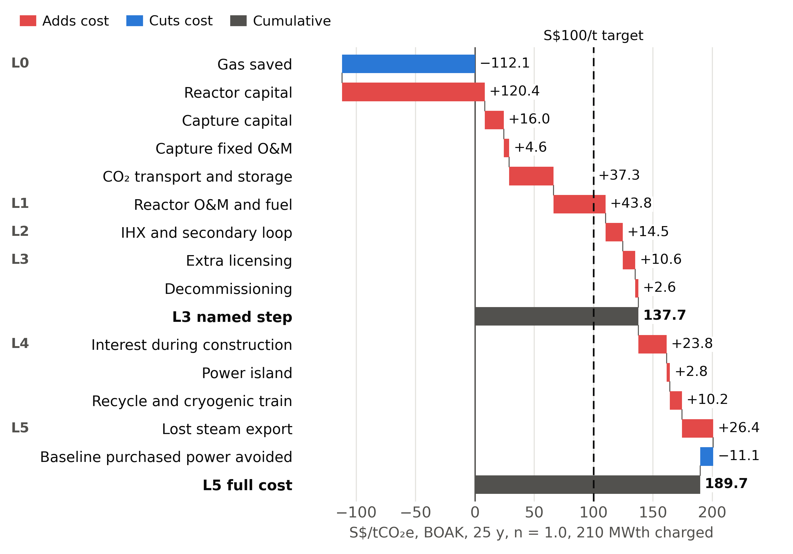
Every real cost is on the ladder
ABATEMENT COST
S$189.7/t
Rebuilt full cost
BOAK, 25 y, n = 1.0, 210 MWth charged. Named step L3: S$137.7/t.
Source: Economic_Ledger.csv; Decision D08. Status: reduced-order balances anchored on INL cases.
NUS-H2
38
Notes:
This ladder shows what each line adds at BOAK over 25 years. Gas saved pays back S$64.8 million a year. Reactor capital costs S$69.6 million. Stop at the named step L3 and you read S$137.7 a tonne. Construction interest and lost steam export are real costs of this plant too, so the full figure is S$189.7.

Slide 39
Levelised abatement cost: target missed
ABATEMENT COST
Levelised abatement cost, discounted cash flow, S$/t
BOAK, 25 y
BOAK, 60 y
S$190.1
S$166.0
0 of 8
Ledger S$189.7
Ledger S$165.6
FOAK, 25 y
FOAK, 60 y
S$278.4
S$242.2
central cases reach S$100/t
Ledger S$277.9
Ledger S$241.7
Source: Economic_Ledger.csv; Decisions D08, X4. Status: reduced-order balances anchored on INL cases.
NUS-H2
39
Notes:
Here is the levelised abatement cost from the cash flow. BOAK is S$190.1 at 25 years and S$166.0 at 60. FOAK is S$278.4 and S$242.2. Against S$100, the target is missed: 0 of 8 central cases pass.

Slide 40
What S$100/t would take
ABATEMENT COST
US$824/kWt
Needed, against INL’s low of US$1,456/kWt
Lever | Needed at 25 y | Needed at 60 y | Tested range
Gas, S$/GJ | 30.7 | 26.5 | To 20
Reactor, US$/kWt | 824 | 1,031 | From 1,456
T&S, S$/t | −84.2 | −45.5 | From 23.2
Sized to need, S$/t reached | 161.2 | 140.4 | Still above target
Source: Report section 4.7. Status: reduced-order balances anchored on INL cases.
NUS-H2
40
Notes:
What would S$100 take? One lever at a time, at BOAK and 25 years, the plant is S$51.9 million a year over the ceiling. Gas would have to reach S$30.7 per gigajoule, 2.0 times the central price. Reactor cost would have to fall to US$824, under INL’s low of 1,456. Transport and storage would have to go negative. Sizing to need reaches only S$161.2. No single lever closes it.

Slide 41
S$96/t: S$100/t target met for a 10th‑of‑a‑kind plant over 60 years with gas at S$20.7/GJ
ABATEMENT COST
MATURE_60Y: 10th‑of‑a‑kind on INL’s BOAK learning route, 60 y, gas at S$20.7/GJ
Base full cost
BOAK, 25 y, n = 1.0, 210 MWth charged
S$95.6/t
S$95.9/t
S$189.7/t
Annual ledger, L5
Discounted cash flow
Annual ledger, L5
S$20.7/GJ
S$15/GJ
S$190.1/t
Gas price that meets the target
Central gas price
Discounted cash flow
Higher gas prices lower the abatement cost, because NUS-H2 burns less gas than an unabated steam methane reforming plant of the same output. S$20.7/GJ lies above the S$10 to S$20/GJ range tested. At S$20/GJ the scenario gives S$99.6/t on L5 and S$99.9/t by DCF.
S$100/t target missed at the base
Source: Sensitivity_Results.csv MATURE_60Y rows; Economic_Ledger.csv; INL/RPT‑23‑72972 PDF p46. Status: reduced-order balances anchored on INL cases.
NUS-H2
41
Notes:
In the named scenario MATURE_60Y, a 10th‑of‑a‑kind plant on INL’s BOAK learning route, run for 60 years, meets the S$100 target at S$96 a tonne when gas costs S$20.7 a gigajoule: S$95.6 on the ledger and S$95.9 by cash flow. Dearer gas lowers the cost because NUS-H2 burns less gas. That price is above the tested range, and at S$20, its top, the scenario gives S$99.6 and S$99.9. The base stays on screen: BOAK over 25 years costs S$189.7 and S$190.1, and misses.

Slide 42
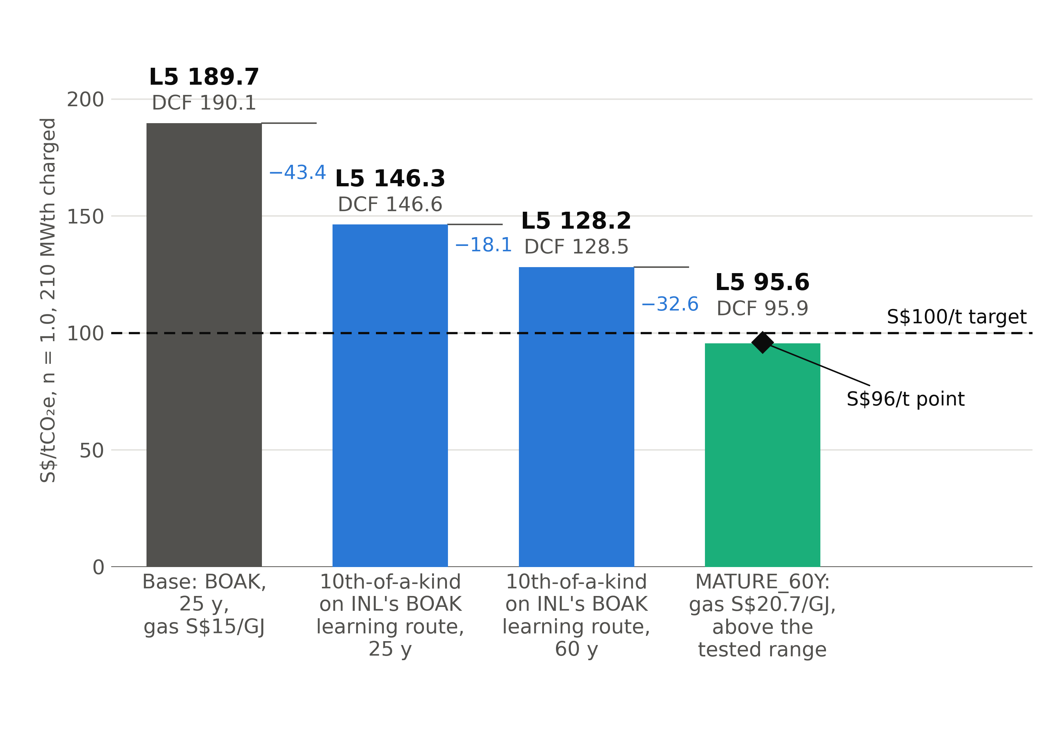
How the cost steps down to the target
ABATEMENT COST
Base
S$189.7/t
DCF S$190.1/t
After the three steps
S$95.6/t
DCF S$95.9/t
The reactor steps cut S$43.4/t for a 10th‑of‑a‑kind unit and S$18.1/t for a 60 year life. Gas at S$20.7/GJ then cuts S$32.6/t.
Source: Sensitivity_Results.csv STEPDOWN rows; INL/RPT‑23‑72972 PDF p46. Status: reduced-order balances anchored on INL cases.
NUS-H2
42
Notes:
Every bar is an engine run, ledger first. From the base of S$189.7, a 10th‑of‑a‑kind reactor on INL’s BOAK learning route and a 60 year life take off S$43.4 and S$18.1. Gas at S$20.7, above the tested range, then takes off S$32.6, to S$95.6, under the line at the S$96 point. These are conditions on the base, which stays the reference.

Slide 43
Overall feasibility
OVERALL FEASIBILITY
Carbon
Cost
Technology
Site and policy
0.578 Mt/y
S$165.6 to S$277.9/t
IHX
Open
Abatement met
Cost missed
Unqualified
No decision
On this boundary, with working capture and recycle
At central inputs. Met at S$96/t for a 10th‑of‑a‑kind plant on INL’s BOAK learning route over 60 y with gas at S$20.7/GJ, above the tested range
No IHX built at this duty
Land and a national decision do not yet exist
Source: Report sections 4 and 5. Status: reduced-order balances anchored on INL cases.
NUS-H2
43
Notes:
So is it feasible? On carbon, yes, on this boundary. On cost, the target is missed at central inputs and met only in the mature case, at a gas price above the tested range. On technology, the plant rests on an IHX nobody has built at this duty. On siting, it rests on land and a national decision that do not yet exist. NUS-H2 is a credible carbon route whose cost closes only for a mature plant, after demonstration overseas.

Slide 44
What this model has yet to show
LIMITS OF THE MODEL
Still to close
Recycle transfer to MEA
Ship liquefaction load
360 of 650
Capture capital basis
SRD on syngas
HTGR availability
checks are independent of the source data
Site links
Backup firing capital
325 pass (92 on independent data), 32 fail, 251 reported without a limit, 42 not run.
Offshore accounting
Source: Validation_Results.csv; Design decisions sections 4 and 9. Status: reduced-order balances anchored on INL cases.
NUS-H2
44
Notes:
Now the limits of these numbers. Many results are reduced-order balances anchored on INL cases. Of 650 validation rows, 360 are independent of the source data. 325 rows pass, 92 of them on independent data. 32 fail and stay on the record. 251 have no limit to test against, and 42 did not run. The list on screen is what the next stage has to close.

Slide 45
The author
AUTHOR
Wee Zhern Ray
NUS-H2
45
Notes:
NUS-H2 is presented by its author, Wee Zhern Ray.

Slide 46

NUS-H2 in one slide
CONCLUSION
What
Carbon
Cost
Next
0.578 Mt/y
S$189.7/t
2050
Target met
Base: target missed
IHX qualification and a design-specific safety case, on an illustrative path
210 MWth
93.8% cut against same-size unabated steam methane reforming
BOAK, 25 y. Target met at S$96/t for a 10th‑of‑a‑kind plant on INL’s BOAK learning route over 60 y with gas at S$20.7/GJ, above the tested range
Helium-heated steam methane reforming with MEA capture
Source: Emissions_Ledger.csv; Economic_Ledger.csv; Sensitivity_Results.csv MATURE_60Y rows. Status: reduced-order balances anchored on INL cases.
NUS-H2
46
Notes:
To close. NUS-H2 heats a reformer with a 210 megawatt HTGR and captures CO₂ with MEA. It abates 0.578 million tonnes a year, so the carbon target is met. Abatement costs S$189.7 a tonne at BOAK and S$277.9 at FOAK, so the cost target is missed at the base. A 10th‑of‑a‑kind plant on INL’s BOAK learning route over 60 years meets it at S$96 with gas at S$20.7, above the tested range. The next steps are IHX qualification overseas and a design-specific safety case. Thank you.

Slide 47
Reference Frame: variables
BACKUP
Symbol | Definition | Units | Central
ṁ_{H₂} | Annual hydrogen | t/y | 66,925
a | Availability | % | 85
T_{ROT} | Reactor outlet | °C | 925
T_{He} | Secondary helium supply | °C | 900
R_{rated} | Reactor rating | MWth | 210
R_{need} | Reactor needed | MWth | 178.5
Q_{proc} | Process heat | MWth | 120.8
E_{site} | Site electrical load | MWe | 19.8
e_{base} | Baseline intensity | kg CO₂/kg H₂ | 9.21
Symbol | Definition | Units | Central
E_{base} | Baseline emissions | t/y | 616,361
E_{atm} | Emissions to atmosphere | t/y | 38,309
A | Net abatement | Mt/y | 0.578
η_{pass} | Per-pass capture | % | 90
η_{plant} | Plant capture | % | 90.4
q_{reb} | Specific reboiler duty | GJ/t | 3.8
r | Real discount rate | % | 8
n | Reactor size exponent | none | 1.0
L | Learning rate per doubling | % | 10
Source: Final_Design_Basis.csv. Status: reduced-order balances anchored on INL cases.
NUS-H2
47
Notes:
Backup. The symbols used in the talk, with today’s central values.

Slide 48
Reference Frame: equations
BACKUP
(1)
A = E_{base} − E_{atm}
(7)
AC = ΔC / A
(2)
E_{base} = e_{base} ṁ_{H₂}
(8)
LCOH_{x} = NPV(c_{x}) / NPV(m_{H₂})
(3)
η_{plant} = m_{cap} / (m_{cap} + E_{atm})
(9)
LAC = NPV(Δc) / NPV(A)
(4)
R_{need} = Q_{IHX} + Q_{loss} + Q_{power} − W_{shaft}
(10)
C(S) = C_{ref} (S / S_{ref})^{n}
(5)
Q = ṁ c_{p} ΔT
(11)
C_{N} = C₁ (1 − L)^{log₂ N}
(6)
CRF = r / (1 − (1 + r)^{−N})
Ranges: SRD 3.4 to 4.2 GJ/t, life 25 to 60 y, 1.3 to 2.1 FOAK premium. CRF at 25 y is 0.0937 and at 60 y is 0.0808.
Source: Project derivations; INL/RPT‑23‑72972 PDF p46, p47. Status: reduced-order balances anchored on INL cases.
NUS-H2
48
Notes:
Backup. These are the equations behind the headline numbers. Learning from FOAK and from BOAK are both published, and each use states its route.

Slide 49
Steam methane reforming plus CCS comparator
BACKUP
S$203.0/t
IEAGHG Case 3 at matched T&S
Item | NUS-H2 | IEAGHG Case 3
Capture route | MEA on shifted syngas | MEA on flue gas
Overall capture | 90.4% | 90.0%
Baseline, kg/kg | 9.21 | 8.996
Abatement, Mt/y | 0.578 | 0.536
Cost as published, S$/t | not applicable | 162.1
Cost at T&S S$60/t, S$/t | BOAK 189.7, FOAK 277.9 | 203.0
Indicative. Gas price and availability differ from this ledger.
Source: IEAGHG 2017‑02 Tables 2 to 5; Decisions D11, X17. Status: reduced-order balances anchored on INL cases.
NUS-H2
49
Notes:
Backup. IEAGHG Case 3 at matched transport and storage sits above the NUS-H2 BOAK case and below its FOAK case, so NUS-H2 competes only once a reactor is past first of a kind. Its gas price and availability differ from this ledger, so read this as indicative.

Slide 50
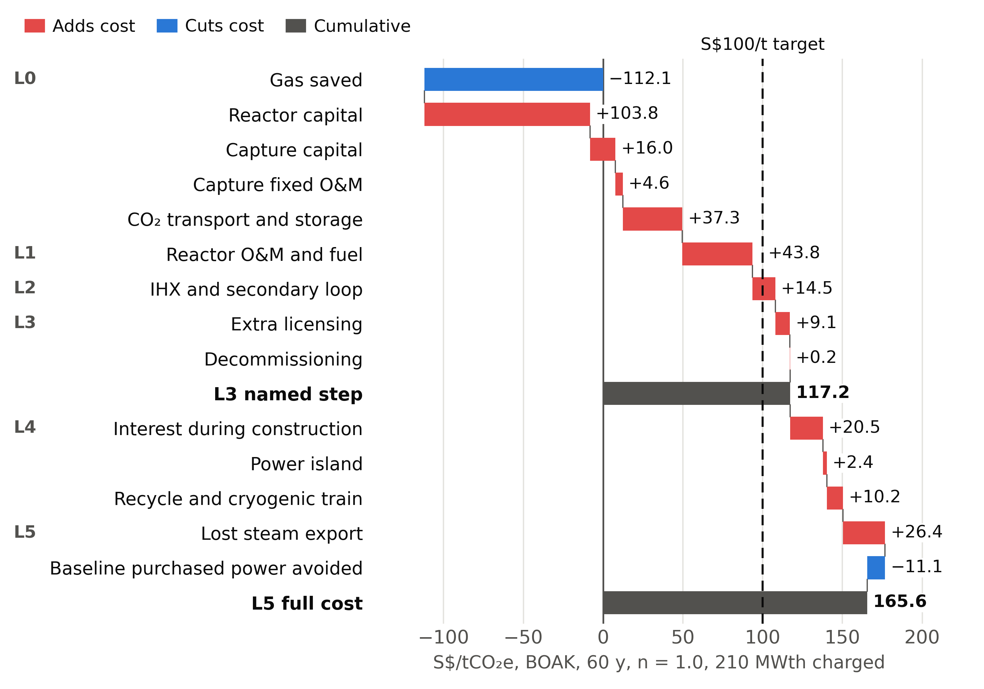
Cost ladder at 60 y
BACKUP
S$165.6/t
Rebuilt full cost
BOAK, 60 y, n = 1.0, 210 MWth charged.
Source: Economic_Ledger.csv. Status: reduced-order balances anchored on INL cases.
NUS-H2
50
Notes:
Backup. The same ladder over 60 years. Longer life changes only the reactor-linked lines.

Slide 51
Cost ladder, every level
BACKUP
S$57.8M/y
Ceiling at the cost target
S$/t | BOAK 25 y | BOAK 60 y | FOAK 25 y | FOAK 60 y
L0 gas, capital, capture, T&S | 66.2 | 49.7 | 138.5 | 112.0
L1 reactor O&M and fuel | 110.0 | 93.5 | 182.3 | 155.8
L2 IHX and loop | 124.5 | 108.0 | 196.7 | 170.3
L3 licensing, decommissioning | 137.7 | 117.2 | 209.9 | 179.5
L4 interest, power island, recycle train | 174.5 | 150.4 | 262.7 | 226.4
L5 lost steam, avoided purchased power | 189.7 | 165.6 | 277.9 | 241.7
DCF levelised abatement cost | 190.1 | 166.0 | 278.4 | 242.2
Source: Economic_Ledger.csv. Status: reduced-order balances anchored on INL cases.
NUS-H2
51
Notes:
Backup. Each row adds the named items. L5 and the cash flow are the headline, and L3 stays as a named step.

Slide 52
Assumptions: plant
BACKUP
Item | Value | Status
Reactor outlet, IHX approach | 925 °C, 25 K | INL assumption, 50 K tested
Secondary helium | 900 °C out, 466 °C back | INL
Reformer outlet | 871 °C | INL equilibrium assumption
Power conversion | 39.7% | INL, 47.5% tested
MEA | 30 wt%, rich 0.50, lean 0.25 | Project assumption
Absorber, stripper | 26.8 bar, 2 bar | INL, amine specification
SRD | 3.8 GJ/t, 3.4 to 4.2 | Assumed from flue gas pilots
Availability | 85% | Assumed, no measured HTGR record
Source: Final_Design_Basis.csv; INL TEV‑961; Decisions D26 to D33
NUS-H2
52
Notes:
Backup. Each plant value with its status. INL values are published, and the rest are assumptions labelled as such.

Slide 53
Assumptions: cost
BACKUP
Input | Low | Central | High | Unit
Reactor overnight capital | 1,456 | 2,184 | 2,548 | US$2019/kWt
FOAK premium | 1.3 | 1.6 | 2.1 | × BOAK
Reactor O&M and fuel | 6 | 10 | 14 | US$2019/MWth-h
Gas | 10 | 15 | 20 | S$/GJ
T&S | 23.2 | 60 | 112 | S$/t
Extra licensing | 0 | 50 | 137.5 | US$M
Decommissioning | 750 | 1,000 | 1,250 | US$2022/kWe
Discount 8%. FX S$1.3065/US$. Construction 5.5 y.
Source: INL/RPT‑23‑72972 Table 1; IEAGHG 2017‑02; FRED, AEXSIUS; IMF via FRED, PNGASJPUSDM; ERIA 2024; Decision D10
NUS-H2
53
Notes:
Backup. Every cost input with its range. Several lines are labelled proxies, including IHX and licensing, which rest on primary sources not verified here.

Slide 54
Cost sensitivities
BACKUP
Change | Full cost, S$/t | Change | Full cost, S$/t
T&S S$23.2 | 166.8 | T&S S$112 | 222.1
Gas S$10/GJ | 218.3 | Gas S$20/GJ | 161.2
Availability 65% | 253.0 | Availability 90% | 178.3
Reactor capital low | 141.7 | Reactor capital high | 213.8
Gas saving on Ahn and Lee, carbon held | 242.0 | Capture capital on MEA flue gas | 220.5
Sized to need | 161.2 | No recycle | 283.1
Source: Sensitivity_Results.csv; Report section 4.5. Status: reduced-order balances anchored on INL cases.
NUS-H2
54
Notes:
Backup. Reactor cost treatment and the transfer of recycle move the result most. SRD moves the spare at a fixed rating and leaves cost almost unchanged. Corner runs carry no probability.

Slide 55
References: Singapore and policy
BACKUP
Energy Market Authority of Singapore. Our Energy Story: Gas. Link
Energy Market Authority of Singapore. Singapore Energy Statistics 2025, Chapter 2: Energy Transformation. Link
Ministry of Energy, Trade and Industry, Singapore. Hydrogen. Link
World Nuclear Association. Shidaowan HTR-PM 1, Nuclear Reactor Database (construction start 9 December 2012, commercial operation 5 December 2023). Link
Singapore Department of Statistics. Environment: latest news and data (total land area, 744.3 km² as at December 2025). Link
Ministry of Energy, Trade and Industry, Singapore. Singapore to undertake IAEA review by international experts to assess its ability to make informed decision on nuclear energy deployment. 19 May 2026. Link
NUS Singapore Nuclear Research and Safety Institute. SNRSI Lectures (public lectures open to anyone, including students). Link
Shabana Begum. First CEO of NUS nuclear institute lays out plans to help energy transition. The Straits Times, 18 May 2026, p. A3. Link
International Atomic Energy Agency. Stakeholder Engagement in Nuclear Programmes. IAEA Nuclear Energy Series No. NG-G-5.1, 2021. Link
Ministry of Energy, Trade and Industry, Singapore. Singapore and Indonesia sign memoranda of understanding on cross-border electricity trade, carbon capture and storage, and sustainable industrial zone. 13 June 2025. Link
Energy Market Authority and Ministry of Energy, Trade and Industry, Singapore. Launch of manpower development schemes. Media release, 26 October 2026. Link
Ministry of Energy, Trade and Industry, Singapore. Singapore Energy Lecture 2026 by the Minister. 26 October 2026. Link
Government of Singapore. National Day Rally 2026: Future Ready. Link
British Chamber of Commerce Singapore. Government will do studies on rich marine biodiversity before Western Island reclamation. 25 August 2026. Link
National Climate Change Secretariat, Singapore. Carbon Tax. Link
National Climate Change Secretariat, Singapore. Singapore submits 2035 Nationally Determined Contribution. 10 February 2025. Link
Air Liquide. SOXAL develops key hydrogen business in Singapore. Press release, 15 January 2008. Link
Air Liquide. Further investment in Singapore. Press release, 30 November 2011. Link
Air Liquide and Aster. Air Liquide and Aster sign MOU to collaborate on low-carbon hydrogen production in Singapore. Joint release, 24 November 2025. Link
Ministry of Energy, Trade and Industry, Singapore. Written reply to PQ on projected cost per tonne of carbon dioxide abated through carbon capture and storage in Singapore. 8 April 2025. Link
NUS-H2
55
Notes:
Backup. Sources for the Singapore context.

Slide 56
References: engineering and cost
BACKUP
IEAGHG. Techno-Economic Evaluation of [Steam Methane Reforming] Based Standalone (Merchant) Hydrogen Plant with CCS. Report 2017-02, 2017. Link
D. Mears. Module 2b: HTGR Motivations and Applications. NRC HTGR Technology Course, Technology Insights for Idaho National Laboratory, 24 to 27 May 2010 (slide: Process Application Temperatures).
Idaho National Laboratory. Sensitivity of Hydrogen Production via Steam Methane Reforming to High Temperature Gas-Cooled Reactor Outlet Temperature Process Analysis. Technical Report TEV-961 Rev. 0, 2010.
Idaho National Laboratory. HTGR-Integrated Hydrogen Production via Steam Methane Reforming Process Analysis. Technical Report TEV-953 Rev. 0, 2010.
Japan Atomic Energy Agency. Testing and Research Using HTTR, 2026. Link
Long Mott Energy, LLC. Long Mott Generating Station Construction Permit Application, Part VI, Supplemental Information, including the X-energy Xe-100 plume exposure pathway EPZ technical report (Doc. ID 010810 Rev. 3, preliminary). NRC ADAMS ML25090A066, 2025. Link
H.H. Cho, V. Strezov and T.J. Evans. Environmental impact assessment of hydrogen production via steam methane reforming based on emissions data. Energy Reports 8 (2022) 13585-13595. Link
S. Ahn and C.-J. Lee. Comparative techno-economic and environmental assessment of HTGR-integrated hydrogen production via helium-heated and electrified steam methane reforming. International Journal of Hydrogen Energy 247 (2026) 155890.
A. Abou-Jaoude, L. Lin, C. Bolisetti, E. Worsham, L.M. Larsen and A. Epiney. Literature Review of Advanced Reactor Cost Estimates. Idaho National Laboratory, INL/RPT-23-72972 Rev. 3, October 2023. Link
International Atomic Energy Agency. Industrial Applications of Nuclear Energy. IAEA Nuclear Energy Series No. NP-T-4.3, Vienna, 2017.
IEAGHG. Low-Carbon Hydrogen from Natural Gas: Global Roadmap. Report 2022-07, 2022.
World Nuclear News. Chinese HTR-PM demo begins commercial operation. December 2023. Link
X-energy. Xe-100 reactor page. Link
Economic Research Institute for ASEAN and East Asia. Comprehensive CCUS Research Report, 2024 (Fig. 2.13). Link
Federal Reserve Bank of St. Louis (FRED). Singapore Dollars to U.S. Dollar Spot Exchange Rate, annual average (AEXSIUS). Link
International Monetary Fund. Global price of LNG, Asia (PNGASJPUSDM), US dollars per million BTU, monthly, via FRED, Federal Reserve Bank of St. Louis. Link
International Atomic Energy Agency. Design and evaluation of heat utilization systems for the high temperature engineering test reactor. IAEA-TECDOC-1236, Vienna, August 2001.
International Atomic Energy Agency. Evaluation of high temperature gas cooled reactor performance: Benchmark analysis related to initial testing of the HTTR and HTR-10. IAEA-TECDOC-1382, Vienna, November 2003.
D. Tochio and S. Nakagawa. Thermal Performance of Intermediate Heat Exchanger during High-Temperature Continuous Operation in HTTR. Journal of Nuclear Science and Technology 48:11 (2011) 1361-1368. Link
H. Sato, H. Ohashi, Y. Inaba, T. Nishihara, K. Hayashi and Y. Inagaki. Evaluation of Hydrogen Production System Coupling with HTTR Using Dynamic Analysis Code. Transactions of the Atomic Energy Society of Japan 5:4 (2006) 292-304.
L.O. Nelson, A. Gandrik, M. McKellar, M. Patterson, E. Robertson and R. Wood. Optimum Reactor Outlet Temperatures for High Temperature Gas-Cooled Reactors Integrated with Industrial Processes. INL/EXT-11-21537, Idaho National Laboratory, 2011. Link
Idaho National Laboratory. TRISO fuel qualification. Link
Nuclear-Power.com. Nuclear fission. Link
OUTRAM PARK, open-source nuclear simulation suite, credited as a reference. Link
NUS-H2
56
Notes:
Backup. Sources for the engineering and cost basis, with OUTRAM PARK credited as a reference.

Slide 57
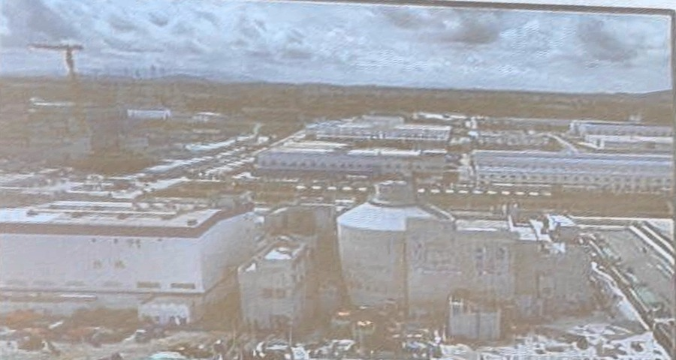
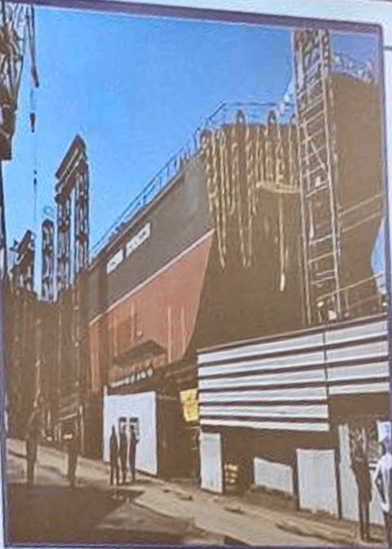
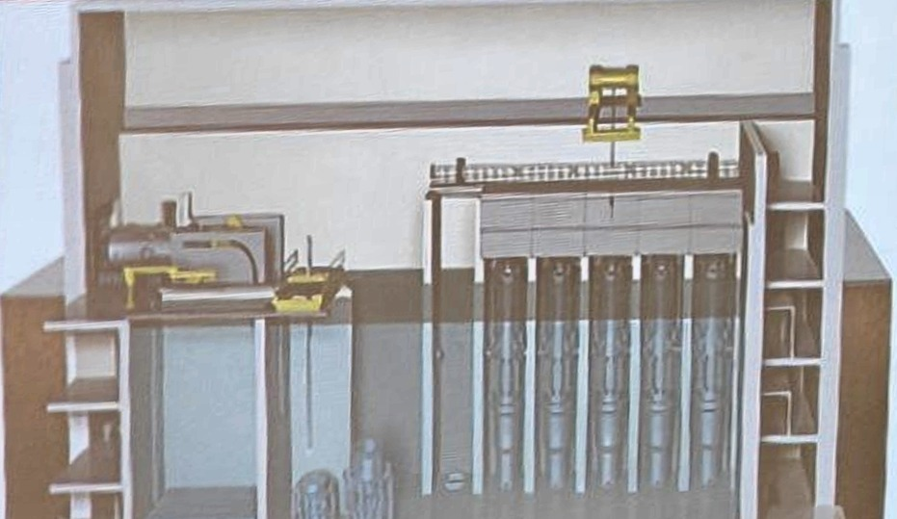
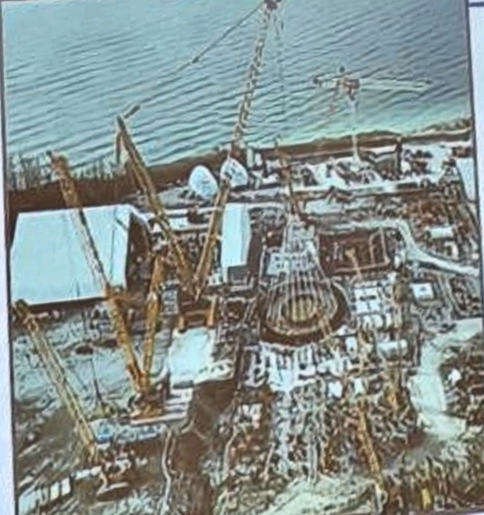
What are some of the notable light-water small modular reactor designs?
Q&A
ACP100 (China, 125 MWe)
KLT-40S (Russia, 2 x 35 MWe)
Construction began in July 2021 at Changjiang NPP in Hainan province.
Completed cold functional tests in 2025 and expected to be in commercial ops in 2026 or early 2027.
Towed and reached final destination in Sep 2019.
Connected to the grid in Dec. 2019, commercial operation at the end of May 2020.
Expected to be one-of-a-kind.
ACP100 (CNNC)
Akademik Lomonosov docked
NuScale (USA, 12 x 77 MWe)
BWRX-300 (USA-Japan, 300 MWe)
Received Standard Design Approval issued by U.S.NRC in Sept. 2020.
NRC agreed that the small modular reactor does not need backup power and may have a smaller emergency planning zone.
UAMPS will build its first plant at Idaho National Lab.
BWR developed by GE Vernova Hitachi Nuclear Energy (GVH).
First unit construction started at Darlington, Canada in 2026.
Also strong interest in Poland, US, etc.
NuScale reactor modules
Cancelled in Nov 2023
BWRX-300 Reactor (Installation of basemat)
Notes:
Q&A backup, for the question on screen: What are some of the notable light-water small modular reactor designs? Answer from the slide, then return to the close.

Slide 58

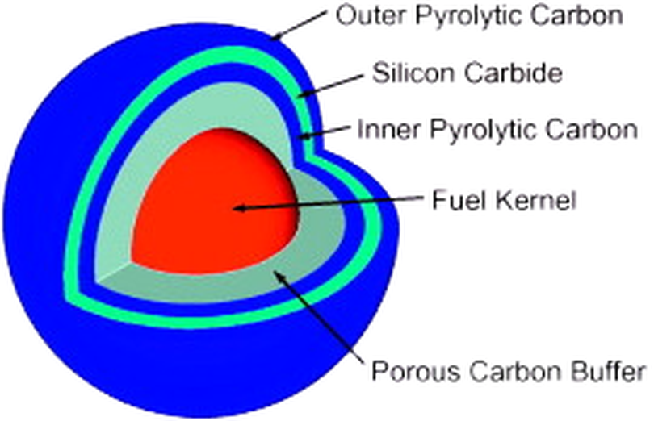
What are High-Temperature Gas-Cooled Reactors?
Q&A
High temperature gas-cooled reactors (HTGRs) are advanced reactors that used helium, an inert gas, instead of water as coolant.
Allows higher temperature (~750°C – 1000°C)
  higher efficiency in electricity production
  allows other applications, e.g., hydrogen production, petrochemical processing, etc.
Uses TRISO fuel – a vastly improved fuel – in spherical balls or prismatic blocks
The fuel is embedded into 100,000s of billiard ball-sized “pebbles” or prismatic blocks of graphite.
Nuclear-grade graphite is used as neutron moderator (reduce speed of neutrons), structural materials as well as reflector of neutrons.
~10,000 coated particles embedded in graphite sphere
Fuel Sphere
Dia 60 mm
Fuel spheres form a graphite pebble bed in reactor vessel
TRISO Coated Particle: Dia 0.92 mm
Fuel Kernel: Dia 0.5 mm, ~0.0007 g of UO₂
Silicon carbide barrier coating: withstand up to 1,600°C
Notes:
Q&A backup, for the question on screen: What are High-Temperature Gas-Cooled Reactors? Answer from the slide, then return to the close.

Slide 59
What are TRISO particles?
Q&A
60 mm
Each TRISO particle consists of a kernel of uranium dioxide (UO₂) fuel (sometimes UC or UCO), which has been coated with four layers:
  porous buffer layer made of carbon
  dense inner layer of pyrolytic carbon (IPyC)
  ceramic layer of silicon carbide (SiC)
  dense outer layer of pyrolytic carbon (OPyC)
Designed not to crack from thermal or mechanical stresses at temperatures up to 1600°C, and therefore can contain the radioactive fission products during all conceivable “accident” situations.
5 mm fuel-free zone
TRISO particle (0.8 – 1.0 mm)
Spherical fuel pebbles
~12 mm
Prismatic graphite blocks
Cylindrical fuel compacts
Notes:
Q&A backup, for the question on screen: What are TRISO particles? Answer from the slide, then return to the close.

Slide 60
How does pebble-bed HTGR (e.g., HTR-PM) work?
Q&A
Fuel element charge inlet
During normal operation, helium carries heat produced in the core to the steam generator through the hot gas duct.
Pebbles move downwards due to gravity. They are discharged at the bottom of the reactor vessel, tested and either returned to the core from the top, or sent to the spent fuel canister (continuous refueling).
Considered to be “inherently safe” due to:
  Strong negative feedback to change of temperature – fission stop if there is a sudden large increase in temperature.
  Graphite reflectors have excellent heat transfer properties that enable the core to cool down to a stable and safe end-state without any operator action.
  TRISO fuel’s ability to retain fission products below 1600°C which will not be reached in any situation.
  Experimentally tested in reactors by shutting down helium flow to demonstrate the inherent safety – “walkaway safe”.
Graphite reflector
Helium circulator
Reactor core
Steam generator
Fuel element discharge outlet
Notes:
Q&A backup, for the question on screen: How does pebble-bed HTGR (e.g., HTR-PM) work? Answer from the slide, then return to the close.

Slide 61
What is the prospect of HTGRs?
HTR-PM (China, 2 x 105 MWe)
Xe-100 (USA, 80 MWe each)
Criticality were achieved at the two reactors on 12 Sep and 10 Nov 2021
Loss-of-cooling tests successfully conducted at near full power in Aug 2023
Commercial operations in Dec 2023
HTR-PM600 [6 modules] with 2 HPR1000 reactors commenced construction in 2026
Awarded US$80 million (initial) in US DOE Advanced Reactor Demonstration Project in Oct 2020 [up to US$1.2b federal cost-shared funding]
Plan to deploy, with utility partner Energy Northwest, to deliver the commercial scale Xe-100 (960 MWe) by 2030
Submitted CPA (with Dow) for 320 MWe plant at Seadrift, Texas.
In our region:
Indonesia earlier initiated the process to construct an Experimental Power Reactor (RDE, 10 MWt / 3 MWe) in Serpong and also worked on a 40 MWt / 15 MWe PeLUIt-40 Reactor with Tsinghua University through their joint lab on HTGR technology.
US firm Valar Atomics plans to build a micro high temperature gas reactor (100-kW, prismatic design) with the Philippine Nuclear Research Institute as a “proof of concept.”
Notes:
Q&A backup, for the question on screen: What is the prospect of HTGRs? Answer from the slide, then return to the close.

Slide 62
How would the enhanced safety of small modular reactors affect siting?
Q&A
Conventional large reactors requires a large “emergency planning zone (EPZ)” of around 15 – 30 km to ensure that population around the plant can be protected or evacuated in the unlikely event of a severe accident with large release of radioactive materials.
For small modular reactors (including HTGR-type), due to the (1) smaller core radionuclide inventories and (2) efficient passive or “inherent” safety systems, EPZ are expected to be substantially smaller.
Small modular reactor vendors target to reduce to hundreds of metres or within plant site boundary – anyone outside EPZ will not be subjected to dose above regulatory dose limits.
This could allow small modular reactors to be located closer to population centres, or to co-locate with industrial facilities or possibly replace current coal plants.
10²
LMP F-C Target
10 CFR 20
10⁰
EPA PAG
Event Sequence Frequency [1/plant-year]
10⁻²
10⁻⁴
10 CFR 50.34
10⁻⁶
0.001
0.01
0.1
1
10
100
1000
QHO
30-day Total Effective Dose Equivalent (TEDE) at 400 m [rem]
Example of EPZ determination [slightly modified from the Preliminary Safety Analysis Report (PSAR) submitted to US NRC for the construction of 4 x 80 MWe XE-100 at Long Mott Generating Station, Texas].
Notes:
Q&A backup, for the question on screen: How would the enhanced safety of small modular reactors affect siting? Answer from the slide, then return to the close.

Slide 63
How can nuclear contribute beyond electricity?
From the CO₂ emission profile of Singapore in 2023, industry contributed to 64.3% of the 55.5 MtCO₂e.
Using heat directly from nuclear power reactors for the industry could potentially accelerate the decarbonization process.
Steam from the secondary circuit after passing through the turbine in Haiyang NPP, China, have been used to heat the homes of 400,000 residents around Haiyang.
Nuclear power has also been used in desalination projects, e.g., 14,000 m³ of potable water per day in
Emissions: 55.5 MtCO₂e
PRIMARY EMISSIONS
SECONDARY EMISSIONS
Power 38.7%
Industry 17.0%
Transport
Industry 47.3%
Transport 2.2%
Transport 11.7%
Buildings 12.4%
Power
Buildings 0.8%
Household 6.1%
Household 0.4%
Waste and Water 0.7%
Waste and Water 0.6%
Others 0.2%
Industry
Others 0.6%
Primary emissions refer to direct emissions from the sector’s owned or controlled sources. Secondary emissions refer to the sector’s share of Power sector’s emissions based on its share of electricity consumption. Outer ring: Power sector emissions allocated by electricity use.
Emission profile of Singapore in 2023
Notes:
Q&A backup, for the question on screen: How can nuclear contribute beyond electricity? Answer from the slide, then return to the close.

Slide 64
How can process heat be used in the industry?
Q&A
Higher temperature heat is needed for many other industrial processes.
HTGRs are more suited for these process due to the higher temperature that it can produce.
Molten Salt Reactors (with output temperature of 500 - 800°C) could also be used for industrial heat when they are commercialized.
HTSE and Thermo-Chemical Hydrogen Production
Coal Gasification
800-1000°C
Steam Reforming of Natural Gas
Biomass Hydrothermal Gasification
500-900°C
Cogeneration of Electricity and Steam
350-800°C
Oil Shale and Oil Sand Processing
300-600°C
Petroleum Refining
250-550°C
Ethanol Concentration
Seawater Desalination
District Heating
80-200°C
0
100
200
300
400
500
600
700
800
900
1000
Process Temperature °C
LWRs
HTGRs
Notes:
Q&A backup, for the question on screen: How can process heat be used in the industry? Answer from the slide, then return to the close.

Slide 65
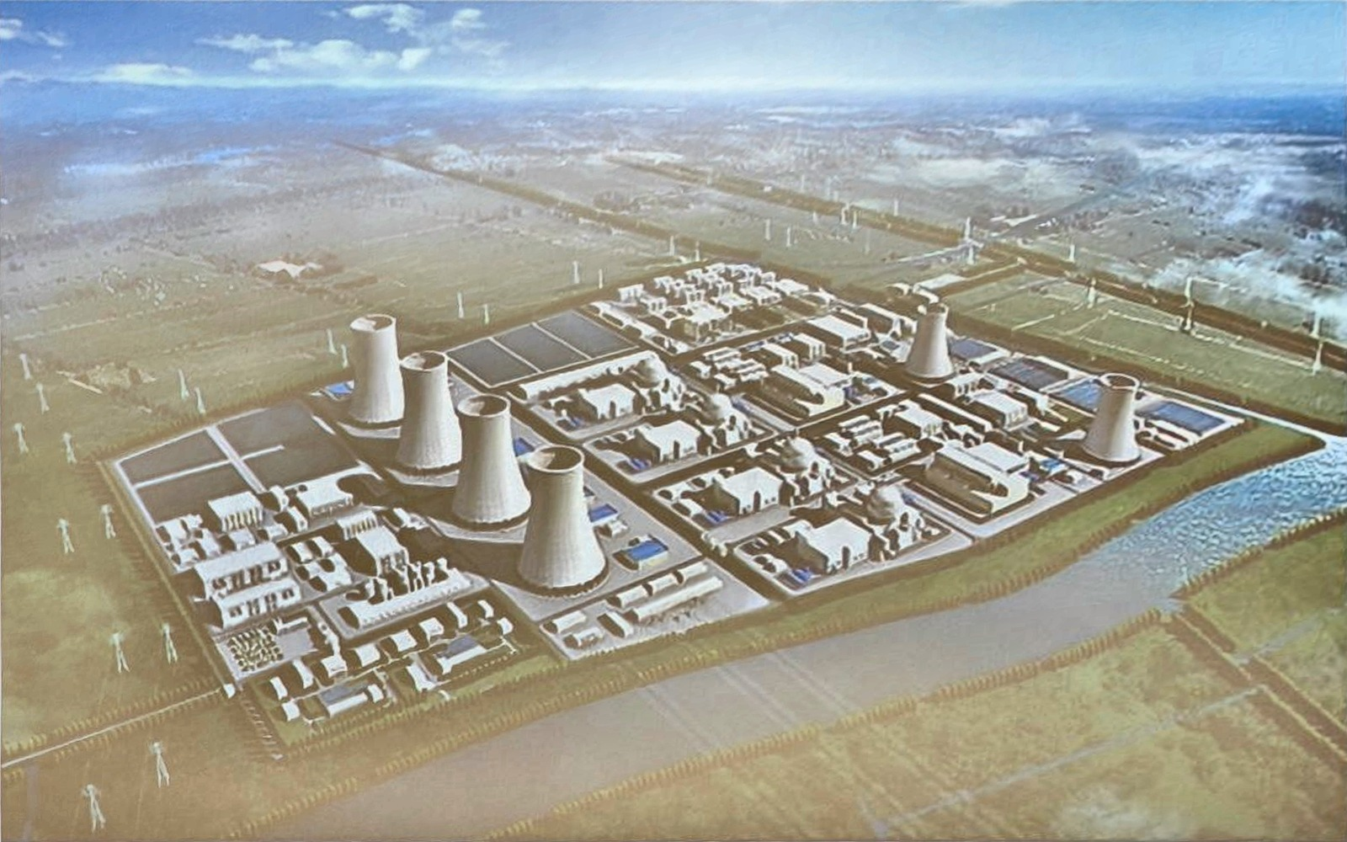
Can HTGRs be used for industry?
Q&A
China State Council approved construction for HTR-PM600 with 2 HPR-1000 (1000 MWe PWRs) at Xuwei, Jiangsu in China in 2024.
Construction of first HPR1000 in Jan 2026 and for HTR600 expected in Sep 2026.
Demineralised water is heated by the primary steam of the HPR-1000s to produce saturated steam.
The primary steam of the HTGR will then be used to heat the saturated steam for the second time to be used in the petrochemical plant (about 10 km away).
Xuwei site is expected to contain 2 x HTR-PM600 coupled to 4 x HPR1000 and constructed in 2 phases.
Rendering of the Xuwei nuclear site, Jiangsu
https://www.youtube.com/watch?v=GSk3CKOZrC0
Notes:
Q&A backup, for the question on screen: Can HTGRs be used for industry? Answer from the slide, then return to the close.

Slide 66
Will small modular reactors be too costly (per kWh) to be used?
Q&A
There are only a couple of real FOAK small modular reactors and no NOAK small modular reactors at this time to give a good real world comparison of the cost (say LCOE) of small modular reactors vs large conventional reactors. Following are points for consideration:
All first-of-a-kind (FOAK) reactors are very costly due to the development cost, new supply chain, regulatory cost, etc. Cost is expected to fall significantly for the Nth-of-a-kind (NOAK) reactor as seen in various past examples in most countries.
Further cost savings could come from manufacturing (in a factory) vs construction (at the site) due to the modular nature of small modular reactors.
Additional cost to use conventional large reactors, e.g., grid improvement, will have to be taken into account in comparison, or for isolated communities that are not connected to grid.
Small modular reactors built for special purpose, e.g., high temperature heat for petrochemical industry or thermochemical hydrogen production, may also be more cost effective.
Cost of the nuclear island is usually a small part (typically < 20% in US) of the total cost of a nuclear power construction which includes the balance of plant (turbine, electrical yards, EPC costs, etc.).
With expected shorter construction time and flexibility in deployment for small modular reactors, financing could be significantly easier with lower cost.
Notes:
Q&A backup, for the question on screen: Will small modular reactors be too costly (per kWh) to be used? Answer from the slide, then return to the close.

Slide 67
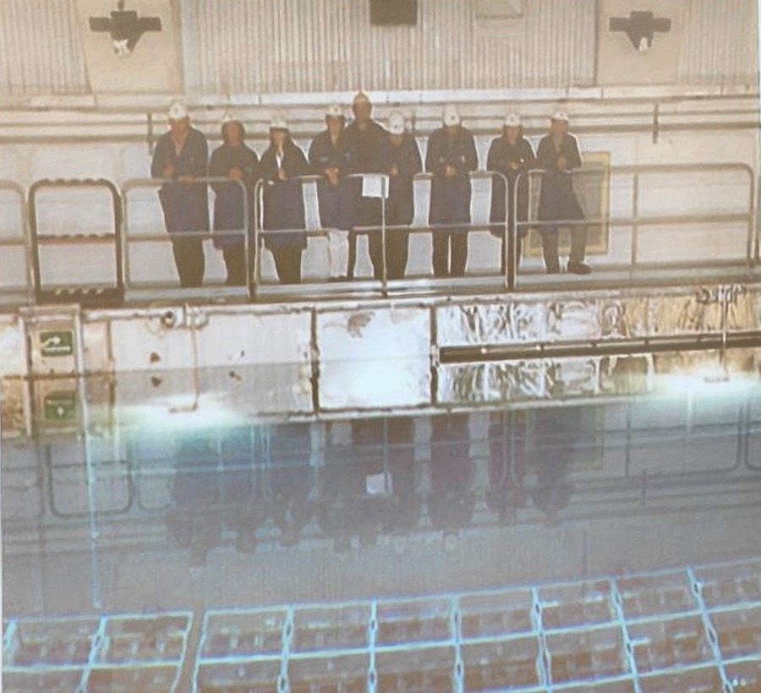
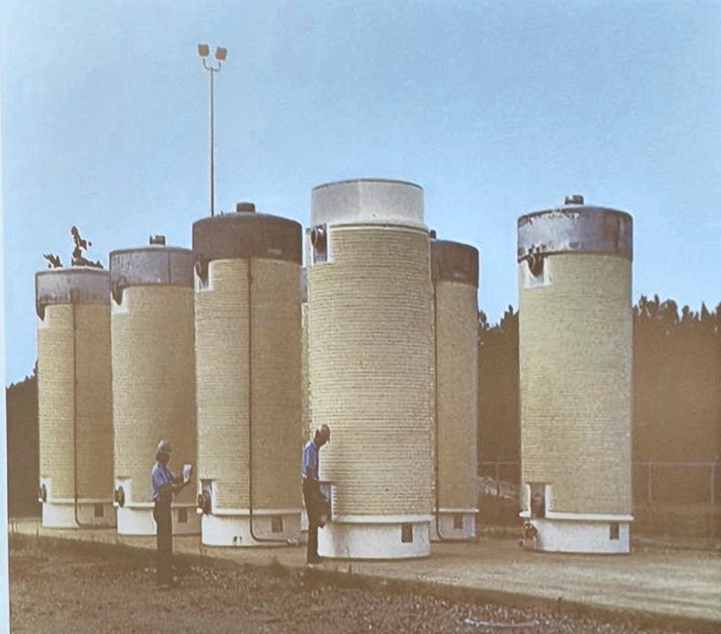
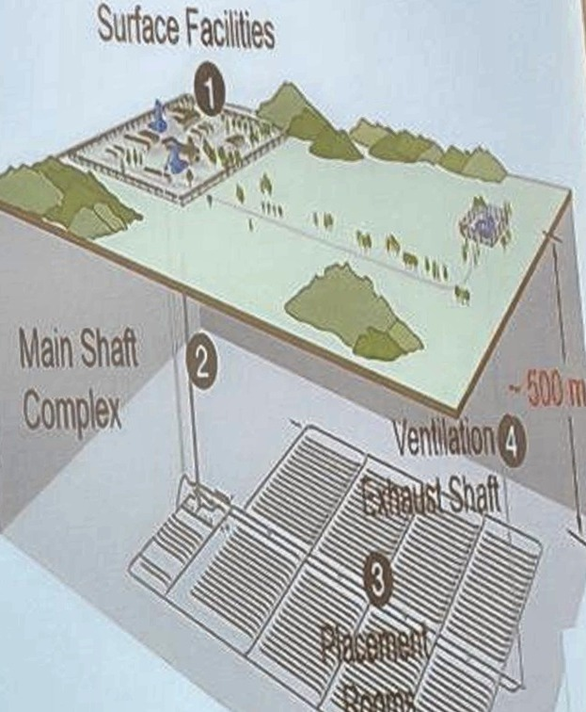
How are spent fuels managed?
Q&A
Spent nuclear fuels are extremely radioactive, with atoms having lifetimes ranging from very short (much less than a second), to intermediate (decades) to very long (billions of years).
Must be cooled initially, and then stored safely for a very long time.
1 Surface facilities
2 Main shaft complex
3 Placement rooms
4 Ventilation exhaust shaft
Depth ~500 m
Spent fuels are first cooled in spent fuel pools within the power plant.
After sufficiently cooled in SFP, the spent fuels are transferred to dry casks usually still within the plant.
Deep Geological Repository provides long-term storage (may be retrievable) for spent fuel. Alternative: deep bore-holes (up to 5 km) with the lower portion sealed off.
Notes:
Q&A backup, for the question on screen: How are spent fuels managed? Answer from the slide, then return to the close.

Slide 68
Are the wastes from small modular reactors harder to manage?
Q&A
Nuclear waste light-water small modular reactors, such as NuScale small modular reactor or BWRX-300 will not be too different from conventional PWRs or BWRs. Volume for some wastes, such as low-level wastes could be higher due to higher level of radiation because of the smaller core.
Wastes from non light-water small modular reactors will require different methods of treatment. HTGR spent fuel is an interesting example.
  It has a larger volume if not treated, requiring more storage space (-)
  Would be harder to be reprocessed, i.e., remove the long-lived radionuclides like uranium and plutonium (?)
  It does not need to be put into a spent fuel pool after taken out of the core and can be stored as it is during intermediate stage (air cooled is sufficient) or for final disposal (++)
Notes:
Q&A backup, for the question on screen: Are the wastes from small modular reactors harder to manage? Answer from the slide, then return to the close.

Slide 69
What are some key takeaways?
Q&A
Gen III / III+ Reactors based on large pressurised water reactors (PWR) will continue to be the main reactors to be connected to grid in the next decade that will help in reducing CO2.
FOAK Small Modular Reactors using PWR technologies with passive safety features are starting to be deployed and will very likely be commercialised in early 2030.
High Temperature Gas-cooled Reactor (HTGR) technologies has been deployed and their inherently safety has been demonstrated (to a certain extent). They have great potential for supplying quality high temperature heat to relevant industries and a new plant is currently under construction in China and one planned in US for this purpose.
Hybrid systems combining nuclear and renewables are considered by many to be most likely to achieve net zero emission by 2050.
Notes:
Q&A backup, for the question on screen: What are some key takeaways? Answer from the slide, then return to the close.

Slide 70
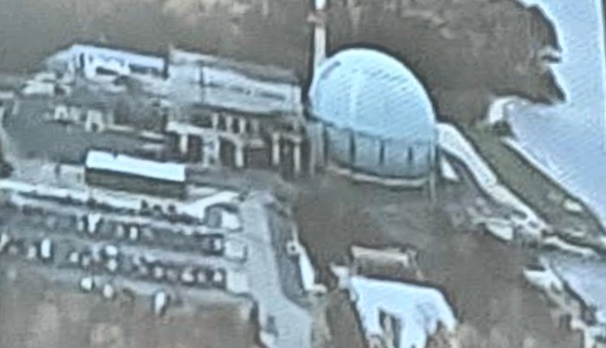
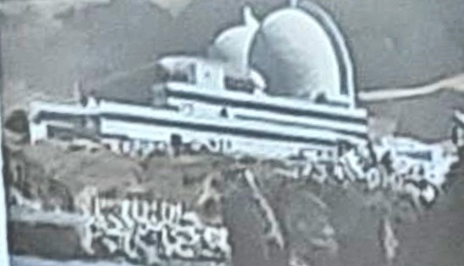
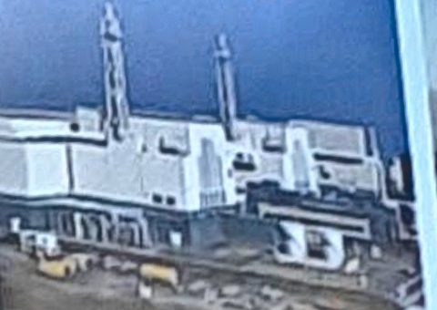


What about Nuclear Fusion?
Q&A
Generation I
Generation II
Generation III / III+
Generation IV
Fusion Reactors
Safe
Secure
Sustainable
Competitive
Versatile
Big Rock Point, GE BWR
Diablo Canyon, Westinghouse PWR
Kashiwazaki, GE ABWR | Olkiluoto 3, AREVA PWR
Arriving ~2030
Arriving ~2060?
Early prototypes
Large-scale power stations
Evolutionary designs
Innovative designs
Ultimate Energy Source
Calder Hall (GCR)
Douglas Point (PHWR/CANDU)
Dresden-1 (BWR)
Fermi-1 (SFR)
Kola 1-2 (PWR/VVER)
Peach Bottom 1 (HTGR)
Shippingport (PWR)
Bruce (PHWR/CANDU)
Calvert Cliffs (PWR)
Flamanville 1-2 (PWR)
Fukushima II 1-4 (BWR)
Grand Gulf (BWR)
Kalinin (PWR/VVER)
Kursk 1-4 (LWGR/RBMK)
Palo Verde (PWR)
ABWR (GE-Hitachi; Toshiba BWR)
ACR 1000 (AECL CANDU PHWR)
AP1000 (Westinghouse-Toshiba PWR)
APR-1400 (KHNP PWR)
APWR (Mitsubishi PWR)
Atmea-1 (Areva NP-Mitsubishi PWR)
CANDU 6 (AECL PHWR)
EPR (AREVA NP PWR)
ESBWR (GE-Hitachi BWR)
Small Modular Reactors
  B&W mPower PWR
  CNEA CAREM PWR
  India DAE AHWR
  KAERI SMART PWR
  NuScale PWR
  OKBM KLT-40S PWR
VVER-1200 (Gidropress PWR)
GFR gas-cooled fast reactor
LFR lead-cooled fast reactor
MSR molten salt reactor
SFR sodium-cooled fast reactor
SCWR supercritical water-cooled reactor
VHTR very high temperature reactor
ITER / DEMO (Tokamak)
EAST / CFETR (Tokamak)
NIF (Inertial Confinement Fusion)
CFS (Tokamak, HTS)
TAE (FRC, aneutronic)
GF (Magnetized Target Fusion, piston)
Hyperjet (MTF, plasma jets)
1950
1970
1990
2010
2030
2050 ?
2070
2090
Notes:
Q&A backup, for the question on screen: What about Nuclear Fusion? Answer from the slide, then return to the close.

Slide 71
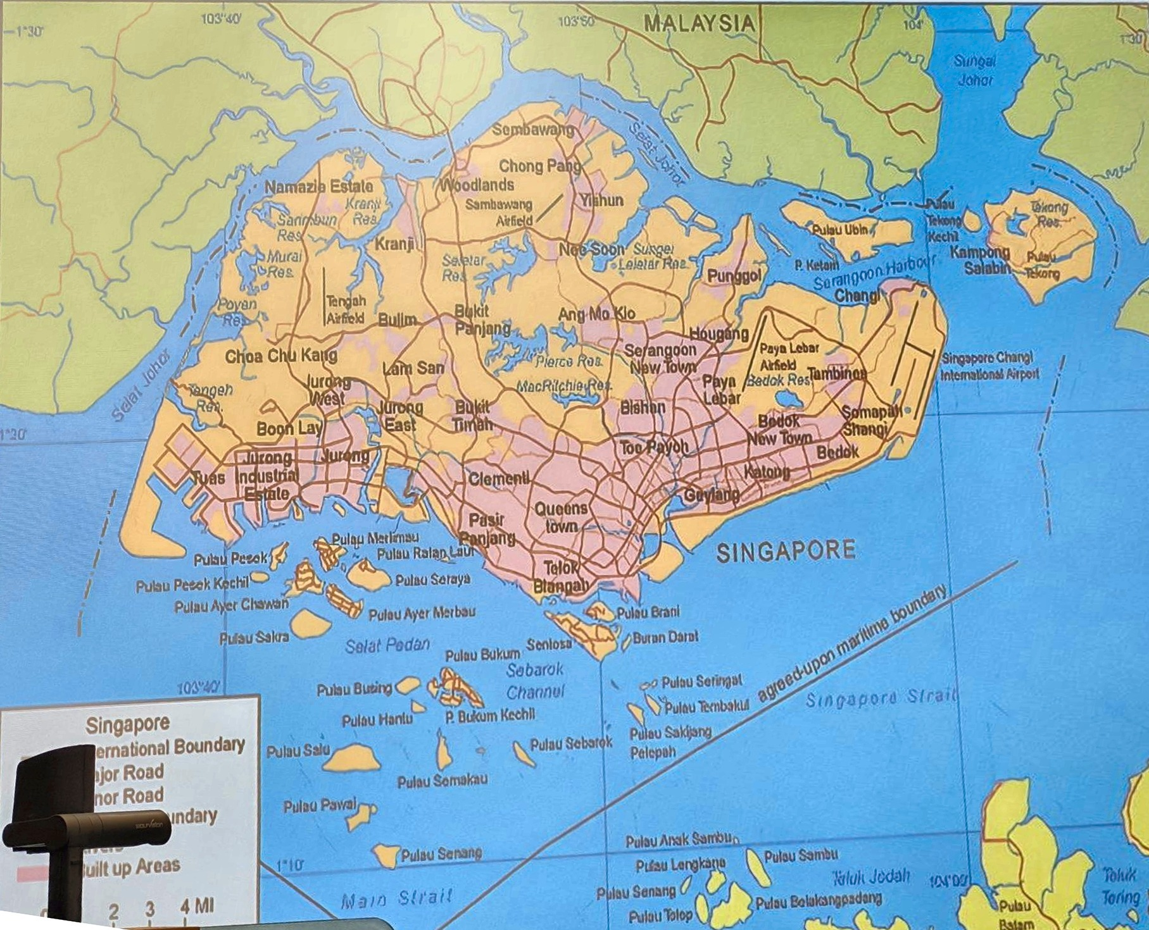
If an accident happens, where to run?
Q&A
Selected technology should have:
  Very low frequency (say 1 in 1,000,000 reactor-years of operation) of any significant accident that could affect the public.
  Even in the event of such an accident, the release will be low enough so that there is no evacuation or
  There are mitigation measures to ensure no evacuation.
That is Low frequency and Very Low Consequences!
Answer: “No need to run”
Singapore
International Boundary
Major Road
Minor Road
Built up Areas
Notes:
Q&A backup, for the question on screen: If an accident happens, where to run? Answer from the slide, then return to the close.

Slide 72
Can government co-funding lower the abatement cost further?
Q&A
Co-funding S$483.0M, 65.0% of the S$742.8M reactor capital, brings BOAK over 25 years to S$96/tCO₂e on the annual ledger. The cash flow needs S$483.6M, 65.1%.
Over 60 years, S$416.0M, 56.0%, is enough on the ledger. The cash flow needs S$417.1M, 56.2%.
Without co-funding, BOAK costs S$189.7 and S$165.6/tCO₂e on the ledger, and S$190.1 and S$166.0/tCO₂e by cash flow (n = 1.0, 210 MWth charged).
Co-funding moves cost to the public budget. The total resource cost stays the same.
Government support can reduce early deployment risk, while technological maturity and industrial offtake determine long-term commercial viability.
Notes:
Q&A backup. The co-funding of reactor capital that brings BOAK to S$96 a tonne is S$483.0 million, 65.0 percent of S$742.8 million, over 25 years on the ledger, and S$416.0 million, 56.0 percent, over 60 years. The cash flow needs S$483.6 million and S$417.1 million. Co-funding moves cost to the public budget, and the total resource cost stays the same.

