Slide 1
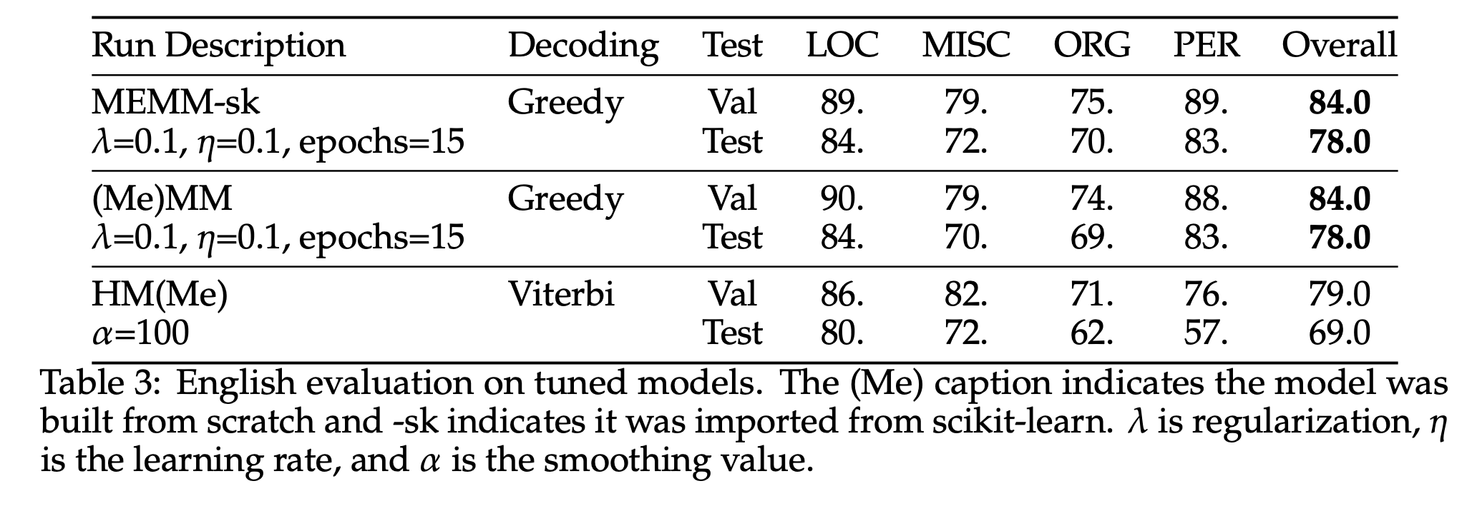

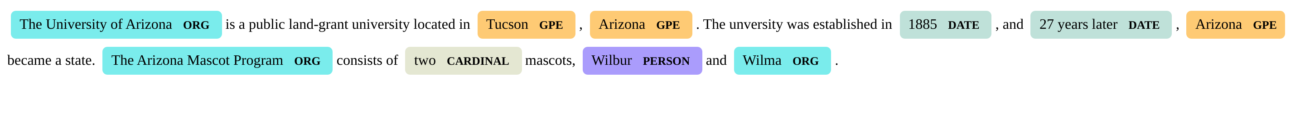
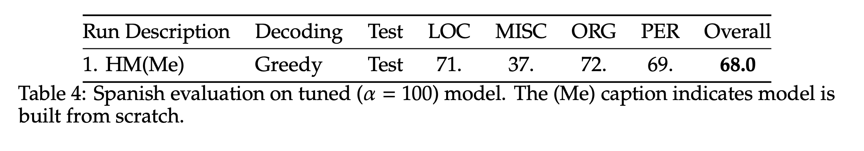
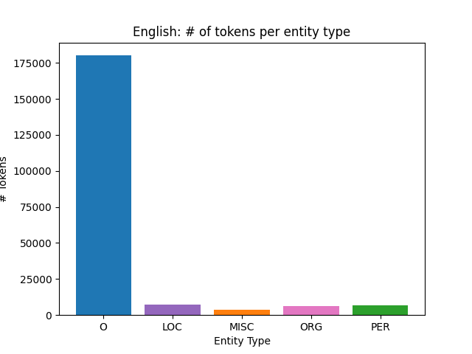
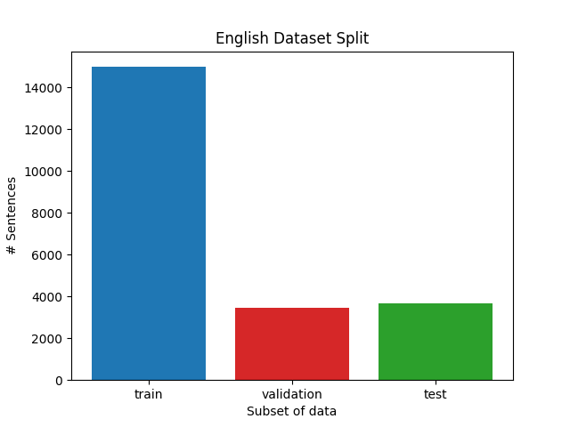
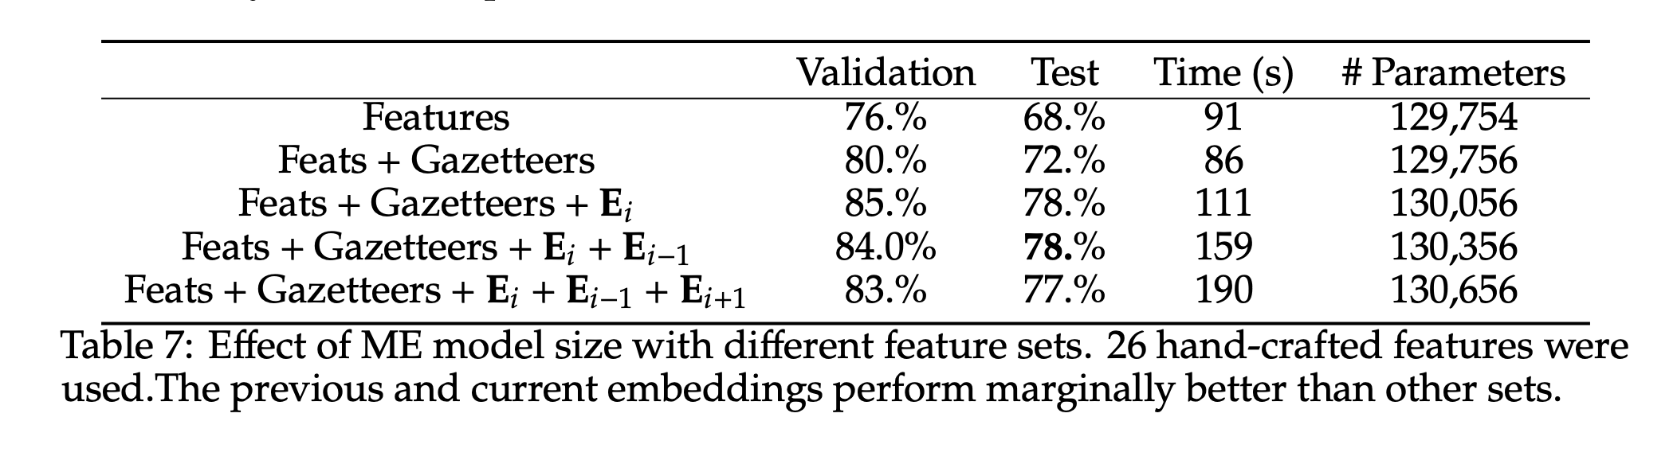
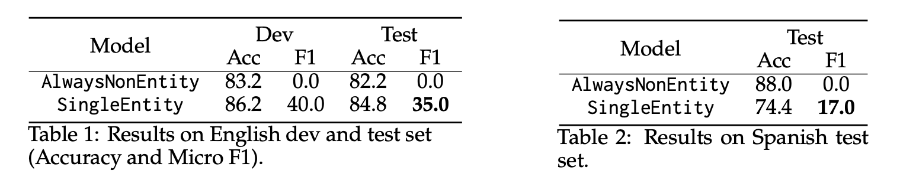
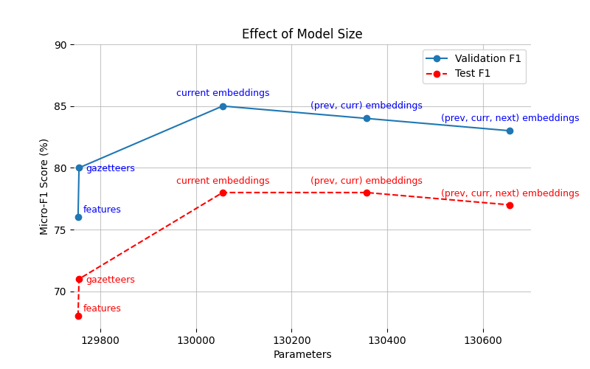
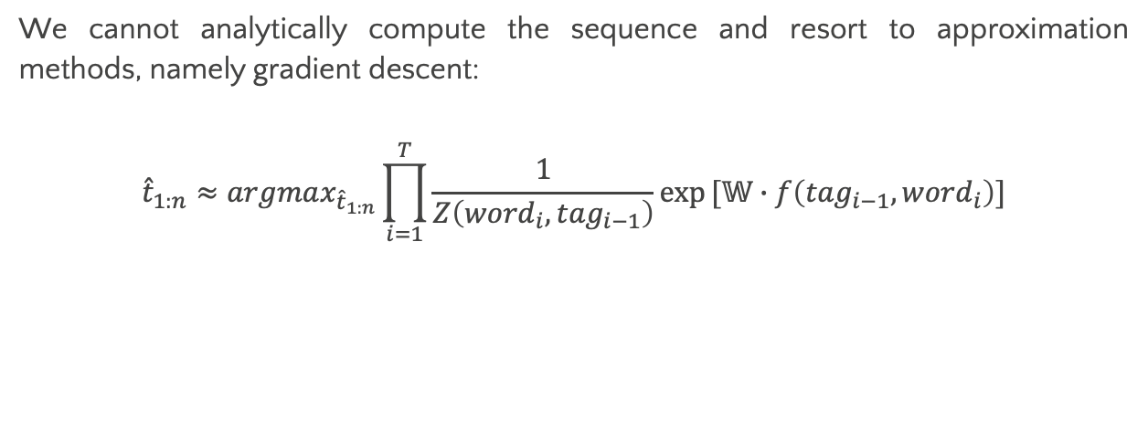
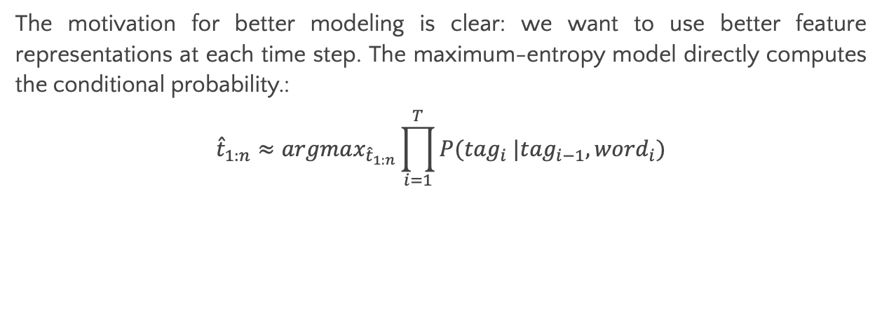
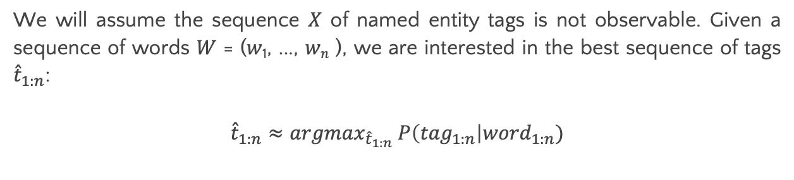
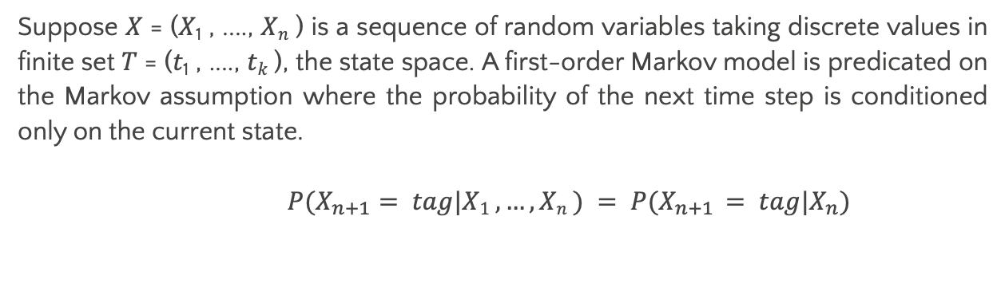
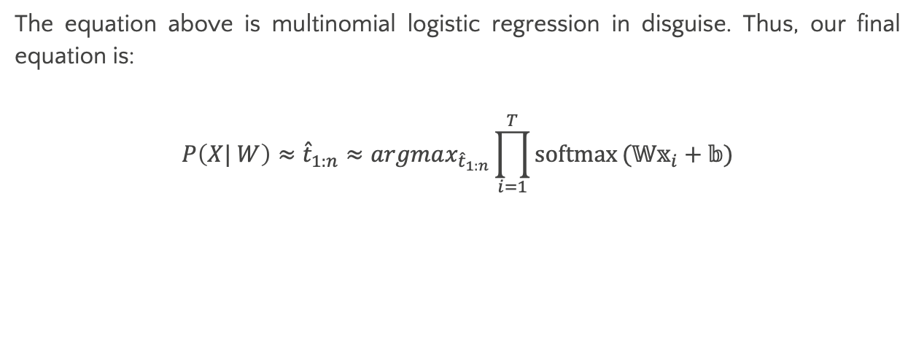
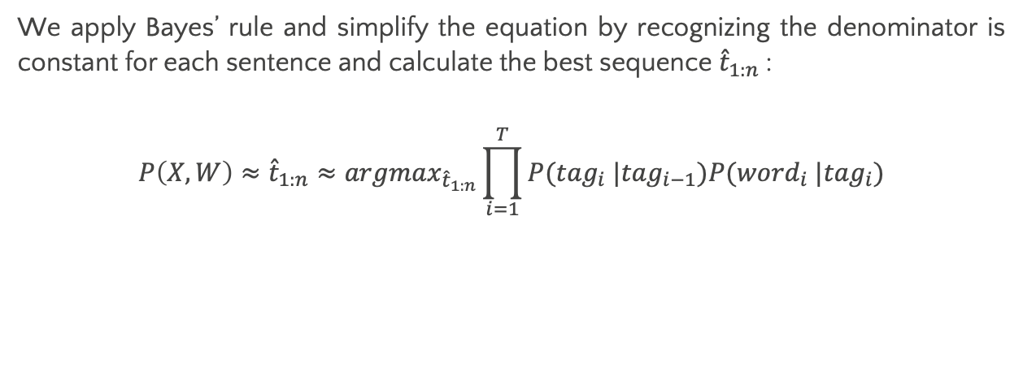
Revisiting CoNNL-2003 with Classical Machine Learning
Matthew A. Hernandez,
INFO 521, Fall 2024
University of Arizona, Linguistics Department
Abstract
Methodology
Results
We present a brief survey on classical machine learning algorithms in the
context of the CoNNL-2003/02 Shared Task. A named entity recognition
(NER) system is built to recognize and classify objects in a body of text into
predefined categories.
Suppose 𝑋 = (𝑋₁ , ...., 𝑋_{𝑛} ) is a sequence of random variables taking discrete values in finite set 𝑇 = (𝑡₁ , ...., 𝑡_{𝑘} ), the state space. A first-order Markov model is predicated on the Markov assumption where the probability of the next time step is conditioned only on the current state.
$$P(X_{n+1}= tag|X1 , …, Xn ) = P(X_{n+1} = tag|X_{n})$$
The motivation for better modeling is clear: we want to use better feature representations at each time step. The maximum-entropy model directly computes the conditional probability.:
$${\hat{t}}_{1:n}≈argmax_{{\hat{t}}_{1:n}}\prod_{i=1}^{T}{P({tag}_{i} |{tag}_{i−1}, {word}_{i})}$$
The performance of our algorithms and their variants is in Tables 3 & 4. The ME approach clearly shows discriminative modeling gives good results; it easily outperforms the baselines and beats an HMM as well.
Introduction
We will assume the sequence 𝑋 of named entity tags is not observable. Given a sequence of words 𝑊 = (𝑤₁, ..., 𝑤_{𝑛} ), we are interested in the best sequence of tags ${\hat{t}}_{1:n}$:
$${\hat{t}}_{1:n}≈argmax_{{\hat{t}}_{1:n}} P\left({tag}_{1:n}\right|{word}_{1:n})$$
We cannot analytically compute the sequence and resort to approximation methods, namely gradient descent:
$${\hat{t}}_{1:n}≈argmax_{{\hat{t}}_{1:n}}\prod_{i=1}^{T}{\frac{1}{Z\left({word}_{i}, {tag}_{i−1}\right)}exp}[𝕎∙f\left({tag}_{i−1},{word}_{i}\right)]$$
The Named Entity Recognition and Classification (NERC) task refers to the process that identifies phrases in text into various categories. Common entity types include ORGANIZATION (ORG), PERSON (PER), LOCATION (LOC), and MISCELLANEOUS (MISC). Tagging is the process of labeling each word in a sentence with its respective named entity (NE). As an example:
We apply Bayes’ rule and simplify the equation by recognizing the denominator is constant for each sentence and calculate the best sequence ${\hat{t}}_{1:n}$:
$$P\left(X, W\right)≈{\hat{t}}_{1:n}≈argmax_{{\hat{t}}_{1:n}}\prod_{i=1}^{T}{P({tag}_{i} |{tag}_{i−1})P({word}_{i} |{tag}_{i})}$$
The equation above is multinomial logistic regression in disguise. Thus, our final equation is:
$$P\left(X| W\right)≈{\hat{t}}_{1:n}≈argmax_{{\hat{t}}_{1:n}}\prod_{i=1}^{T}{softmax}(𝕎𝕩_{i}+𝕓)$$
While the Spanish dataset was evaluated exclusively by an HMM, the results in Table 4
suggest a first-order model is an appropriate benchmark for the task.
Our contributions:
We include a principled framework that motivates the use of machine learning by creating two baseline systems.
The analysis between generative and discriminative machine learning algorithms and recent advancement in natural language processing suggest the CoNNL-2003 dataset is subject to temporal drift.
HMM
MEMM
B-PER
O
O
O
O
B-PER
O
O
O
O
Conclusion
CoNNL-2003
We conclude that advancements in NLP have improved our model (see Table 7) with little feature engineering and can reach competitive performance if a more complex model is chosen. However, we are not interested in performance and propose the CoNNL-2003 dataset is dated and we should instead access the generalization of these models. That is, we should start considering the upper bound of new named entities.
The English dataset was preprocessed into training, development, and test sets, Additionally, the number of tokens per entity type highlight the imbalanced nature of the CoNNL-2003 dataset and of NER.
Susan is very happy today.
Susan is very happy today.
Baselines
Effect of Model Size
Two rule-based systems were computed for the English and Spanish corpora. The
AlwaysNonEntity is a naive baseline that labels all tokens as ’O’ or as non-entities, see Table 1.
The addition of features for the MEMM allows for a model to recognize more difficult entities. This increase in features, and in effect the parameters, improved the performance of the system.
Citations
The paper describes a baseline & benchmark methodology for developing a NER system in the context of the CoNNL-2003 Shared Task [3]. This paper will focus on the English dataset and compare the Spanish corpus from the CoNNL-2002 Shared Task [4].
The less naive baseline SingleEntity is based on a lookup table where only the beginning (B-) of entities are added, see Table 2. Named entity recognition is an imbalanced problem and traditionally we use the micro-F1 score for evaluation.
[1] Erik F. Tjong Kim Sang and Fien De Meulder. Introduction to the CoNLL-2003 Shared Task: Language-Independent Named Entity Recognition. In: Proceedings of the Seventh Conference on Natural Language Learning at HLT-NAACL 2003. 2003, pp. 142–147.
[2] Erik F. Tjong Kim Sang. Introduction to the CoNLL-2002 Shared Task: Language-Independent Named Entity Recognition. In: COLING-02: The 6th Conference on Natural Language Learning 2002 (CoNLL-2002). 2002.

