Slide 1

NIH Grant Expansion, Ancestral Diversity, and Scientific Discovery in Genomics Research
Wei Fu, PhD
Postdoctoral Researcher, Wang Lab
Department of Pathology
Perelman School of Medicine
University of Pennsylvania
PNGC Seminar Series
September 21, 2022

Slide 2
Facts – Disparity and Underrepresentation
5% to 42%
Precision Medicine
New molecular entities approved by FDA patients that are precision medicine in 2005 and 2018 (Urban and Naylor, 2018).
3.1% & 2.9%
Minority in Clinical Trials
Share of African Americans and Hispanics in 230 clinical trials leading to FDA oncology drug approvals between 2008 to 2018 (Loree et al., 2019).
80%+
Insufficient Funding
Faculty respondents list insufficient funding as a barrier to engaging in diversity and inclusion activities (Jimenez et al., 2019).
×2
Asthma Inequality
The treatment failure risk of long-lasting-β2-agonist is 2 time higher among African Americans, compared to white patients (Burchard, 2014).
4.5% to 12%
Minority in GWAS
Share of minority subjects in GWAS in 2007 and 2017 (Mills and Rahal, 2019).
×1.7
Funding Gap
European White PIs were 1.7 times more likely to be funded than African American PIs between 2011 and 2015 (Hoppe et al., 2019).

Slide 3
Translating Science to Health
Underrepresentation
of minority in Biomedical Science
Inadequate funding
Shortage of minority scientists
Communication barriers between the minority community and scientific team
…
Disparity
in Treatments and Health
Treatment less effective among a particular population
Limited access to precision medicine
…

Slide 4

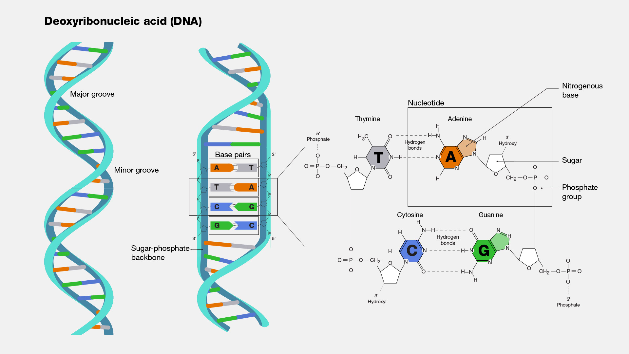




Research Questions
Whether improved funding opportunity facilitates minority health research?
How significant is the scientific value of funding science on underrepresented populations?
American Recovery and Reinvestment Act of 2009 (ARRA)
Genome-Wide Association Studies (GWAS)
$10 billion directly to NIH, available for two years, from February 2009 through September 2010.
% of
Minority
Scientific Collaboration
Genetic
Discovery

Slide 5
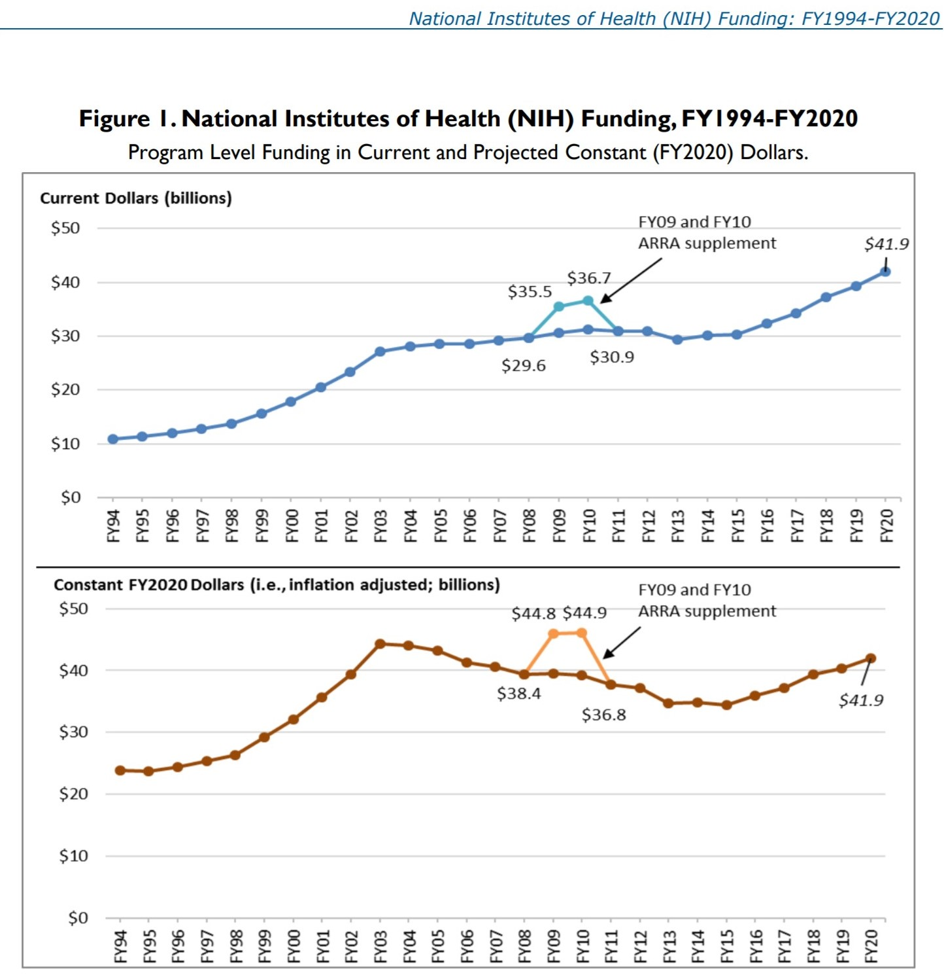




American Recovery and Reinvestment Act of 2009 (ARRA)
10 billion, 2 years
80% for extramural scientific research
Training program for junior or minority, or female scientists, providing start-up packages
12,000 grants
21,581 projects
13,000 PIs
9% new PIs
1/6 of total funding

Slide 6
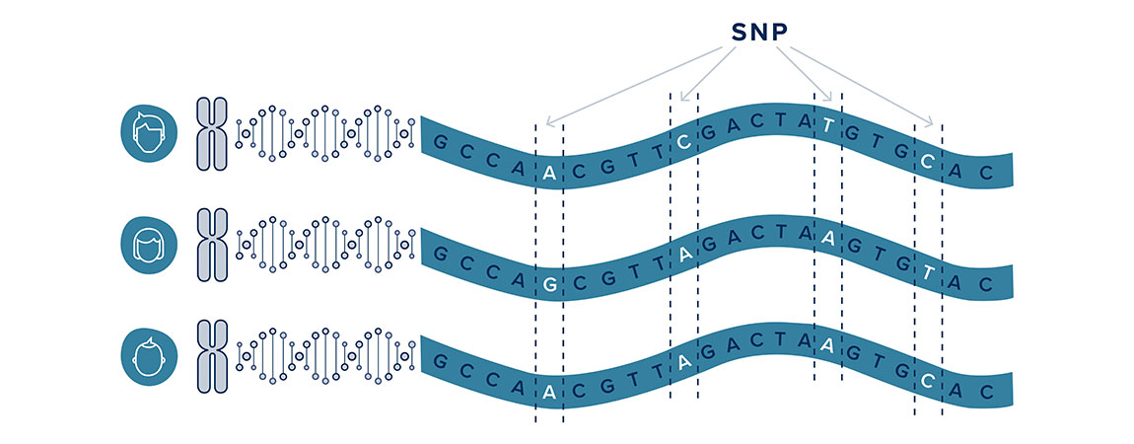
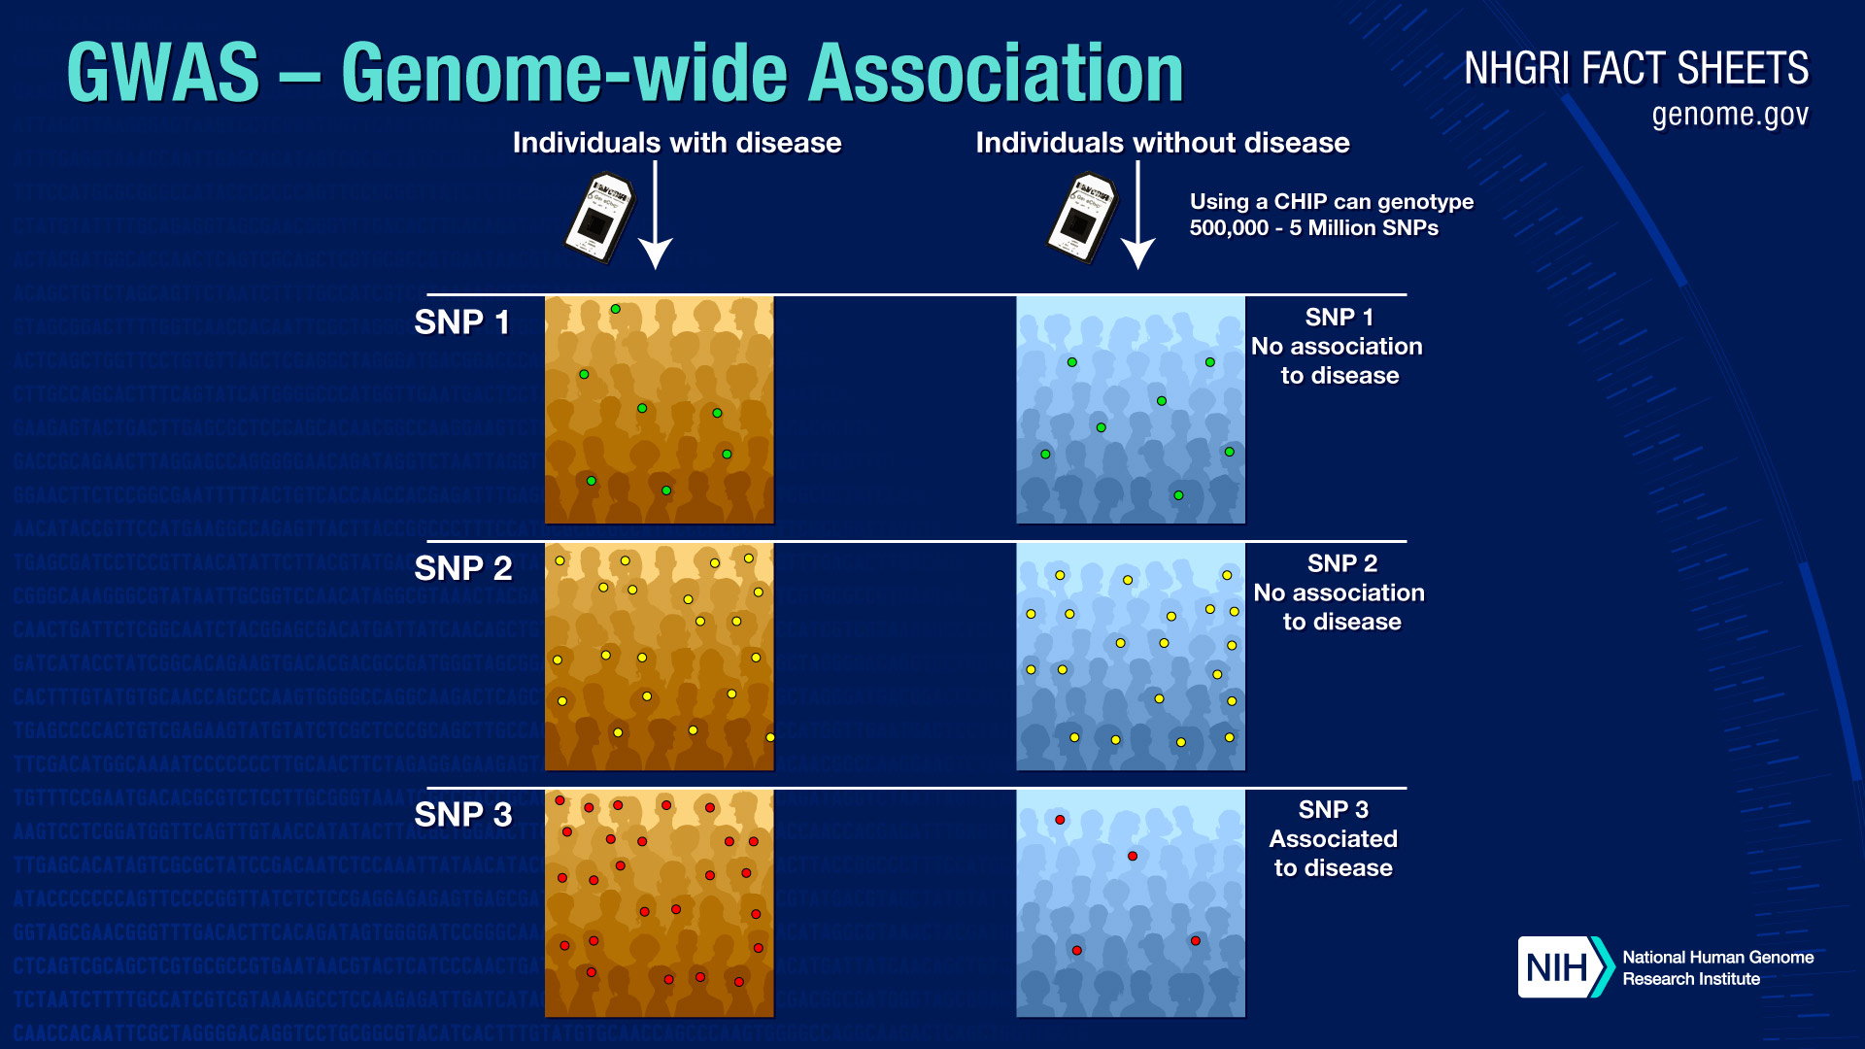
GWAS Premier
Single Nucleotide Polymorphism
Genome-Wide
Association Studies

Slide 7
Research Questions
Whether improved funding opportunity facilitates minority health research
How significant is the scientific value of funding science on underrepresented populations
American Recovery and Reinvestment Act of 2009 (ARRA)
Genome-Wide Association Studies (GWAS)
$10 billion directly to NIH, available for two years, from February 2009 through September 2010.
% of
Minority
Scientific Collaboration
Genetic
Discovery

Slide 8

Data Creation
Web-Scaping
Text Mining
Prediction
Fuzzy-wuzzy Matching
Database Joining
GWAS Catalog:
A comprehensive collection of GWAS articles since 2005.
PubMed Portal:
Ordered author list & grant information.
NIH RePORTER:
A list of ARRA-NIH grants
Medical Expenditure Panel Survey (MEPS):
National-representative disease estimates
2700+ GWAS Studies
(27 diseases, 2005-2016)
Study sample
Subject’s ancestry
Author’s ancestry
Author’s order
Grant information
SNPs/Genes discovered

Slide 9
Analysis Sample
2700+ GWAS Studies
(27 diseases, 2005-2016)
183 Disease-Year
Observations
Study sample
Subject’s ancestry
Author’s ancestry
Author’s order
Grant information
SNPs/Genes discovered
Share of minority subjects
Share of minority authors
Share of minority-based SNPs discoveries

Slide 10
Empirical Identification
Goal: Causal estimates for the funding policy impacts
Challenge: No explicit definition for the treated and control
Identification Intuition: Disease research may benefit from the ARRA-NIH grant expansion differently
Minority health research that is more feasible may be more likely to be supported by ARRA-NIH grant
How to measure “feasibility”? -> Relative Referral Base (RRB) for minority subjects

Slide 11
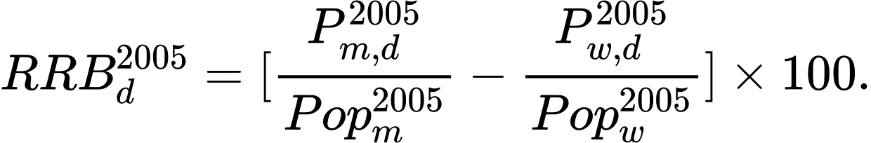
Empirical Identification
Relative Referral Base (RRB) for minority subjects:
Number of minority with medical conditions
associated with disease d in 2005
Referral base for minority
Population of minority in 2005
Higher RRB → Lower recruitment cost of minority → Higher feasibility → Higher funding chance

Slide 12


Empirical Design
Disease fixed effects
Dose-Response Difference-in-Differences Design:
Year fixed effects
$ζ$ > 0 → Positive policy impact
Event-Study Design:
Plot $ζ_{j}$ in figures
We address the standard errors in two ways:
Huber-White robust standard errors
Cluster at disease level, wild-bootstrap cluster p-values and wild-bootstrap cluster 95% confidence intervals

Slide 13

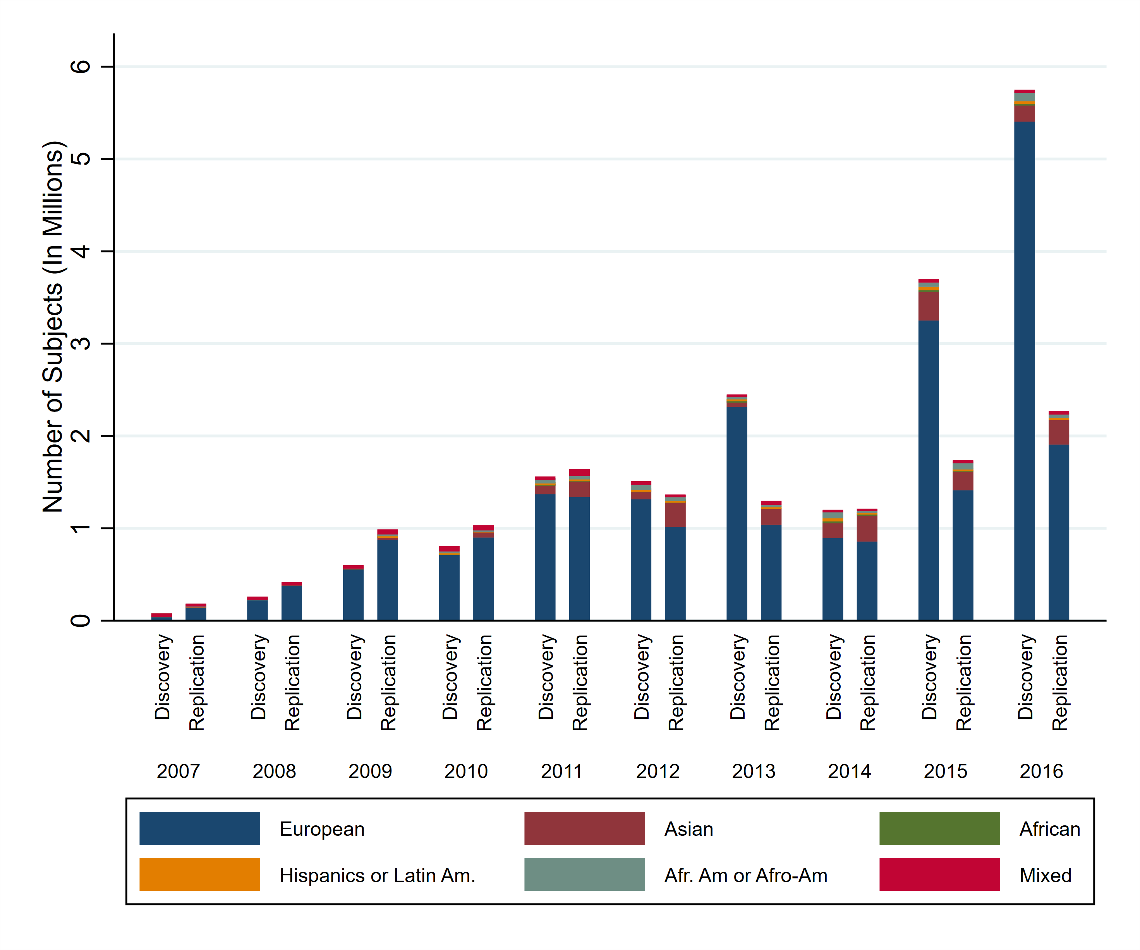
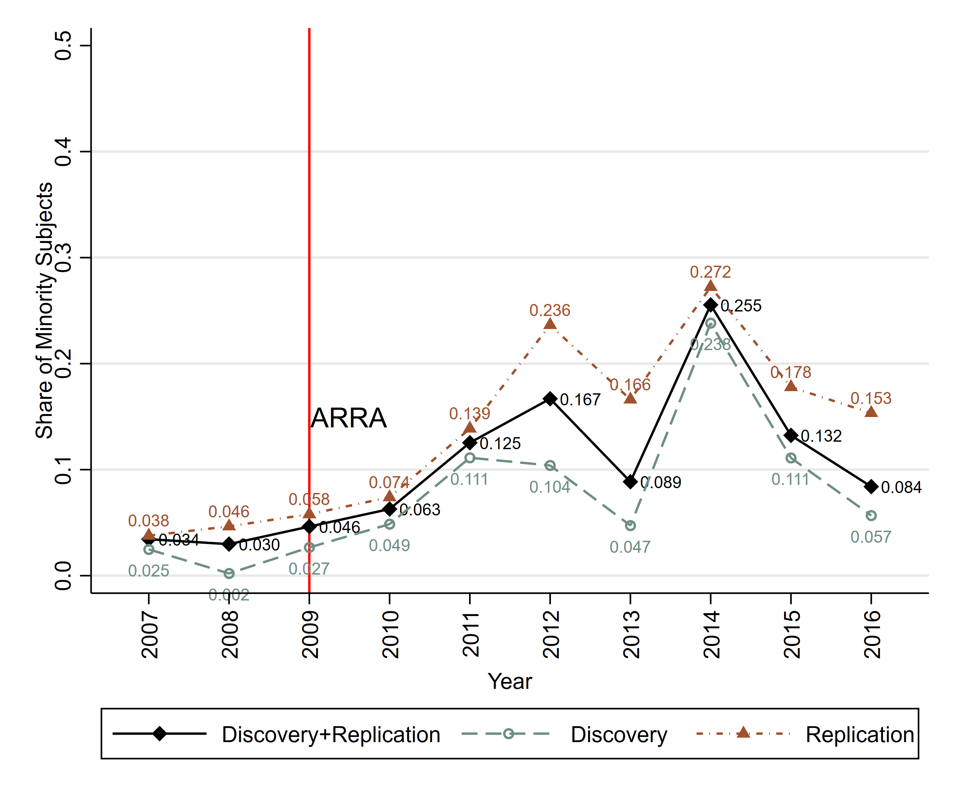
1. Does ARRA-NIH grant expansion contribute to increasing inclusion of minority subjects in GWAS?

Slide 14
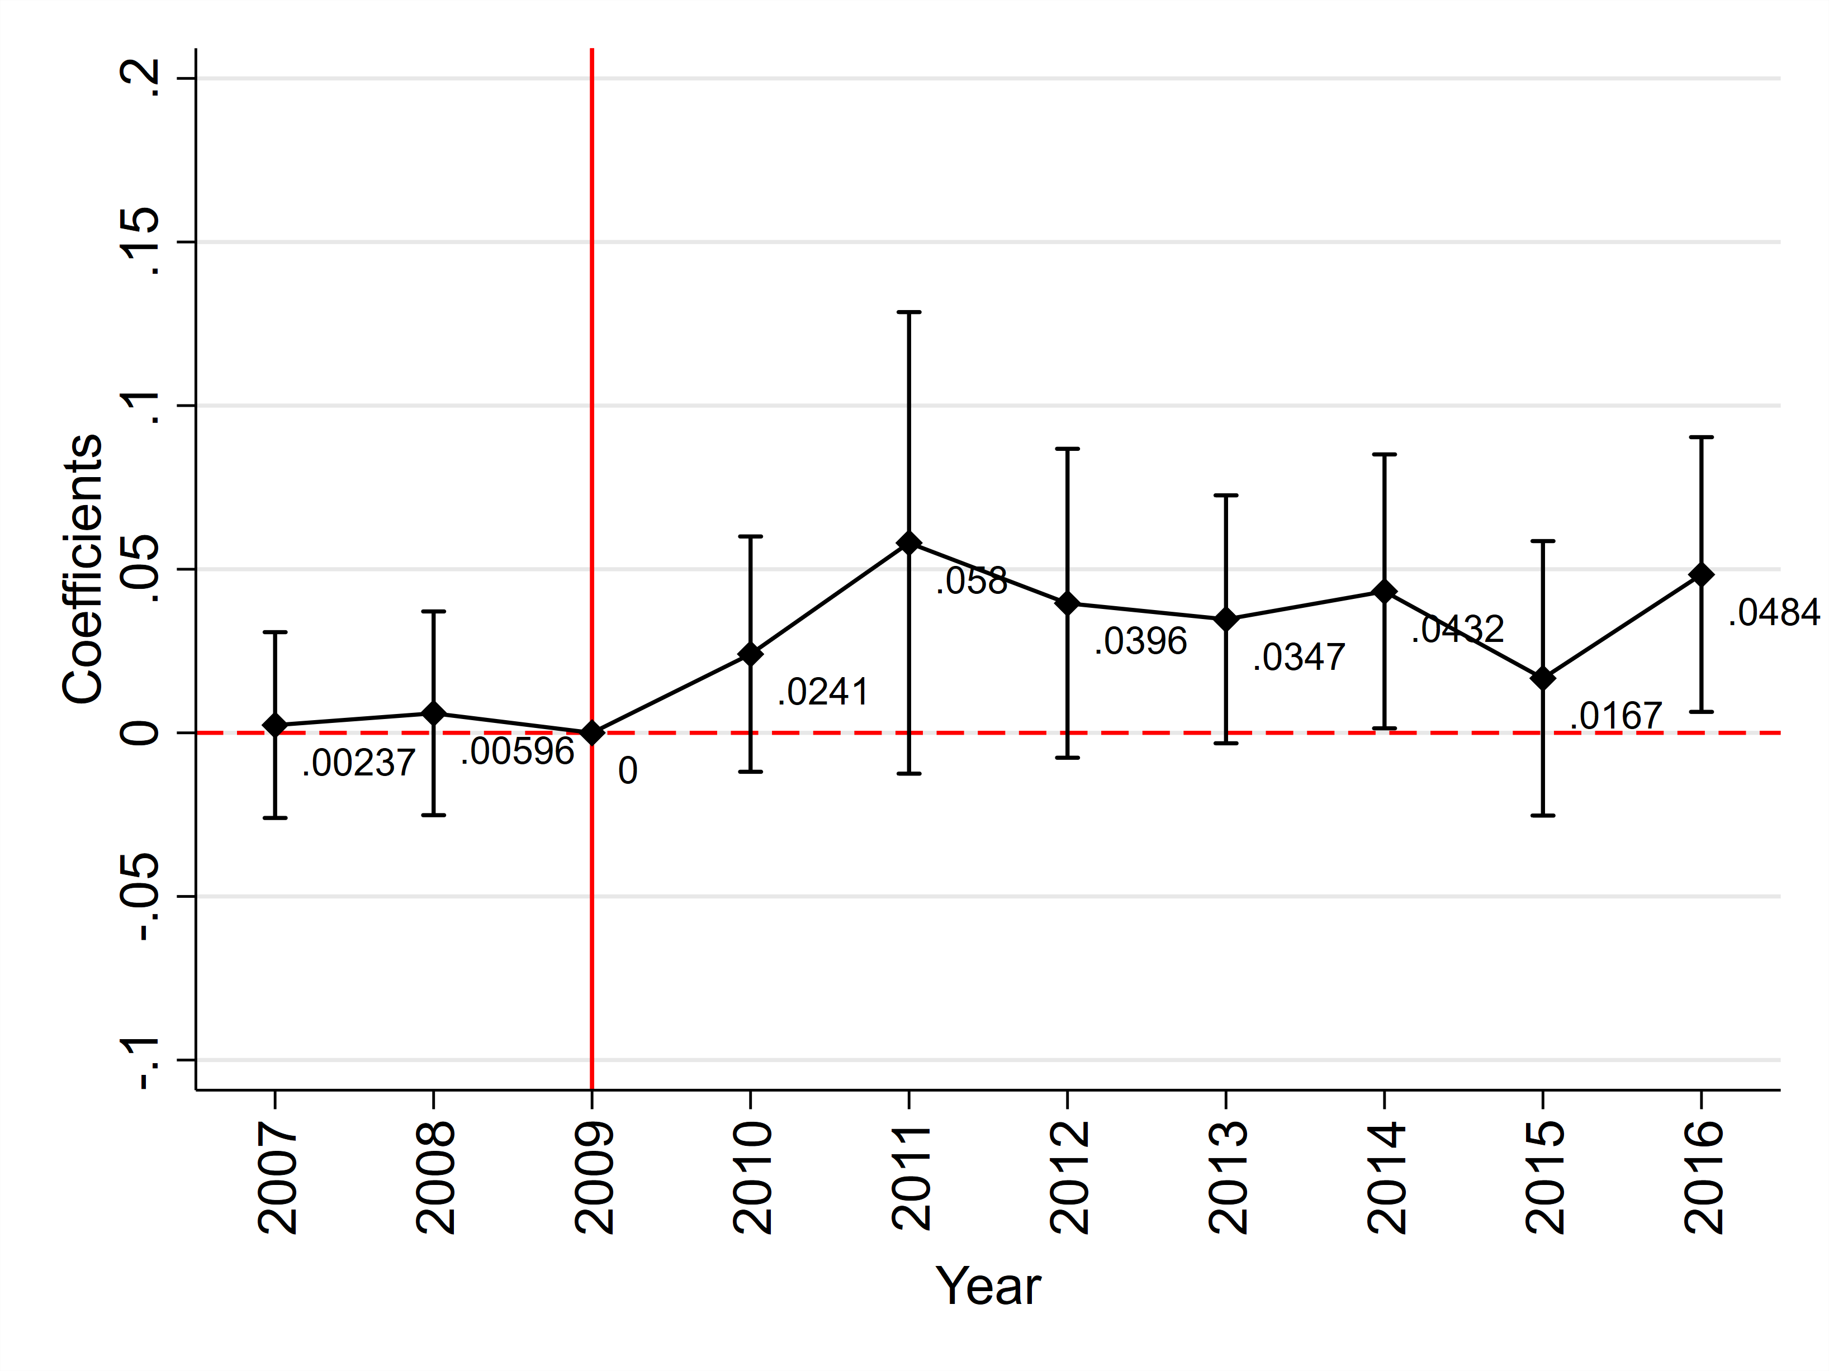
1. Does ARRA-NIH grant expansion contribute to increasing inclusion of minority subjects in GWAS?
Dependent Var: Share of minority subjects
Event Study Estimates
A substantial jump
No significant pre-existing trends
Policy effect persisted though 2016

Slide 15
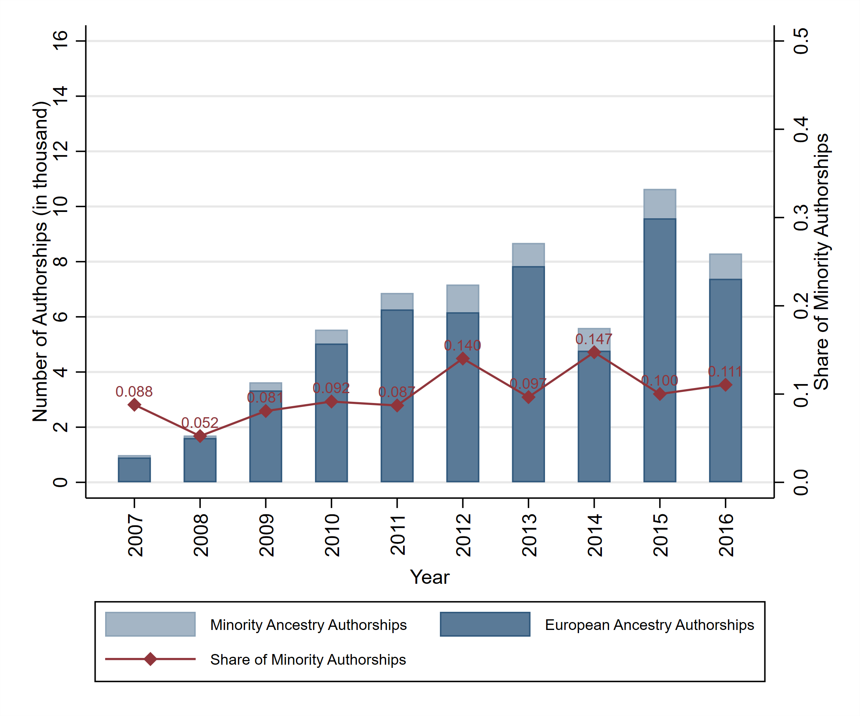
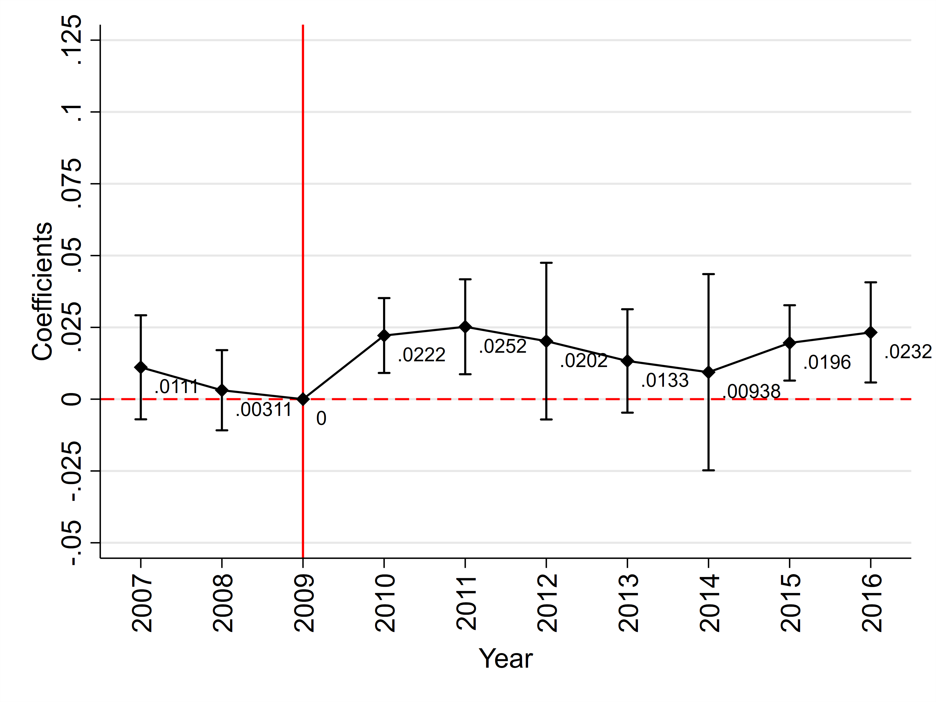
2. How the ARRA-NIH grant expansion influences entry of minority scientists and scientific collaborations?
Dependent Var: Share of minority authors
Event Study Estimates
A substantial jump
No significant pre-existing trends

Slide 16
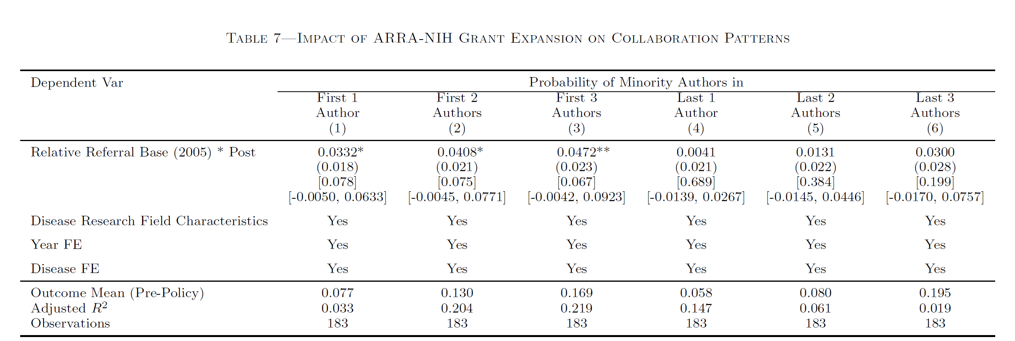
2. How the ARRA-NIH grant expansion influences entry of minority scientists and scientific collaborations?
No significant effect on promoting minority scientists as PIs
ARRA Grant expansion increases the likelihood of minority scientist serving as first few authors

Slide 17
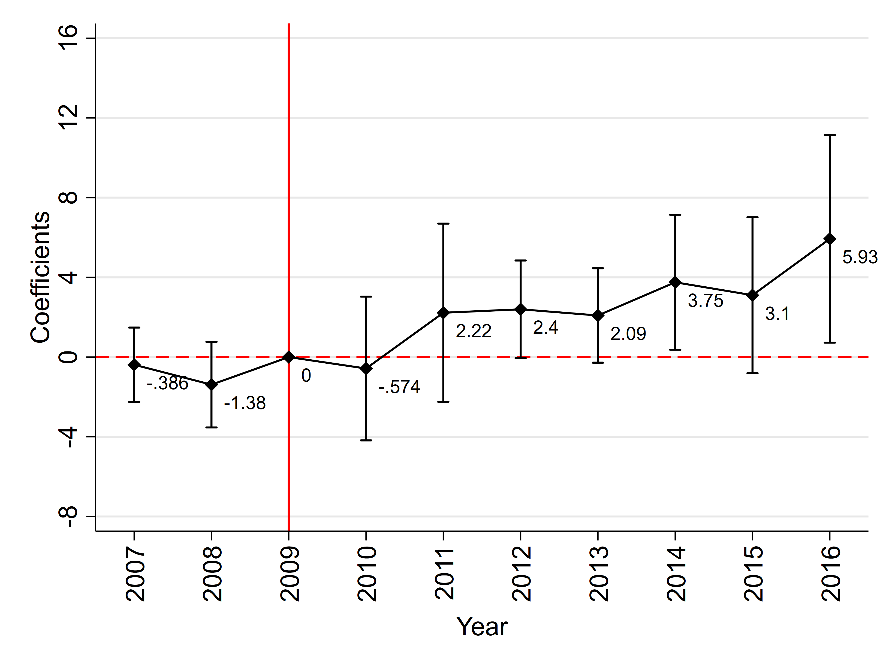
3. Whether ARRA-NIH grant expansion also fosters a wealth of scientific fruits from minority populations?
Dependent Var: Share of minority-based genetic discovery
Event Study Estimates
A substantial jump

Slide 18

Results Summary
The grant expansion
increases the inclusion of minority subjects
facilitates the academic engagement of minority scientists
boosts the genetic discoveries from minority ancestries
Key Takeaways
Policy Implications?

Slide 19
Policy Implications
Health Equity
Sufficient Fundings
Diversity in Science
The NIH has initiated a variety of funding opportunities to support science on underrepresented populations in recent years
”All of Us” research program in 2015
We are among the few that quantitatively assess how public funding policy addresses the missing diversity

Slide 20
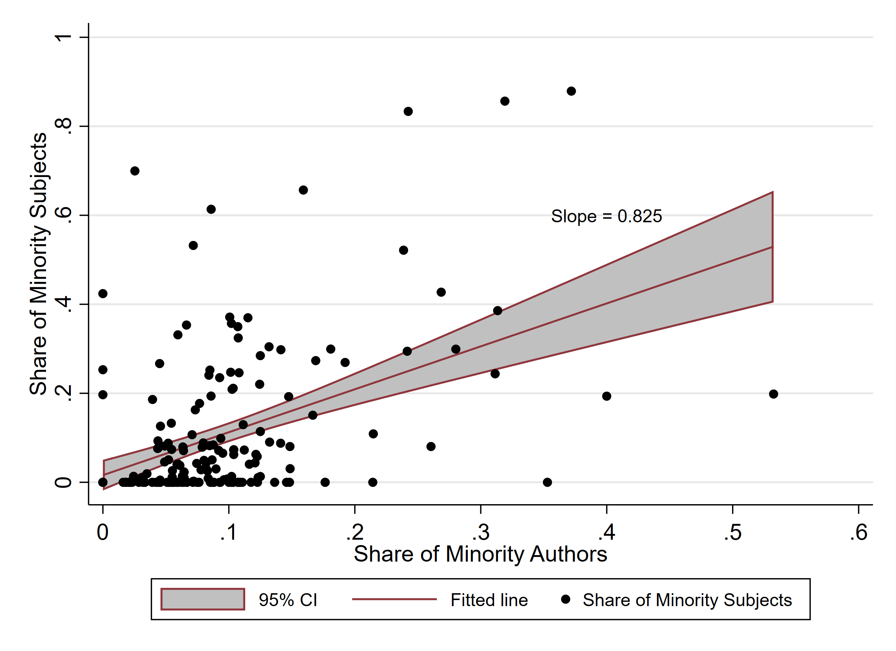
Policy Implications
Our paper also advocates an inclusive evaluation system to reflect faculties’ scientific efforts in promoting minority community engagement

Slide 21
Policy Implications
Diversity in Scientific Community
Diversity in Subjects
Biomedical Discovery
Public support can be a driving force

Slide 22
Thank You

Slide 23
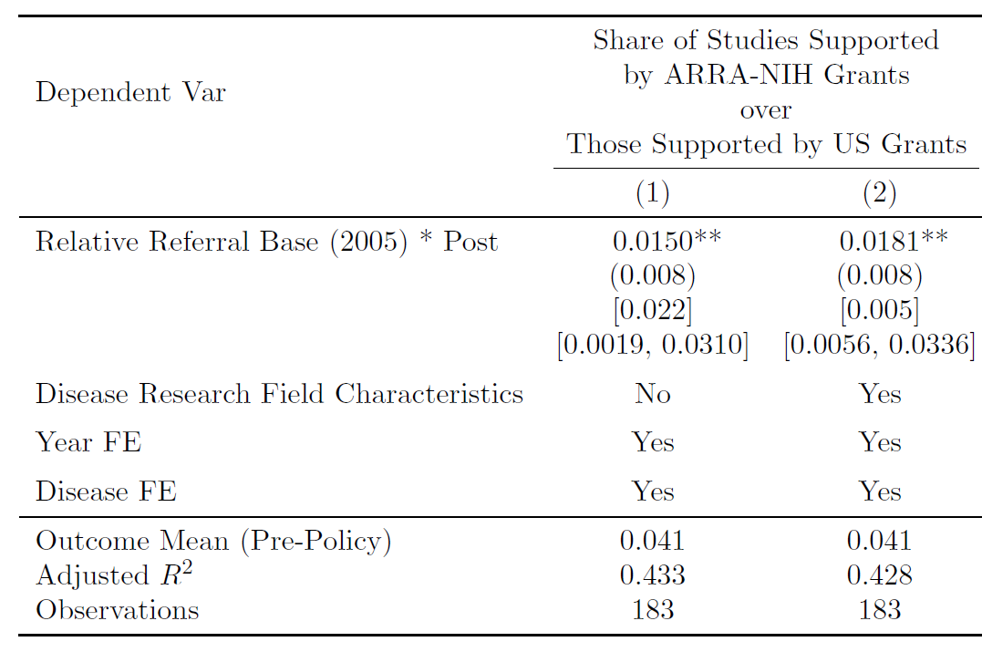
First Stage: Would disease research with a higher RRB be more likely to be supported by ARRA-NIH grants?

Slide 24
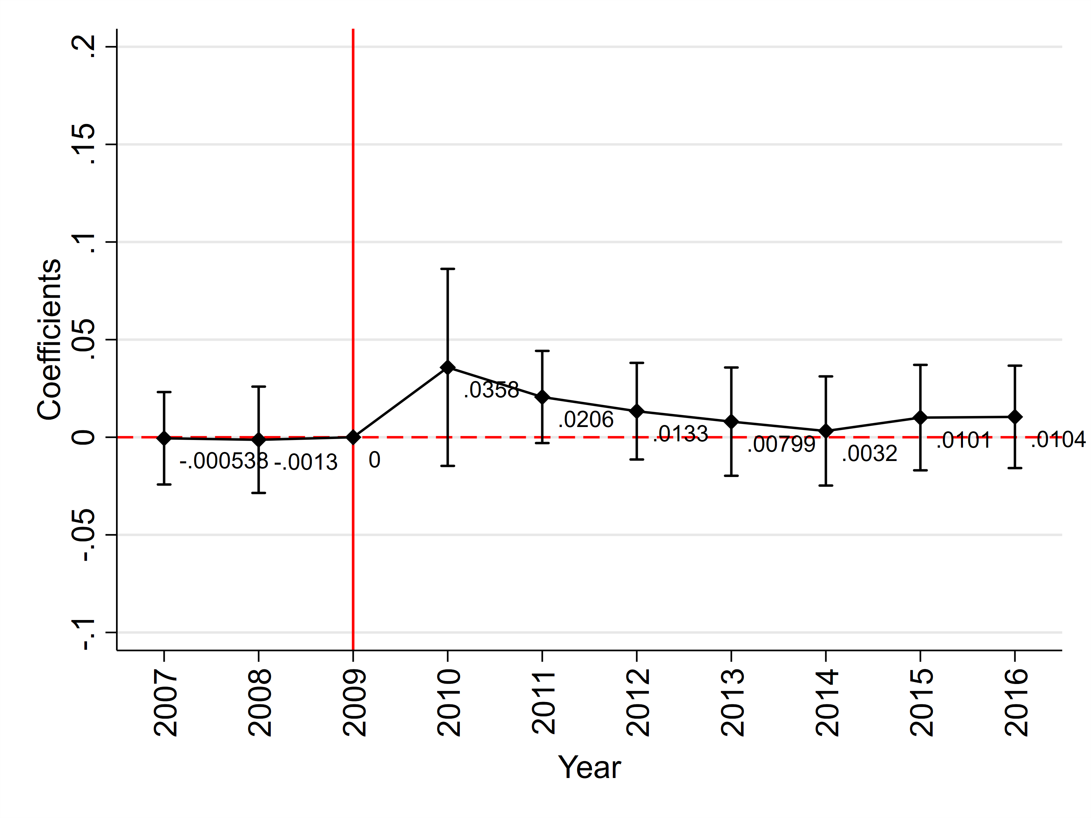
First Stage: Would disease research with a higher RRB be more likely to be supported by ARRA-NIH grants?
Event Study Estimates
A substantial jump
Policy effect quickly diminished

