Slide 1
The Unix Shell
and an introduction to working with data

Slide 2
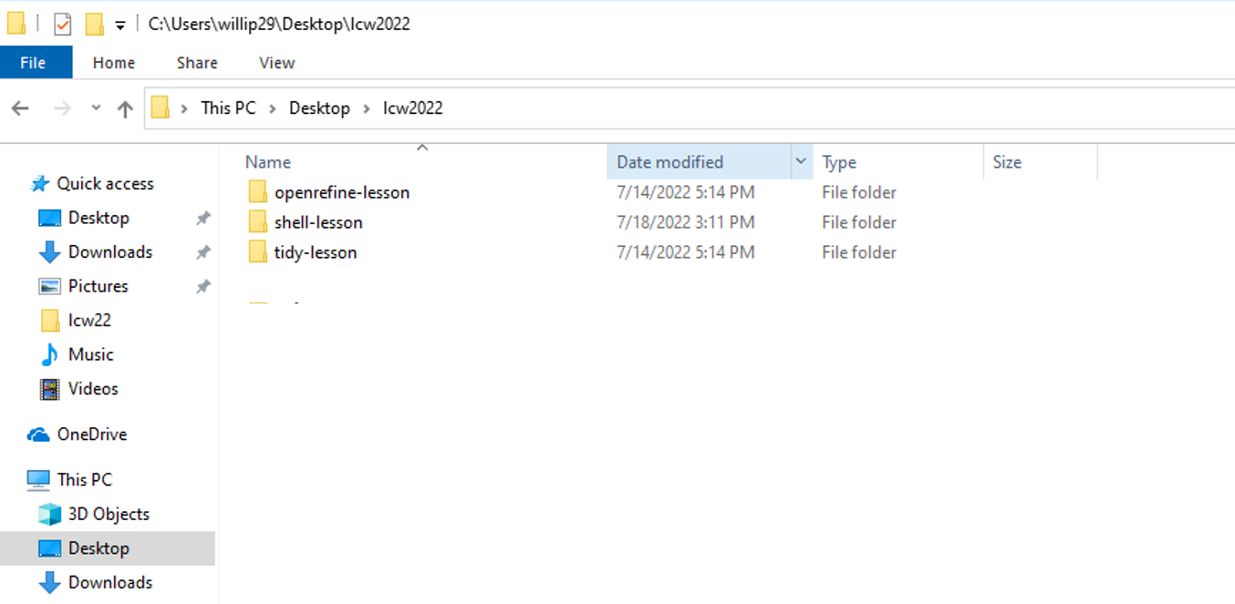
The “lcw2022” file needs to be downloaded, unzipped, and placed onto your desktop

Slide 3
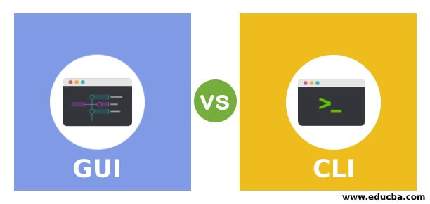
What is Unix?
Graphical User Interface
Command Line Interface
Notes:
Although we typically communicate with computers using the WIMP method (windows, icons, mice, and pointers); this became more popular in the 80s. Before that, interaction with computers occurred by using tools that only allowed text input and output, where you input text. CLI- command-line interface. The person types a command, the computer printer executes, displaying output, and so on.

Slide 4
Bash as a shell program
Bash is one of shell programs that can be used to interact with Linux OS. It is a program that runs other programs, and it is also a programming language itself.
Bash is available on Linux/Mac machines by default through Terminal. On Windows, bash is available through Git Bash that you installed earlier. Both applications provide command-line interface (CLI) and will be referred in our lessons as "terminal" or ”shell".
Notes:
This interaction is facilitated by the shell. The shell is a program that runs other programs. The shell (sometimes referred to as the “Unix shell”, for the operating system where it was first developed) is a program that allows you to interact with your computer using typed text commands. It is the primary interface used on Linux and Unix-based systems, such as macOS, and can be installed optionally on other operating systems such as Windows.
The most popular is bash (Bourne again shell)
Using it feels a lot more like programming, and learning it can help you enter the programming world in terms of behaviours (comments, scripts, loops, etc.) and using commands which are terse, often only a couple characters long, and often cryptic.

Slide 5
Why learn CLI?
Many tools only have command line interfaces
Allows you to combine many powerful tools
Notes:
requires little to no programming where you can do a lot of work with just a few keystrokes, once you have learned how the shell works and what its basic commands are. The shell is one of the most productive programming environments ever created.
This automation not only makes you more productive, but also improves the reproducibility of your workflows by allowing you to save and then repeat them with a few simple commands. Understanding the basics of the shell provides a useful foundation for learning to program, since some of the concepts you will learn here—such as loops, values, and variables—will translate to programming.

Slide 6
Why learn Linux?
Most widely used OS in research and technology
Open-source: free to get, free to use, free to modify
Availability: Linux VM, Linus servers / clusters (UTA, TACC)
CLI (command line interface) and GUI (graphical user interface) are available

Slide 7
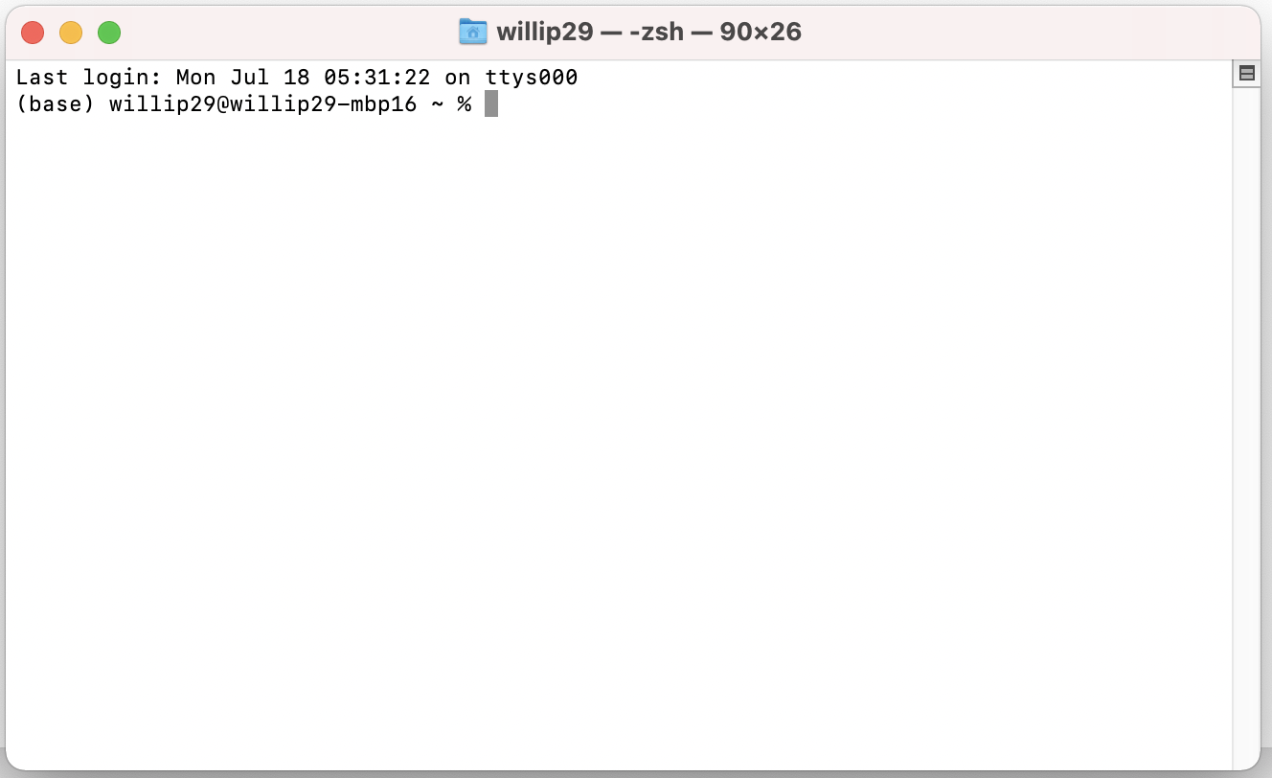
Terminal
Notes:
Where is my shell?
The shell is a program that is usually launched on your computer much in the way you would start any other program. However, there are numerous kinds of shells with different names, and they may or may not be already installed. The shell is central to Linux-based computers, and macOS machines ship with Terminal, a shell program. For Windows users, popular shells such as Cygwin or Git Bash provide a Unix-like interface, but may need to be installed separately. In Windows 10, the PowerShell natively provides that functionality.
For this lesson, we will use Git Bash for Windows users, Terminal for macOS, and the shell for Linux users.

Slide 8
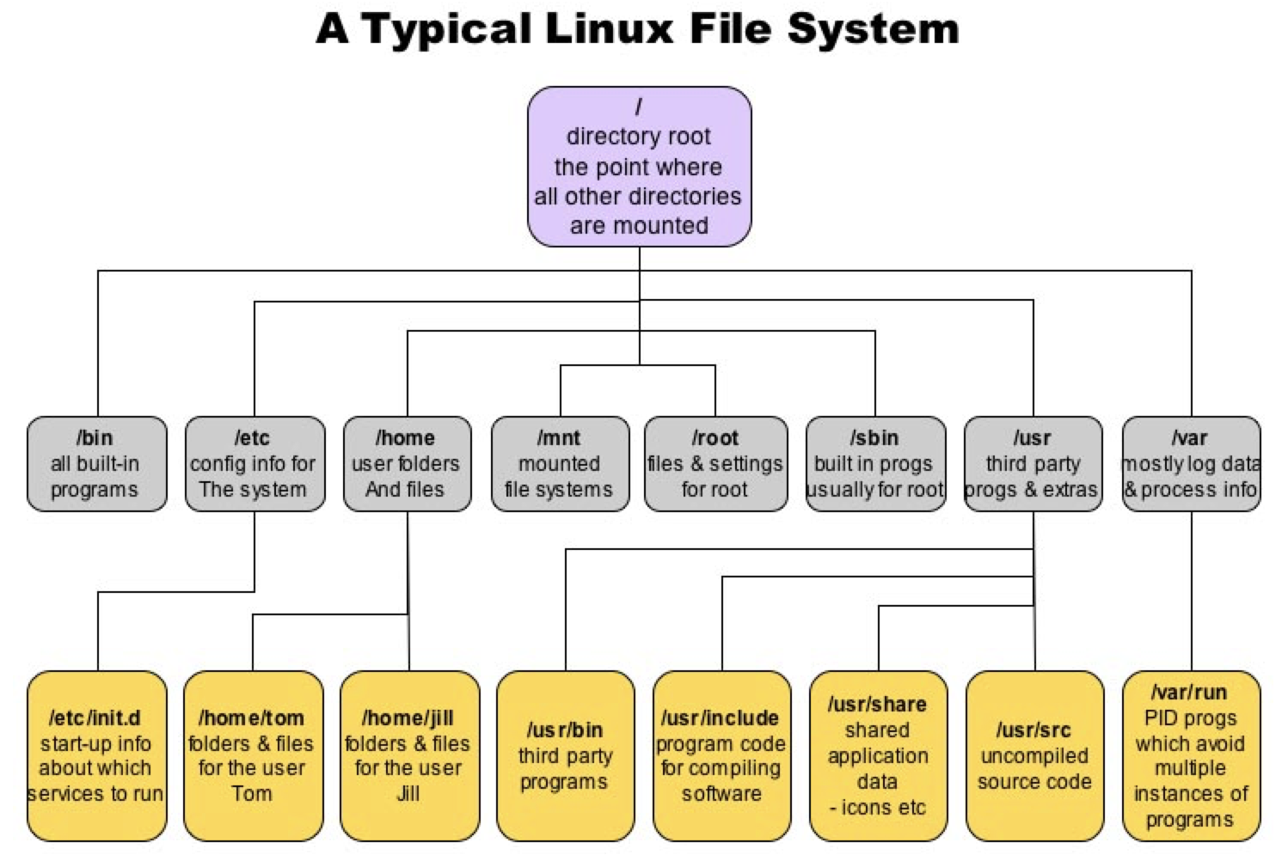

Slide 9
Useful Unix Commands
Command | Meaning
echo | Print
whoami | Prints username
pwd | Print working directory path (Where am I?)
cd | Change directory
mkdir | Make directory
touch | Create empty file
cat | View file / concatenate files
mv | Move file / rename file
cp | Copy file
rm | Delete file
Notes:
? Wildcard (whatever is before it is optional)
* Match zero or more of the preceding token (includes more than 1)
. Matches any ONE token
Tips:
Typically capitalization matters. The =/= the

Slide 10
Challenge 1 (practice navigation commands)
Find out where you currently are.
Go to “shell-lesson” folder, what is there?
Go back where you came from (with ”cd –” command).
Go one directory up.
Get comfortable navigating across the file system.
Try changing directories into different folders within “lcw2022” folder and explore their contents.
Use “-a” flag, does every directory have hidden files?
Notes:
As you navigate around, try to use Tab to autocomplete paths and names of files and directories.

Slide 11
Challenge 2
Remember, we added “lcw2022” folder to the Desktop in the beginning of the workshop?
Can you now list the contents of the “lcw2022” directory from your current directory?
What happens if you use ls –a? or ls –F?
Notes:
at the end of episode 2

Slide 12
Challenge 3
Make a copy of “gulliver.txt” folder and call it “gulliver-backup.txt”.
Move the file “gulliver-backup.txt” into the “backup” directory.
Make sure you understand the directory structure of ”lcw2022” before we continue.

Slide 13
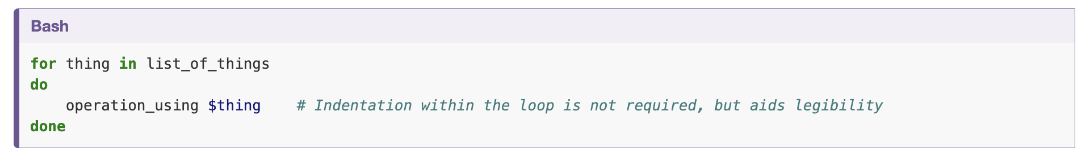
Writing a Loop
Notes:
Loops are key to productivity improvements through automation as they allow us to execute commands repetitively. Similar to wildcards and tab completion, using loops also reduces the amount of typing (and typing mistakes).

Slide 14
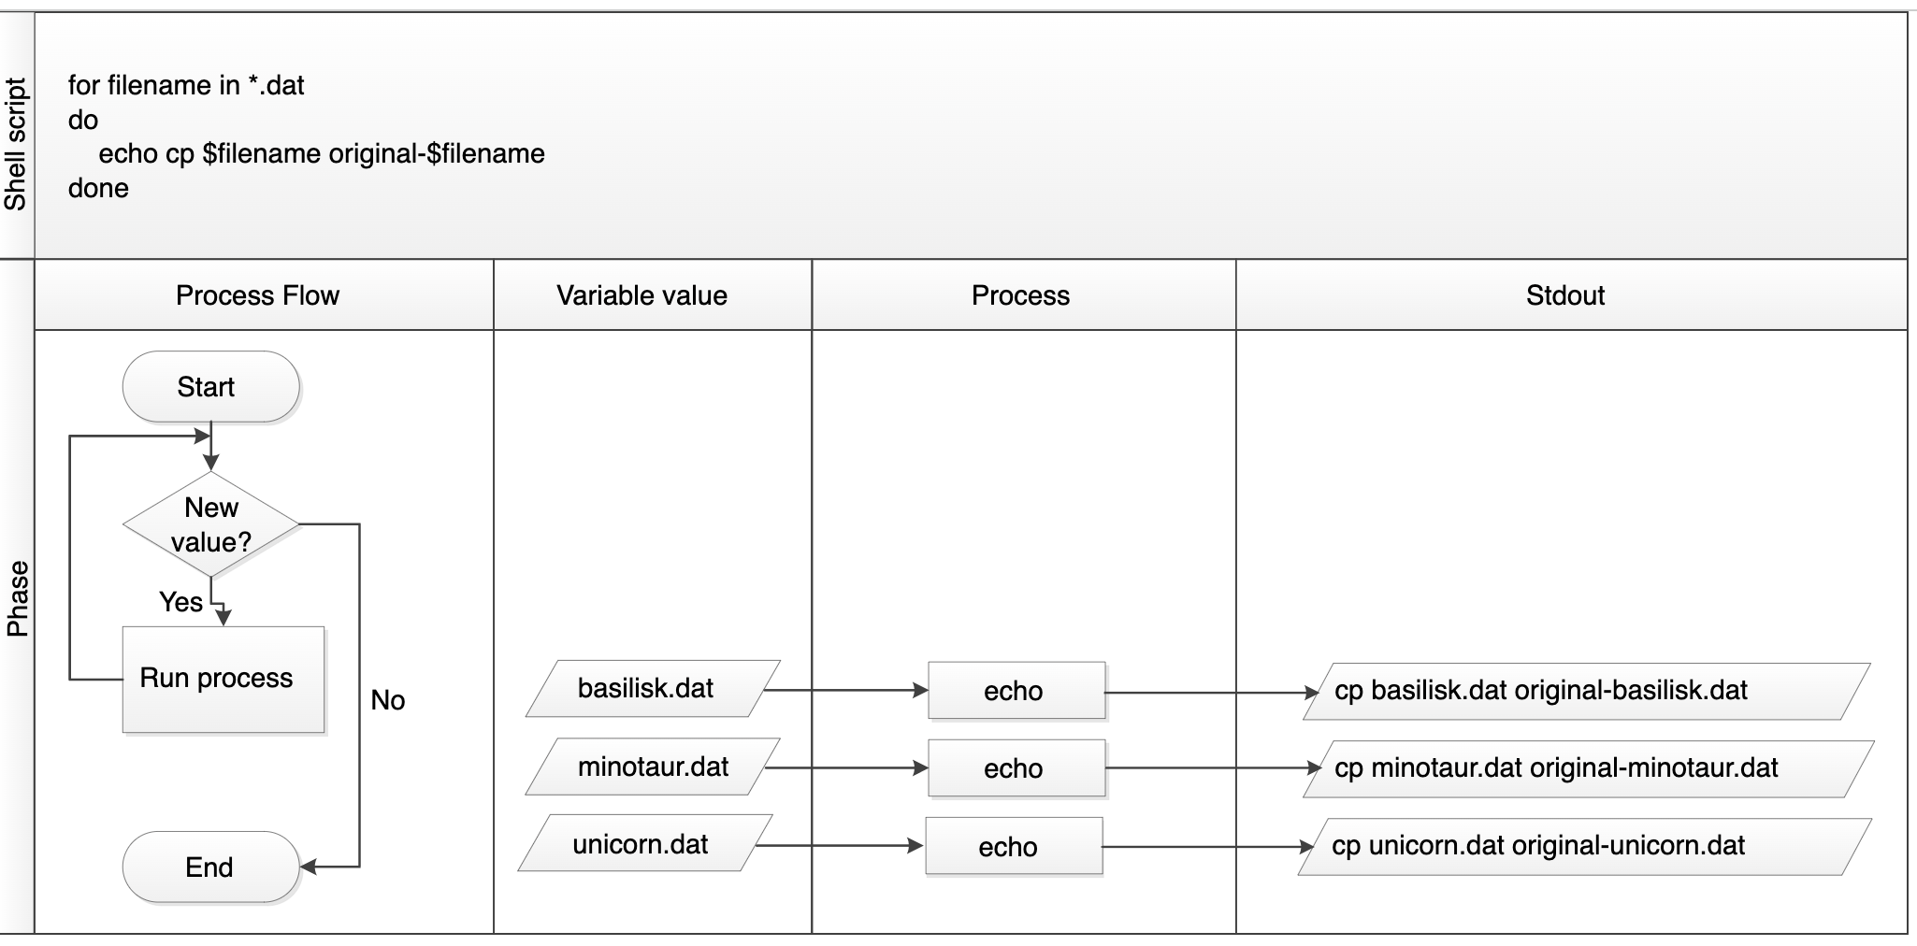
Writing a Loop
Notes:
Suppose we have several hundred txt document files. We would like to change these files, but also save a version of the original files, naming the copies backup_filename. txt.
We can use a loop to do that.

Slide 15
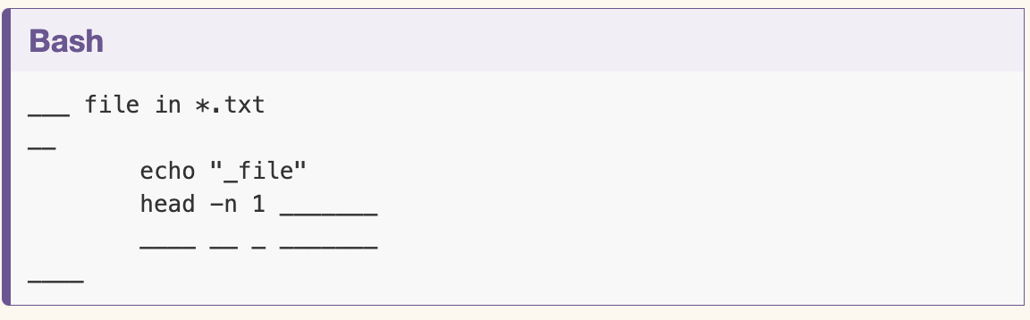
Challenge 5
Complete the blanks in the for loop below to print the name, first line, and last line of each text file in the current directory.

Slide 16
Challenge 5x
Compare the output of the two for loops below. Can you explain why the outputs are different?
Write a for loop that outputs the highest life expectancy with a corresponding year and country name for every file that starts with “U” and contains “a”
$ for datafile in G*.txt;do ls G*.txt;done
$ for datafile in G*.txt;do ls $datafile;done

Slide 17
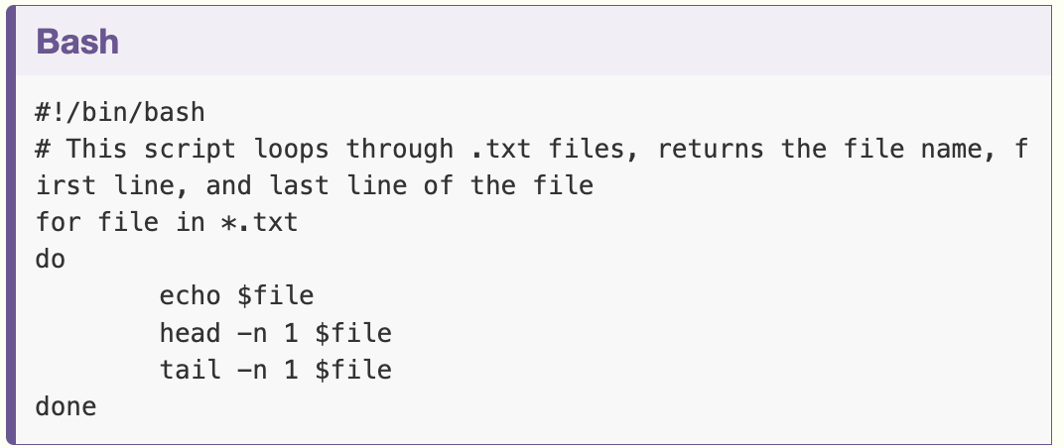
Scripting Loops
Notes:
Alternatively, rather than running a loop on the command line, you can save it in a script file and run it from the command line without having to rewrite the loop again. This is what is called a Bash script which is a plain text file that contains a series of commands like the loop you created above. In the example script here, the first line of the file contains what is called a Shebang (#!) followed by the path to the interpreter (or program) that will run the rest of the lines in the file (/bin/bash). The second line demonstrates how comments are made in scripts. This provides you with more information about what the script does. The remaining lines contain the loop you created above. You can create this file in the same directory you’ve been using for the lesson and by using the text editor of your choice (e.g. nano) but when you save the file, make sure it has the extension .sh (e.g. my_first_bash_script.sh). When you’ve done this, you can run the Bash script by typing the command bash and the file name via the command line (e.g. bash my_first_bash_script.sh).

Slide 18
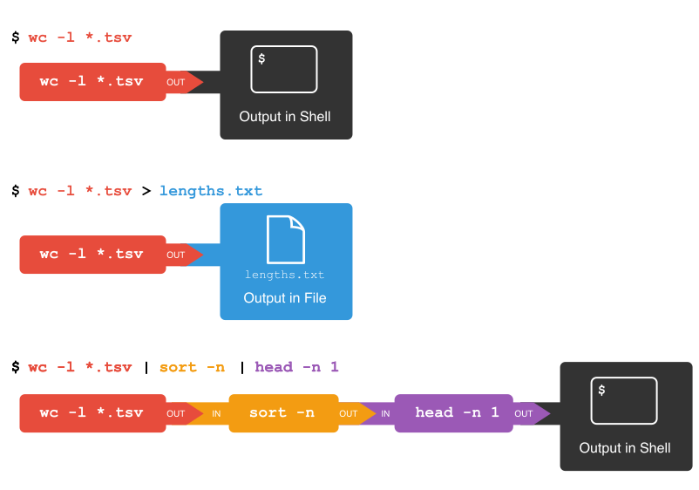
Pipes

Slide 19
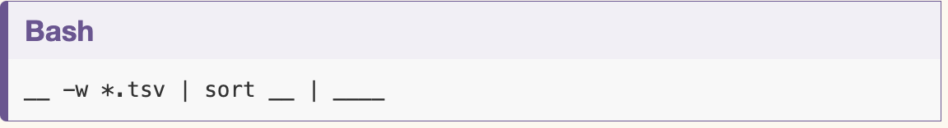
Challenge 6
To count the total lines in every tsv file, sort the results and then print the first line of the file we use wc -l *.tsv | sort -n | head -n 1
Now let’s change the scenario. We want to know the 10 files that contain the most words. Fill in the blanks below to count the words for each file, put them into order, and then make an output of the 10 files with the most words (Hint: The sort command sorts in ascending order by default).
Hint: Describe the steps you need to get the answer in your natural language, then think how to implement them using the commands you just learned

Slide 20
Breakout Challenges
Let’s make a different pipeline. You want to find out how many files and directories there are in the current directory. Try to see if you can pipe the output from ls into wc to find the answer.
The date command outputs the current date and time. Can you write the current date and time to a new file called logfile.txt? Then check the contents of the file.
While > writes to a file, >> appends something to a file. Try to append the current date and time to the file logfile.txt?
Check the manual for the wc command (either using man wc or wc --help) to see if you can find out what flag to use to print out the number of words (but not the number of lines and bytes). Try it with the .tsv files. If you have time, you can also try to sort the results by piping it to sort. And/or explore the other flags of wc.

Slide 21
Regular Expressions
A regular expression (or regex) is a method of using a sequence of characters to define a search to match strings.
String = a contiguous sequence of symbols or values (e.g., a word, a date, a set of numbers, or an alphanumeric value). A string can be any length, ranging from empty (zero characters) to one that spans many lines of text (including line break characters).
The terms ‘string’ and ‘line’ are sometimes used interchangeably, even when they are not strictly the same thing.
In library searches, we are most familiar with the “wild card character,” but there are many more features to the complete regular expressions syntax. Regular expressions will let you:
Match on types of characters (e.g. ‘upper case letters’, ‘digits’, ‘spaces’, etc.).
Match patterns that repeat any number of times.
Capture the parts of the original string that match your pattern.

Slide 22
Regular Expressions
You can group searches together in order to “find and replace.”
Special Character | Meaning
. | Matches any element
^ | Matches beginning of sequence
+ | Matches one or more of the preceding token
＄ | Matches end of sequence
? | This symbol matches up zero or one character
* | Matches zero or more occurrences of a character
\ | This symbol represents special characters
( ) | This symbol groups several regular expressions
{m} | Exactly m repetitions
{m,n} | Between m and n repetitions
| | Matches either regex before or after the symbol
Notes:
? Wildcard (whatever is before it is optional)
* Match zero or more of the preceding token (includes more than 1)
. Matches any ONE token
Tips:
Typically capitalization matters. The =/= the

Slide 23
Regular Expressions
You can group searches together in order to “find and replace."
? Wildcard (whatever is before it is optional)
* Match zero or more of the preceding token (includes more than 1)
. Matches any ONE token
Tips:
Typically capitalization matters. The =/= the

Slide 24
Challenge 7
The ? wildcard matches one character. The * wildcard matches zero or more characters. Thinking back to what we learned about regular expressions, do you remember how you would express that as regular expressions?

Slide 25
Challenge 7
The ? wildcard matches one character. The * wildcard matches zero or more characters. Thinking back to what we learned about regular expressions, do you remember how you would express that as regular expressions?
Answer:
The ? wildcard matches the regular expression . (a dot)
The * wildcard matches the regular expression .*

Slide 26
Breakout Challenges
Search for all case sensitive instances of a whole word you choose in all four derived .tsv files in this directory. Print your results to the shell.
Search for all case sensitive instances of a word you choose in the ‘America’ and ‘Africa’ .tsv files in this directory. Print your results to the shell.
Count all case sensitive instances of a word you choose in the ‘America’ and ‘Africa’ .tsv files in this directory. Print your results to the shell.
Use regular expressions to find all ISSN numbers (four digits followed by hyphen followed by four digits) in 2014-01_JA.tsv and print the results to a file results/issns.tsv. Note that you might have to use the -E flag (or -P with some versions of grep, e.g. with Git Bash on Windows).
If you pipe something to the uniq command, it will filter out adjacent duplicate lines. In order for the ‘uniq’ command to only return unique values though, it needs to be used with the ‘sort’ command. Try piping the output from the command in the last exercise to sort and then piping these results to ‘uniq’ and then wc -l to count the number of unique ISSN values.

Slide 27
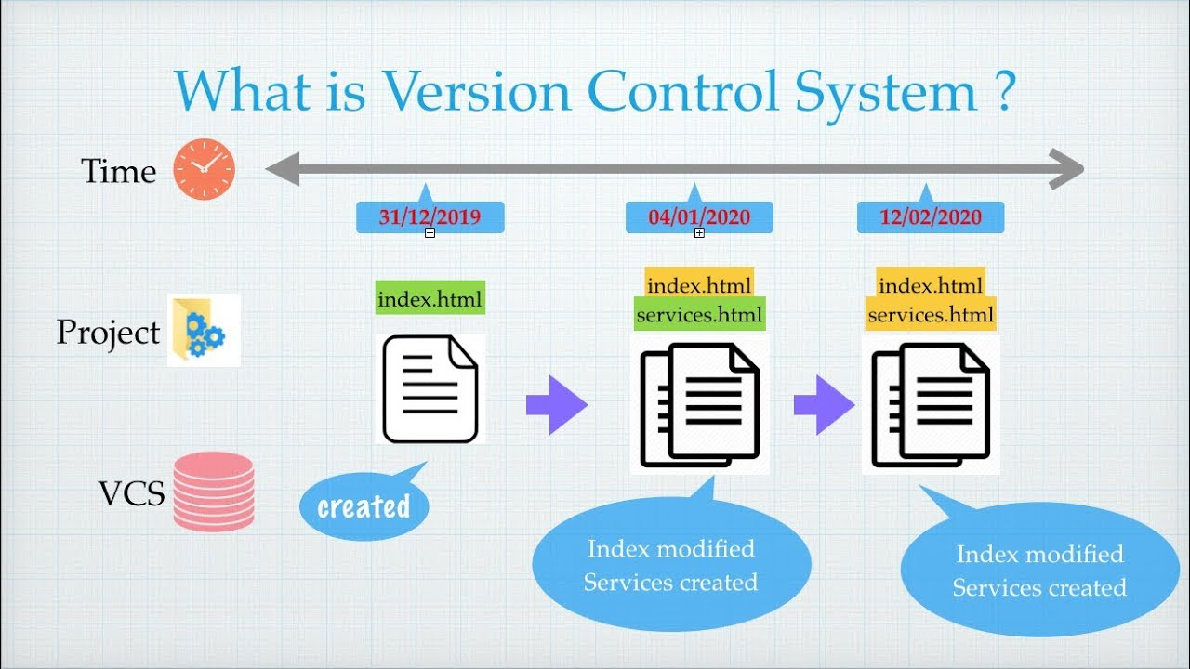
git
Notes:
Version control is a name used for software which can help you record changes you make to the files in a directory on your computer. Version control software and tools (such as Git and Subversion/SVN) are often associated with software development, and increasingly, they are being used to collaborate in research and academic environments. Version control systems work best with plain text files such as documents or computer code, but modern version control systems can be used to track changes in any type of file.
At its most basic level, version control software helps us register and track sets of changes made to files on our computer. We can then reason about and share those changes with others. As we build up sets of changes over time, we begin to see some benefits.

Slide 28
Benefits of using version control
Collaboration
Versioning
Restore Previous
Background
Backup
Notes:
Collaboration - Version control allows us to define formalized ways we can work together and share writing and code. For example merging together sets of changes from different parties enables co-creation of documents and software across distributed teams.
Versioning - Having a robust and rigorous log of changes to a file, without renaming files (v1, v2, final_copy)
Rolling Back - Version control allows us to quickly undo a set of changes. This can be useful when new writing or new additions to code introduce problems.
Understanding - Version control can help you understand how the code or writing came to be, who wrote or contributed particular parts, and who you might ask to help understand it better.
Backup - While not meant to be a backup solution, using version control systems mean that your code and writing can be stored on multiple other computers.
There are many more reasons to use version control, and we’ll explore some of these in the library context, but first let’s learn a bit about a popular version control tool called Git.

Slide 29

What is git?
one of the most widely used version control systems in the world
free, open source tool that can be downloaded to your local machine and used for logging all changes made to a group of designated computer files (referred to as a “git repository” or “repo” for short) over time
can be used to control file versions locally
can be used to coordinate simultaneous work on a group of files shared among distributed groups of people.
Notes:
Git is one of the most widely used version control systems in the world. It is a free, open source tool that can be downloaded to your local machine and used for logging all changes made to a group of designated computer files (referred to as a “git repository” or “repo” for short) over time. It can be used to control file versions locally by you alone on your computer, but is perhaps most powerful when employed to coordinate simultaneous work on a group of files shared among distributed groups of people.
Rather than emailing documents with tracked changes and some comments and renaming different versions of files (example.txt, exampleV2.txt, exampleV3.txt) to differentiate them, we can use Git to save (or in Git parlance, “commit”) all that information with the document itself. This makes it easy to get an overview of all changes made to a file over time by looking at a log of all the changes that have been made. And all earlier versions of each file still remain in their original form: they are not overwritten, should we ever wish to “roll back” to them.

Slide 30
What is git?
How can understanding Git help with work in libraries?
Enables you to contribute to, collaborate on, and support digital research projects
Enables you to control changes to your files over time without keeping multiple copies of those files
GitHub on the other hand is a popular website for hosting and sharing Git repositories remotely.
Notes:
Git was originally developed to help software developers work collaboratively on software projects, but it can be and is used for managing revisions to any file type on a computer system, including text documents and spreadsheets. Once installed, interaction with Git is done through the Command Prompt in Windows, or the Terminal on Mac/Linux. Since Word documents contain special formatting, Git unfortunately cannot version control those, nor can it version control PDFs, though both file types can be stored in Git repositories.

